Slide 1
A* and Dijkstra: A Comparison
Ali Hassan
CS 131 – Discrete Structures

Slide 2

Comparison Study
In this presentation we will be looking at the differences between Dijkstra’s Algorithm and A* Search Algorithm for finding the shortest path from $a$ to $z$ in a graph.
We will look at the pseudocode and understand the differences between the two algorithms.

Slide 3
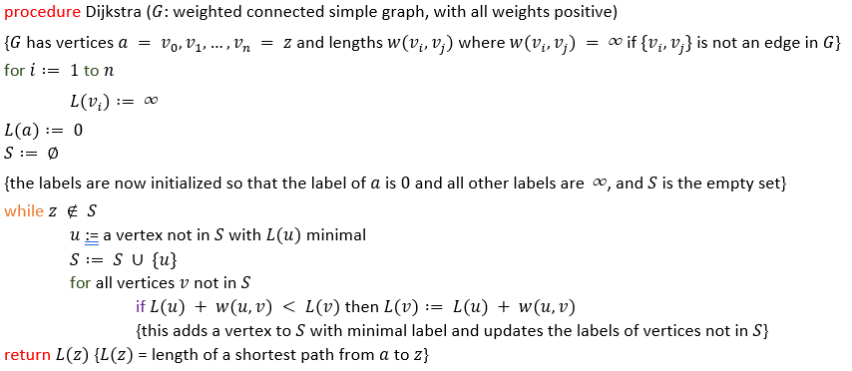
Dijkstra’s Algorithm
Simple and Effective
Starts at the start location and moves to the closest node with the lowest weight.
Tracks the values required to travel to every node, only moving to new nodes and not returning to previous nodes.
Compares the route to other routes to check for the optimal route.
Checks every possible route, even routes that are obviously not optimal.
Finds the most optimal route for every point on the graph, from start to finish.

Slide 4
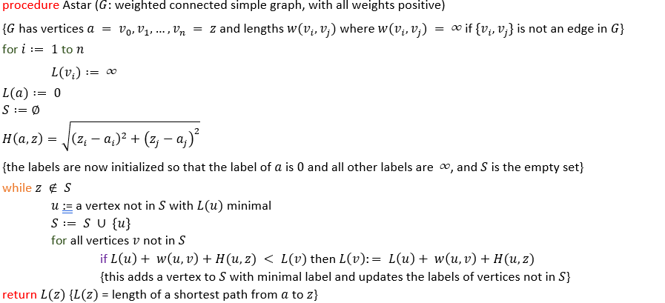
A* Search Algorithm
Quick and Direct
Extremely similar to Dijkstra’s Algorithm in function.
However, this uses a heuristic to estimate the fastest route.
This adds another value to every node based on how close they are to the end node.
Nodes obviously farther away from the end will not be considered unless it is the last option.
Heuristic function can massively change the optimization of the algorithm.
However, in theory, it will reach the end node in a smaller amount of time.

Slide 5
Comparison
A* Search Algorithm
Dijkstra’s Algorithm

Slide 6
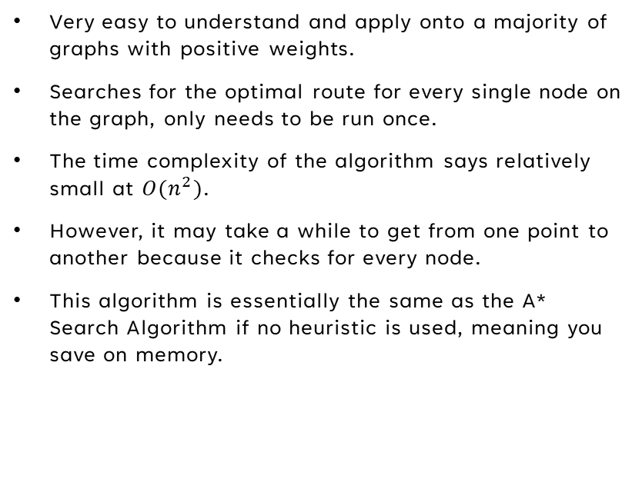
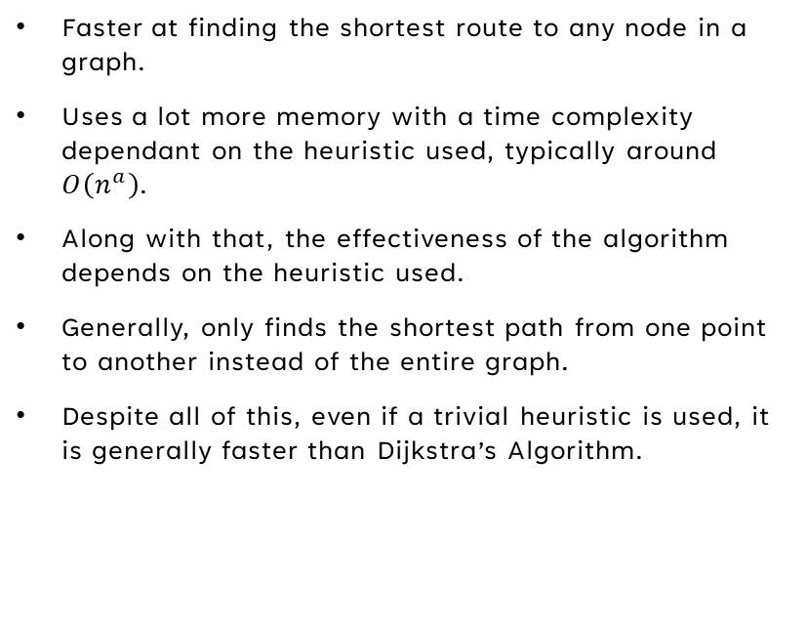
OVERVIEW
A* Search Algorithm
Dijkstra’s Algorithm
Faster at finding the shortest route to any node in a graph.
Uses a lot more memory with a time complexity dependant on the heuristic used, typically around $O\left(n^{a}\right)$.
Along with that, the effectiveness of the algorithm depends on the heuristic used.
Generally, only finds the shortest path from one point to another instead of the entire graph.
Despite all of this, even if a trivial heuristic is used, it is generally faster than Dijkstra’s Algorithm.
Very easy to understand and apply onto a majority of graphs with positive weights.
Searches for the optimal route for every single node on the graph, only needs to be run once.
The time complexity of the algorithm says relatively small at $O(n^{2})$.
However, it may take a while to get from one point to another because it checks for every node.
This algorithm is essentially the same as the A* Search Algorithm if no heuristic is used, meaning you save on memory.

Slide 7
Applications
No matter which of the two algorithms you use, they are generally used for the same things!
IP and Network Routing
Mapping and Traveling Services
Artificial Intelligence in Software and Video Games
Computers have been using both of these algorithms for a very long time for solving complex search problems.

Slide 8
THANK YOU

