Slide 1
$-Calculus in Common Lisp

Slide 2
Basics of $-Calculus
A 'calculus' for optimization problems, anytime algorithms, parallelism.
A basis in describing 'Super Turing' program behaviors: unbounded computation, parallelism, user interaction.
Borrows from lambda calculus and pi calculus.
Includes new operators that work with a basis in $ ('cost').
Operators allow us to create satisfaction requirements for our algorithms.

Slide 3
$
Total cost can be subdivided into two categories.
Solution cost
(How optimal is this solution?)
Algorithm cost
(How many resources did we use to get it?)
These costs are then combined to form $
For traditional algorithms, we only really look at solution cost.
An example would be distance in a traveling salesman problem.

Slide 4
How do we do this?
Trees
Essentially, we can generalize a large subset of optimization algorithms into operations on decision trees.
Each step in a solution can be represented by a node in the tree.
Children of a node are potential next steps.
Total state as of a given node is the aggregate of that node and its ancestors.

Slide 5
To 'solve' with a given algorithm, we first define the method of building its solution tree, and then we apply $-operators to that tree in a certain way.
The generalization of this technique takes the form of the k-omega optimization meta-algorithm.
Provides for elegant descriptions of algorithms

Slide 6
$-operators
Min – selection with minimum cost
Max – selection with maximum cost
Choice – random selection with 'guard' conditions
Send – Put an object in a channel
Receive – Take an item out of a channel
Cost – Cost of an object based on its type
Seq – Sequential composition of cost objects
Par – Parallel evaluation of cost expressions.

Slide 7
Extensions to Common Lisp
Repeat – create a circular list of one item
Cycle – create a circular list out of another list
Split – split a list into n partitions
Mp – map function over items in a list, unless the item is a terminal or epsilon
Filter – filter list by a given function
Curry – create new function out of function and input values
Channel – create a new channel

Slide 8
Node Implementation
Create-epsilon – Make an epsilon node
Create-terminal – Make a terminal node
Make- Children generic function dispatches on type, create children of a given node
Ancestors – A list of all the parents of a given node, starting with the oldest
Children – A list of the children of a node
Stack – Ancestors of a node, plus itself.

Slide 9
Used CLOS to create a type-system including 4 basic types, tree, $node, epsilon, and terminal.
Then define node operators as 'generic' functions to work with these types.
From there can use CLOS and multiple inheritance to override the way in which different types of node are used by the $-operators, create new nodes, and to override the generic functions.

Slide 10
K-omega
Implemented as a macro.
Bind a certain number of $-operators as local functions, and then go through a iterative/recursive process of selection (node expansion), examination, execution, and checking of a goal.
In the head of the function we also define max iterations, search depth, search breadth, and number of moves expanded at a time.

Slide 11
Select: From a given node, expand new nodes to k depth (until reaching a terminal or epsilon node).
Examine: From a given node, use $ operators to evaluate the expanded nodes for $. Min, max, seq and choice are primarily used here.
Execute: Perform some operation associated with the execution of a node chosen in the examine phase.
Goal: Check to see if the goal has been achieved based on the current state.

Slide 12
Lisp Environment
Using Steel Bank Common Lisp
Uses a generational garbage collector; functions compile to fast x86-64 assembly code.
Has extensions for threading and sockets.
Runs best in Linux/Unix environments.
Primary development IDE was emacs.

Slide 13
Programmer Responsibilities
Define node generation functions
Define cost functions
Define a function that uses k-omega and $-calculus functions to select/examine/execute on a given tree.

Slide 14
Demonstrations
Have implemented:
  Minimax solution to tic-tac-toe
  A* heuristic graph search algorithm
  Solutions to traveling salesman problem

Slide 15
Tic-Tac-Toe
Placement of an x or o on the board is represented by a node in the tree
Minimax is based on the assumption that your opponent will make a decision that has the worst implications for you.
We simulate this by having A and B.
A making the min choice.
B making the max choice.
Cost is 1 for a loss, 0 for a tie, and -1 for a win.

Slide 16
Tree is first expanded to the terminals in the select phase.
Approximately 9! nodes are created in this process.
A takes the sequence of a node, and applies b to each node, unless it is a terminal, then takes the min of that.
B takes the sequence of a node, applies a to each node, unless it is a terminal, and takes the max of that.

Slide 17
Seq and mp expand to leave us with a tree of mins and maxes, ending in terminals.
When we reach the terminals, we then begin evaluating the mins and maxes.
When we have finished evaluating the min and max operators, we have one of the best possible solutions for our given state.

Slide 18
Interestingly, the tree implementation and cost calculus combine to make this a particularly easy algorithm to parallelize
All we must do is create a channel, and subdivide one of the generations of max calls to separate threads, and have it send to that channel upon completion.
We can then pull from that channel and apply a final 'min' operator to everything in the channel.
We use the functional operator 'curry' and the circular-list operator 'repeat' to make this easy.

Slide 19
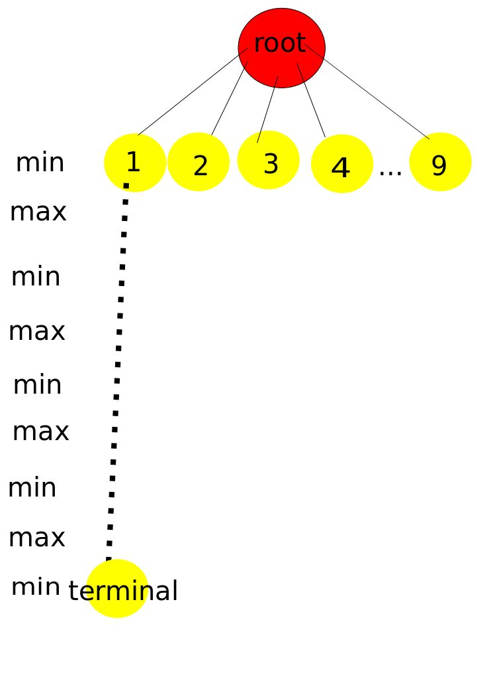

Slide 20
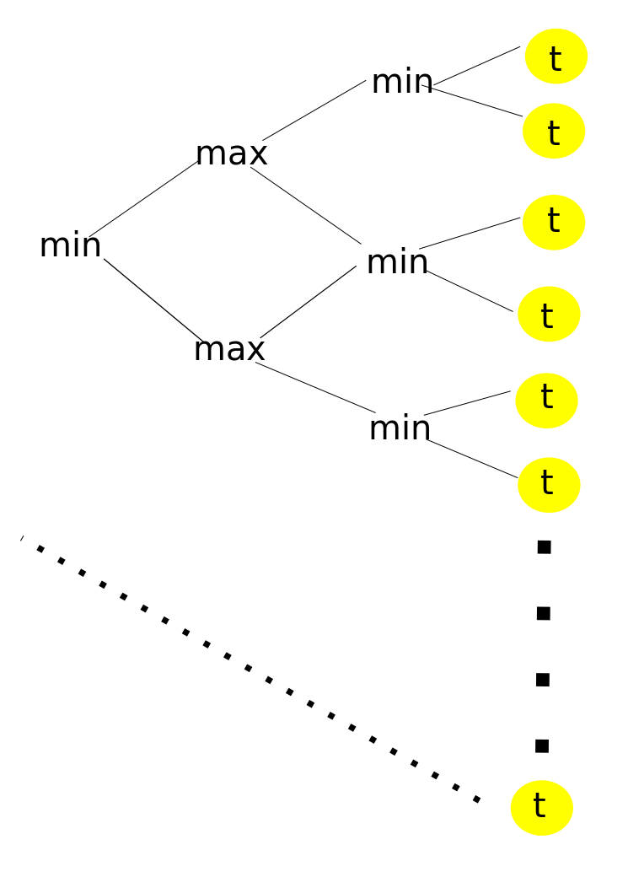

Slide 21
A* Algorithm
A* is a classic Pathfinding algorithm.
It uses a combination of single step lookahead and an 'admissible' heuristic to find the shortest path between two points on a graph.
We use 'distance' as our cost function, and 'as the crow flies' distance between a node and the goal as our 'admissible' heuristic.
Our heuristic is invoked when encountering an epsilon node.
The goal node is considered terminal, and does not have a cost.
(when we reach the goal, we are done).

Slide 22
We begin by expanding the first node of the tree.
This yields the children of that node, as well as epsilons connected to each child.
From the root of the tree, we evaluate our $ operators ($min (seq root-of-tree)).
We expand again from the selected location, and then search again, from the root.
We do this until we reach the goal node, at which point, its ancestry is the shortest path.

Slide 23
Traveling Salesman
Traveling salesman is very similar to A* in problem definition.
Difference is that we act as if every node is potentially connected, and that we can only use each node once.
We start with an implementation of the nearest neighbor algorithm.
Using $-Calculus and k-omega we can then generalize it to an algorithm that solves TSP fully.

Slide 24
Nearest Neighbor
Start at a given location
Compute the distance from that node to all of the other nodes.
Pick the nearest of those nodes.
Do this again, with the selected as root, and the previous node not available for selection.
This is an okay way to produce a quick heuristic solution to a tsp.
It is not optimal and could even be the worst possible solution. (But generally is ok).

Slide 25
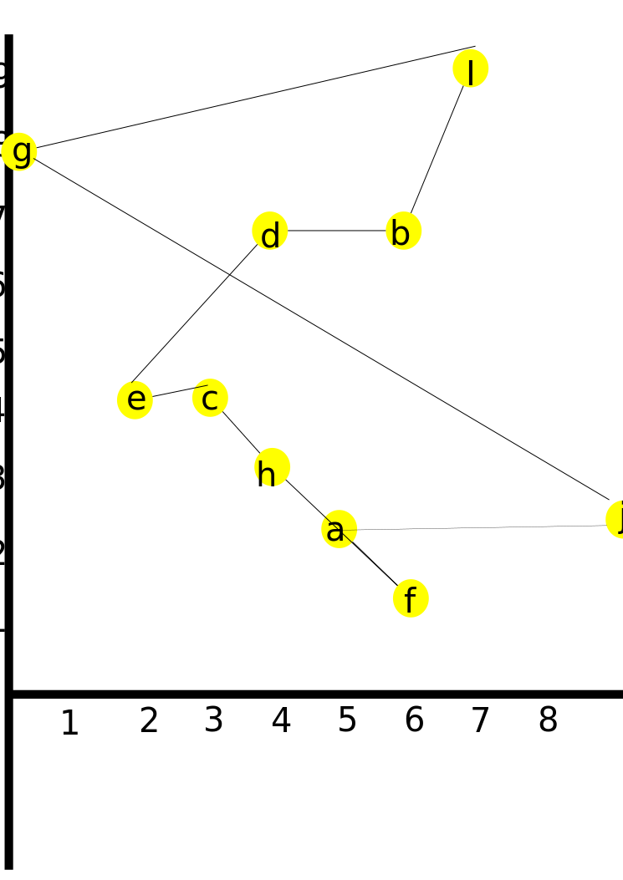

Slide 26
Solution to TSP
Because we have cost calculus representing our depths, we are able to generalize our nearest neighbor implementation.
This provides us with next-nearest-neighbor, next-next-nearest-neighbor, etc.
The limit of this, with our depths set to infinite, will provide an optimal solution to the traveling salesman.

Slide 27
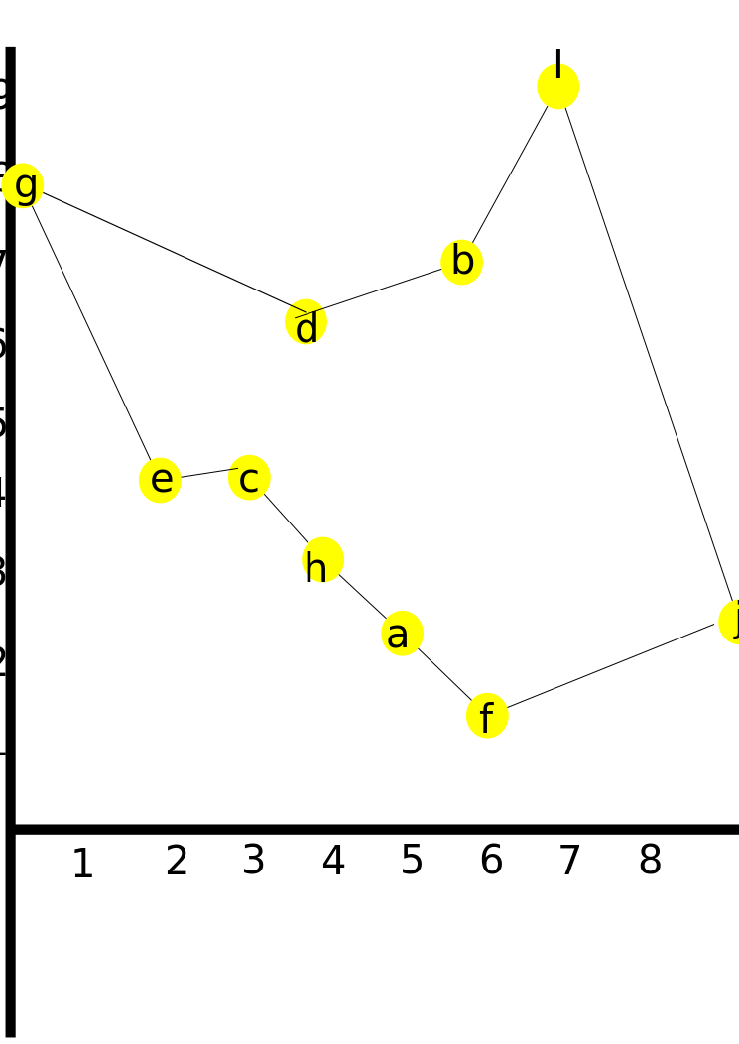

Slide 28
Future Improvements
Would be nice to have transparently cross-computer channels using sockets.
The node generation syntax is a little clunky. CLOS is fairly verbose. A more declarative syntax would be nice.
Something similar to prolog's Warren Abstract Machine should be possible for actually implementing it efficiently.
Current implementation uses quite a bit of memory.

Slide 29
It might be useful to have 'lightweight' threads, similar to those used in programming languages such as Erlang. Right now SBCL uses 'heavy weight' OS threads.
It would be interesting to have a compiler that uses k-omega to optimize various things. (Efficient GC, code optimization are both 'hard' problems to solve).
Still need an example that uses algorithm cost as well as solution cost. Will most likely need special operators to determine that sort of thing.
It would be very interesting to recompile SBCL with $-calculus as the default package, and to also include a subset of common lisp operators in that package.

