Slide 1
Boosting & Deep Learning

Slide 2
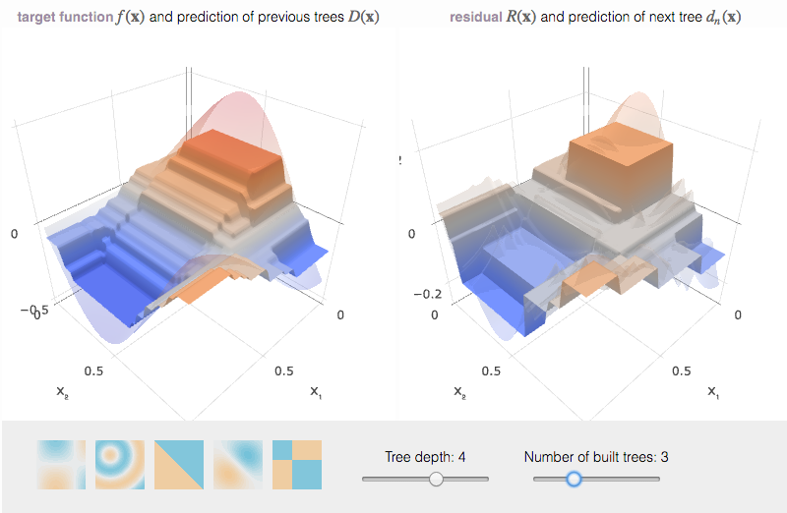
boosting
Iteratively learn many models
Each model “boosts” the performance
Regression – gradient boosting learn on errors
Classification – adaboost weight observations
Classification – gradient boosting ?
Nice resource

Slide 3
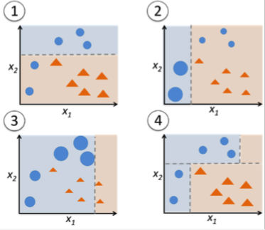
adaboost
Learn a week learner
Weight observations according to classification success
Learn a new week learner
Aggregate models

Slide 4
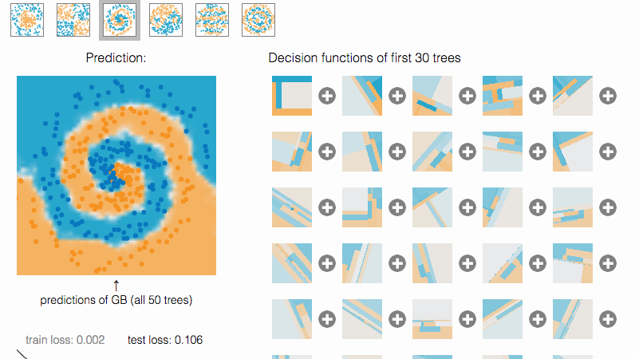

Slide 5



Gradient boosting for classification
Cross entropy + softmax
Good resource for intuition
Good resource for math
Notes:
O = a

Slide 6
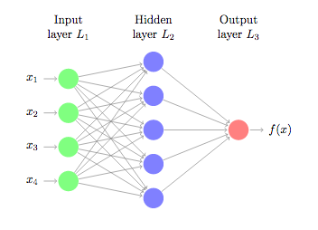
Neural networks
Perceptron (1958)
Math on graph
Some nice history

Slide 7
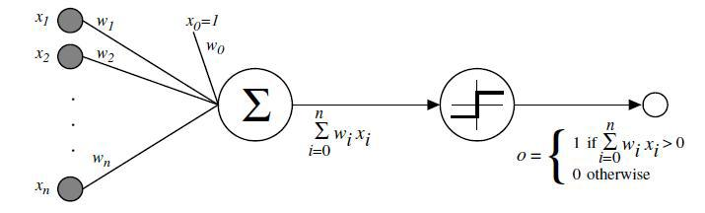
perceptron

Slide 8
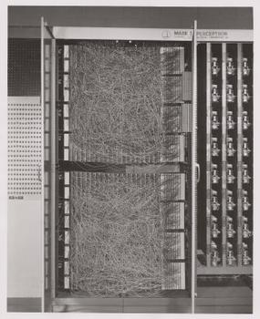
perceptron
The original idea of neural networks
More advanced ideas:
CNN
RNN
LSTM
Regularization
Dropout
Pooling
Bias

Slide 9
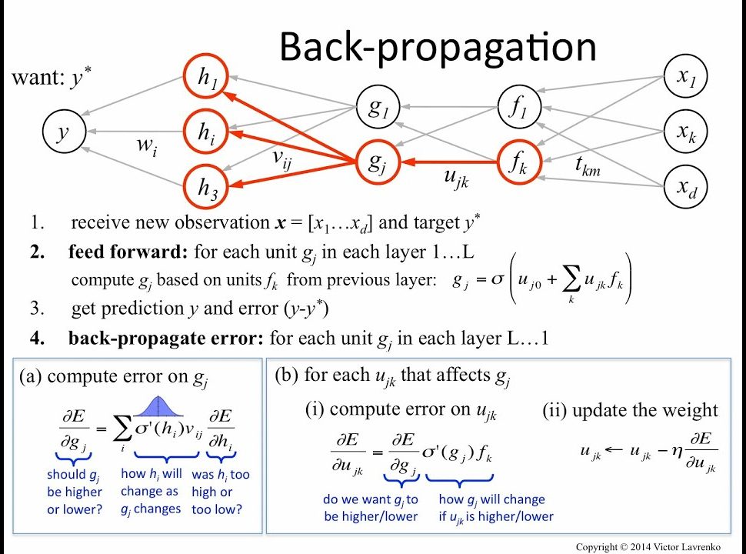
Back propagation
Apply the chain rule for derivatives
Update with learning rate * derivative
Good example – video
Good resource - text

Slide 10
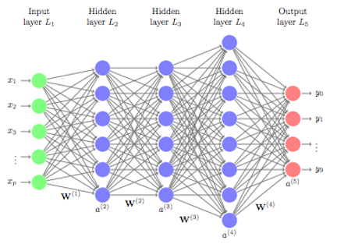

Slide 11
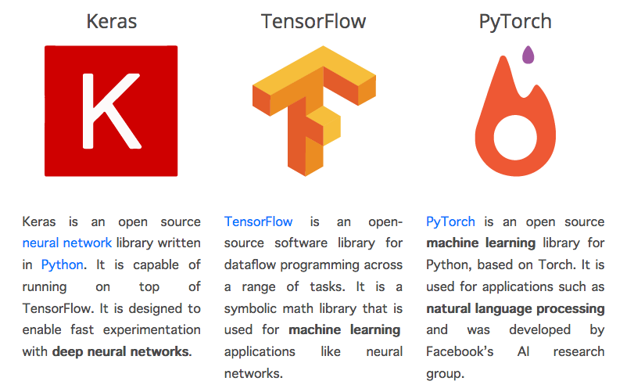
Deep learning in python

