Slide 1
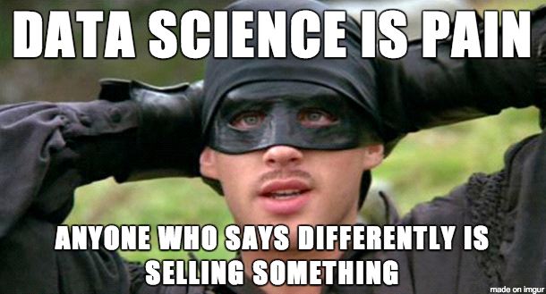

Slide 2
Pandas recap

Slide 3
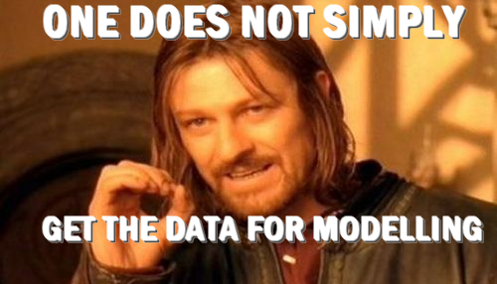
Step 1: Data Gathering

Slide 4
Step 1: Data Gathering
Public data:
CBS
open gov
Academia
Web:
APIs
scrapping
Casual data:
Historic data
Sensor data
App data
Requested Data:
Survey
Pannel
Experiments
Organized collection

Slide 5
What’s in a webpage

Slide 6
Beautiful soup

