Slide 1


Slide 2
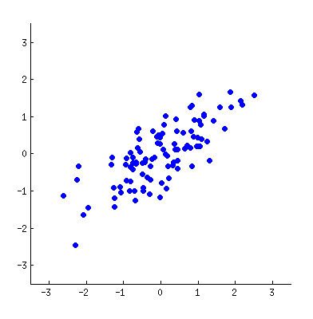
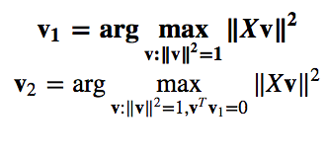
PCA

Slide 3
PCA

Slide 4
PCA
Further explanations

Slide 5
PCA
Example in notebook

Slide 6
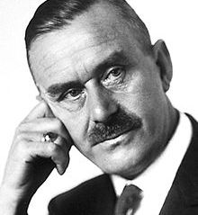
Statistics
“A writer statistician is someone for whom writing answering questions is more difficult than it is for other people.”
Thomas Mann

Slide 7
statistics
The art of answering questions with data
Prorbability theory + infi + linear algebra
world
sample
Answer + confidence

Slide 8
Statistical inference
What is the expected weight of a newborn baby in 2018?
Measure all babies in the hospital when they are born.
What is the expected weight of a human in their 30s?
measure a random sample of people in their 30s.
Is the expected weight for men greater than the expected weight for women?
Measure a random sample of men and women and compare.
Hypothesis testing

Slide 9
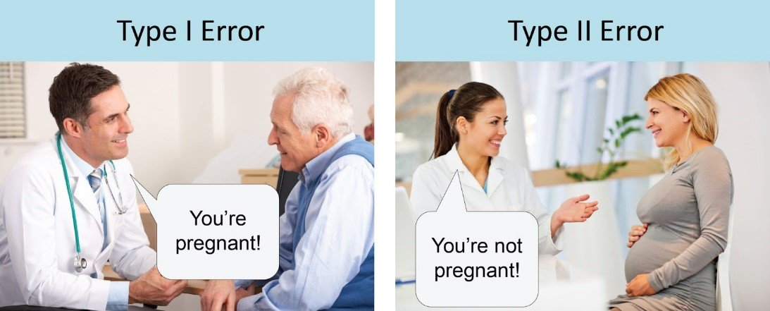

Slide 10
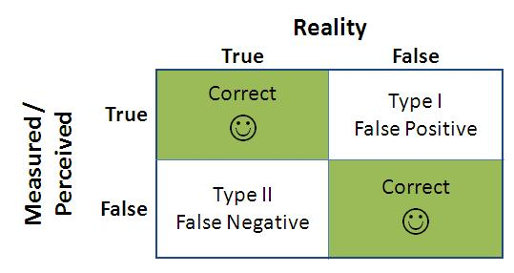

Slide 11
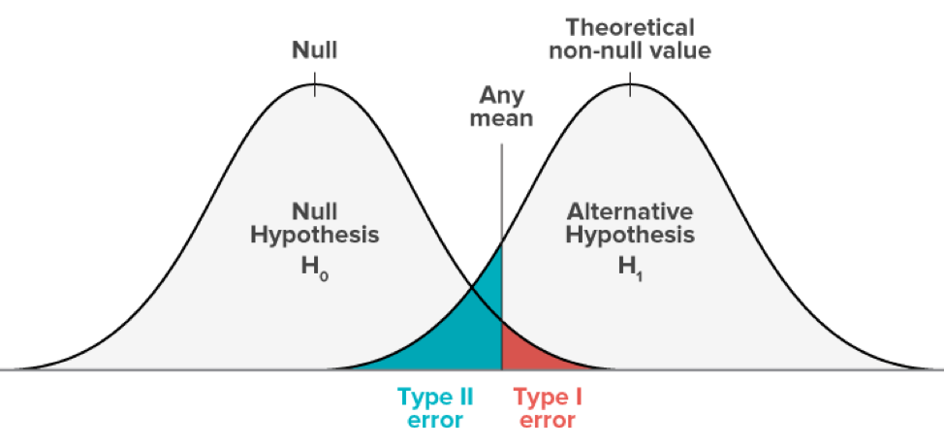

Slide 12
statistics
Point estimation
Confidence interval
hypothesis testing
Time series, survival analysis, causal inference, Bayesian statistics, multiple comparisons, statistical learning, decision theory, …….

