Slide 1
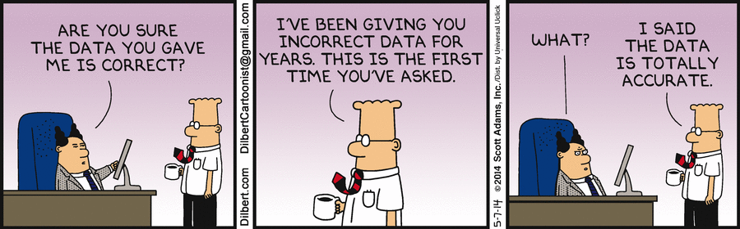

Slide 2
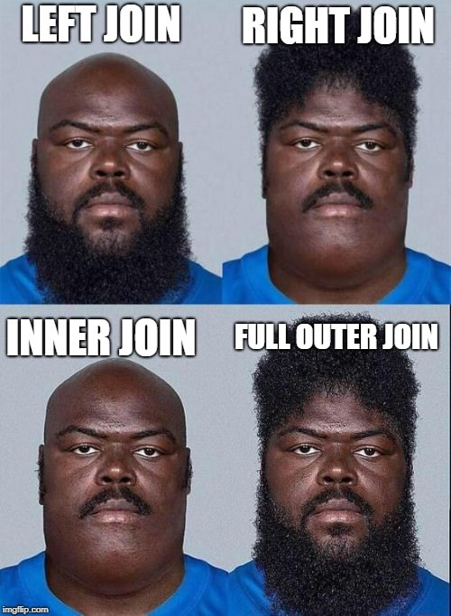
Merge - recap

Slide 3

Merge - recap

Slide 4
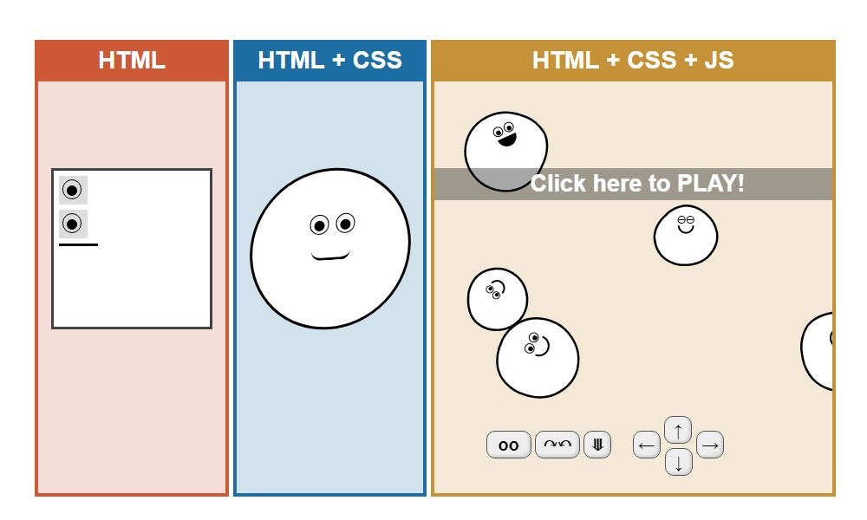
Web scraping - recap

Slide 5

Beautiful soup - recap
Imports:
requests.get(“url”)
BeautifulSoup(r.content, "lxml")
soup.find("table", class_ = ”class_name")
soup.find_all("a") – returns list of tags
soup.prettify()

Slide 6

REGEX
Import re
Tutorial - https://ryanstutorials.net/regular-expressions-tutorial/regular-expressions-basics.php
Regex 101 - https://regex101.com/

Slide 7
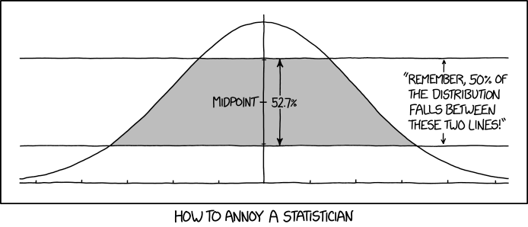
EDA

Slide 8
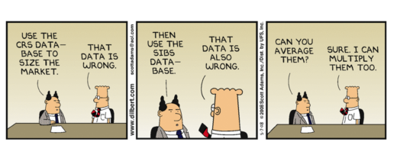
GIGO

Slide 9
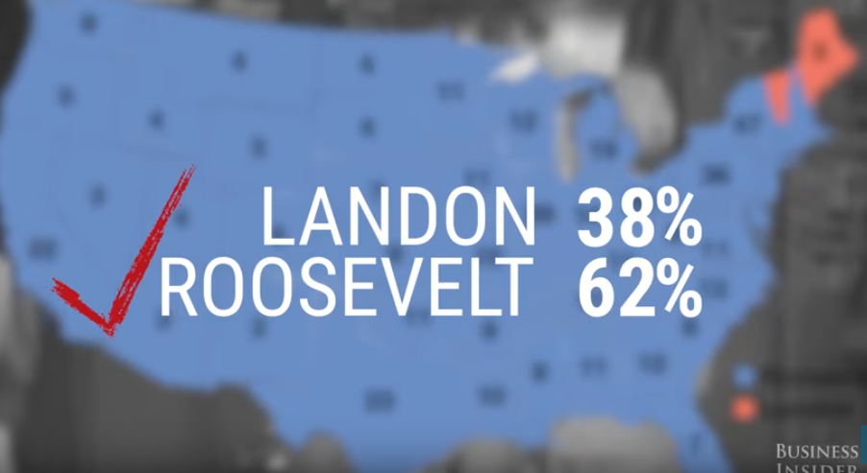
Literary digest poll
1916, 1929, 1924, 1928, 1932 polls got it right
2.4 million people surveyed (largest poll in US history)
Landon 57%, Roosevelt 43%
Survey sent to subscribers and people with home phones
Less than 25% responded to the survey

Slide 10
Visualizations – data journalism
The pudding - https://pudding.cool/2019/02/gyllenhaal/

