Slide 1


Slide 2
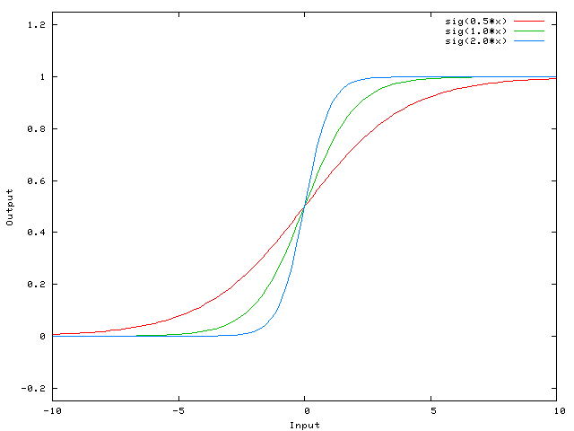

Hidden layer without bias

Slide 3
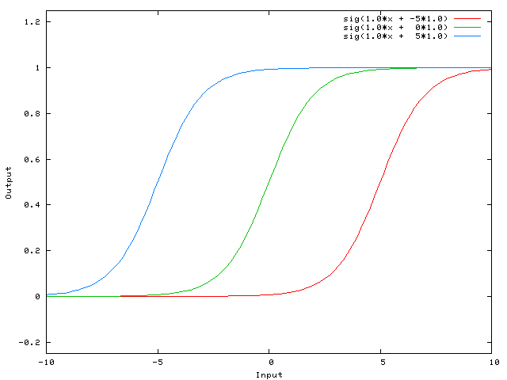
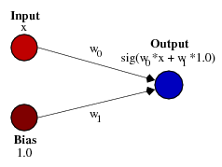
Hidden layer with bias

Slide 4
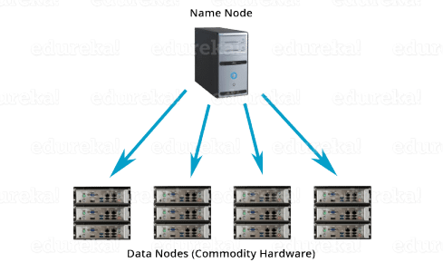
HDFS
Name node
(backup node)
Data nodes

Slide 5
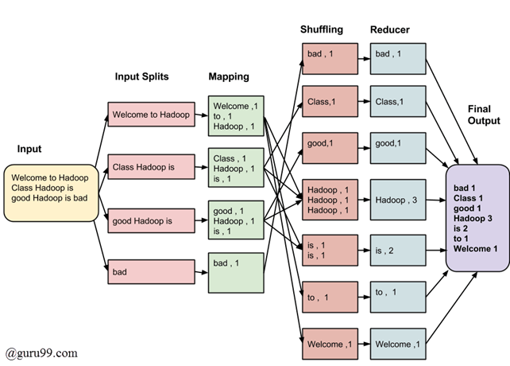
MapReduce
Analysis layer over hdfs
Mining of massive datasets

Slide 6
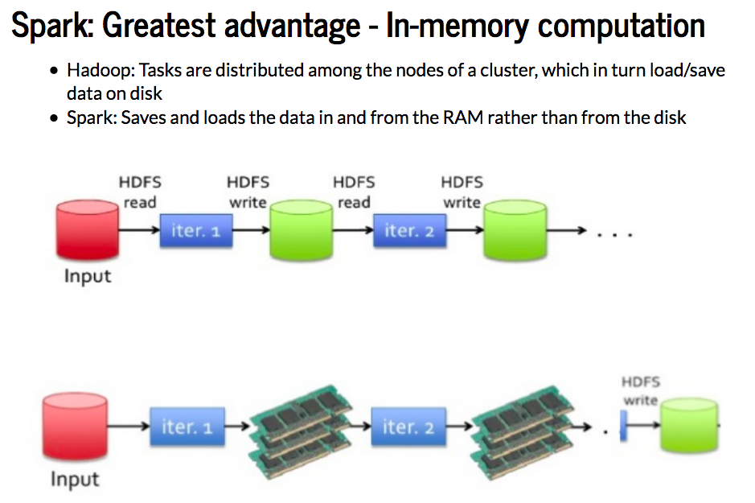
spark
Map reduce 2004-2009
Spark 2009-2014
In memory = fast
In memory = expensive

Slide 7
Spark vs sklearn

Slide 8




Managed services

Slide 9


SQL vs NoSQL
Relational vs documents

Slide 10
Word embeddings

Slide 11


Slide 12
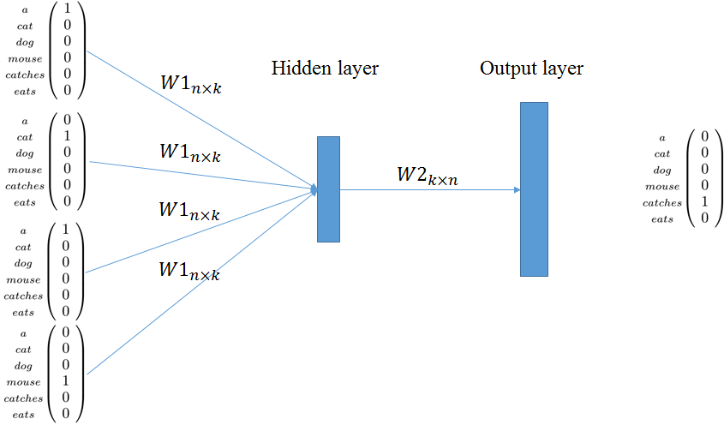

Slide 13
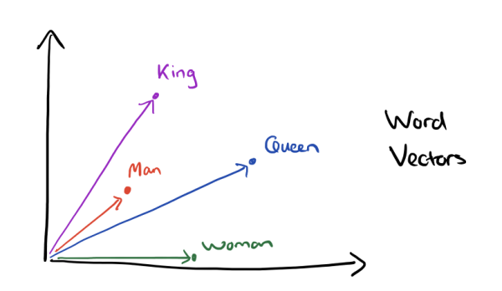

Slide 14
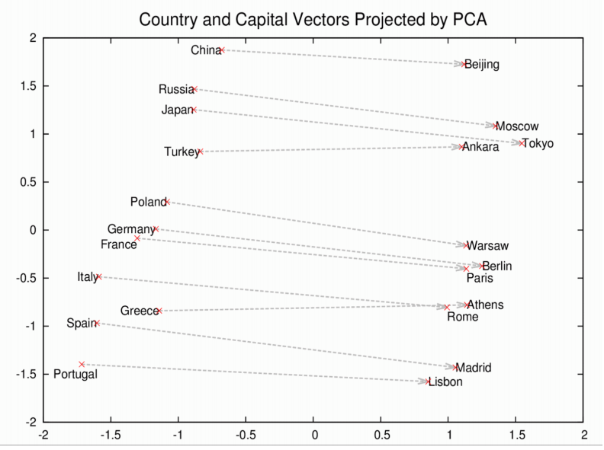

Slide 15
Racist sentiment analysis

