Slide 2
Convolution
Imagenet story
Pooling
Rnn + lstm
Deepfakes(?) style transfer (?) GAN (?)
Adversarial examples (?)
Beeing skeptical with research

Slide 3
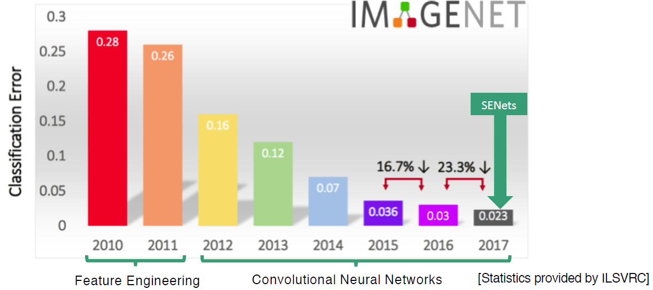
What are SENets?

Slide 4
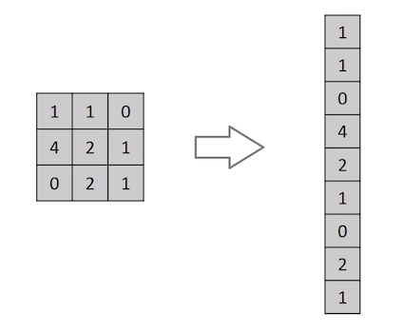
Convolutional Neural Network (CNN)
Until now: Flatten image
Why not?

Slide 5
Convolutional Neural Network (CNN)
kernels

Slide 6
Convolutional Neural Network (CNN)
“stride”
padding

Slide 7
Convolutional Neural Network (CNN)
pooling

Slide 8
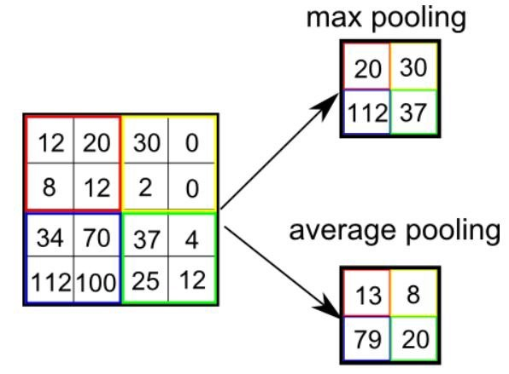
Convolutional Neural Network (CNN)
Pooling
https://towardsdatascience.com/a-comprehensive-guide-to-convolutional-neural-networks-the-eli5-way-3bd2b1164a53

