Slide 1


Fast, Low-Cost Passive Load-Pull Measurements Using AI Load-Pull Extrapolation and Switched Impedance Network
Jonathan E. Swindell, Oliver Jarvis, Adam C. Goad, Austin Egbert, Charles Baylis, Robert J. Marks

Slide 2
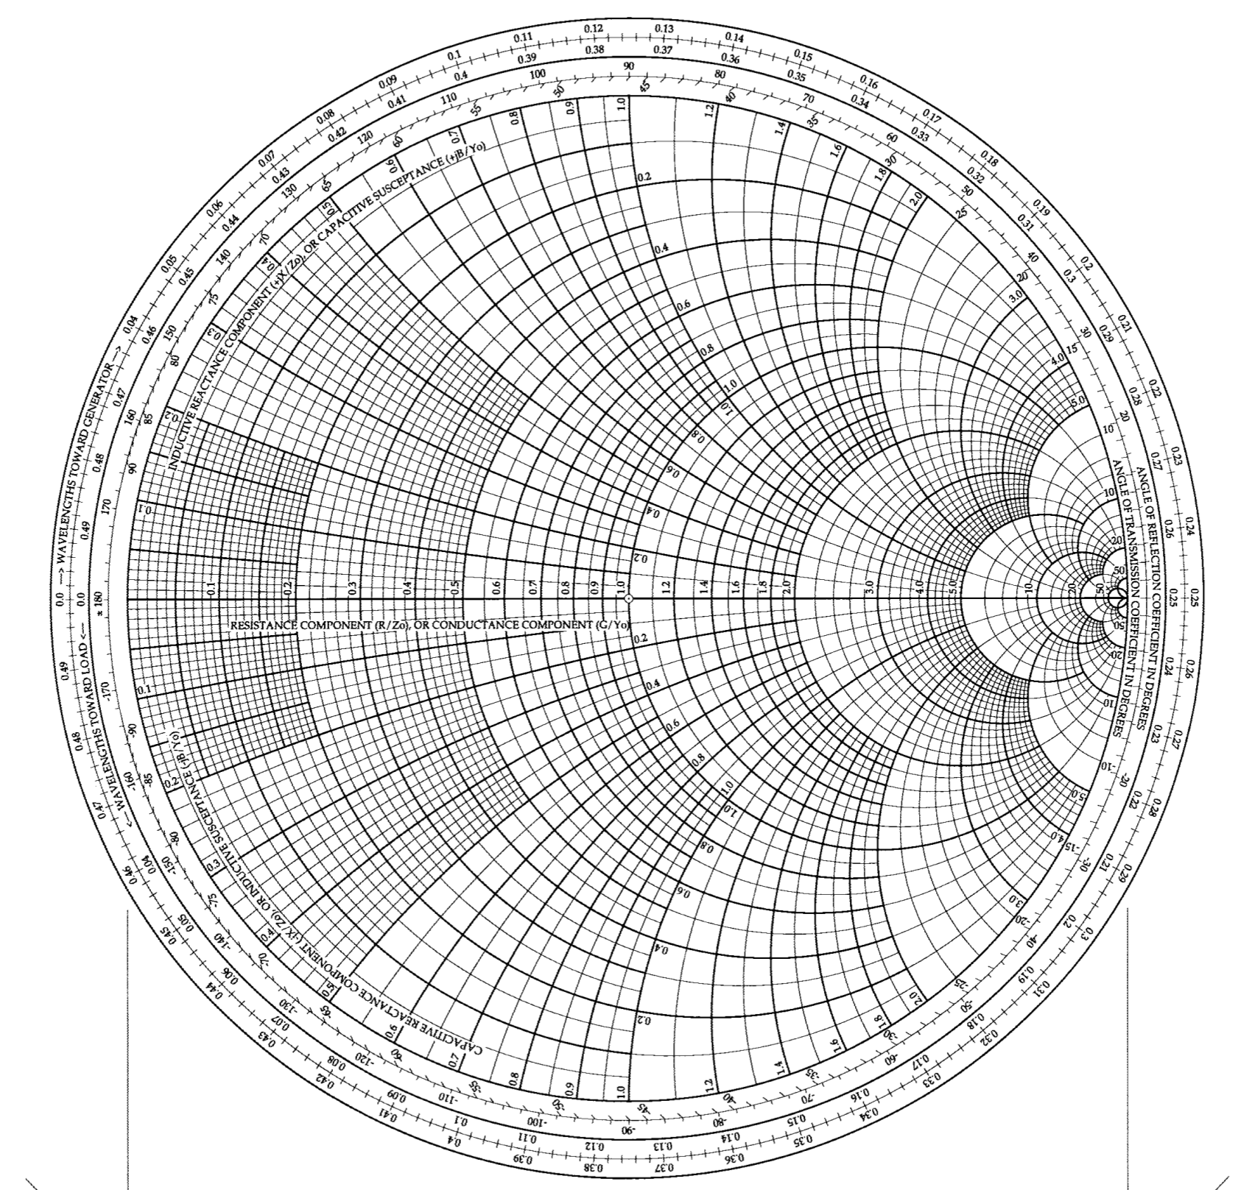

Load-Pull
Source impedance changes the performance of the device.
Load-pull provides known impedances to a device while its performance is measured.
Smith Chart
Source
Device Measurements
Load
R + jX
R + jX
Device
[1]

Slide 3
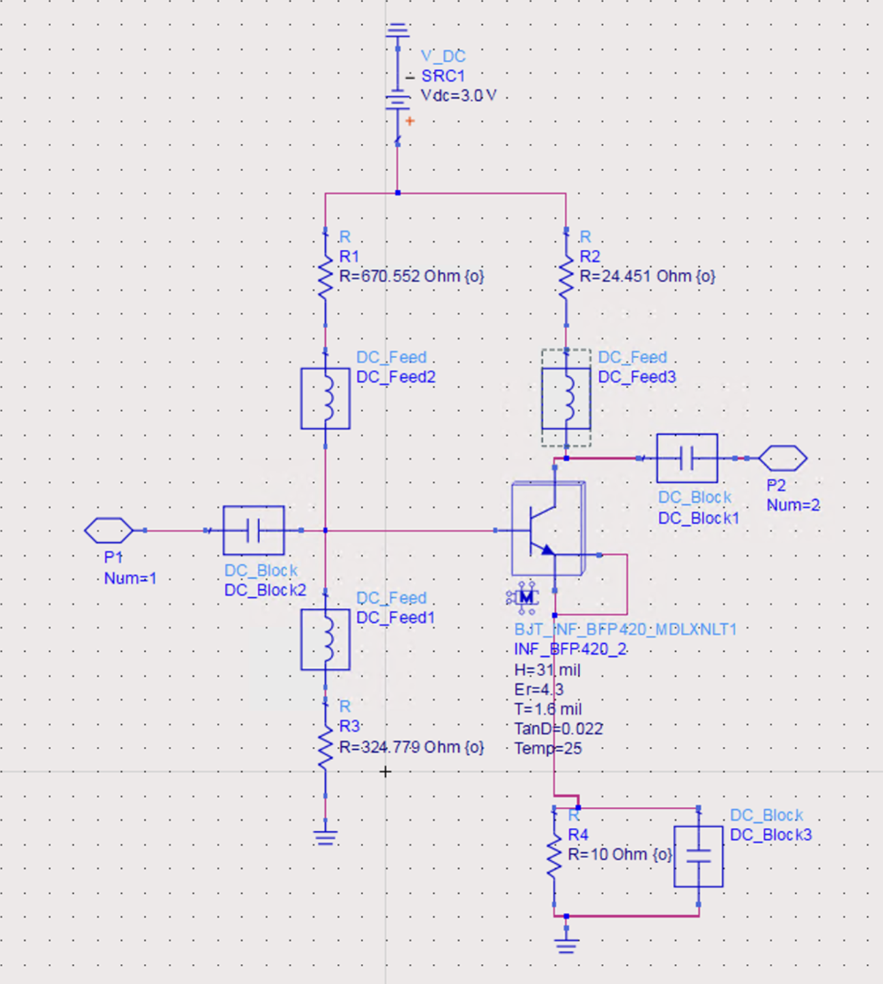
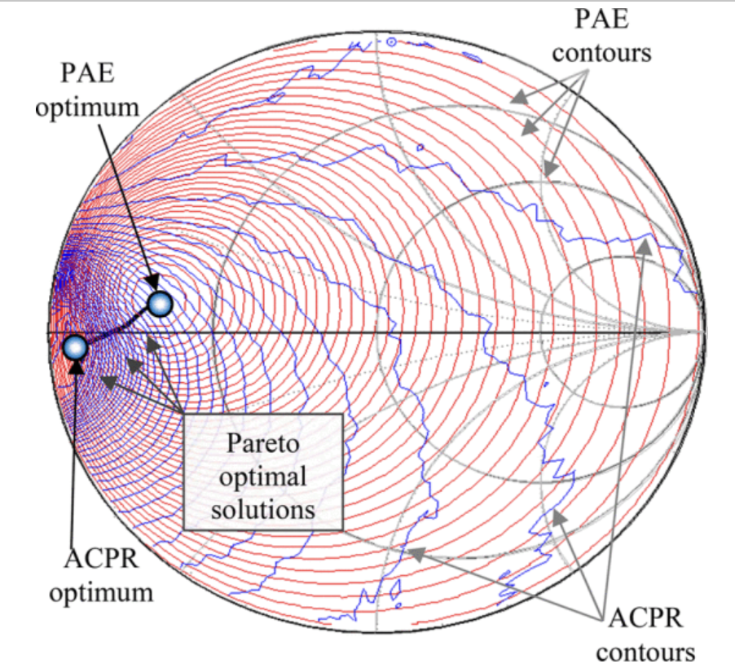
Load-Pull is Important
Collecting enough load-pull measurements to characterize performance across the Smith chart is time-consuming and must be done for each set of design parameters
RFPA Schematic with many optimization parameters
Example of ACPR and PAE performance contours for a single PA design [2]
Load-pull measurement reduction techniques can be applied in optimization problems under real-time constraints such as when developing adaptive and reconfigurable systems.

Slide 4

Load-Pull is Important
Bias Sweeps
Power Sweep
Load-Pull
Applications Requires Many Measurements

Slide 5
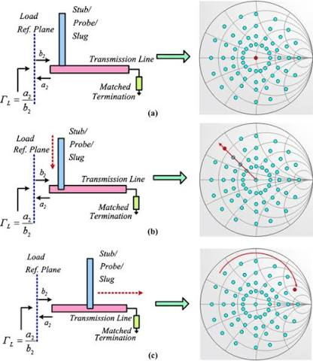
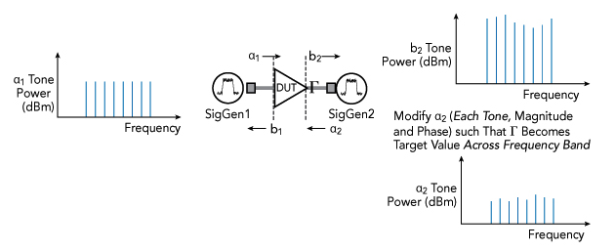
Load-Pull can be Difficult to Measure
Passive load-pull
  High Power Handling
  Mechanically Actuated
  Slow
Active load-pull
  Fast
  Struggles at high powers
  Expensive
[4]
[3]

Slide 6
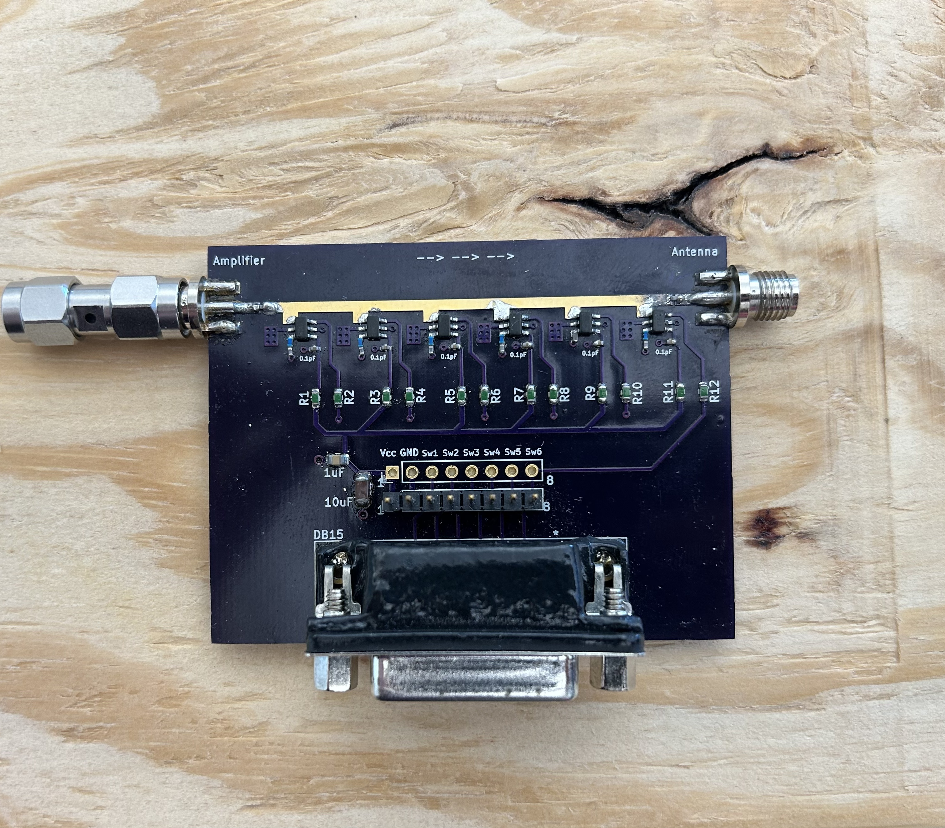
Contributions
The contribution of this work is a fast, low-cost passive load-pull measurement system.
This works using:
  A Low-Cost Custom Impedance Tuner
  Generative Adversarial Network Load-Pull Extrapolation

Slide 7
Custom Hardware Tuner
This paper uses a low-cost prototype of the reconfigurable impedance tuner presented in [5].
  At the time of this submission, the bill of materials required to assemble this tuner totals $103.42.
Unlike many expensive commercial tuners, this tuner cannot achieve full Smith chart coverage.
We can present a small number of reflection coefficients to the DUT, and these reflections are limited in magnitude
However, load-pull extrapolation can complete the contours using only the measured points.
[5] J. Roessler et al., "A Low-Loss Reconfigurable Plasma Impedance Tuner for Real-Time, Frequency-Agile, High-Power RF Applications," 2022 IEEE/MTT-S Int. Microw. Symp., Denver, CO, USA, 2022, pp. 183-186, doi: 10.1109/IMS37962.2022.9865404.

Slide 8
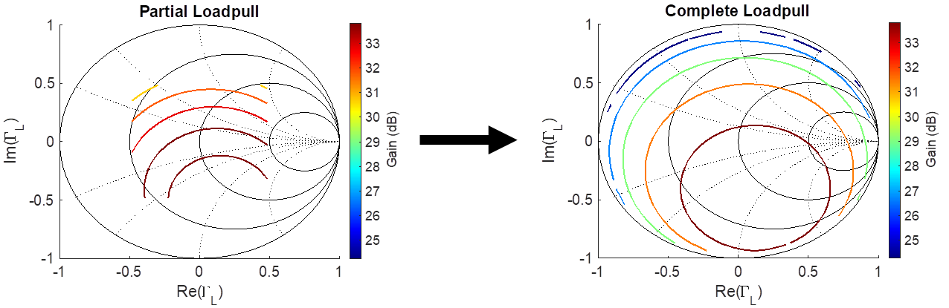
Load-Pull Extrapolation
Can Reduce the Number of Measurements [6]

Slide 9
Generative Adversarial Networks (GAN)
Two neural networks trained iteratively
Generator: produces reliable data that resembles the training dataset.
Discriminator (Critic): trained to recognize data from the training datasets.
Wasserstein GAN was used for this work.

Slide 10
Generative Adversarial Networks (GAN) Image Completion
Wasserstein GAN was used in this work

Slide 11
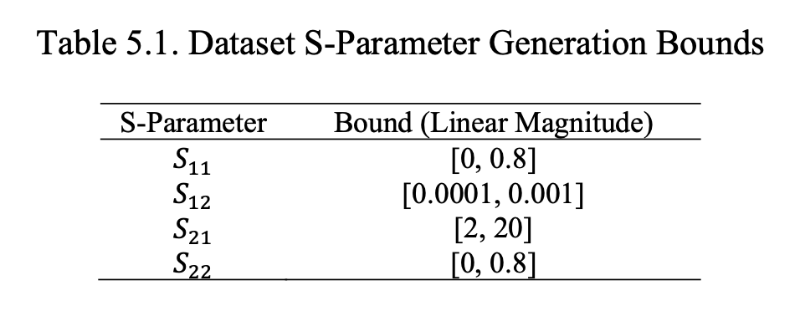
Output Power Training Data Generation
Output power contours from randomly generated, synthetic S-parameters were used to train the GAN model
The bounds from Table 5.1 were used, and filtering was applied so that only unconditionally stable amplifiers were used for training.
More details on network training can be found in [6].
[6] A. Egbert, C. Baylis and R. J. Marks, "Extrapolation of Load-Pull Data: A Novel Use of GAN Artificial Intelligence Image Completion," in IEEE Trans. Microw. Theory Techn., vol. 70, no. 11, pp. 4849-4856, Nov. 2022, doi: 10.1109/TMTT.2022.3209700.

Slide 12
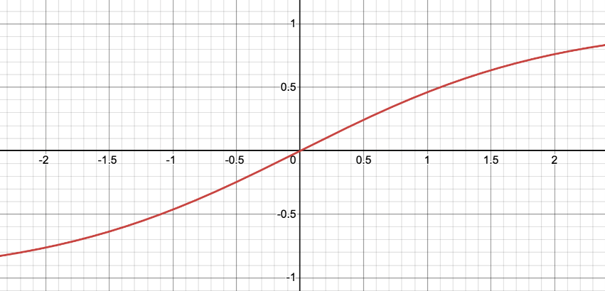
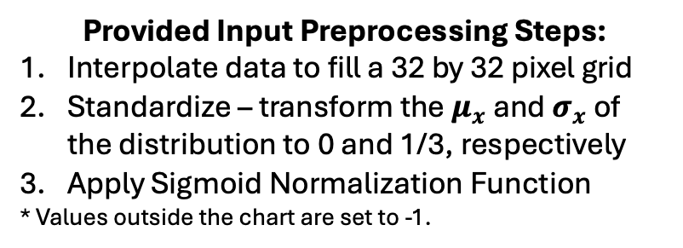
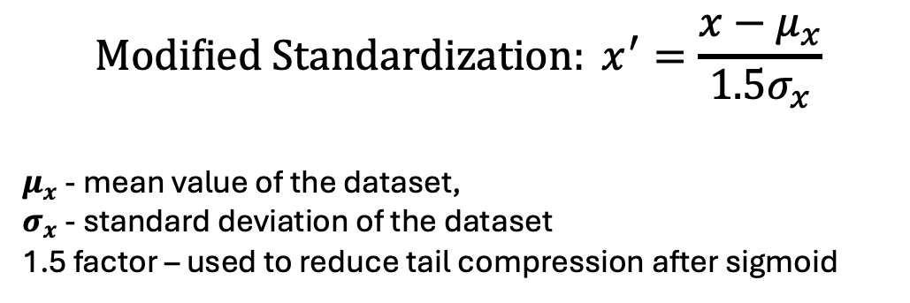
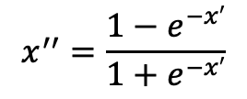
Output Power Load-Pull Extrapolation Input Data Preprocessing
$$Modified Standardization: x^{′}=\frac{x−μ_{x}}{1.5σ_{x}}$$
$μ_{x}$ - mean value of the dataset,
$σ_{x}$ - standard deviation of the dataset
1.5 factor – used to reduce tail compression after sigmoid
Provided Input Preprocessing Steps:
Interpolate data to fill a 32 by 32 pixel grid
Standardize – transform the $μ_{x}$ and $σ_{x}$ of the distribution to 0 and 1/3, respectively
Apply Sigmoid Normalization Function
* Values outside the chart are set to -1.
Output Power Contours
Grayscale Image
After Preprocessing
Sigmoid Normalization Function
Map dB output power values to grayscale pixel values
$$x^{′′}=\frac{1−e^{−x′}}{1+e^{−x′}}$$

Slide 13
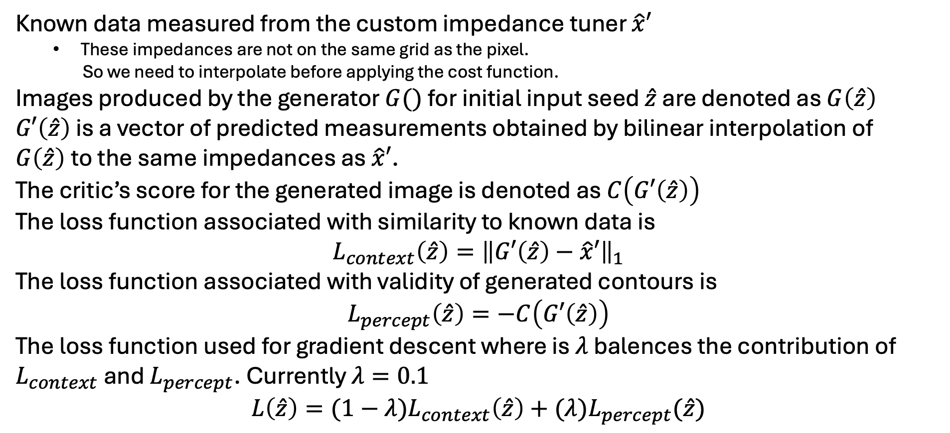
GAN Inference Loss Functions from Tuner Impedances
Known data measured from the custom impedance tuner $\hat{x}′$
  These impedances are not on the same grid as the pixel.
  So we need to interpolate before applying the cost function.
Images produced by the generator $G()$ for initial input seed $\hat{z}$ are denoted as $G\left(\hat{z}\right)$
$G′\left(\hat{z}\right)$ is a vector of predicted measurements obtained by bilinear interpolation of $G\left(\hat{z}\right)$to the same impedances as $\hat{x}′$.
The critic’s score for the generated image is denoted as $C\left(G′\left(\hat{z}\right)\right)$
The loss function associated with similarity to known data is
$$L_{context}\left(\hat{z}\right)={\left\|G′\left(\hat{z}\right)−\hat{x}′\right\|}_{1}$$
The loss function associated with validity of generated contours is
$$L_{percept}\left(\hat{z}\right)=−C\left(G′\left(\hat{z}\right)\right)$$
The loss function used for gradient descent where is $λ$ balences the contribution of $L_{context}$ and $L_{percept}$. Currently $λ=0.1$
$$L\left(\hat{z}\right)={(1−λ)L}_{context}\left(\hat{z}\right)+(λ)L_{percept}(\hat{z})$$
[F]
[E]
[H]
[C]
[I]
[A]
[B]
[G]
[D]

Slide 14
64 Multi-shot Images
Because of the stochastic nature of the AI image completion process, the extrapolated contours are obtained by averaging the results of 64 different extrapolations performed on the same measured data. This improves performance.
To report the error, three metrics are used:
1. Average Output Power Error (dB)
2. Average Opt. Reflection Coefficient Magnitude Error
3. Uncertainty Radius
Uncertainty Radius is defined by choosing the greater of the standard deviations in the real and imaginary components of the extrapolations’ optimal reflection coefficients over the 64 images.
[F]
[E]
[H]
[C]
[I]
[A]
[B]
[G]
[D]

Slide 15
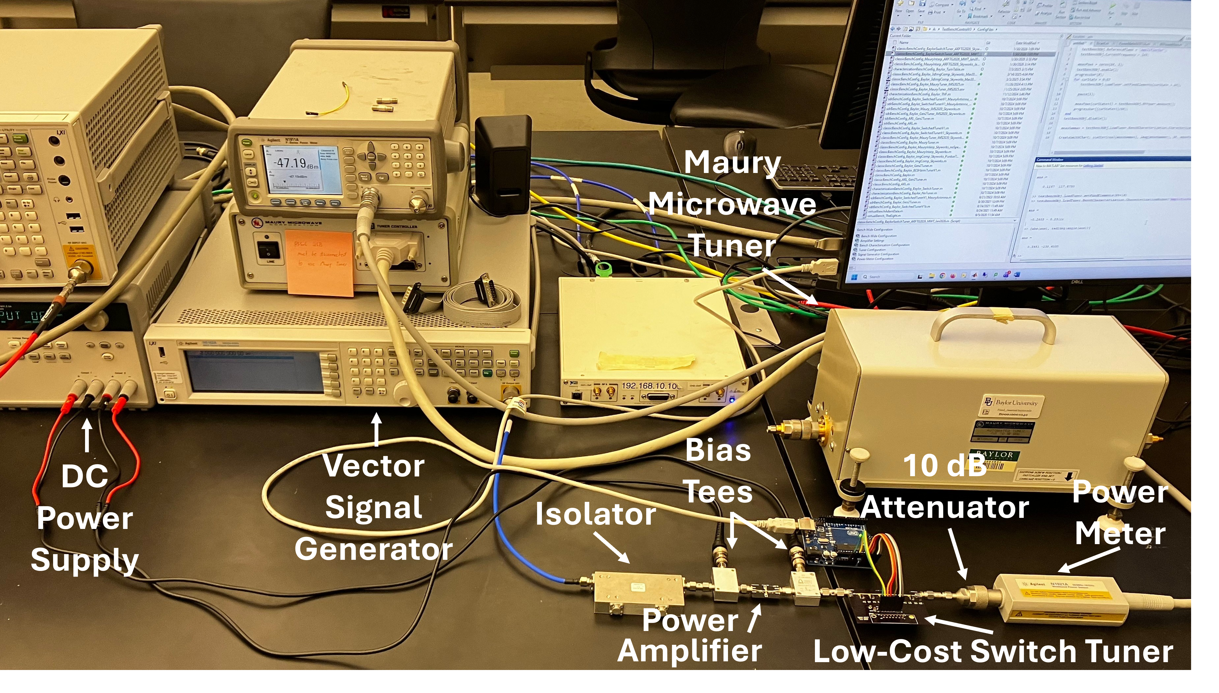
Measurement Setup
A) DC Power Supply
B) Vector Signal Generator
C) Isolator
D) Power Amplifier
E) Bias Tees
F) Maury Microwave Tuner
G) Low-Cost Switch Tuner
H) 10 dB Attenuator
I) Power Meter
[F]
[E]
[H]
[C]
[I]
[A]
[B]
[G]
[D]
This standard load-pull setup was used to validate extrapolation performance.

Slide 16
Linear Extrapolation
Overall, the extrapolation process applied to the low-cost tuner measurements provides good agreement with the standard load-pull setup.
In this example, the contour shape, optimum, and predicted output power level are in good agreement.

Slide 17
Non-Linear Extrapolation
This example shows a load-pull extrapolation of a device operating nonlinearly at 2 GHz on the MwT1 transistor.
The extrapolation fails to capture the more ovular contour shape toward the right-half of the chart, though the contours are in good agreement on the left half where the measurements were taken.

Slide 18
Non-Linear Extrapolation
The neural network was trained on linear contours generated from synthetic S-Parameter data, with some simulated measurement noise applied (about 0.1 dB of noise at 15 dBm) to facilitate the extrapolation of non-linear contours.
We expect that accuracy could be improved by training a network with non-linear load-pull data collected from devices operating in compression.

Slide 19
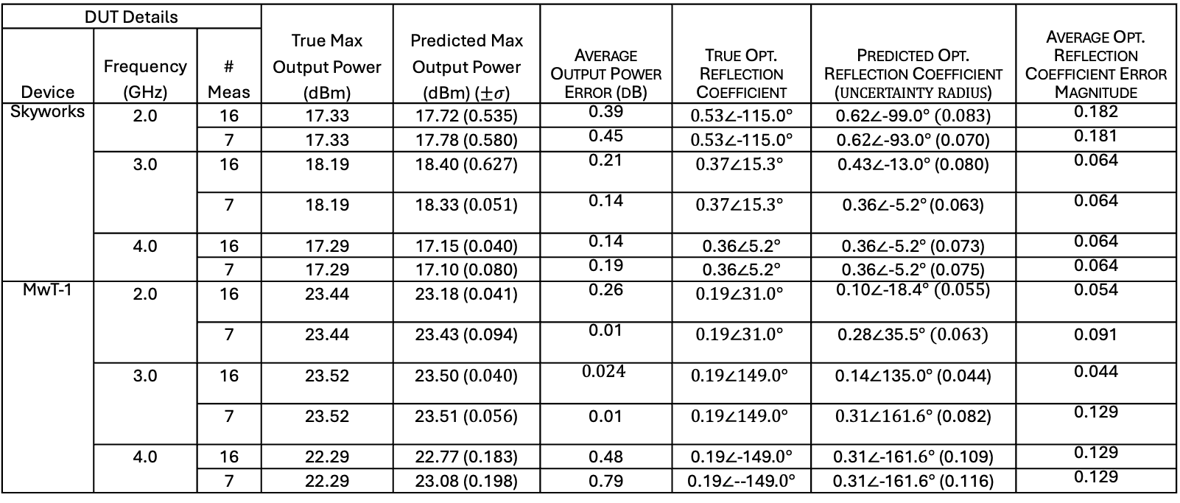
Performance Results
Performances were tested over different devices, frequencies, and numbers of provided impedances over the provided metrics.
DUT Details |  |  | True Max Output Power (dBm) | Predicted Max Output Power (dBm) ($±σ$) | Average Output Power Error (dB) | True Opt. Reflection Coefficient | Predicted Opt. Reflection Coefficient ($uncertainty radius$) | Average Opt. Reflection Coefficient Error Magnitude
Device | Frequency (GHz) | # Meas
Skyworks | 2.0 | 16 | 17.33 | 17.72 (0.535) | 0.39 | $0.53∠$-115.0$°$ | 0.62$∠$-99.0$°$ $(0.083$) | 0.182
 |  | 7 | 17.33 | 17.78 (0.580) | 0.45 | $0.53∠$-115.0$°$ | 0.6$2∠$-93.0$°$ (0.070) | 0.181
 | 3.0 | 16 | 18.19 | 18.40 ($0.627$) | 0.21 | $$0.37∠15.3°$$ | 0.43$∠$-13.0$°$ (0.080) | 0.064
 |  | 7 | 18.19 | 18.33 ($0.051$) | 0.14 | $$0.37∠15.3°$$ | 0.36$∠$-5.2$°$ (0.063) | 0.064
 | 4.0 | 16 | 17.29 | 17.15 (0.040) | 0.14 | 0.36$∠$5.2$°$ | 0.36$∠$-5.2$°$ (0.073) | 0.064
 |  | 7 | 17.29 | 17.10 (0.080) | 0.19 | 0.36$∠$5.2$°$ | 0.36$∠$-5.2$°$ (0.075) | 0.064
MwT-1 | 2.0 | 16 | 23.44 | 23.18 (0.041) | 0.26 | $$0.19∠31.0°$$ | 0.10$∠$-18.4$° (0.055$) | 0.054
 |  | 7 | 23.44 | 23.43 (0.094) | 0.01 | $$0.19∠31.0°$$ | 0.28$∠$35.5$°$ $(0.063)$ | 0.091
 | 3.0 | 16 | 23.52 | 23.50 ($0.040$) | $$0.024$$ | $$0.19∠149.0°$$ | 0.14$∠$135.0$°$ (0.044) | 0.044
 |  | 7 | 23.52 | 23.51 ($0.056$) | 0.01 | $$0.19∠149.0°$$ | $0.31∠161.6°$ (0.082) | 0.129
 | 4.0 | 16 | 22.29 | 22.77 (0.183) | 0.48 | 0.19$∠$-149$.0°$ | 0.31$∠$-161$.6°$ (0.109) | 0.129
 |  | 7 | 22.29 | 23.08 (0.198) | 0.79 | 0.19$∠$--149$.0°$ | 0.31$∠$-161.6$°$ (0.116) | 0.129

Slide 20
Performance Takeaways
Typical error in the optimal reflection coefficient stays below 2 pixels, corresponding to an error vector magnitude of about 0.13 in the reflection coefficient on the Smith chart.
The power levels predicted by the extrapolated data to be in agreement with the standard measurements, with a typical error of around 0.2 dB or less.

Slide 21
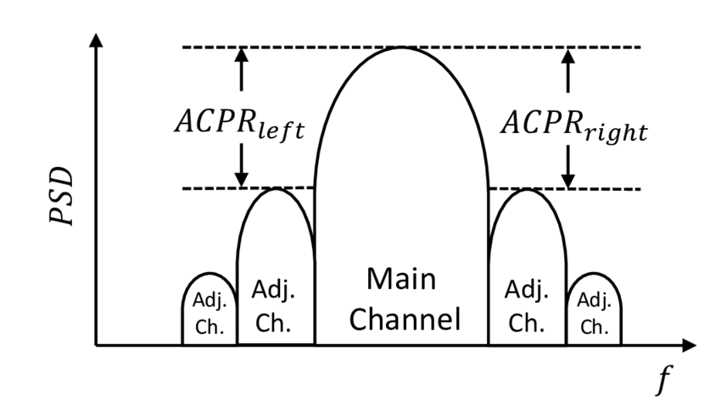
Future Directions
Improvements to either the model or the tuner’s coverage can improve load-pull extrapolation accuracy.
Investigating load-pull extrapolation for additional RF design metrics such as Adjacent Channel Power Ratio (ACPR).
Investigate trade-offs between other generative model architectures, such as diffusion models, variational autoencoders, and potentially others.

Slide 22
Conclusion
Problem:
  Measuring load-pull is expensive, and most applications require numerous iterative measurements
Solution:
  Our low-cost load-pull system reduces both the hardware requirements and the number of measurements required to characterize a device.

Slide 23
References
[1] https://www.everythingrf.com/community/what-are-load-pull-measurements
[2] J. Martin, C. Baylis, L. Cohen, J. de Graaf and R. J. Marks II, "A Peak-Search Algorithm for Load–Pull Optimization of Power-Added Efficiency and Adjacent-Channel Power Ratio," in IEEE Transactions on Microwave Theory and Techniques, vol. 62, no. 8, pp. 1772-1783, Aug. 2014, doi: 10.1109/TMTT.2014.2331626.
[3] F. M. Ghannouchi and M. S. Hashmi, “Passive Load-Pull Systems,” in Load-Pull Techniques with Applications to Power Amplifier Design, F. M. Ghannouchi and M. S. Hashmi, Eds., Dordrecht: Springer Netherlands, 2013, pp. 29–54. doi: 10.1007/978-94-007-4461-5_2.
[4] “Advancing PA Test Methods With VNA-based Wideband Active Load-Pull | Microwave Journal.” Accessed: Sep. 23, 2026. [Online]. Available: https://www.microwavejournal.com/articles/41605-advancing-pa-test-methods-with-vna-based-wideband-active-load-pull
[5] J. Roessler et al., "A Low-Loss Reconfigurable Plasma Impedance Tuner for Real-Time, Frequency-Agile, High-Power RF Applications," 2022 IEEE/MTT-S Int. Microw. Symp., Denver, CO, USA, 2022, pp. 183-186, doi: 10.1109/IMS37962.2022.9865404.
[6] A. Egbert, C. Baylis and R. J. Marks, "Extrapolation of Load-Pull Data: A Novel Use of GAN Artificial Intelligence Image Completion," in IEEE Trans. Microw. Theory Techn., vol. 70, no. 11, pp. 4849-4856, Nov. 2022, doi: 10.1109/TMTT.2022.3209700.

Slide 24
Thank You!
I’m happy to take questions.

