Slide 1
Signal and System Final Project
ECG signal processing
Name: 唐郁翔 ID: 10811040

Slide 2
TABLE OF CONTENTS
01
02
Background
Method
03
04
Result
Discussion

Slide 3
OUR Goal
透過訊號處理的方式，處理掉心電圖的雜訊(denoise)，和做到基線移除(baseline correction)，並且找出QRS 複合波(QRS complex)，來幫助我們更容易地去判讀心電圖，最後找出ST節段(ST segment)不正常的案例。

Slide 4
01
Research Background

Slide 5
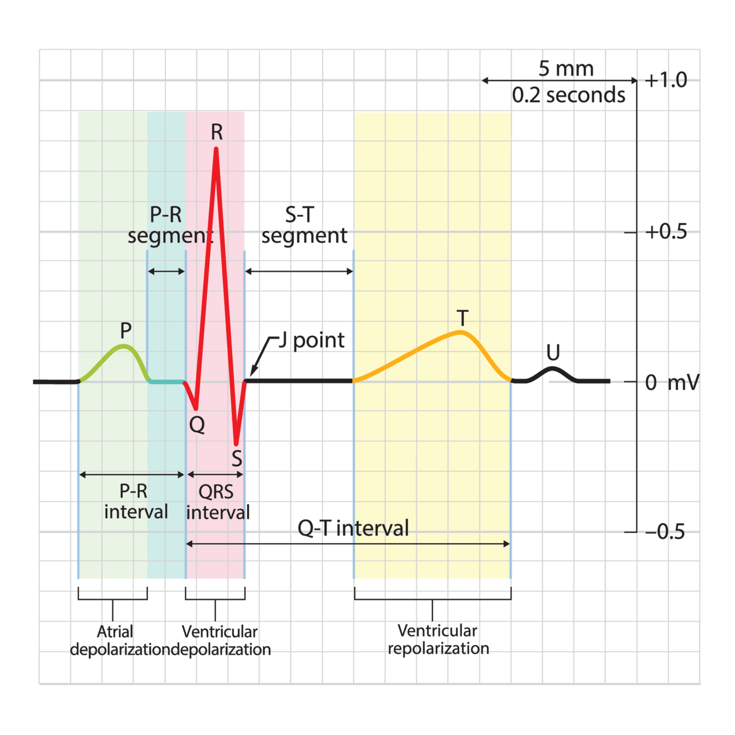
What is ST Segment?
ST節段:
表示QRS複合波（QRS complex）至T波之間的間期，一般介於 0.005 至 0.150 秒之間。

Slide 6
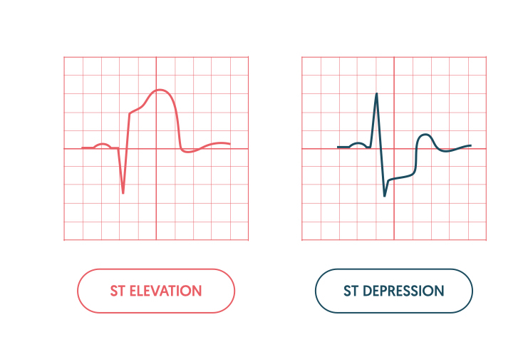
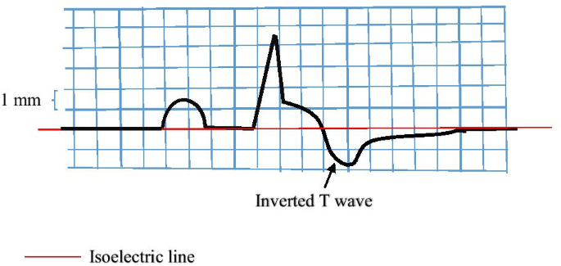
What can we learn form ST Segment?
正常的情況
節段上升(elevation): 表示可能有心肌透壁性梗塞（Transmural myocardial infarction）的狀況。
節段下降(depression): 則可能代表心內膜下梗死、低鉀血症，毛地黃苷中毒（digitalis toxicity）
T反轉(T-inversion):可能表示冠心性缺血（coronary ischemia）、Wellens症候群、左心室肥大（left ventricular hypertrophy），或中樞神經系統疾病。
Notes:
Elevation: 心肌梗塞的警訊
Depression:
Inversion:代表心肌缺血

Slide 7
02
Research Method

Slide 8
Programming Flowchart
Filter Design
& De-noise
Load data
Extract Features
Step 0
Step 2
Step 4
Step 1
Step 3
Find Noise Frequency
Remove Baseline

Slide 9
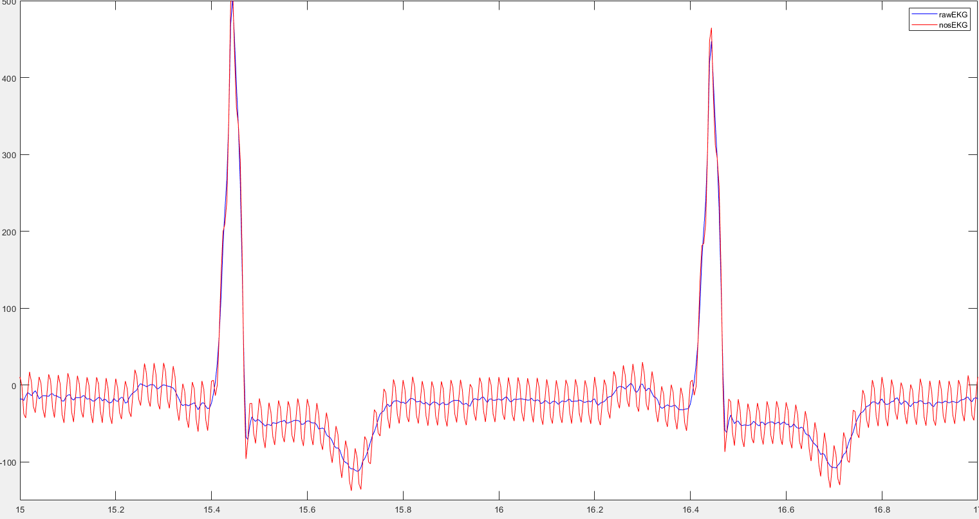
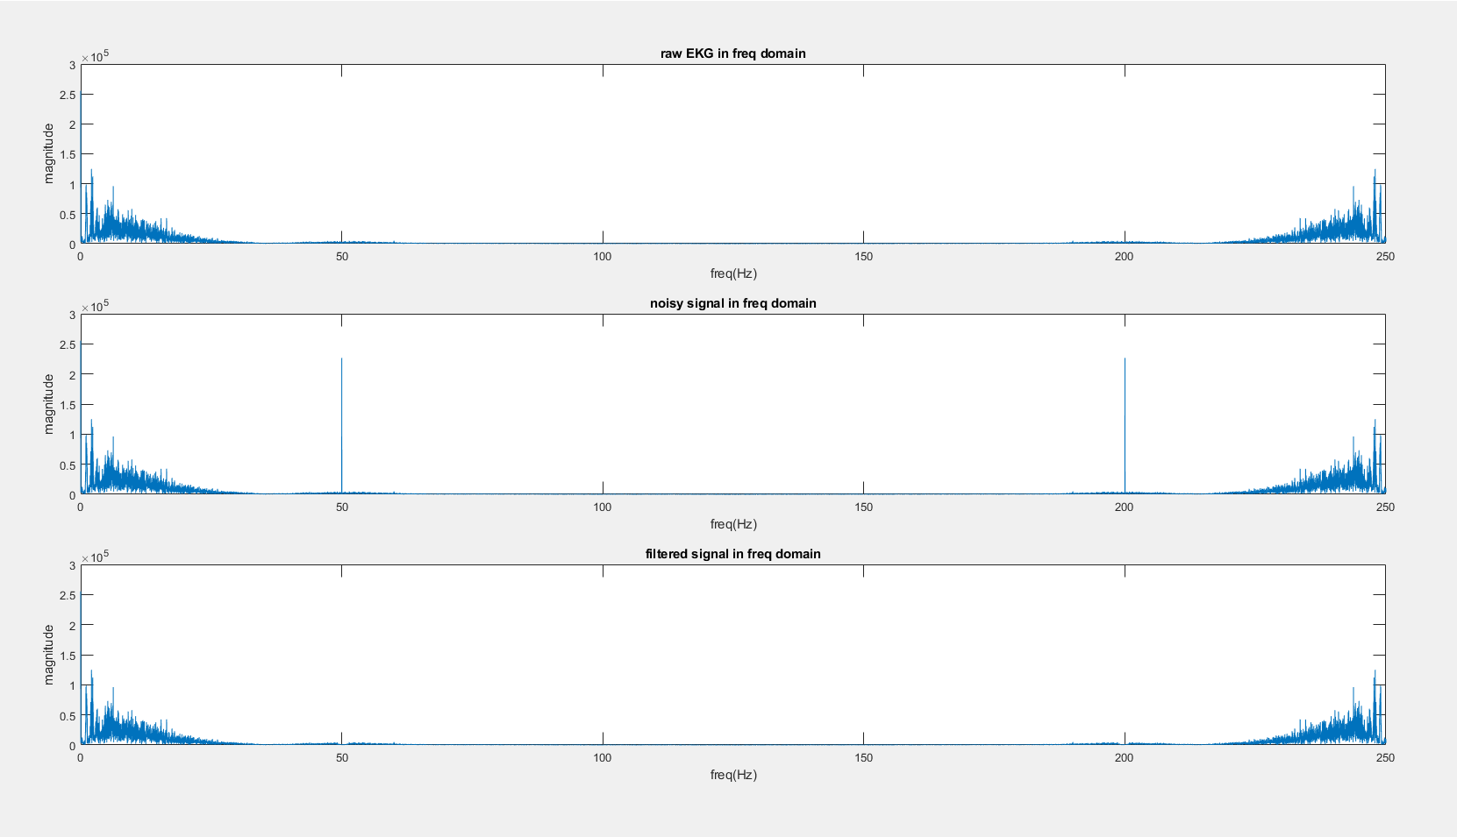
Step 1: Find Noise
Observation
Using FFT
發現雜訊出現在50Hz(200Hz)

Slide 10
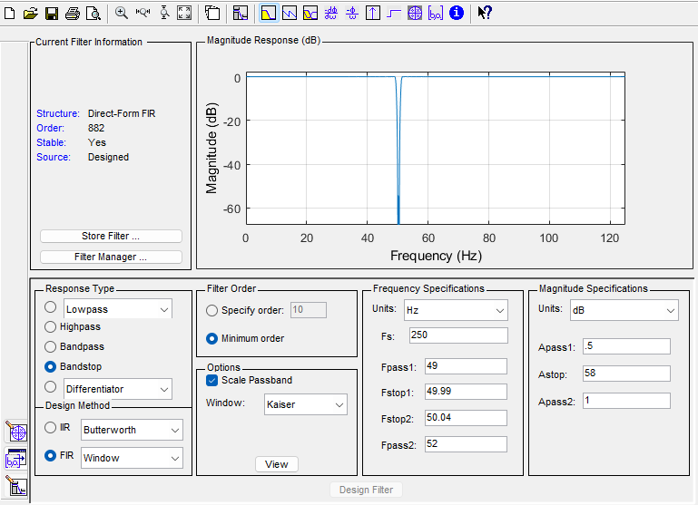
step 2: Design Filter
Filter Designer
Freq Specification
Fpass1=49
Fstop=49.99
Fstop2=50.04
Fpass2=52
Magnitude Specification
Apass1=0.5
Astop=58
Apass2=1
Bandstop FIR Filter
Order=822
Window=Kaiser
Basic Setting

Slide 11
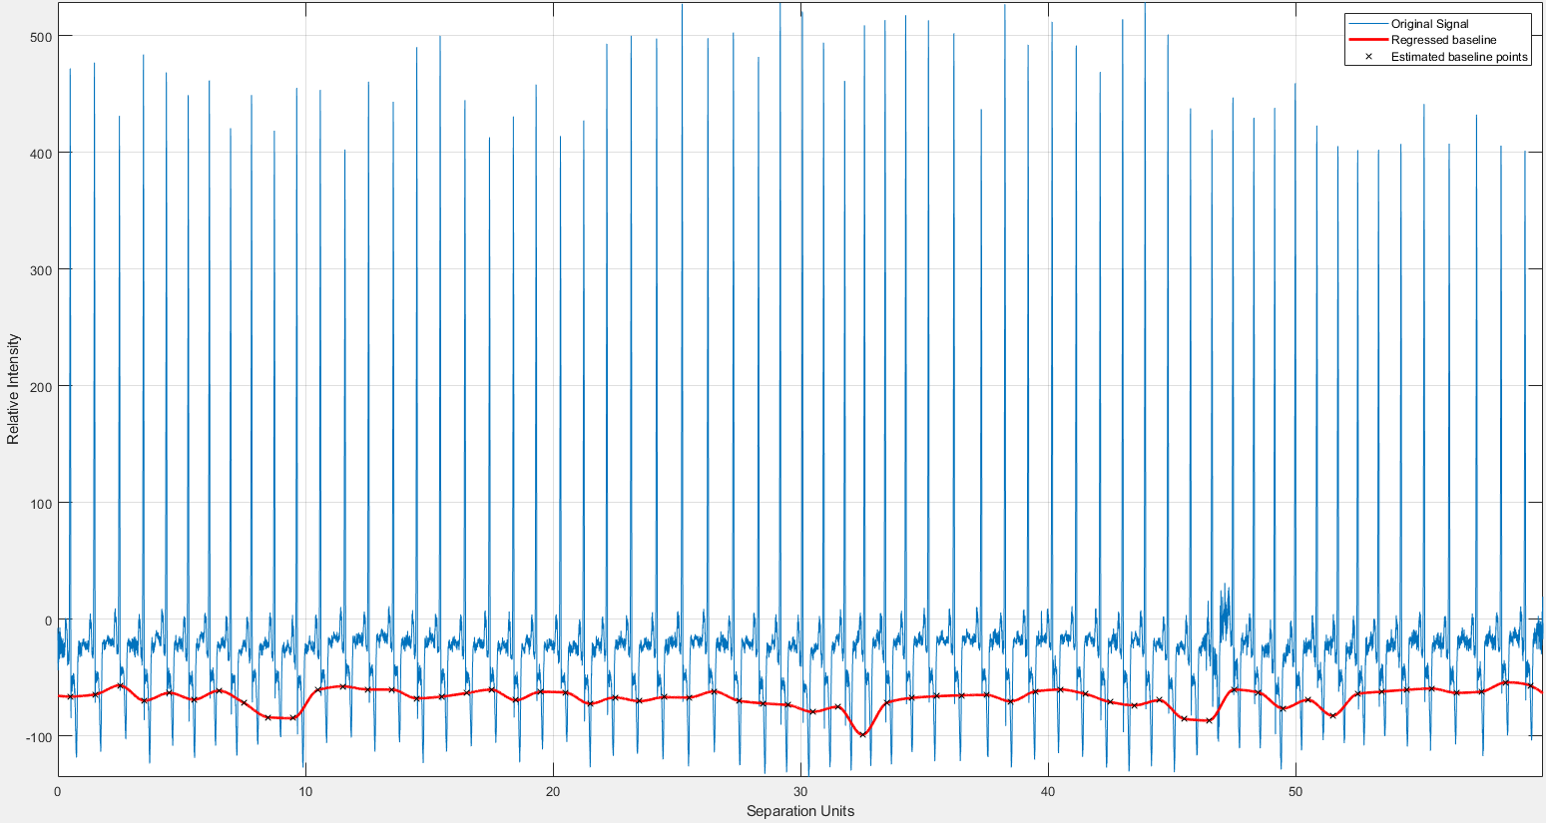
step 3: Remove Baseline
How is Baseline Generated
Respiration,
electrode impedance variations,
body movements.
Find Baseline
msbackadj()
Remove Baseline
+baseline'
Notes:
Electrode: 電極

Slide 12
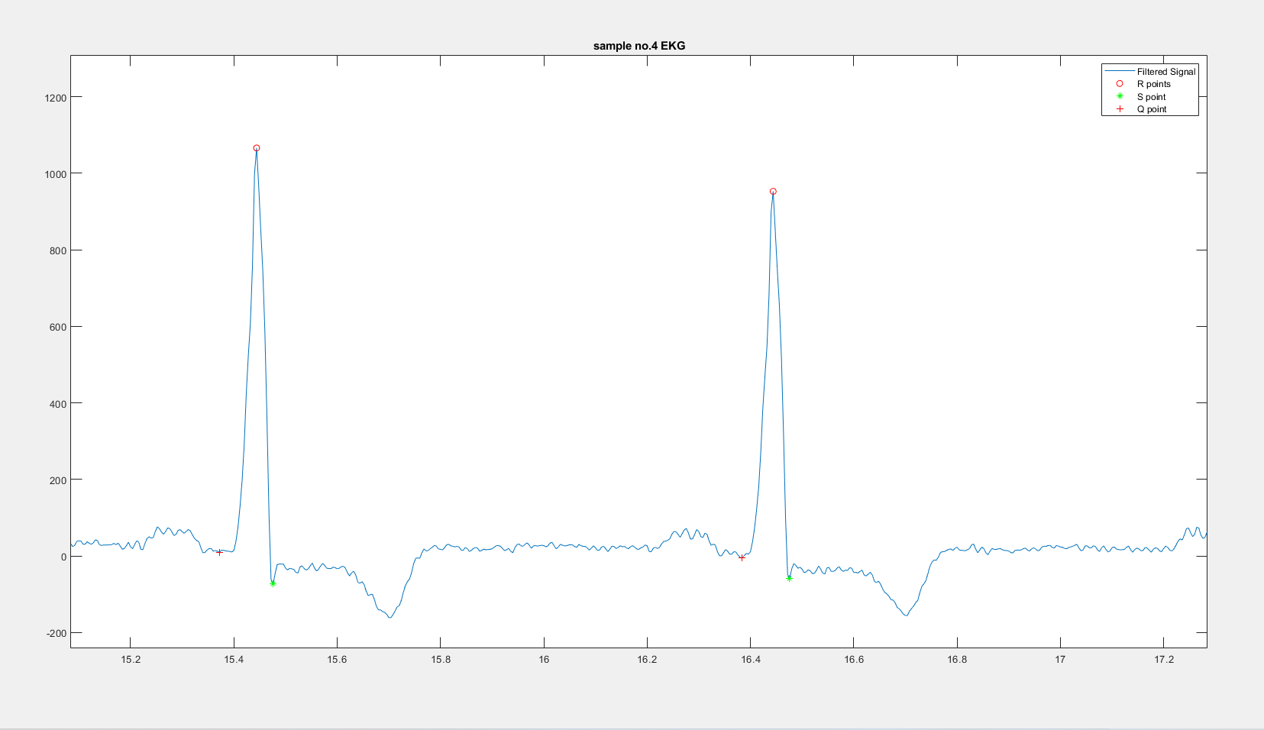
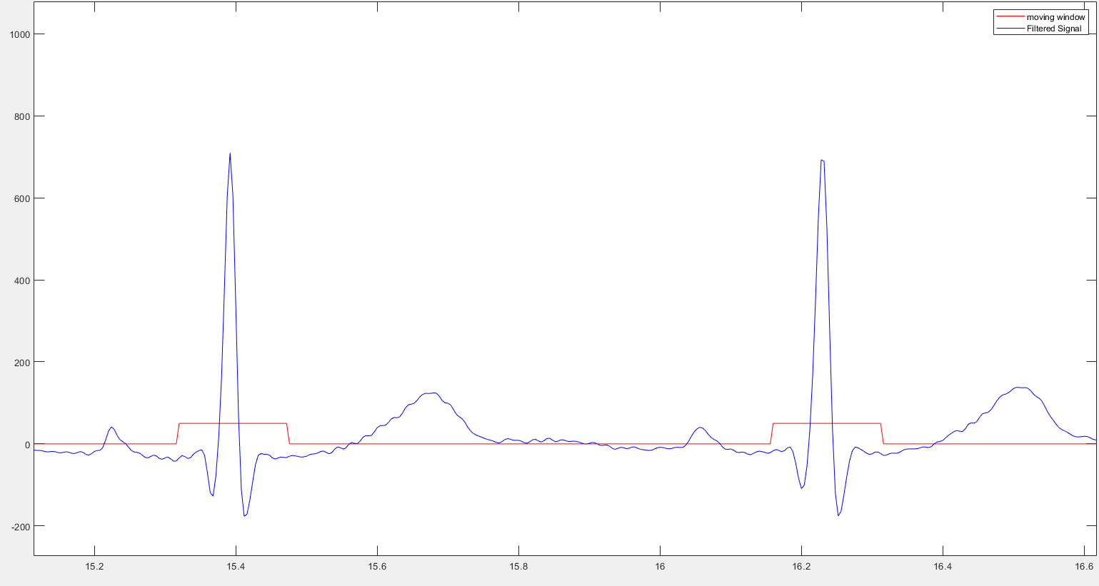
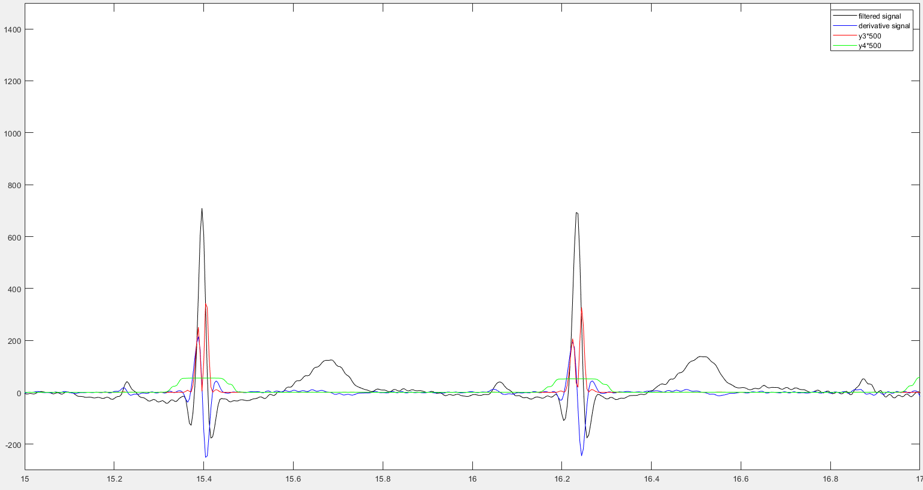

Step 4: Moving Window Features
01
03
02
Mark QRS
Create a filter
Using for loop:
R: max value
S: min value
Q: min value before R
Create a moving window integration filter
Setting threshold
Notes:
藍色視為分後訊號
紅色是平方後訊號
綠色的是視窗後訊號

Slide 13
03
Research Result

Slide 14
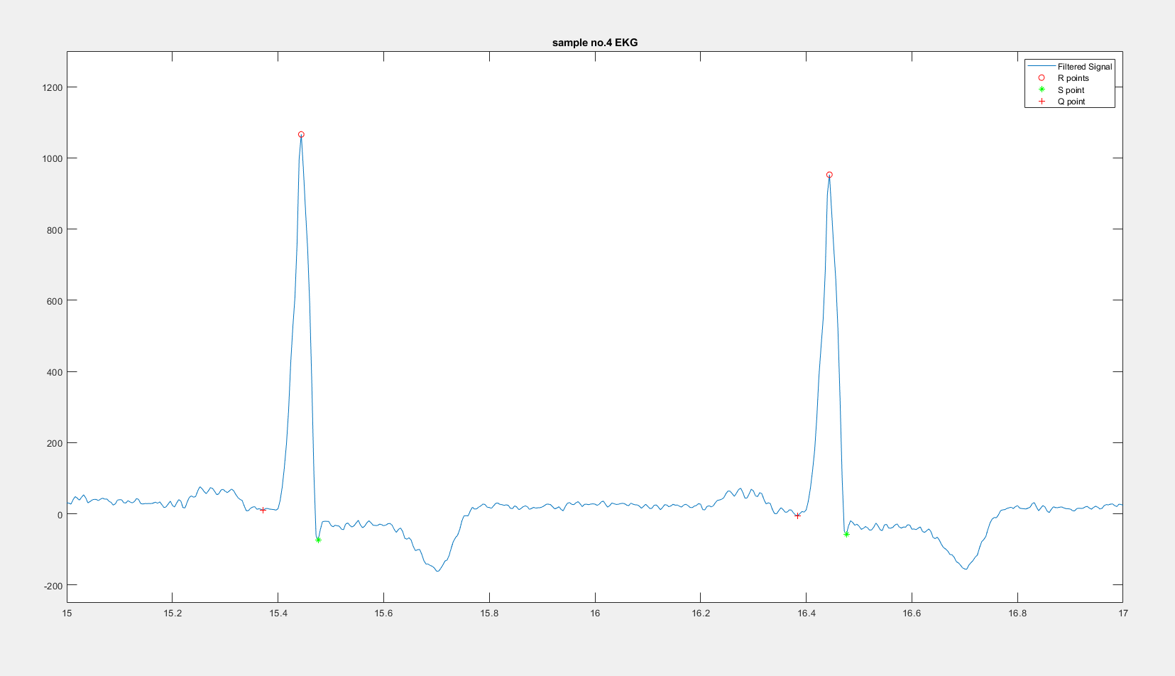
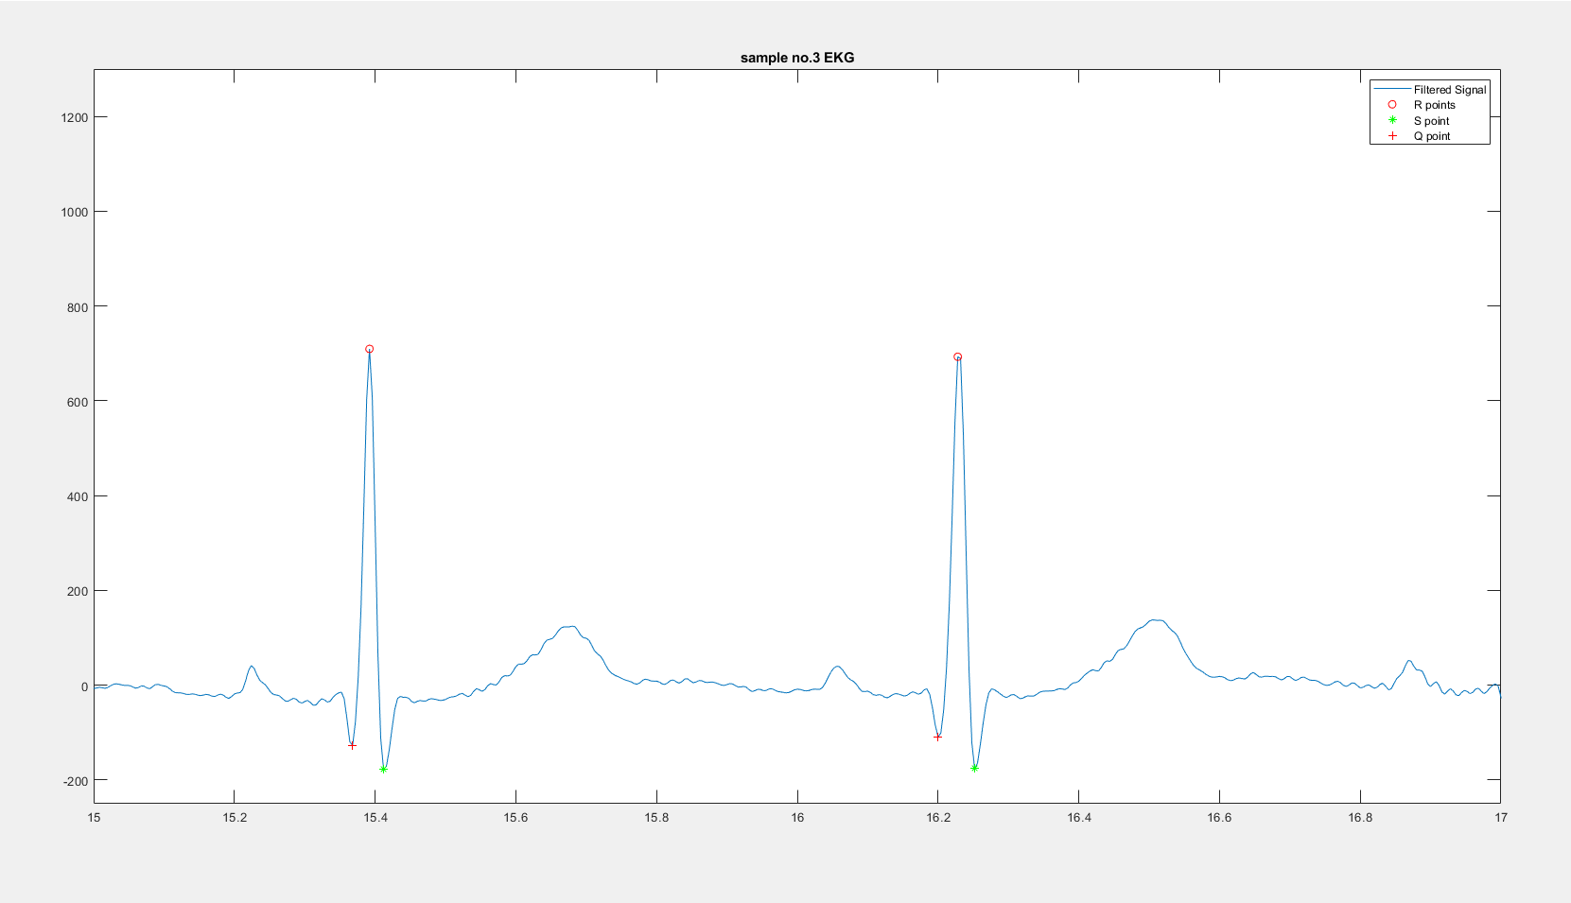
Sample no.3 VS. Sample no.4
No. 3
No. 4
Normal ST segment
T-wave inversion

Slide 15
Signal to Noise Ratio
Noise EKG SNR
Filtered Signal SNR
Sample No.3
33.01
8.06
31.79
Sample No.4
11.66

Slide 16
04
Discussion

Slide 17
Pros & Cons of Finite Impulse Response
Advantages
Disadvantages
Simple & Stable
Having linear phase response
Good performance
Non-causal
Requires large storage
Harder to implement than IIR
Requires complex computational techniques

Slide 18
Pros & Cons of Fast Fourier Transform
Advantages
Disadvantages
Fast, more efficient
low computing complexity, which means it makes the calculation easier.
Frequency limitation: 0~0.5*sample rate(Nyquist point)
Need to apply a window weighting function to compensate for spectral leakage
Notes:
FFT的範圍最多到0.5倍的sample rate(Nyquist point/frequency)，因此大於奈奎斯特頻率之上的訊號會發生錯誤
可能需要利用窗函數來補償頻譜洩漏
信號為無限長序列，運算需要截取其中一部分（截斷），於是需要加窗函式，加了窗函式相當於時域相乘，於是相當於頻域卷積，於是頻譜中除了本來該有的主瓣之外，還會出現本不該有的旁瓣，這就是頻譜泄露！為了減弱頻譜泄露，可以採用加權的窗函式，加權的窗函式包括平頂窗、漢寧窗、高斯窗等等。而未加權的矩形窗泄露最為嚴重。

Slide 19
REFERENCE
https://zh.m.wikipedia.org/zh-tw/T%E6%B3%A2
https://www.edn.com/know-the-limitations-of-your-scopes-fft-capabilities/
https://www.dataq.com/data-acquisition/general-education-tutorials/fft-fast-fourier-transform-waveform-analysis.html

Slide 20
Thanks for listening!

