Slide 1

West Nile Virus (WNV)
Mosquito Test Results Analytics
Team 4
Shimanta Chakraborty
Metitiri Disi
Yue He
Gitesh Patil
Chen Wong
Instructor
Dr. Mahdi Moqri
WNV

Slide 2

Agenda
Exploring Analytics
Predictive Analytics
Evaluation of Models and Results
Future Scope

Slide 3
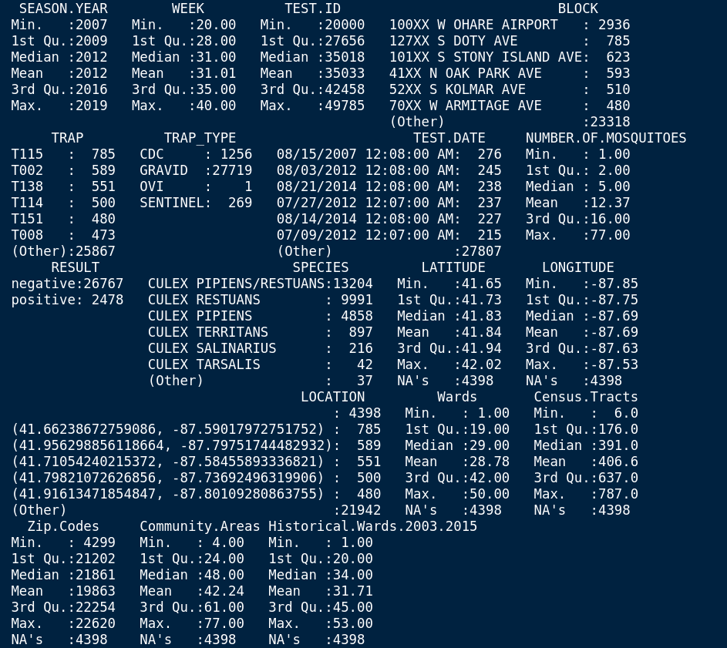
Exploring data
Statistics/Summary

Slide 4
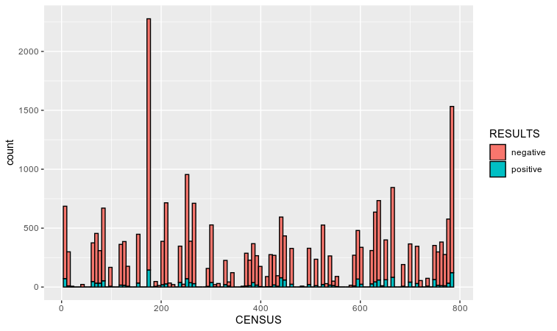
Exploring data
Chart: Human Census with Test results as filter

Slide 5
Dimension Reduction
Target Variables:
RESULT
Possible Predictors:
SEASON.YEAR, WEEK, TRAP_TYPE,
NUMBER.OF.MOSQUITOES,SPECIES, LATITUDE,LONGITUDE,
Wards, Census.Tracts,Zip.Codes,
Community.Areas,
Historical.Wards.2003.2015
Removed Variables:
TEST.ID - unique each row(0.99 cor with year)
BLOCK - specific address
TRAP - trap ID
Test.Date - test once a week
Location - combined Longitude and Latitude
Notes:
Shim

Slide 6
Model Comparisons
GML Regression Model | 1 | 2 | 3
Number of Predictors | 8 | 6 | 5
AIC | 6573 | 6568 | 6604
Sensitivity | 0.9983 | 0.9985 | 0.9986
Specification | 0.0192 | 0.0178 | 0.0178
Notes | Stepwise Regression | Manual variable selections without Census Track and Historical Wards | Manual variable selections without Species,Census Track and Historical Wards
Notes:
Jonathon

Slide 7
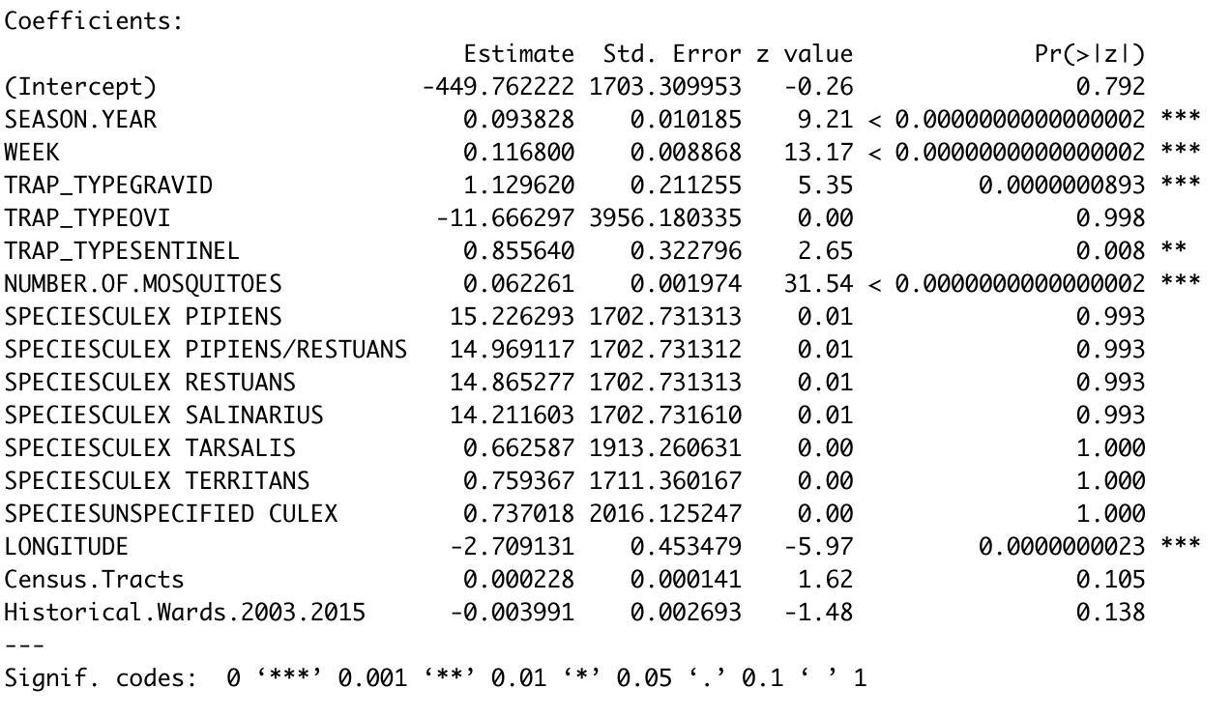

Slide 8
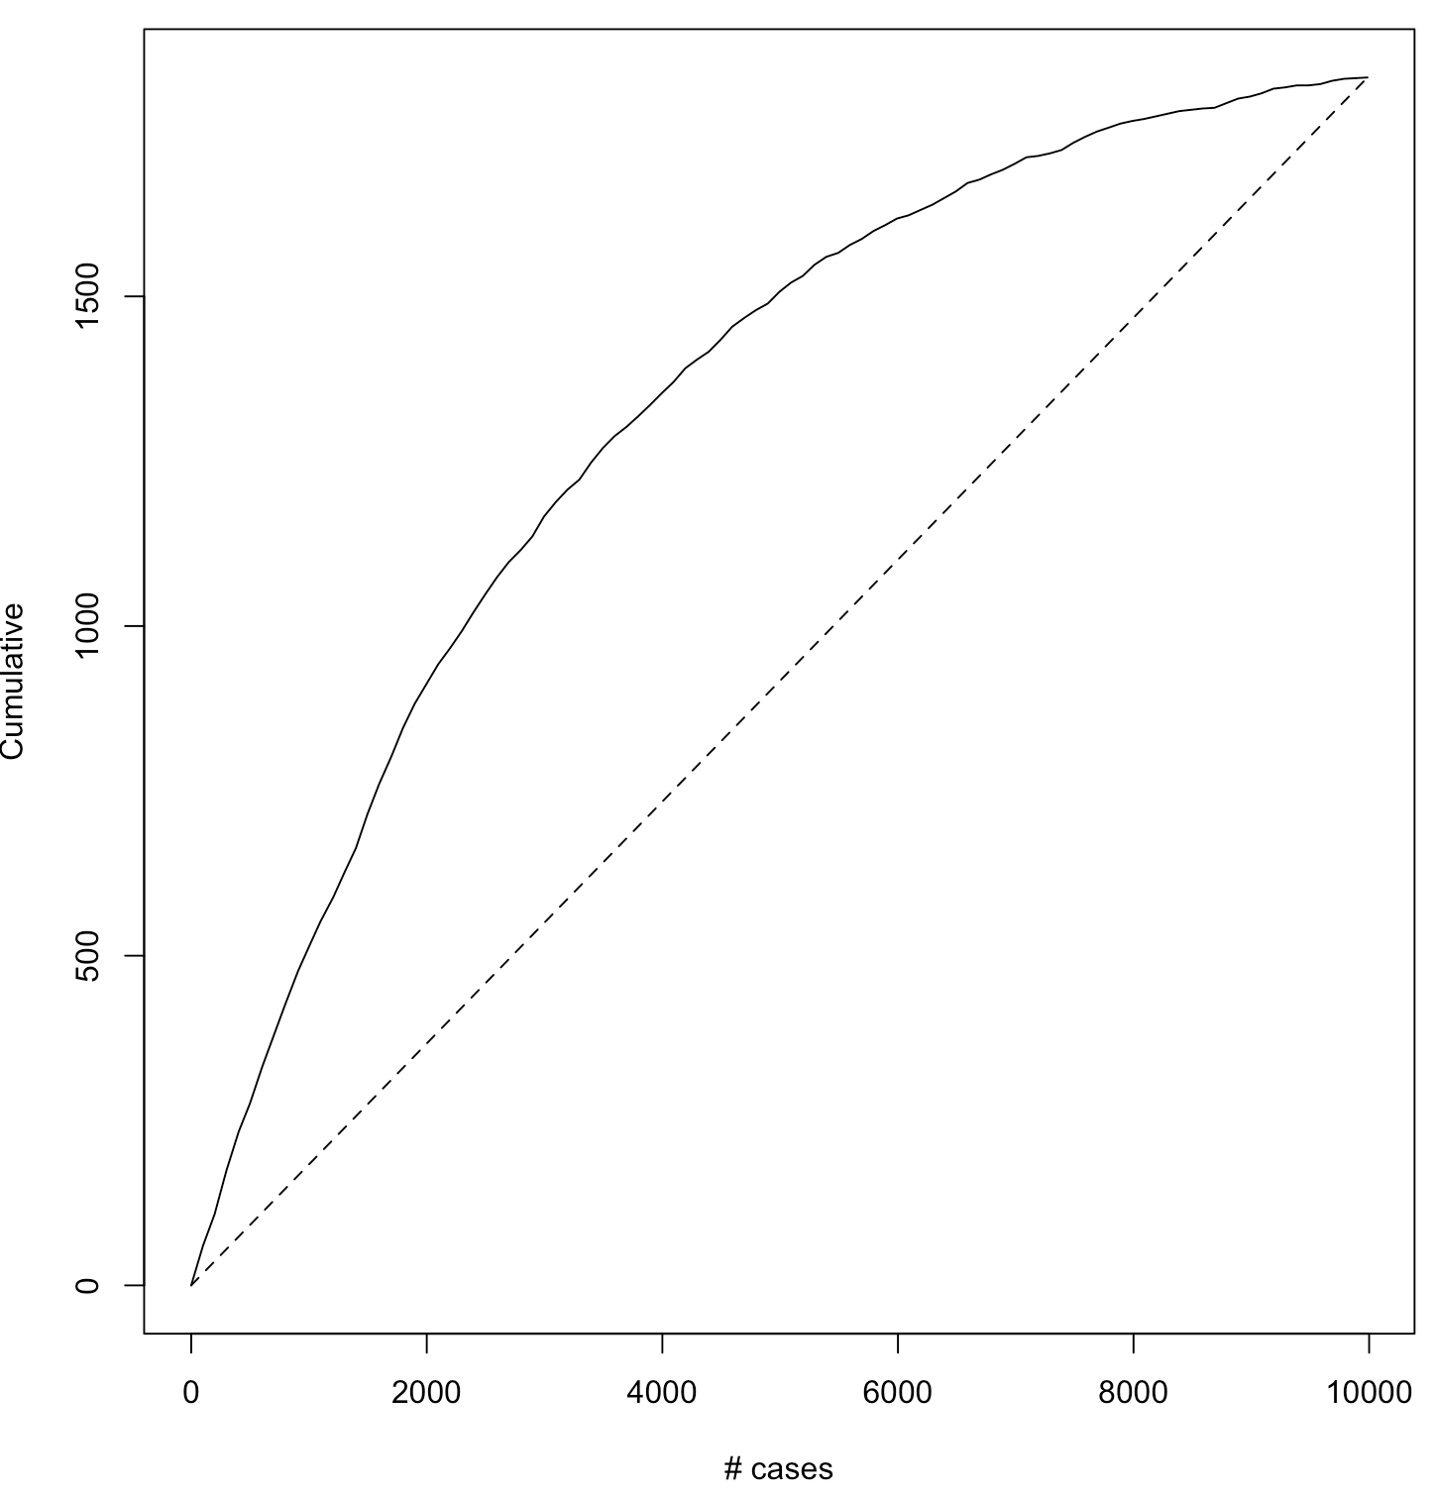
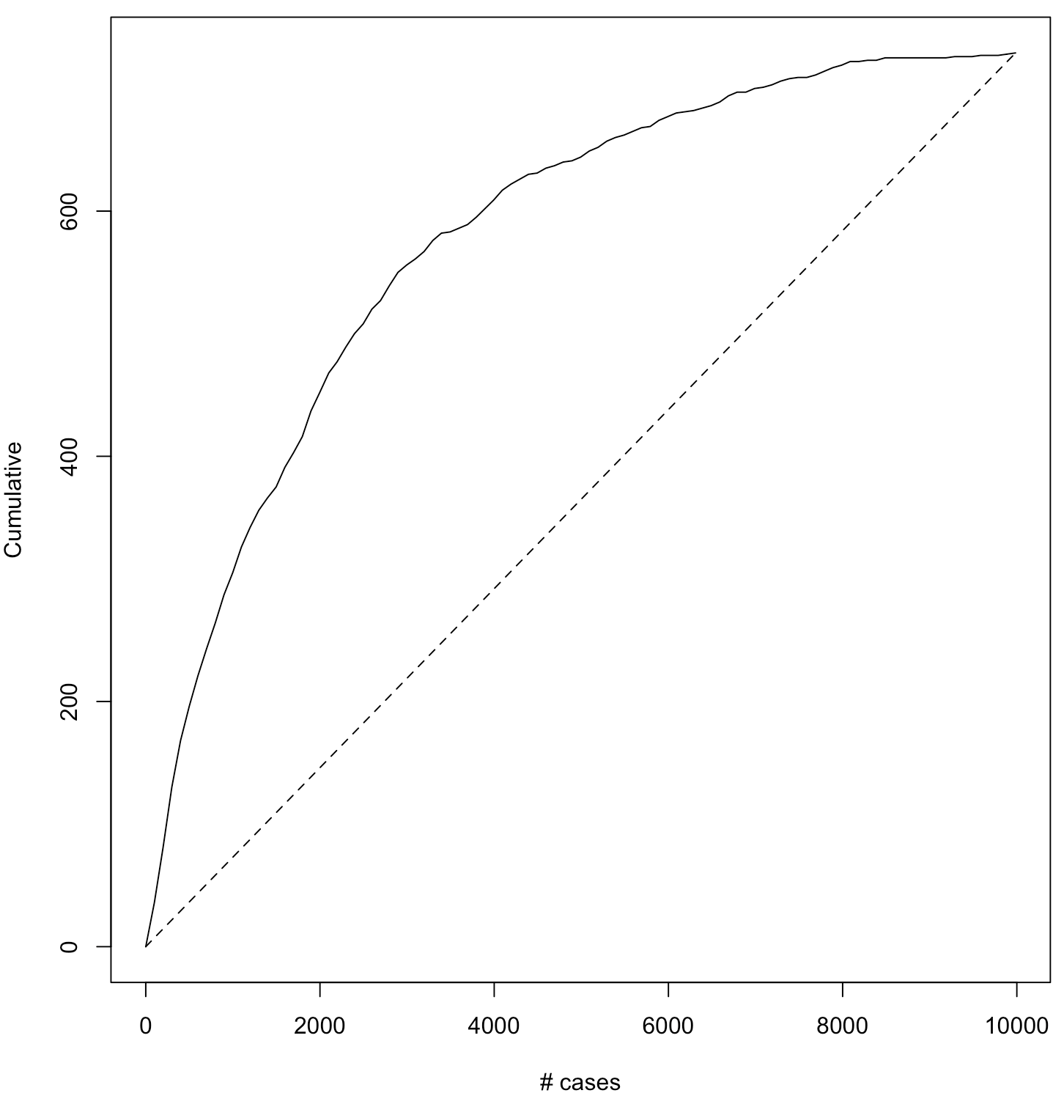
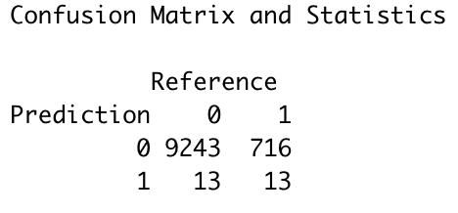
Model Evaluation
Accuracy: 0.927
Sensitivity: 0.9986
Specificity: 0.0178
Lift chart after Oversampling
Lift chart with Sample Data
Notes:
Cindy

Slide 9
Predictive Anal
Predictive Analytics
Odds(Probability of Negative/Probability of Positive) =
e^(- 434 - 5.88*TRAP_TYPEOVI
- 2.88*LONGITUDE
+1.08*TRAP_TYPEGRAVID
+ 0.76*TRAP_TYPESENTINEL
+0.12*WEEK
+0.09*SEASON.YEAR
+ 0.06*NUMBER.OF.MOSQUITOES)
Notes:
Cindy

Slide 10
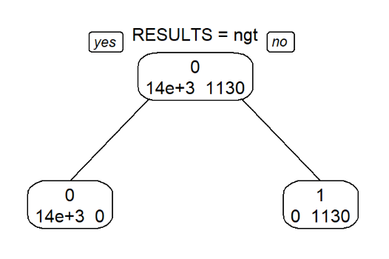
Decision Tree

Slide 11
Questions Answered
What are the most prominent species?
What season (months/quarter) has the most number of mosquitoes? positive WNV mosquitoes to be specified?
What are the important predictors that contribute to positive West Nile Virus?
Can area information (longitude) be used to predict areas prone to infection and high time of infection? This could be dependent on weather, rainfall or temperature in the area.

Slide 12
Future Scope
Potential variable to add: precipitation amount by date in Chicago, Spray data in Chicago neighbourhood
Potential relation to investigate - Testing, location, and weather data to predict WHEN and WHERE different species mosquitoes will test positive WNV.
Importance of the results - A more accurate method of predicting outbreaks of West Nile virus in mosquitoes will help the City of Chicago and CPHD more efficiently and effectively allocate resources towards preventing transmission of this potentially deadly virus.
Notes:
Jonathan

Slide 13
Thanks…..
Any Questions?

