Slide 1

1
Ivey Monopoly
Group 11
Dennis Li, Jonathan Yeung, Eric Ng, Martin Wong

Slide 2

What is Monopoly?
Board game
Use of dice
Goal: is to become the wealthiest player
How: buy/sell/develop properties, earn rent
Also a game of luck: “Chance” and “Community Chest” cards (pay fines, go to jail, receive extra money)

Slide 3

Ivey Monopoly
Monopoly run by Excel VBA
Max number of players is four
Time limit
Modified property names and Chance/CC cards
Requires players’ input throughout the game

Slide 4
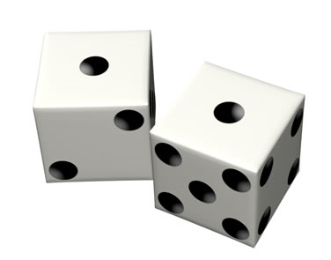
Key Game Elements
User interface to input data and game decisions
Game board
Dice-rolling simulation
Asset possessed by a player at a point in time
VBA codes to process inputs and display outputs

Slide 5
User Inputs
Names of the players
Number of players
Time limit
Buy/not buy upon landing
Pay/not pay fine to get out of jail
Offers to buy/exchange property from other players
Offer price/property
Sell/not sell when there is an offer

Slide 6

Outputs
Rolled dice
Movement across the board
Chance/Community Chest outcomes
Total game money indicator
List of properties acquired
Winner/losers

Slide 7
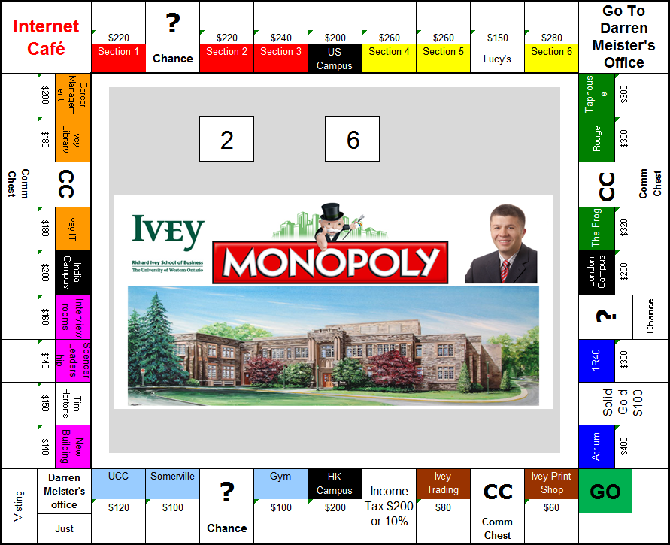
Ivey Monopoly Game Board

Slide 8
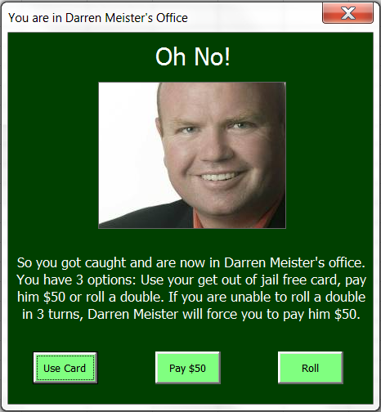
Application of User Forms

Slide 9
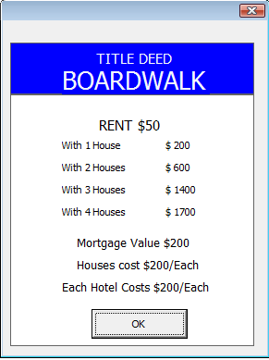
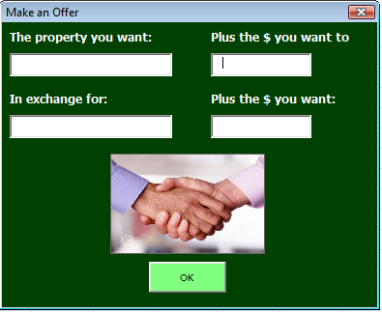
Application of User Forms

Slide 10
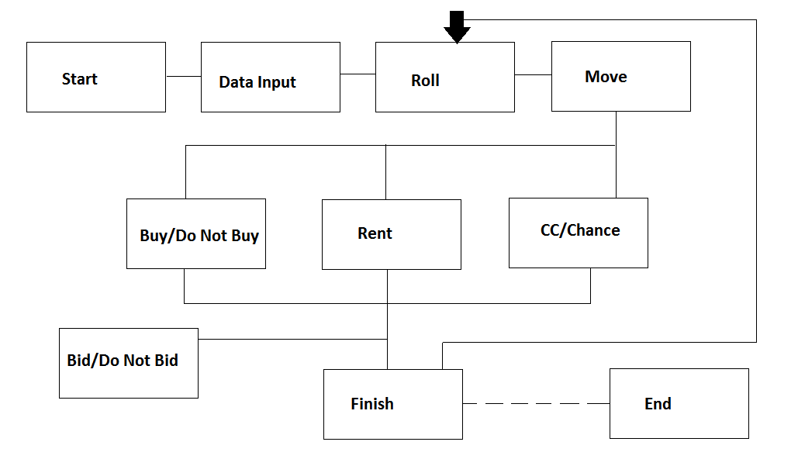
Design

Slide 11

Design
Functionalities converted to classes
Each class will have…
Input
Process
Output
Organized & Cross-compatible approach

Slide 12

Code Generation
Relevant classes split in modules
Once basic functionalities are complete…
Create GUI
User forms, scroll bars, buttons, etc.
Documentation and non-essential features

Slide 13
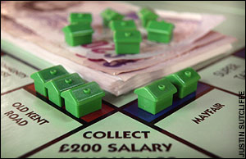
Testing
Begin at the conceptual level
Each class will be tested individually
Use extreme cases
Approach will allow minimal error
Test from the perspective of user

Slide 14
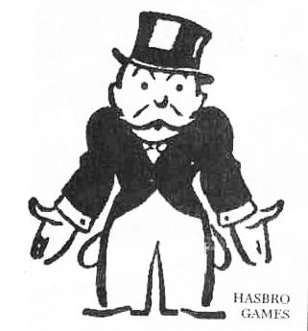
Demo & Challenges Faced
User forms VS Excel board
User forms for properties
Timer implementation
Chance implementation
Connections, rent mechanisms vs mortgage

Slide 15


Questions?

