Slide 1
Data On Sound
Jan 18 2018
Jonathan Zhao

Slide 2
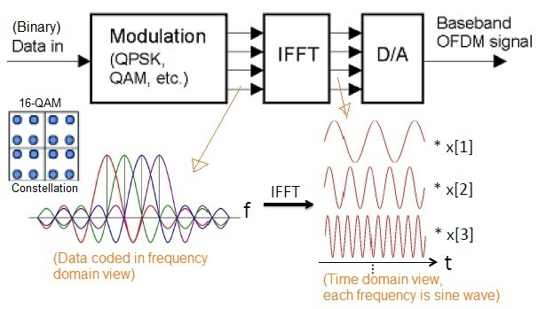

Slide 3
