Slide 1
EG353 HV System
Tuesday, August 07, 2018

Slide 2
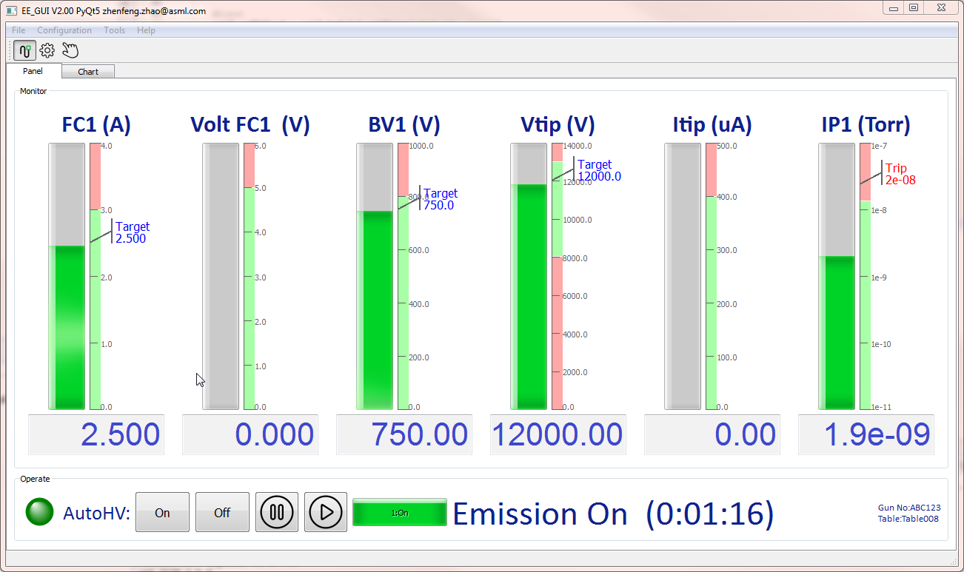
Visual GUI
Visual monitoring object
Automatic connection device
Communication indicator LED
Operating status
Running time

Slide 3
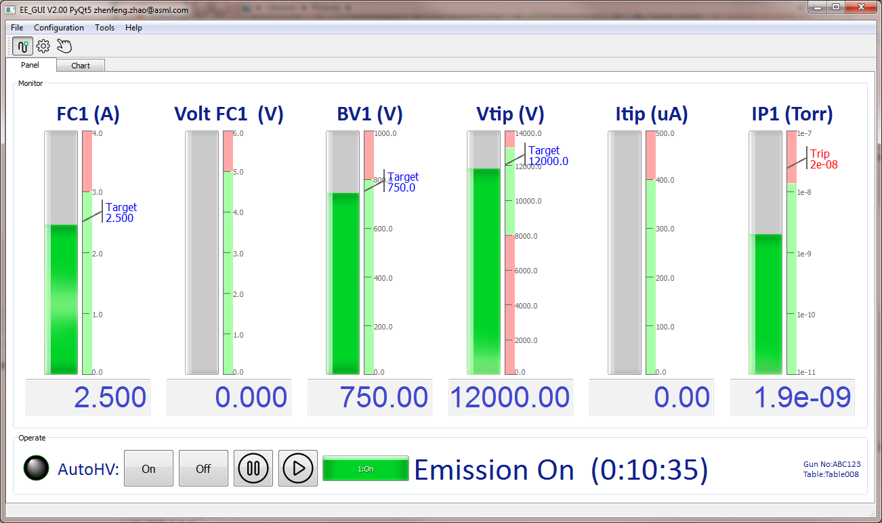
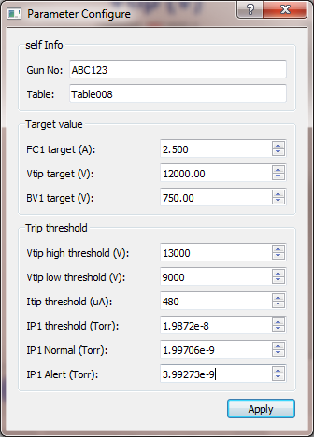
Easy to set up
One-click configuration of all parameters

Slide 4
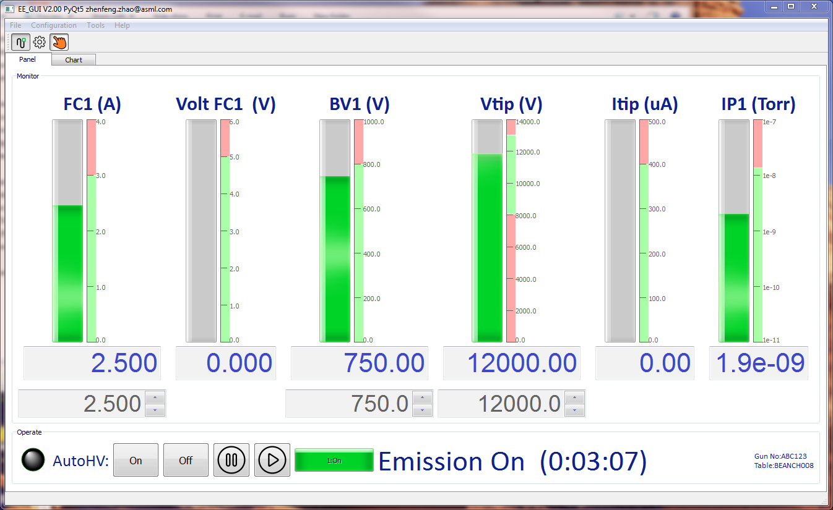
Manual mode
Manual mode

Slide 5
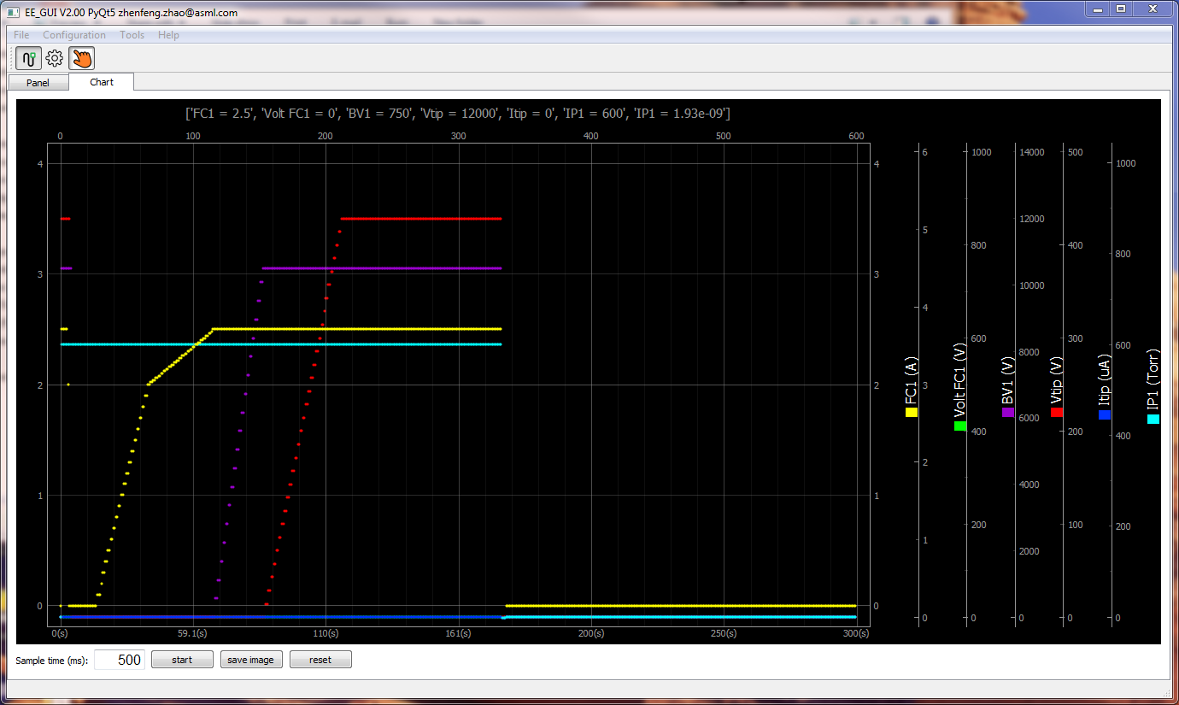
Real-time graphics
6 channel oscilloscope
Max sample rate 20 times/s

Slide 6
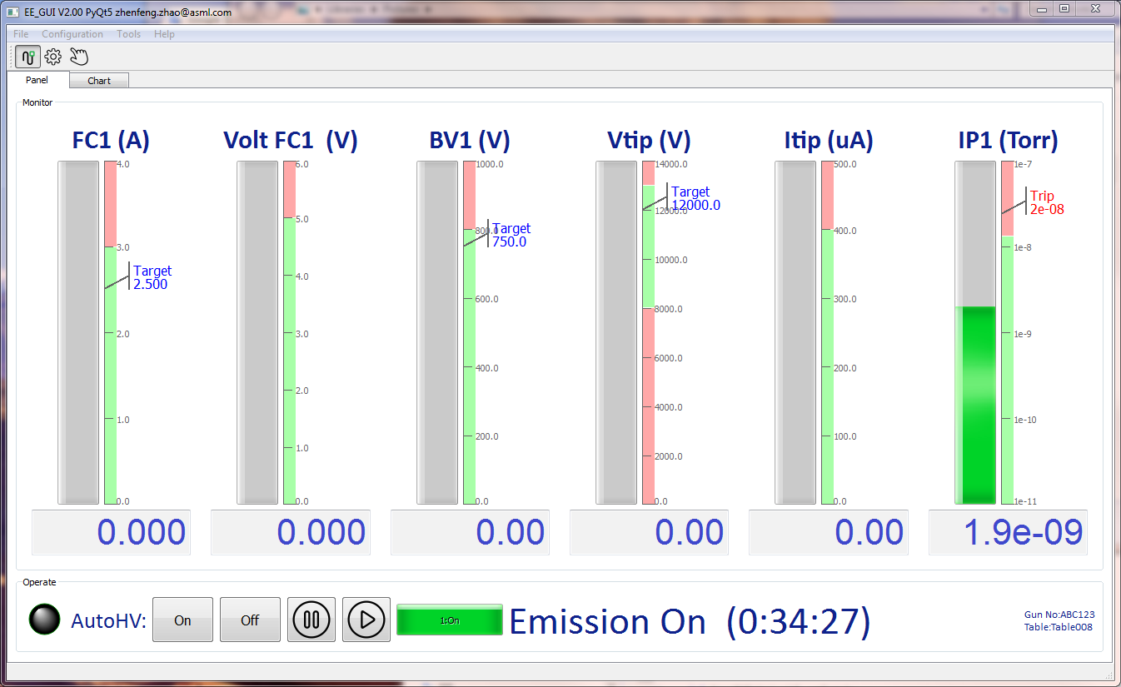
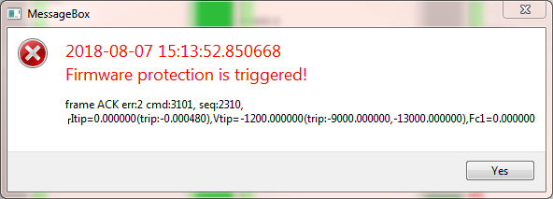
Real-time protection
Real-time protection ,
trigger off power within <50ms.
Make sure the safety of gun

Slide 7

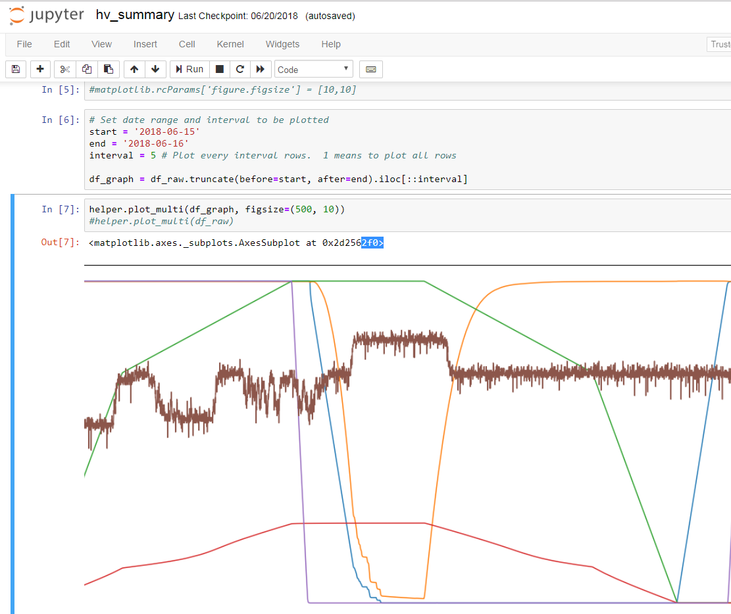
Logging and data
2018-08-07 17:51:47,423:root - INFO - TX: set cmd 3100 value 1
2018-08-07 17:51:47,438:root - INFO - Rx: cmd:3122 Task data:None raw:
2018-08-07 17:51:47,735:root - INFO - Emission Off (0:00:16)
2018-08-07 17:51:47,736:root - INFO - Rx: cmd:3101 Emission start hv on…
2018-08-07 17:51:48,554:root - INFO - Emission start hv on… (0:00:00)
2018-08-07 17:51:48,554:root - INFO - Rx: cmd:3101 Emission set FC1 to 2A
2018-08-07 17:52:08,846:root - INFO - Emission set FC1 to 2A (0:00:19)
2018-08-07 17:52:08,846:root - INFO - Rx: cmd:3101 Emission set FC1 to target
2018-08-07 17:52:33,182:root - INFO - Emission set FC1 to target (0:00:23)
2018-08-07 17:52:33,183:root - INFO - Rx: cmd:3101 Emission set BV1
2018-08-07 17:52:52,636:root - INFO - Emission set BV1 (0:00:18)
2018-08-07 17:52:52,636:root - INFO - Rx: cmd:3101 Emission set Vtip
2018-08-07 17:53:22,657:root - INFO - Emission set Vtip (0:00:29)
2018-08-07 17:53:22,657:root - INFO - Rx: cmd:3101 Emission On
2018-08-07 17:53:23,240:root - INFO - Rx: cmd:3100 Emission data:1 raw:
1.History data analysis, Easily grasp the characteristics of gun
2.Detailed information of operator log and error log

