Slide 1
COP 3503 – Lab Session #1 Basics & Simple C++ Programs
Hesam Salehian
Modified by Max Fresonke

Slide 2
Access remotely You do not need to follow these now.
All of your files in your cise computers are synced and available from the outside - Nice!
Software I recommend to access:
Windows: FileZilla
Mac: Cyberduck
Linux: Native to Interface (if available) or FileZilla
sftp://thunder.cise.ufl.edu
For anyone interested, can go over it after the main presentation.
You can also use ”remote shell”SSH is available too, but we will go over that (maybe) next lab.
Official docs: http://cise.ufl.edu/help/access/remote/

Slide 3
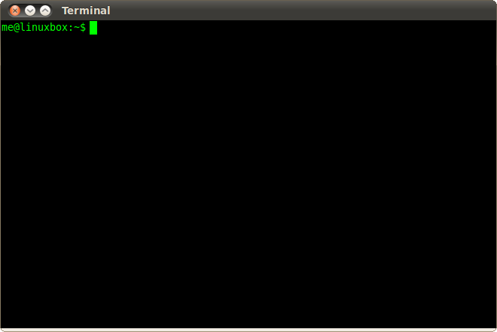
Let’s Start!
You need a CISE account to log in to the computers.
Pick a Linux machine, enter your information and log in!
Then, open a Terminal!
It is your friend! I promise.
http://tinyurl.com/cop3503-cmd-basics

Slide 4
Terminal Basics Why wasn’t this here before?
In the terminal, you are always “in a directory”
Called “Working Directory”
Use “pwd” (present working directory) cmd to find out where we are.
Your “home” directory is all about you. It’s where you get to store all of your files!
Your stuff starts at /cise/homes/<your-cise-username>
To See What’s in your current directory, use “ls” (short for list)
To move into a directory, use “cd” (short for change directory)
E.g. ”cd Desktop”, to move to your desktop
To move “back” or “out” of a directory, type “cd ..”
To make new directories, use “mkdir”
E.g. “mkdir COP3503”
To compile programs, the syntax is “g++ your-program.cpp
Will create a file called “a.out”
You can specify this output name with the –o flag
To run two (or more) commands one after another, use “&&”
Use to compile and run in one go. “g++ my-program.cpp && ./a.out”

Slide 5
Create a new file
Enter the following command in the terminal:
>> gedit helloworld.cpp
This will open a new file for you, named “helloworld.cpp”, where you can create your first C++ program!

Slide 6
Helloworld!
Enter the following code segment, into your cpp file:
// helloworld.cpp
#include <iostream>
int main()
{
std::cout << "Hello World!\n";
return 0;
}

Slide 7
Compile and run
Once you are done with writing the code, save the file, and go to the terminal…
1. Compile the code:
>> g++ -o helloworld.out helloworld.cpp
2. Run the code:
>> ./helloworld.out
Output:
>> Hello World!

Slide 8
A more complicated sample!
Write a code to determine if a given integer is prime. Also, print all its divisors.
#include <iostream>
int main(){
int n; std::cin >> n; int k = 0;
for (int i = 1; i <= n; i++){
if (n % i == 0){
std::cout << i << " , "; k++;
}
}
std::cout << "\n";
if (k == 2) std::cout << "Prime!\n";
else std::cout << "Not Prime!\n";
return 0;
}

Slide 9
Compile and run
Once you are done with writing the code, save the file, name it “prime.cpp”, and go to the terminal…
1. Compile the code:
>> g++ -o prime.out prime.cpp
2. Run the code:
>> ./prime.out

Slide 10
Compile and run (cont.)
>> ./prime.out
52
1 , 2 , 4 , 13 , 26 , 52 ,
Not Prime!
-----------------------------------------
>> ./prime.out
97
1 , 97 ,
Prime!
Input
Output
Input
Output

Slide 11
How Great is gedit??
Yeah, it kind of stinks
You can run a little script (program) I made to install the badass atom editors on your computer!
Navigate to the

Slide 12
Exercise (1)
Write a code to determine if a number is a power of 2.
1, 2, 4, 8, … are powers of 2
3 is not.

Slide 13
Exercise (2)
Write a code to determine if a number is a palindrome.
A palindrome number is equal to its reverse.
121, 14541 are palindrome
134 is not

Slide 14
Exercise (3)
Write a code to print the Fibonacci series up to a given number
Fibonacci Sequence: 1, 1, 2, 3, 5, 8, 13, 21, 34, …
N = 4. → Output: 1,1,2,3.

Slide 15
Exercise (4)
Write a code to compute the Greatest Common Divisor (GCD) of a pair of numbers.
Input: 8, 12
Output: 4

Slide 16
Any Questions?

