Slide 1

NBA Salary Regression Analysis
Jonathan Yun

Slide 2
Goal
The goal is to accurately predict NBA players salaries by using past players career statistics, demographics and salaries.
I plan to achieve this goal by utilizing multiple regression analysis techniques and then compare the regression techniques to each other to find the best performing model.

Slide 3
Data Background and Source
The data comes in two datasets, players and salaries
The players data contains a players unique player ID, birthdate, birthplace, career stats, college, draft pick, draft round, height, high school, position, shooting hand and weight.
The salaries data contains player ID, salary, season start year, season end year and team.

Slide 4
Exploratory Data Analysis
According to this research article, there are three eras of the NBA:
1. Classic Era of the NBA which focused on the inside the arc shots
2. Transitional Era of the NBA which evidences the migration from the rim to the three – point line
3. Modern Era of the NBA which is characterized by better shot selection and replacing inefficient two-point shots by more rewarding three-point shots.

Slide 5
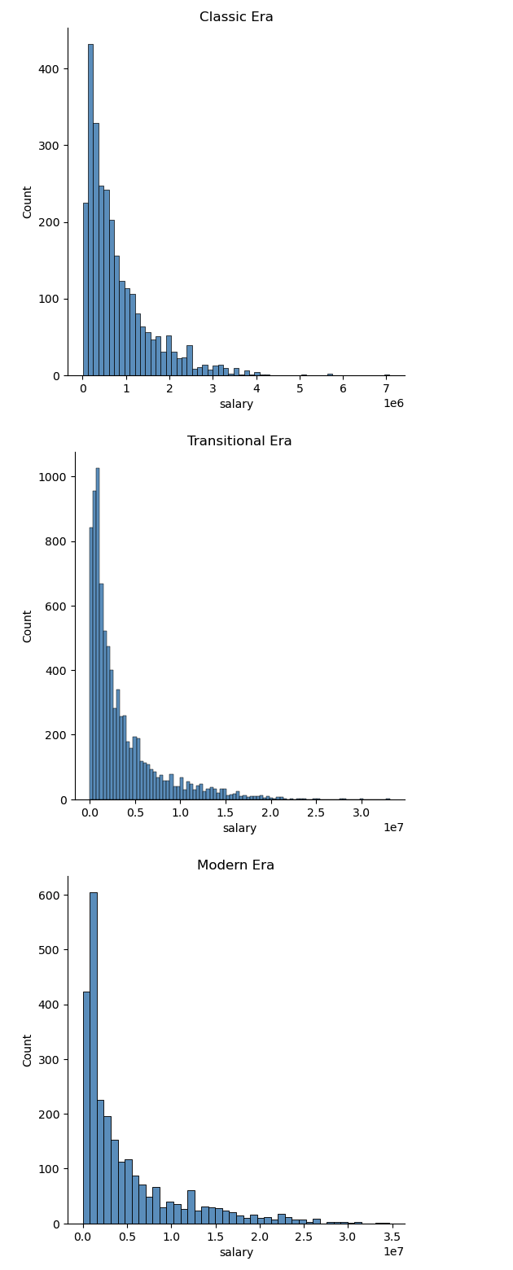

Slide 6
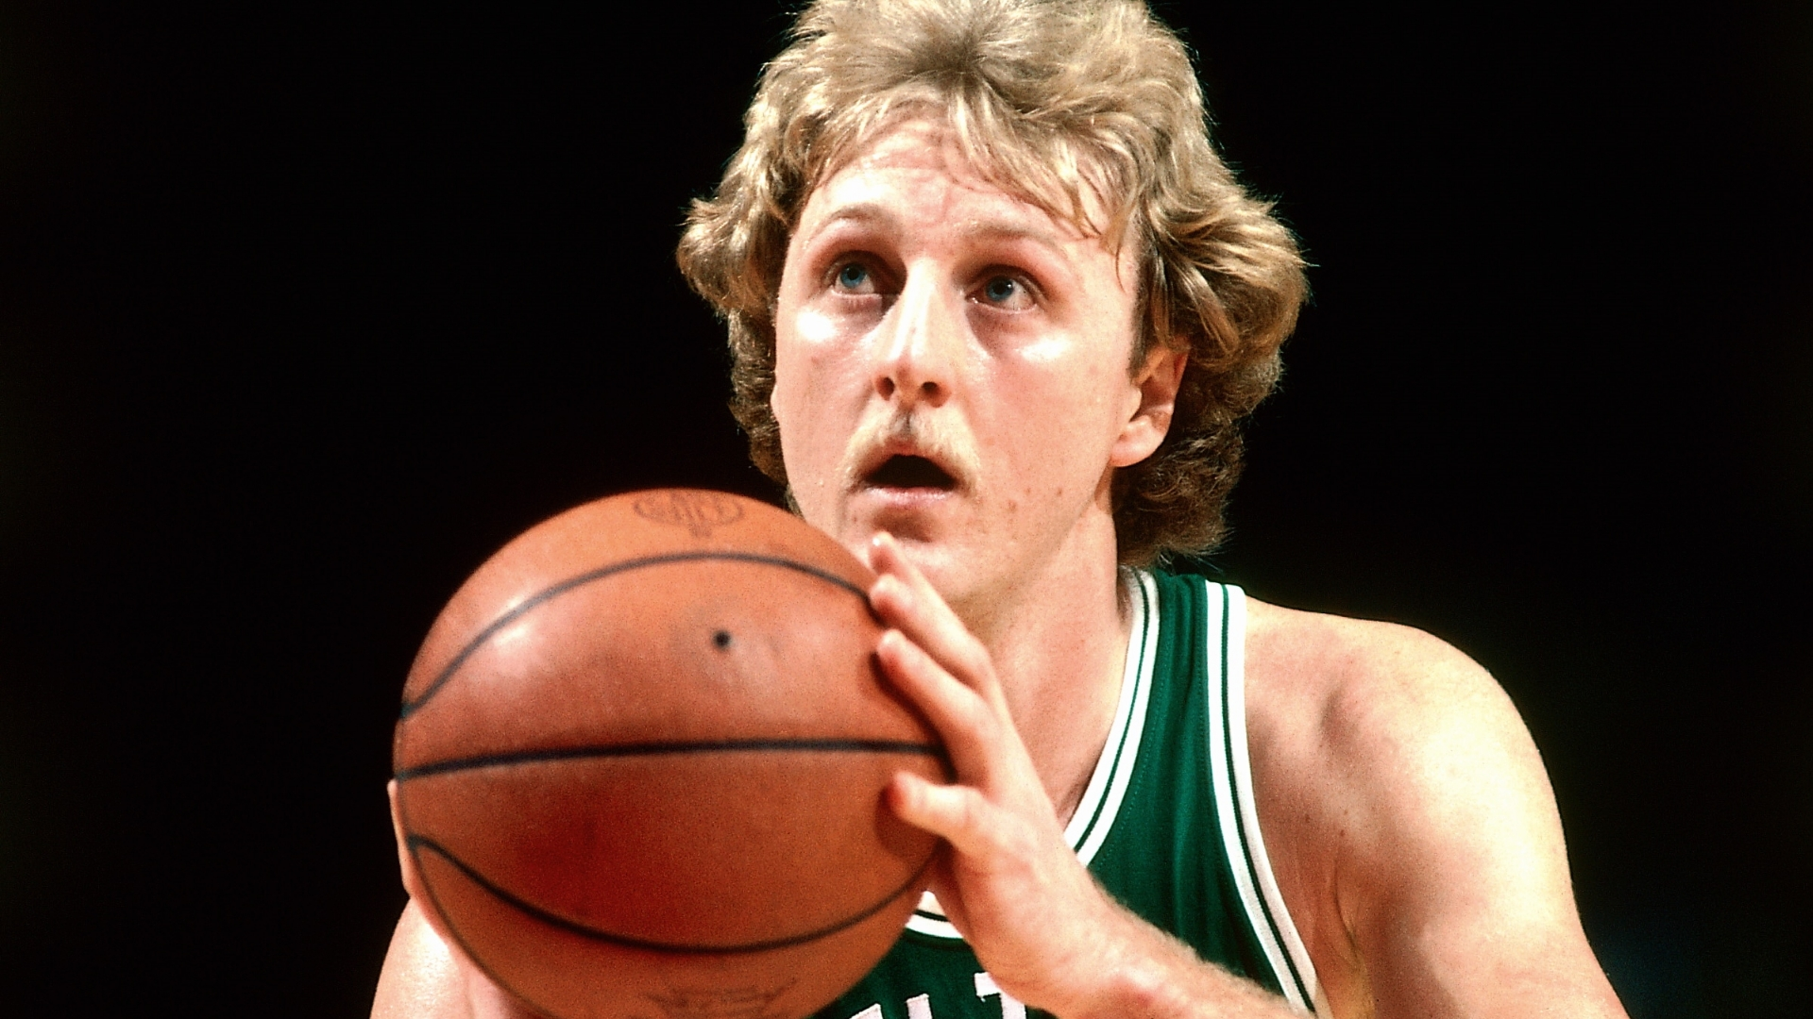
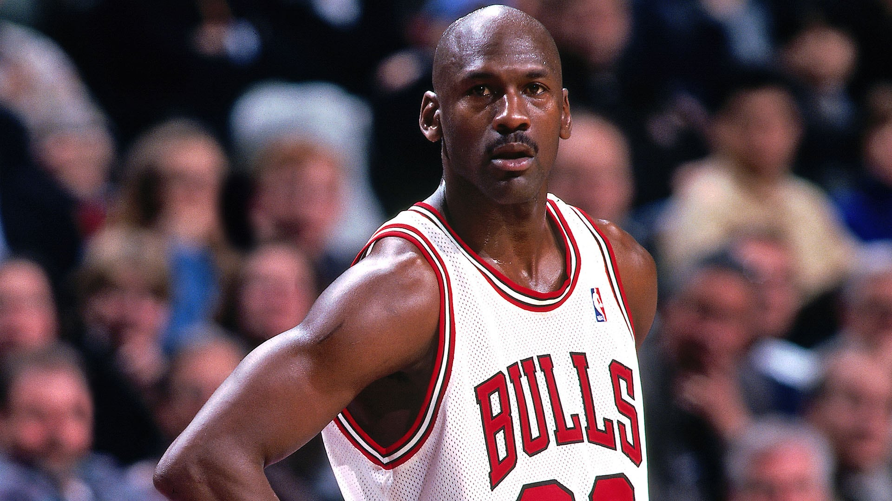

Highest Salaried Players in the NBA for each Era
Larry Bird
Michael Jordan
Stephen Curry

Slide 7
Feature Selection
From there I applied Recursive Feature Elimination, RFE, to the model.
RFE works by training the model on the full set of features and then recursively removing the least important features based on their importance ranking, typically obtained from the coefficients of the model.
From RFE it was determined that the following features were most important to the model:
Season End Year, Season Start Year, Career Assists, Career Free Throw %, Career Points per Match, Career Tries, Career Win Share, Height and Weight

Slide 8
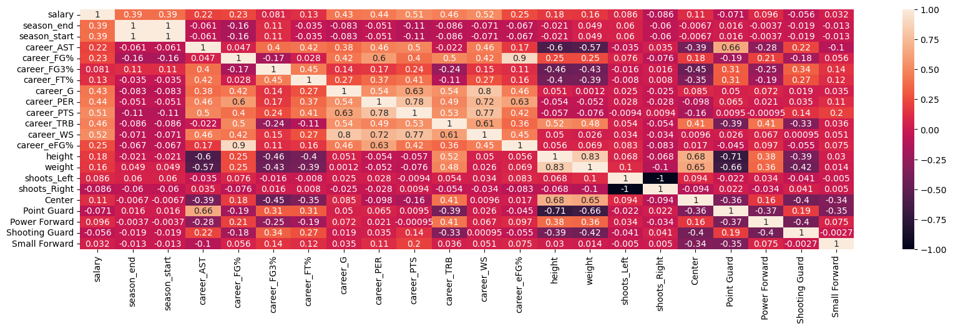

Slide 9
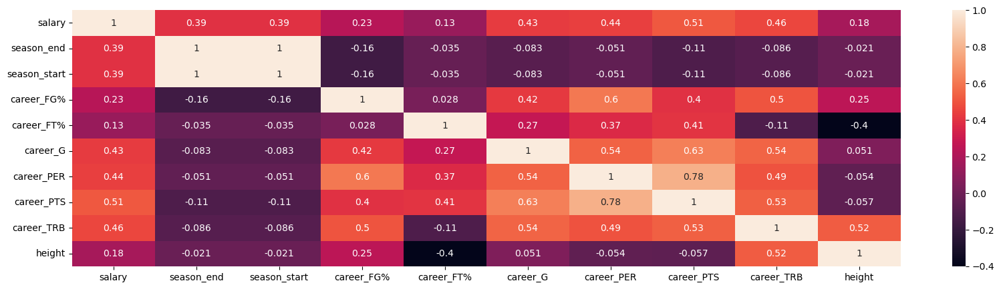

Slide 10
Regression Analysis
Applied Lasso, Ridge and Decision Tree regression models to all three sets of the data.
After comparing the models to each other and determined the best performing regression model.

Slide 11
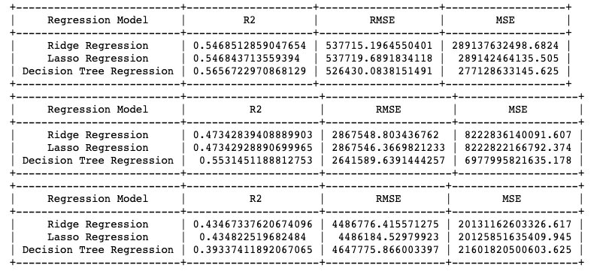

Slide 12
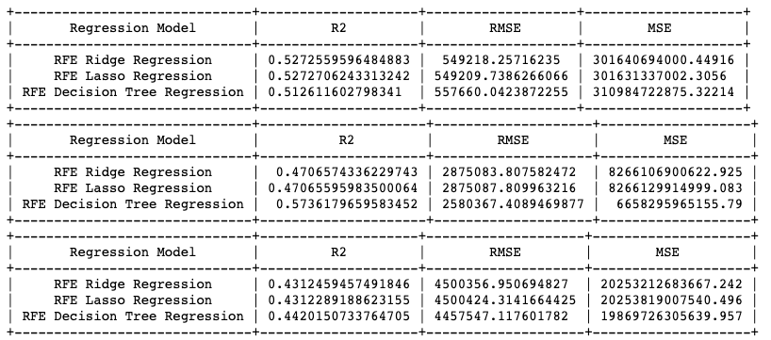

Slide 13
Results and Conclusions
From our model I found that it is extremely hard to calculate the salary of an NBA player accurately.
There can be players that are on rookie deals earning significantly less money but have great career statistics.
There can also be players that are on big deals earning a large sum but have been falling off in their performance.

