Slide 1
Jonathon Desiderio
2021 Beer Case Study

Slide 2
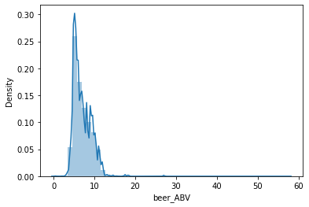
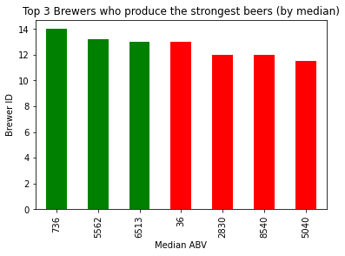
1. Rank top 3 Breweries which produce the strongest beers?
Company
Context
Problem statement
When analyzing the distribution of beer ABV; it is not a gaussian fit. It is positively skewed, therefore I will be using the median to observe which Breweries produce the strongest beers. As we can see from the bar plot, the brewers who produce the strongest beer (by median) are Brewer 736, Brewer 5562 and Brewer 6513. (Mean analysis is also in my code)

Slide 3
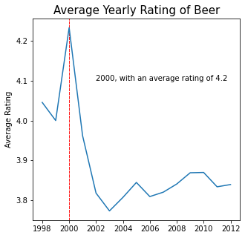
1. Which year did beers enjoy the highest ratings?
Challenge 1
Challenge 2
Challenge 3
This plot was created by converting a unix stamp to a datetime, grouping by the year and an aggregate of the mean overall review. I then found the max in the series and plotted this.

Slide 4
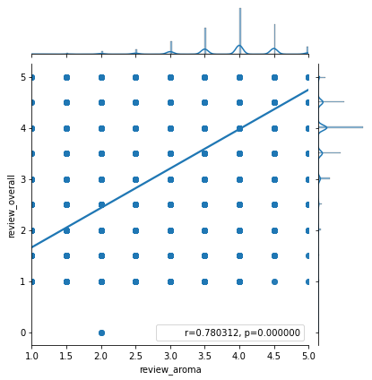
1. Based on the user’s ratings which factors are important among taste, aroma, appearance, and palette?
I plotted a scatter plot with a regression line, and then observed the magnitude and direction of the correlation with all the factor scores and the overall rating. The correlation between the aroma review and the overall rating was the strongest, with a magnitude of .78. Other methods of analysis to tackle this problem were explained in the code.

Slide 5
4. If you were to recommend 3 beers to your friends based on this data which ones will you recommend?
Friends Preferences:
Taste
Cuvée Du 5ème
Pioneer American Lager
Steengoed
Palette
Royal Black
Great Lakes Truth Justice And The American Ale
Flying Magic Zebras
Appearance
Braustüb´l Pilsner
Edsten Triple-Wit
Kannigedda IPA
Aroma
Dark Funk 2.0
Sheep In A Tree Red Ale
Old Gander Barley Wine
No Preference
Overall Rating
Kimono Girl
Sour Brown Ale
Organic Kentucky Christmas
These rankings were computed by grouping the beer names and taking a median aggregate of them, then sorting by descending. I explain the analysis further in the code.

Slide 6
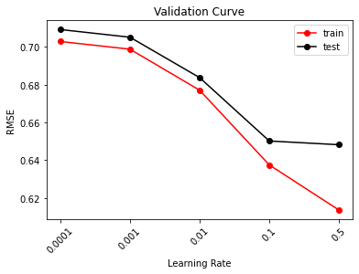
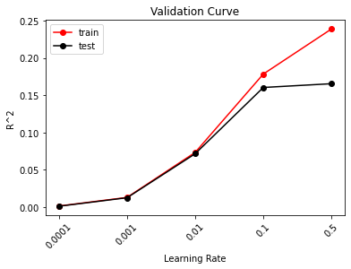
5. Which Beer style seems to be the favorite based on reviews written by users?
The Oatmeal Stout beer style is the most popular based off the written reviews.
This analysis is explained in much more detail in the code. I took a TF-IDF transformation of the written reviews and created a gradient boosting regression model to predict the overall score of the beer based off the written review.
If I did not have the overall review attribute to serve as my target variable, the next best option would be to use an open source library like Afinn in python, in order to develop connotations and sentiment to the words in the TF-IDF matrix.
09.17.XX
10.13.XX
10.20.XX

Slide 7
6. How does written review compare to overall review score for the beer styles?
To look at the difference between the written reviews and the overall reviews, we can take a look at the performance metrics of our gradient boosting regression model to interpret the results. Our best model had a RMSE of .65 for the test data and a r^2 of .15 for the test data. From this and assuming a normal distribution on the residuals (in further analysis I would run tests to see if residuals were normal) and taking account of the empirical rule, we can say that if we had a written review that got a predicted value of 3, 68% of the time the actual value will be between [2.35, 3.65], 95% of the time the actual value will be between [1.7, 4.3] and 99% of the time will be between [1.05, 4.95]. Since the testing r^2 is .15, we can state that 15% of the variance in the overall rating can be explained by the written review.
Back End Lead

Slide 8
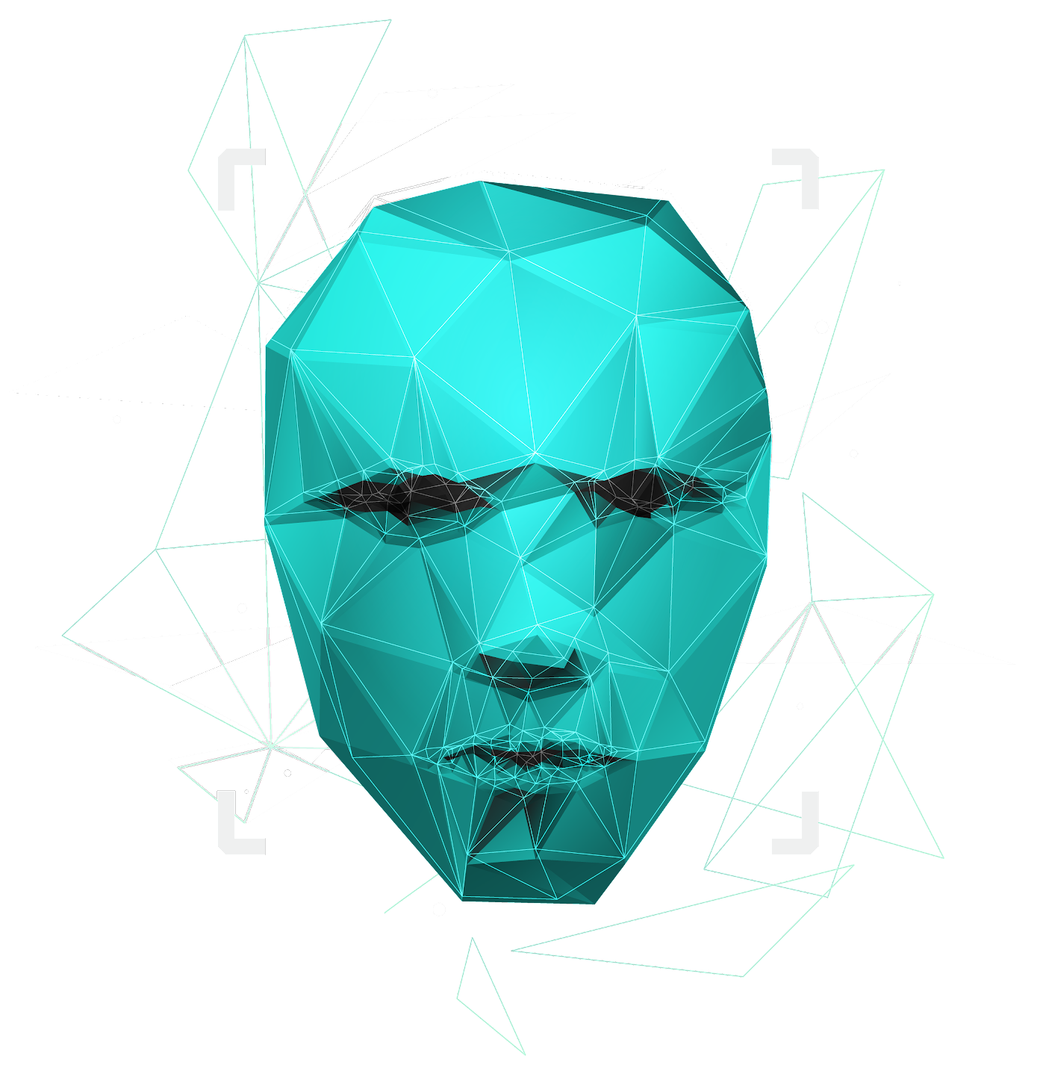
7.. How do find similar beer drinkers by using written reviews only?
For this problem, I would compute a matrix of TF-IDF for the text reviews. I would then compute the cosine similarity to work as a collaborative filtering system. Then, I could feed a review into the recommender system, and this function would return the top N reviewer_profileNames with similar reviews. This is a recommender system based of computing the TF-IDF of the written reviews and the cosine similarity between them.

Slide 9
Thank you
I hope this case study demonstrates both my interest in this position, as well as my programming/statistical analysis skills.
If you have any further questions, please do not hesitate to reach out.
Email:
Jonathon.desi@gmail.com
Phone:
(614)-678-3014
Github link to Project:
https://github.com/Jonathon-M-Desi/2021_Beer_Case_Study/blob/main/Jonathon_Desiderio_Evolent_Case_Study.ipynb

