Slide 1
Introduction to the “tidyverse”
Kate Dodds
Kate.dodds@mq.edu.au
@kate_c_dodds
Notes:
https://syknapptic.netlify.com/2018/03/yet-another-tidyverse-intro/
https://medium.com/@chrisvaccaro_78233/the-absolute-fastest-way-to-learn-r-for-data-science-606ab2b28b7e

Slide 2
Workshops on ZOOM
Please mute your microphone
If you need help:
Post a question on chat and one of the helpers / anyone else will try to respond
I will try and keep an eye on the chat column.
If you’d like more detailed help – eg if there’s this weird error that won’t go away, then we’re suggesting using the break out room. You will have to coordinate this is in the chat – and a helper can join you in the breakout room.
I’m going to try and record the workshop and the chat will be recorded with it (just FYI).
Watch out for trolls… although we think you are all lovely so we should be fine.

Slide 3
Today’s workshop
Please download all the files from:
https://github.com/mqRusers
The workshop files are:
R SCRIPT (It may look a bit weird as it’s a markdown doc)
Powerpoint slides
We’ll Start with the slides – then use the script – then go back to the slides.

Slide 4

Where this workshop fits in…
MQ R user group git hub page: https://github.com/mqRusers
Continually building on previous and adding new lessons
MANY previous workshops dealing with specific aspects of the tidyverse
Go back to these OFTEN
DPLYR: James Lawson: https://github.com/mqRusers/2018_02_Dplyr
GGPLOT: Kyle Zawada: https://github.com/mqRusers/2018_04_ggplot
PURRR: Aniko Toth: https://github.com/mqRusers/loops-and-beyond
SHINY R: Kate Dodds: https://github.com/mqRusers/2018_07_R-Shiny_Workshop
Notes:
Continuation from the beginners workshop.

Slide 5
Caveats**
It impossible to teach a whole universe in one hour
I am certainly not “All knowing”!
Aim is to showcase some great bits of functionality
Point you in the direction of finding out more

Slide 6
Little miss tidy verse
R Ladies Sydney
Great source of learning material – details at the end of the slides.
Before we start….

Slide 7
BUT…
Create muscle memory for the commands you use.
Try Never ever ever to copy and paste commands you’re trying to learn.
Notes:
https://medium.com/@chrisvaccaro_78233/the-absolute-fastest-way-to-learn-r-for-data-science-606ab2b28b7e

Slide 8
How to succeed at data science (or anything): Read, Do, Read, Do, Read, Do, Read, Do
How to stay stuck in data science (or anything): Read, Read, Read, Read, Do, Do, Do, Do.​
How to REALLY stay stuck in data science (or anything): Read, Copy and Paste code, Read, Copy and Paste Code
Notes:
https://medium.com/@chrisvaccaro_78233/the-absolute-fastest-way-to-learn-r-for-data-science-606ab2b28b7e

Slide 9
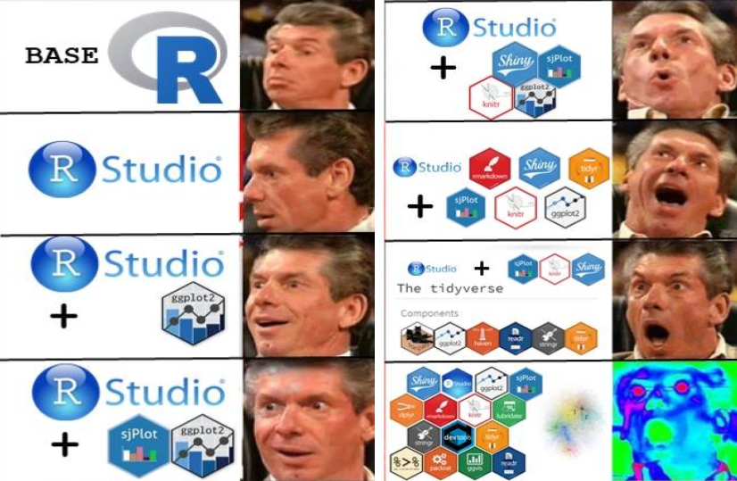
https://syknapptic.netlify.com/2018/03/yet-another-tidyverse-intro/
Notes:
A progression of emotions when learning R…

Slide 10
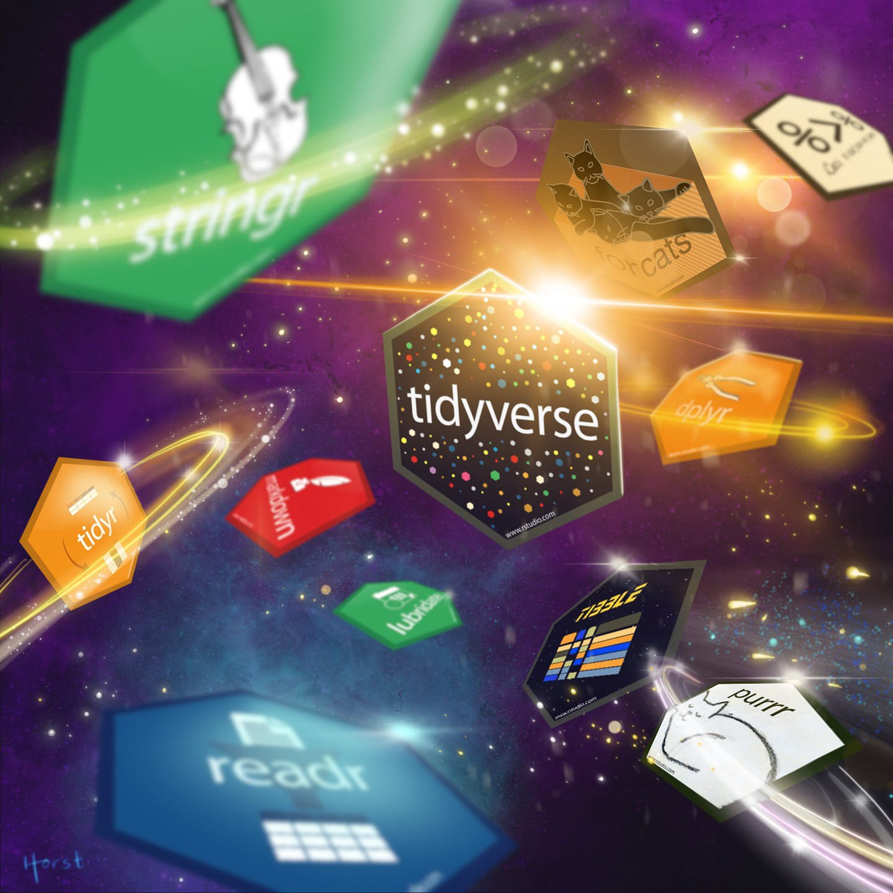
https://www.google.com/imgres?imgurl=https%3A%2F%2Fcdn-images-1.medium.com%2Fmax%2F1600%2F1*z0FQS9XOnRSs9HVwYwpzCA.jpeg&imgrefurl=https%3A%2F%2Fmedium.com%2F%40chrisvaccaro_78233%2Fthe-absolute-fastest-way-to-learn-r-for-data-science-606ab2b28b7e&docid=fwhA7XxCP4J9JM&tbnid=as2N1TdZkABBQM%3A&vet=10ahUKEwiHq-iJ2oXiAhVWcCsKHUvaATwQMwiAASg1MDU..i&w=1440&h=1440&client=firefox-b-e&bih=943&biw=1920&q=Tidyverse%20meme&ved=0ahUKEwiHq-iJ2oXiAhVWcCsKHUvaATwQMwiAASg1MDU&iact=mrc&uact=8

Slide 11
Lets get this universe into our computers..
First we need to install it:
install.packages(“tidyverse”)
OR click on TOOLS > Install packages > tidyverse
Then we initialise it:
library(“tidyverse”)
You need to do this at the beginning of every new R session.
You should now see the various components of the tidyverse and their version numbers.
If not, please raise a hand / ask for help on chat.

Slide 12
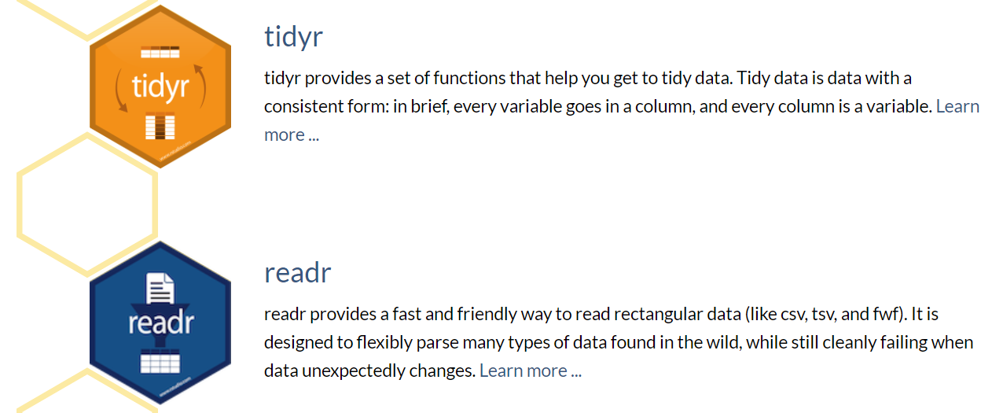
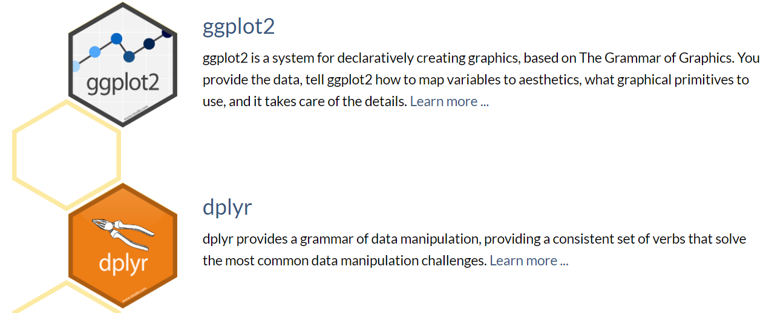
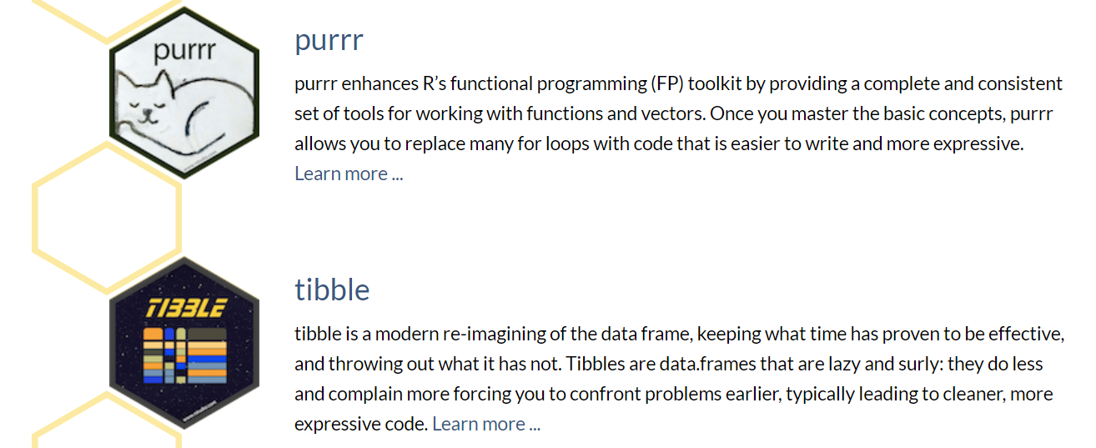
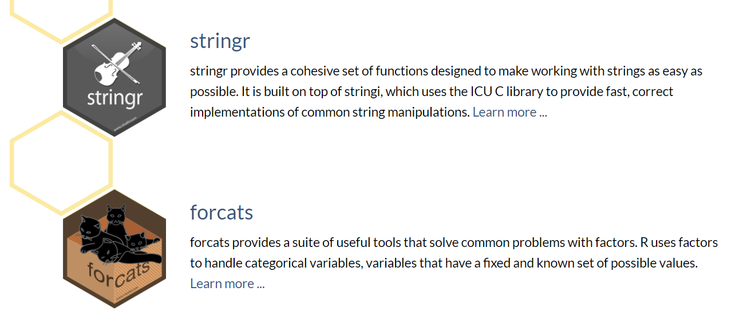
CORE TIDYVERSE
https://tidyverse.tidyverse.org.
Notes:
Information from developer – there are more examples in most recent vingettes..

Slide 13
What is a package??
A TOOL
In this case: a mini toolbox that you can use with other toolboxes.
Group of functions that work together to do specific tasks.
Vignettes: Most packages have Vignettes and they describe the package and are a help document.
Help on functions within the package: Remember to use the ???
Eg: ?mutate
?purr
vignette(“forcats”)
Notes:
Everyone always needs to use the help functions – so try to get used to using them, you will remember new things every time you read/look at the docs.

Slide 14
KEY CONCEPT 1: TIDY DATA
Notes:
SO far this is nothing different from Base R .. And standard packages.. But there are 2 very important concepts that are used in the TIDYVERSE “family” of packages.

Slide 15
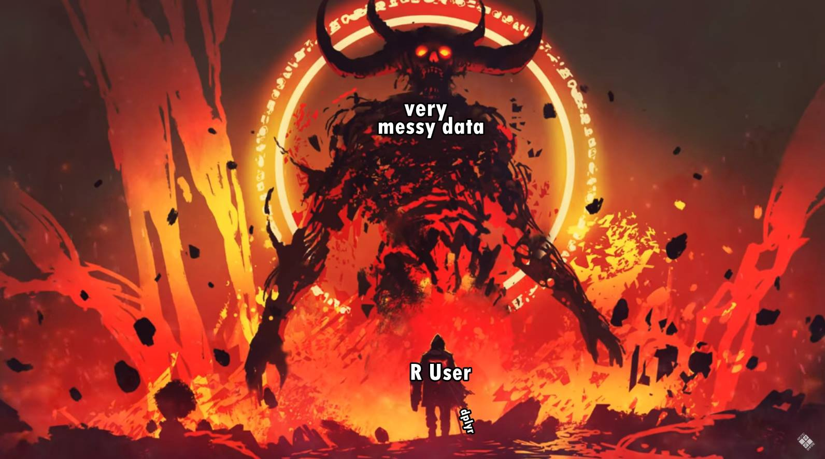
https://medium.com/@chrisvaccaro_78233/the-absolute-fastest-way-to-learn-r-for-data-science-606ab2b28b7e
Notes:
Why the tidyverse was created.. So all post processing and stats could be done using data in the same format

Slide 16
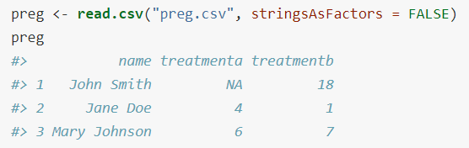
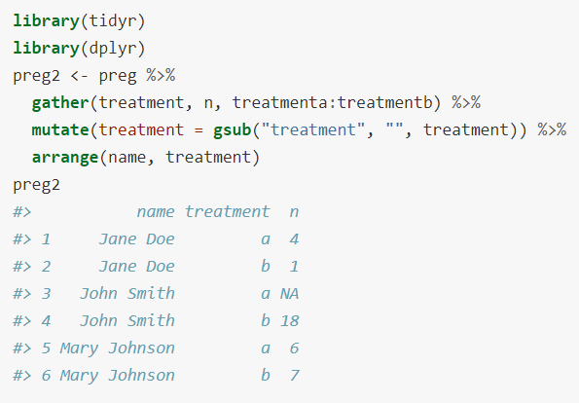
What is tidy data..
Each variable forms a column.
Each observation forms a row.
Each type of observational unit forms a table.
Notes:
There is repetition in some of the variables, but this is how the tidyverse then works. It takes a while to get used to this way of working with data.
We often try to record things in WIDE format when we’re in the field.

Slide 17
Messy Data
Column headers are values, not variable names.
Multiple variables are stored in one column. (common)
Variables are stored in both rows and columns.
Multiple types of observational units are stored in the same table.
A single observational unit is stored in multiple tables.

Slide 18
Ways to Tidy it
tidying: structuring datasets to facilitate analysis.
Tidy datasets and tidy tools work hand in hand to make data analysis easier, allowing you to focus on the interesting domain problem, not on the uninteresting logistics of data.
gathering, separating and spreading.
OR nowadays: pivot_wider and pivot_longer
Mostly using DPLYR
If you’re just starting out with your data collection, try and keep this in mind!
Notes:
Will cover this at the end of the workshop.

Slide 19
KEY CONCEPT 2: THE PIPE

Slide 20
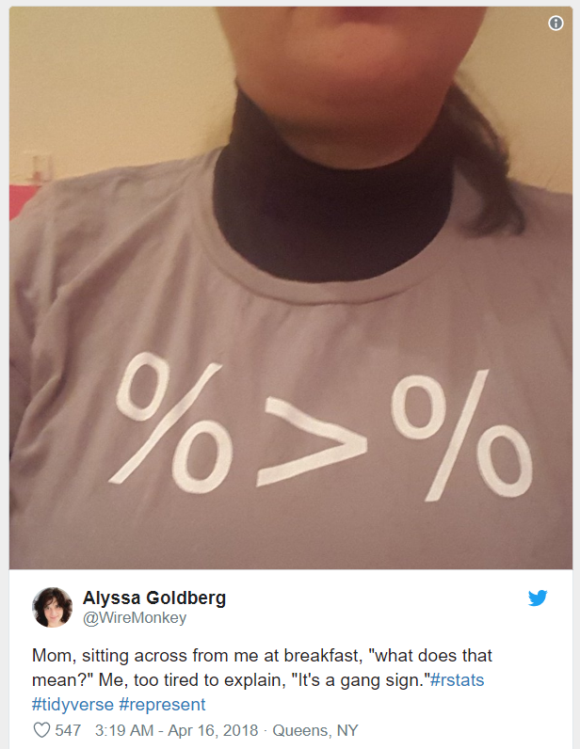
THE PIPE
%>%
a 'pipe' – means.. Do something.. 'and then do this next thing with the output‘
“Pipe” instructions down a workflow
pipes allow us to build chains of operations without making intermediate objects
when using 'pipes' they need to go at the end of a line, not the beginning of a new line
or you can put everything on one line if there isn't too much code
Notes:
Thanks to James Lawsons DPLYR workshop.
How the packages fit together.. And how to write easy to follow and reproducible code

Slide 21
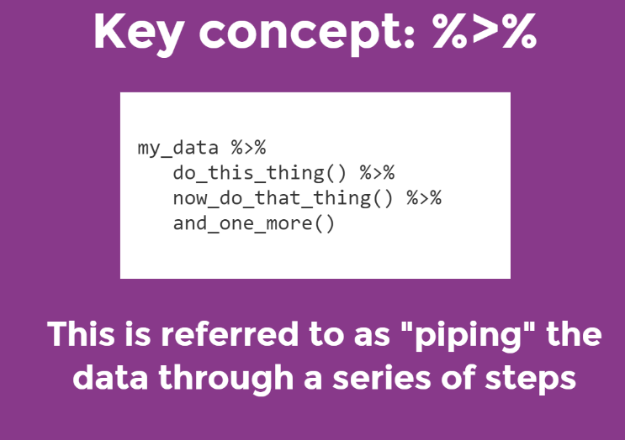

Slide 22
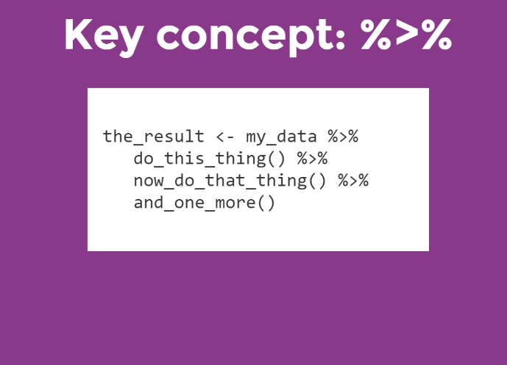
Notes:
Once tested, add this to a variable to “save” the result.

Slide 23
DPLYR VERBS
Group_by() – groups dataset and performs operations on the groups
Filter() – select specific cases of data based on values / arguments
Arrange() – reorder the data
Select() and rename() – select variables and manipulate them/change them
Mutate() – add additional columns
Summarise() – condense multiple values to a single value.
Hint: vigenette(dplyr) gives you detailed examples of these in practice and ?infront of any of them will provide great help too.
Notes:
These verbs can be linked with the PIPE..

Slide 24
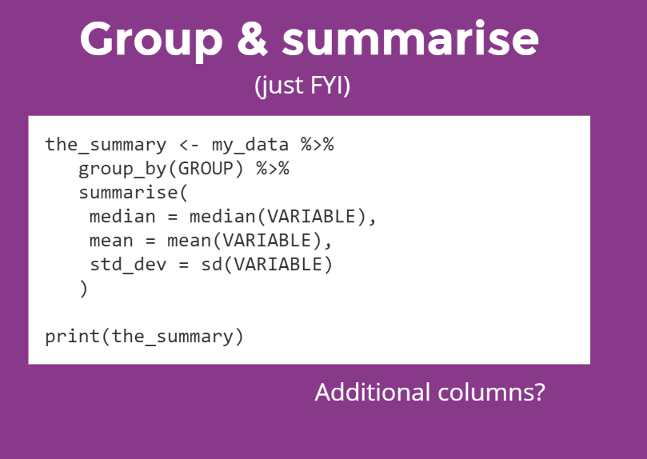
Notes:
Great for summarising your data.

Slide 25
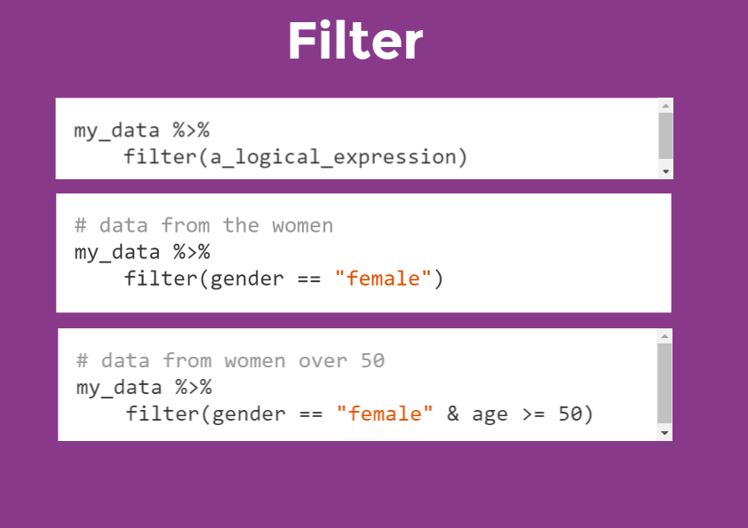

Slide 26
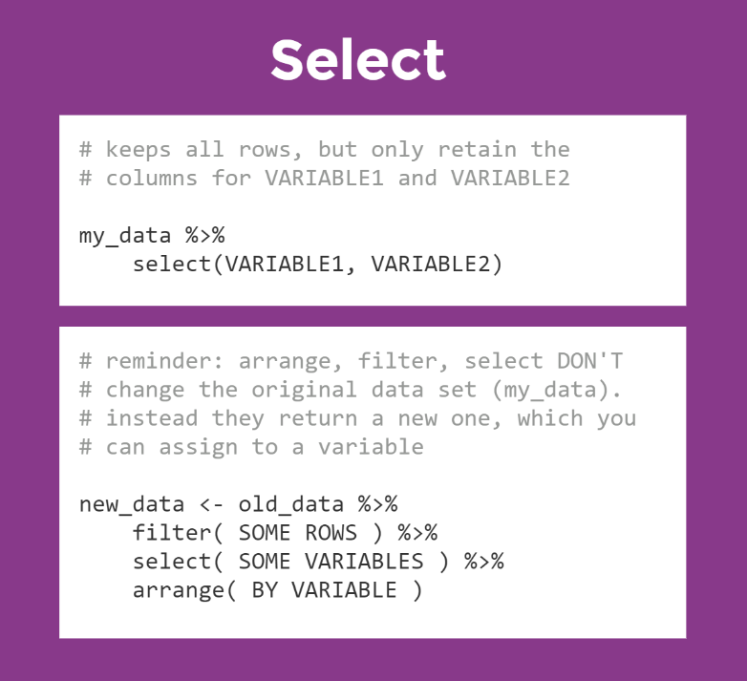
Notes:
Based on COLUMNS..

Slide 27
Lets put that all into practice:
Follow along through the script
We’ll look at:
READR to read in a .csv file
GGPLOT2 to plot this data
Group_by and some others to summarise your data
PURRR to loop through multiple iterations and save them
FORCATS to recode factorial data
PIVOT to make your wide data longer

Slide 28

This was just the tip of the iceberg..
Notes:
Now its up to you to keep finding more out about the packages and functions that you need to use the most.

Slide 29
What's next..
Use bits of the tidyverse in your own data
The beginning is frustrating.. But you WILL get faster
Most of your problems have already been solved by someone on stackoverflow or somewhere on google.
Post your problems on our slack page: https://join.slack.com/t/mqcoders/shared_invite/zt-c2kqitba-E_EBhSXEZouVJOZgOKhuZA
Always think of ways to make your code sleeker and simpler
Once your data is tidy – you can do anything with it
Stats, models etc
If you’re doing something multiple times
Write it as a function
Or better still create your own package… you could expand the tidyverse

Slide 30
Useful resources:
You can always learn more and its sometimes helpful to know where to look for help:
https://adv-r.hadley.nz/ - Advanced R
https://r4ds.had.co.nz/ - Using the Tidy verse for Data science
http://r-pkgs.had.co.nz/ - instructions for using packages correctly and also writing your own packages (ENCOURAGED!).
https://github.com/rladiessydney/littlemisstidyverse – R ladies Sydney workshop in full.
https://rladiessydney.org/ - check out their blog and github page with lots of info.
Rstudio cheatsheets – not a “one stop shop” but very helpful once you’ve tried a few things and done some reading:
https://www.rstudio.com/resources/cheatsheets/

Slide 31
Next Workshops…
Rmarkdown and Thesis down (23rd April)
Brendan Lanham (Biology dept)
Meta-analyses (21st May)
Sebastian Vadillo (UNSW)
Hypothesis testing and the P value(18th June)
Anne Soerensen (Maths & Stats dept)

