Slide 1
The Classical Solvers and
Improving Newton's Method
Based on A. Lima-Silva and F. D. Freitas, "Exploring a Dynamic Homotopy Technique to Enhance the Convergence of Classical Power Flow Iterative Solvers in Ill-Conditioned Power System Models", Energies 17(18):4642, 2024
Presented by Elias Mainur · Team: 2105039, 2105040, 2105057, 2105058, 2105060
CSE 402 Numerical Analysis Sessional
Notes:
We implemented the paper from scratch in Python, reproduced its results, and then tested changes to the method. First the paper, then our implementation and reproduction, then the improvements.

Slide 2
My part of the project
1
NR, FDXB and GSH-NR
2
Tables 7 and 8
the solvers the homotopy hands its result to, and the method it is compared with
iteration counts and run times of all methods
3
Optimal multiplier
4
Our own LU
a smarter Newton step length, and the Newton homotopy
NR and FDXB with Gauss/LU written from scratch
Hasbi's part · Lima-Silva & Freitas (2024): reproduction and improvements
2
Notes:
The homotopy only brings x close to the solution; a classical solver finishes the job. I wrote those solvers, reproduced the tables that compare them, and worked on improving Newton itself.

Slide 3
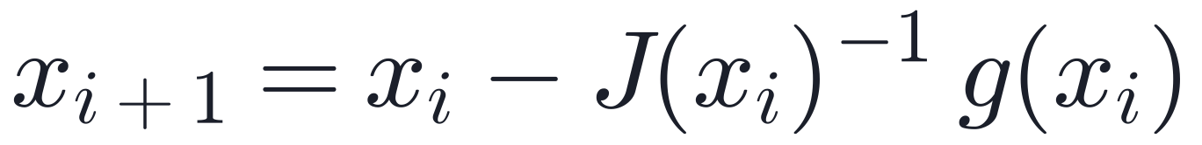
Newton-Raphson
one sparse LU of J per iteration
stop when ‖g‖∞ < 10⁻⁸, at most 10 iterations
fast (quadratic) near the root
0 of 5
large grids solved from the flat start — as in the paper
Hasbi's part · Lima-Silva & Freitas (2024): reproduction and improvements
3
Notes:
Equation 4 of the paper. Same stopping rule as MATPOWER. From the flat start J is nearly singular on the five large grids and NR diverges on all of them, exactly as the paper reports. From the case file's own start (NR-MAT) it converges in 5 or 6 iterations.

Slide 4
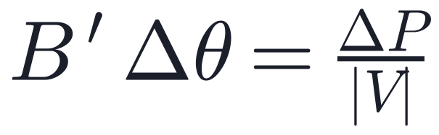
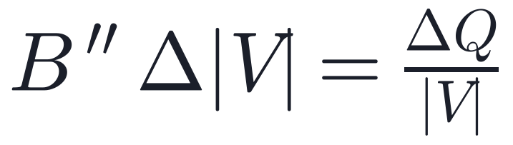
Fast decoupled load flow (FDXB)
B′ and B″ are constant: factorised only once
cheap iterations, but more of them
one cycle = a P half-step + a Q half-step
Finding
The paper counts P and Q half-steps separately:
15 + 14 = 29
With that counting, Table 7 matches.
Hasbi's part · Lima-Silva & Freitas (2024): reproduction and improvements
4
Notes:
Equations 5 to 8. Decoupling P-theta and Q-V gives two constant matrices, so each iteration is two triangular solves instead of a new LU. MATPOWER reports one count per cycle; the paper's numbers only fit if each half-step is counted.

Slide 5
GSH-NR: the static homotopy the paper compares with
h = 0
h = Δh
h = 2Δh
…
h = 1
flat start is exact
the real grid
fictitious shunts absorb the flat-start mismatch
each stage solved by NR
rebuilt from the paper's description in words
Iterations | Ours | Paper
case18482 | 10 | 10
case36964 | 28 | 27
case27318 | fail | 25
Hasbi's part · Lima-Silva & Freitas (2024): reproduction and improvements
5
Notes:
Reference 12 of the paper. Shunts on the Ybus diagonal make the flat start the exact solution at h=0; the branches at the slack bus are scaled by delta; NR solves h = dh, 2dh, ..., 1. We match two of the three grids the paper solves with it.

Slide 6
Table 7: iterations, reproduced
Grid | NR-MAT | NR-flat | BE(NR) | RK2(NR) | BE(FDXB) | RK2(FDXB)
case18482 | 6 | fail | 4 | 3 | 33 | 29
case27318 | 5 | fail | 4 | 3 | 29 | 25
case36964 | 6 | fail | 4 | 3 | 33 | 29
case54636 | 5 | fail | 4 | 3 | 29 | 25
case109272 | 5 | fail | 4 | 3 | 29 (paper 19) | 25
Every cell equals the paper's, except one FDXB count (case109272 and case54636 are copies of one network; both give 29) and GSH-NR on case27318.
Hasbi's part · Lima-Silva & Freitas (2024): reproduction and improvements
6
Notes:
All seven methods on the five large grids. The homotopy makes NR converge in 3 or 4 iterations where NR from the flat start fails. The one FDXB difference is most likely a typo in the paper: case54636 and case109272 are identical in every other cell.

Slide 7
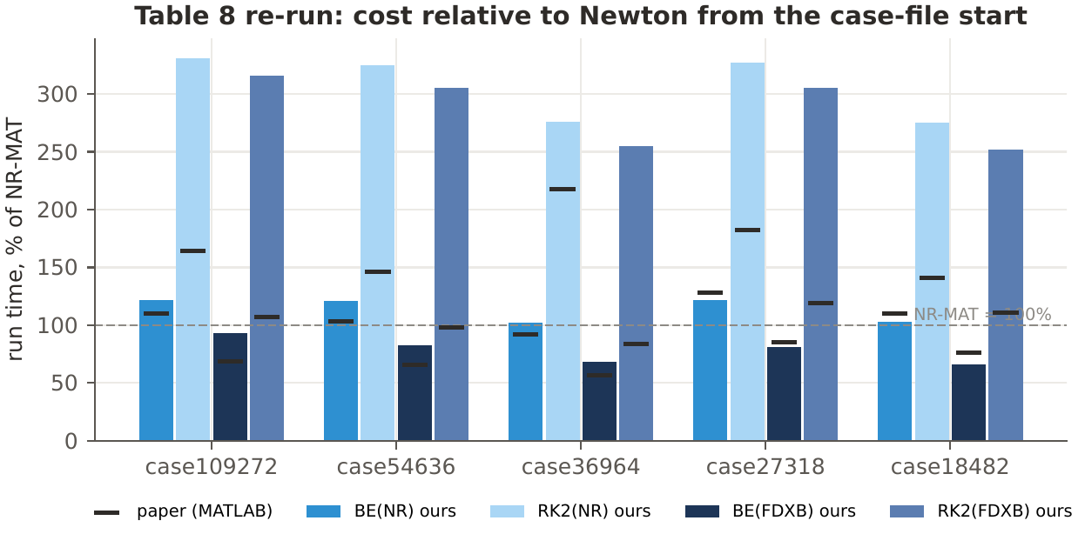
Table 8: run time
66 – 93%
BE(FDXB) time, as % of NR-MAT (paper 57 – 85%)
102 – 122%
BE(NR) time (paper 92 – 128%)
Hasbi's part · Lima-Silva & Freitas (2024): reproduction and improvements
7
Notes:
Median of seven runs, as a percentage of NR from the case file, since the paper used MATLAB on another machine. BE followed by FDXB is faster than a normal NR solve, and it starts from the flat start. Our RK2 rows are relatively slower than the paper's.

Slide 8
Improvement: Iwamoto's optimal multiplier
a = g(x), c = g(x + Δx); choose μ minimising ‖·‖²: a cubic. No extra LU.
−11%
143
152 @ 7.57
LUs: 7.14 per run instead of 8.04
of 170 runs solved (paper 127)
with Apurbo's corrector: the best balance
Hasbi's part · Lima-Silva & Freitas (2024): reproduction and improvements
8
Notes:
Damped Newton. The mismatch along the step is modelled as a quadratic in mu; minimising its squared norm gives a cubic, 2(c.c)mu^3 - 3(a.c)mu^2 + (a.a + 2a.c)mu - a.a = 0. Near the root mu is 1 so quadratic convergence is kept. It saves LUs but does not stop wrong roots on its own.

Slide 9
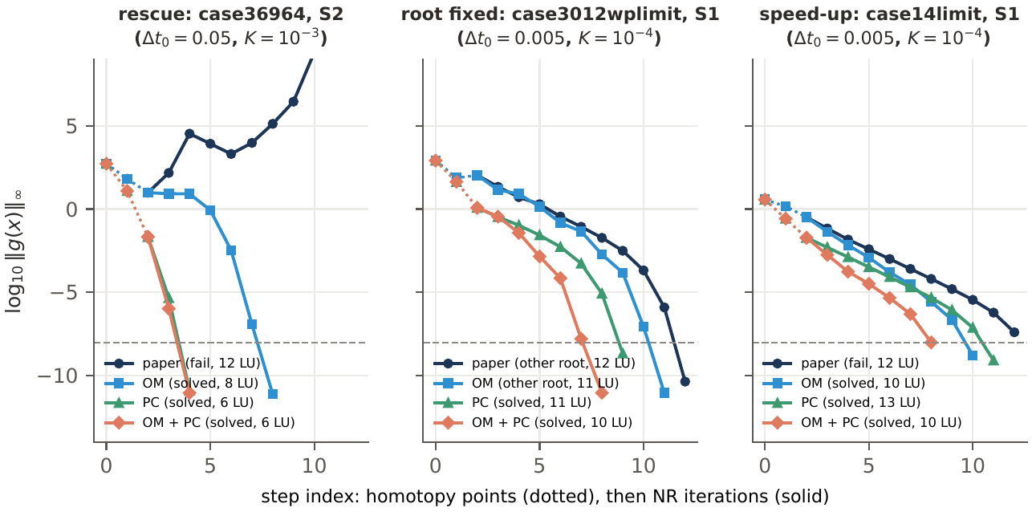
The multiplier in action
Hasbi's part · Lima-Silva & Freitas (2024): reproduction and improvements
9
Notes:
Mismatch history of the paper's method, the multiplier, the corrector and both, on three typical runs: a rescue (case36964, dt0 = 0.05), a root fix (case3012wplimit) and a speed-up (case14limit).

Slide 10
Newton homotopy: what if there is no K·I?
no K·I shift, so J stays nearly singular
the shift is what makes the paper's method work
Hasbi's part · Lima-Silva & Freitas (2024): reproduction and improvements
10
Notes:
The classical Newton homotopy. Its first BE step is a plain Newton step shrunk to 0.5%, with the unregularised flat-start Jacobian. It solves 75 of 170 runs against 127: a controlled experiment showing the K I term matters.

Slide 11
NR and FDXB with our own LU
Grid | Solver | Iterations (SciPy / ours) | SciPy LU | Our LU
2×2 example | NR | 9 / 9 | 0.002 s | 0.002 s
case500limit | NR | 2 / 2 | 0.010 s | 3.5 s
case2000limit | NR | 3 / 3 | 0.04 s | 424 s
case2000limit | FDXB | 22 / 22 | 0.03 s | 101 s
same iterations and the same solution to 5×10⁻¹²
dense LU costs O(n³) and ignores sparsity: fine for learning, not for 100,000 buses
Hasbi's part · Lima-Silva & Freitas (2024): reproduction and improvements
11
Notes:
The paper's BE path, NR and FDXB with every linear system solved by Sadman's hand-written LU with partial pivoting instead of SciPy's SuperLU. Results are identical; the time shows why sparse LU is essential at this size.

Slide 12
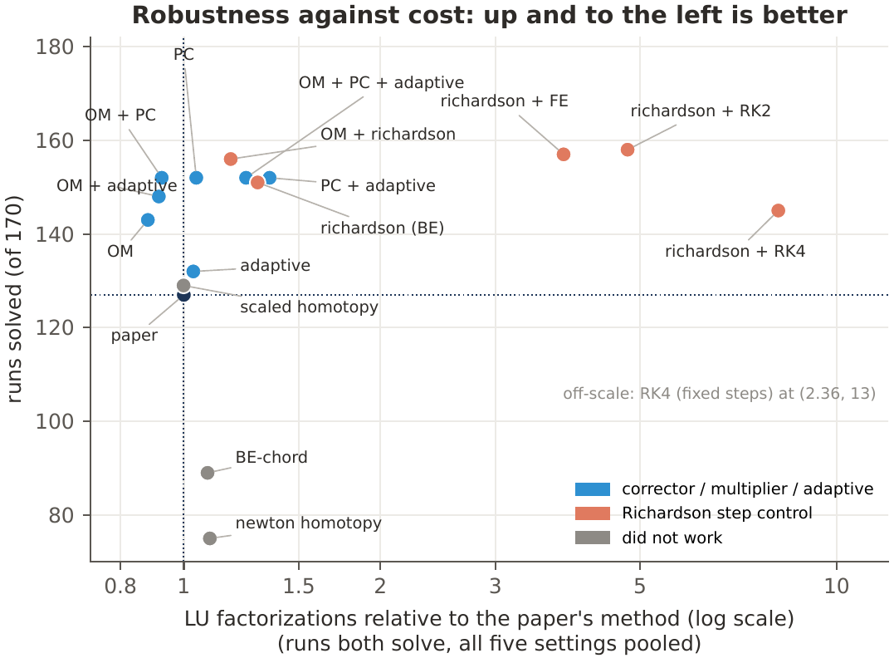
Robust and cheap: all configurations
Hasbi's part · Lima-Silva & Freitas (2024): reproduction and improvements
12
Notes:
Each configuration of the team's study, runs solved against LU cost relative to the paper's method. The multiplier moves left (cheaper); combined with the corrector it is both more robust and cheaper than the paper's method.

Slide 13
Summary
NR, FDXB and GSH-NR written from scratch; Table 7 matches except in 2 cells
BE + FDXB is faster than a normal NR solve, from the flat start
Optimal multiplier: 11% fewer LUs; with the corrector 152 of 170 solved
Newton homotopy (75 of 170) shows that the K·I shift is essential
Thank you. Questions?
Hasbi's part · Lima-Silva & Freitas (2024): reproduction and improvements
13

