Slide 1
The Power Flow Model and
Checking the Answers
Based on A. Lima-Silva and F. D. Freitas, "Exploring a Dynamic Homotopy Technique to Enhance the Convergence of Classical Power Flow Iterative Solvers in Ill-Conditioned Power System Models", Energies 17(18):4642, 2024
Presented by Jonayed · Team: 2105039, 2105040, 2105057, 2105058, 2105060
CSE 402 Numerical Analysis Sessional
Notes:
We implemented the paper from scratch in Python, reproduced its results, and then tested changes to the method. First the paper, then our implementation and reproduction, then the improvements.

Slide 2
My part of the project
1
The power flow model
2
Test systems
from a grid file to the equations g(x) = 0 and the Jacobian J
the paper's 9 grids, checked against the paper, plus 25 more
3
The solution check
4
Study and feasibility maps
did a run reach the right root, not just a root?
all team changes compared on 170 runs; where the method works
Jonayed's part · Lima-Silva & Freitas (2024): reproduction and improvements
2
Notes:
My part is what everything else stands on: turning a grid file into the equations every solver works on, choosing the test systems, and deciding whether an answer is actually right.

Slide 3

From a grid file to the equations
.mat case file
clean and renumber
bus types: slack, PV, PQ
build Y and S
g(x) and J(x)
185,807
one line of code for all buses
exact sparse Jacobian, checked by finite differences
equations in the largest grid, same code as a 2-bus toy
Jonayed's part · Lima-Silva & Freitas (2024): reproduction and improvements
3
Notes:
MATPOWER files are read with SciPy; PYPOWER's ext2int removes switched-off equipment and renumbers the buses. Y is the bus admittance matrix with I = Y V, S_spec is generation minus load in per unit. Every solver in the project only sees g(x) and J(x).

Slide 4
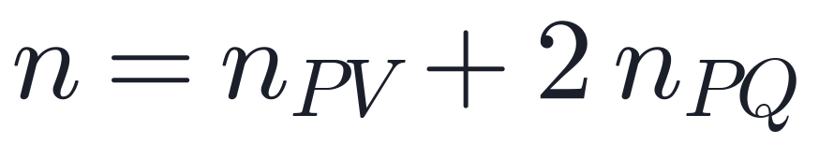
Which quantities are unknown
Bus type | Fixed | Unknown | Equations kept
Slack | |V|, θ = 0 | – | none
PV (generator) | P, |V| | θ | ΔP
PQ (load) | P, Q | θ, |V| | ΔP and ΔQ
a square system: n equations in n unknowns, as Newton needs
Jonayed's part · Lima-Silva & Freitas (2024): reproduction and improvements
4
Notes:
Each bus has |V|, theta, P and Q; two are fixed by what is controlled there. The slack supplies the losses and is the angle reference. A PV generator holds |V| by adjusting Q, so Q is an output. Counting: case18482 has 2,889 PV + 2 x 15,592 PQ = 34,073 unknowns.

Slide 5
Checking the model against the paper
Flat-start mismatch ‖g(x₀)‖∞
Grid | Ours | Paper
case18482 | 533 | 532
case27318 | 201 | 200
case500limit | 13 | 13
case2000limit | 55 | 54
case69limit | 0.012 | 0.012
Finding
Two small grids were off by exactly
10×
Their files store 10 MVA; the paper used 100 MVA.
Jacobian: tested column by column against finite differences
Jonayed's part · Lima-Silva & Freitas (2024): reproduction and improvements
5
Notes:
The flat-start mismatch is the first number in every row of Tables 2 to 5, so it checks the whole model. Seven grids matched at once. At the flat start g(x0) is about -S_spec, which scales like 1/baseMVA, so a 10 MVA base gives exactly 10 times the value.

Slide 6
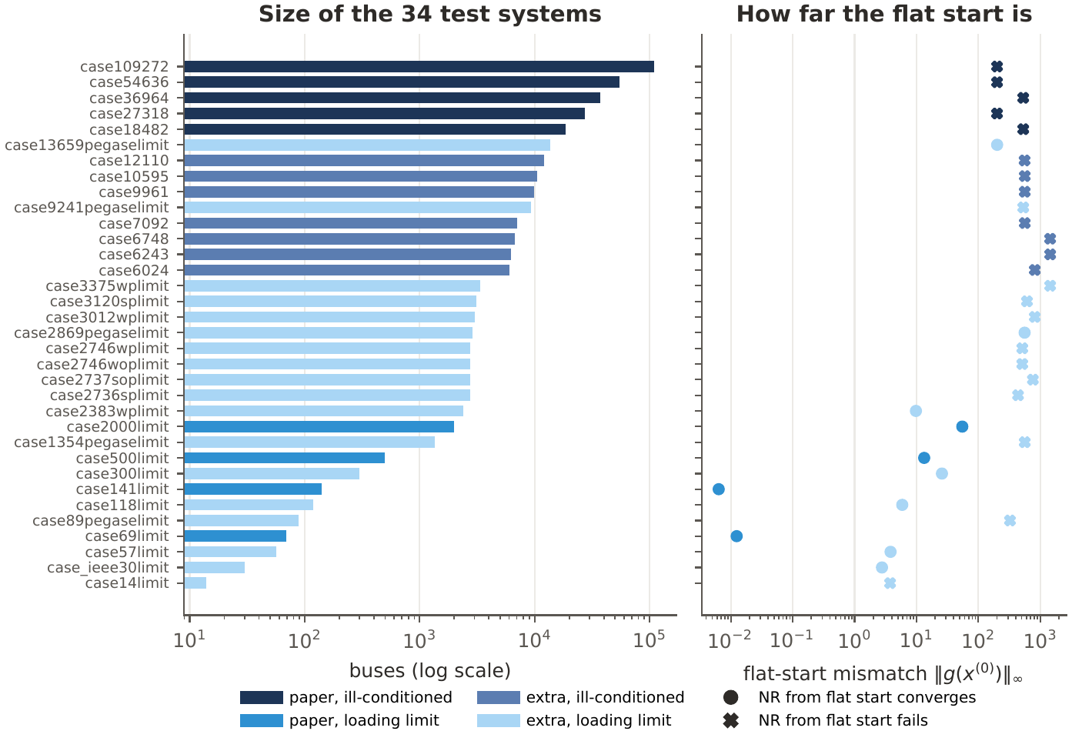
The test systems
34 grids
the paper's 9 plus 25 more from the same Zenodo records
14 – 109,272
buses: four orders of magnitude
Jonayed's part · Lima-Silva & Freitas (2024): reproduction and improvements
6
Notes:
Five ill-conditioned grids are joined copies of European PEGASE grids, the others are standard grids loaded close to their limit. Nine grids, five of them copies of two networks, are too few to judge a change to the method, so I added 25 more. A cross in the figure means Newton from the flat start fails.

Slide 7

Converged is not the same as correct
Power flow equations have several roots. A run counts as correct only if
14 of 141
V_ref: Newton from the voltages stored in the case file
all converged runs in the paper's Table 7 pass
converged runs of the paper's method reached the wrong root
Jonayed's part · Lima-Silva & Freitas (2024): reproduction and improvements
7
Notes:
The equations are quadratic in the voltages, so there is a normal operating point and low-voltage roots that are useless. A small mismatch says x is a root, not which one. The reference is the grid's intended operating point. Without this check those 14 runs would count as successes.

Slide 8
The comparison study: one fair test for everyone
34 grids
× 5 settings of (Δt₀, K)
= 170 runs
× 17 configurations
2,890 runs
Setting | Δt₀ | K
S1 (paper) | 0.005 | 10⁻⁴
S2, S3 (paper, Sec. 4.4) | 0.05, 0.1 | 10⁻³, 2×10⁻³
S4, S5 (weak, strong K) | 0.005 | 10⁻⁵, 10⁻³
Solved
Newton converges in ≤ 10 iterations and reaches the reference root
Cost
number of LU factorizations
Jonayed's part · Lima-Silva & Freitas (2024): reproduction and improvements
8
Notes:
Every team member's change is a switch; the study runs every configuration the same way on the same problems. For runs the paper's method misses, it reruns with 30 NR iterations to tell a real rescue from a root fix or a mere speed-up.

Slide 9
Results of the study
Runs solved of 170
three changes clearly help
corrector: wrong roots 14 → 2
multiplier: 11% fewer LUs
Jonayed's part · Lima-Silva & Freitas (2024): reproduction and improvements
9
Notes:
Corrector is Apurbo's, the multiplier Hasbi's, Richardson Sadman's. Multiplier plus corrector solves 152 at 7.57 LUs, cheaper than the paper's 8.04. Multiplier plus Richardson solves the most, 156.

Slide 10
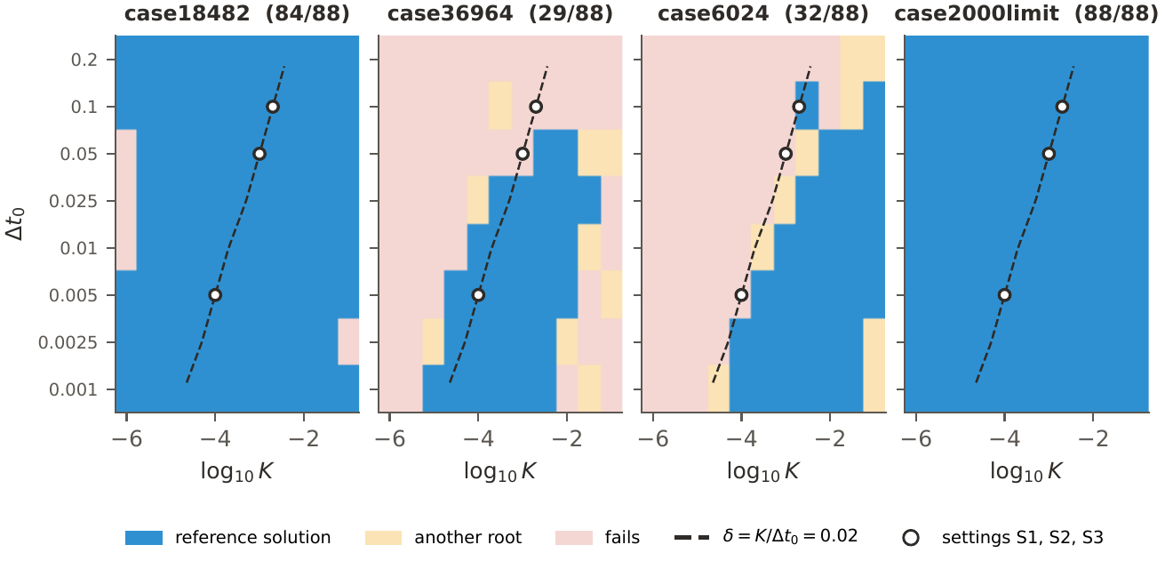
Where does the paper's method work?
Grid | Cells solved | δ that works
case36964 | 29 of 88 | 0.0063 to 3.2
case6024 | 32 of 88 | 0.032 to 32
success follows δ = K/Δt₀
explains a failure the paper left unexplained
Jonayed's part · Lima-Silva & Freitas (2024): reproduction and improvements
10
Notes:
88 full runs per grid over 8 values of dt0 and 11 of K, each judged by the solution check. The first BE step is a Newton step on J + delta I, so the outcome depends on delta: diagonal bands. On case36964 nothing with dt0 >= 0.1 works, which explains the paper's failure at (0.1, 0.002). On case6024 the working band lies above the paper's 0.02.

Slide 11
Summary
One model code from a 2-bus toy to 185,807 equations, matching the paper
Found the 10 MVA / 100 MVA base mismatch in two grids
The solution check: 14 of 141 'successes' were wrong roots
Study of 170 runs: the paper solves 127, our best 156
Thank you. Questions?
Jonayed's part · Lima-Silva & Freitas (2024): reproduction and improvements
11

