Slide 1
DroneBotics: Adopting Coverage Path Planning to the AR.Drone
Albin, D.; Cai, J.; Gentry, R.

Slide 2
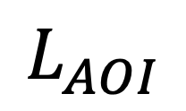
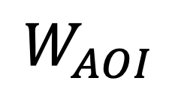
Define the Area of Interest (AOI)
$$W_{AOI}$$
$$L_{AOI}$$

Slide 3

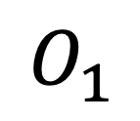
Define the objects
$$O_{1}$$
$$W_{AOI}$$
$$O_{2}$$
$$L_{AOI}$$

Slide 4
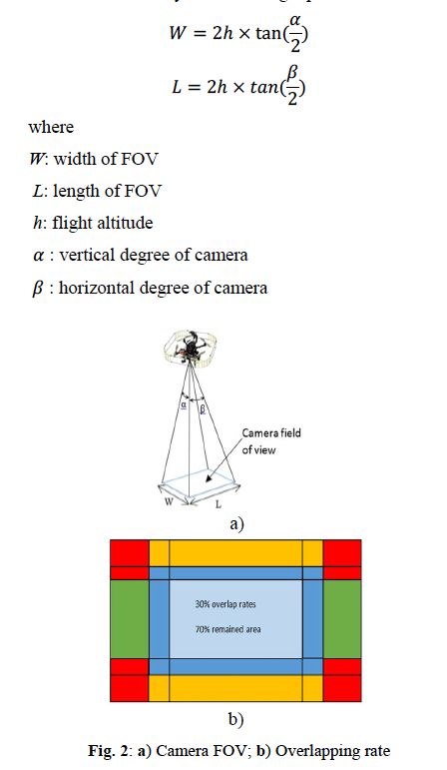
Approximate Cellular Decomposition – S_FOV
W
L

Slide 5
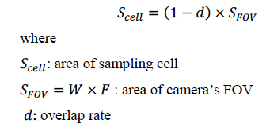
Approximate Cellular Decomposition – cell size

Slide 6
Approximate Cellular Decomposition – cell grid

Slide 7
Approximate Cellular Decomposition - objects

Slide 8
Approximate Cellular Decomposition - objects
0
0
0
0
0
0
0
0
0
0

Slide 9
Approximate Cellular Decomposition - objects
0
0
0
0
0
0
0
0
0
0

Slide 10
Approximate Cellular Decomposition
1
1
1
1
1
1
1
1
1
1
1
1
1
1
1
1
1
1
1
1
1
1
1
1
1
1
1
1
1
1
1
1
1
1
1
1
1
1
1
1
1
1
0
0
0
0
0
0
0
0
1
1
0
0

Slide 11
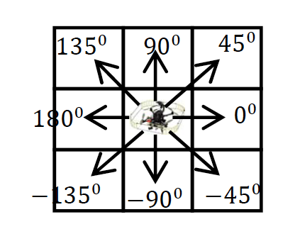
Wavefront Algorithm – Defining Nodes
0
0
0
0
0
0
0
0
0
0

Slide 12
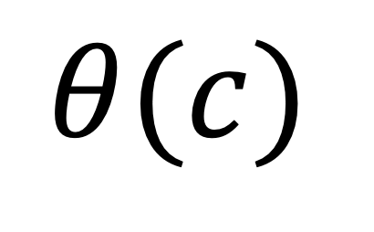
Wavefront Algorithm – Defining Neighbors
0
0
0
0
0
0
0
0
0
0
$$θ(c)$$

Slide 13
Wavefront Algorithm – Defining Neighbors
I.e. These are all overlapping routes the vehicle could take to get from node to node.
0
0
0
0
0
0
0
0
0
0

Slide 14


Wavefront Algorithm – Defining Neighbors
Starting Position, $C_{s}$
0
0
0
0
0
0
0
0
0
0
End Goal, $C_{g}$

Slide 15
Wavefront Algorithm – WAVEFRONT
Starting Position, $C_{s}$
NA
NA
NA
NA
NA
NA
NA
NA
1
NA
NA
End Goal, $C_{g}$

Slide 16
Wavefront Algorithm – WAVEFRONT
Starting Position, $C_{s}$
NA
NA
NA
NA
NA
NA
2
2
NA
NA
2
1
NA
NA
End Goal, $C_{g}$

Slide 17
Wavefront Algorithm – WAVEFRONT
Starting Position, $C_{s}$
NA
NA
NA
NA
3
3
3
3
NA
NA
3
2
2
NA
NA
3
2
1
NA
NA
End Goal, $C_{g}$

Slide 18
Wavefront Algorithm – WAVEFRONT
Starting Position, $C_{s}$
NA
NA
4
4
4
4
4
NA
NA
3
3
3
3
4
NA
NA
3
2
2
NA
NA
4
3
2
1
NA
NA
End Goal, $C_{g}$

Slide 19
Wavefront Algorithm – WAVEFRONT
Starting Position, $C_{s}$
5
5
5
5
5
5
NA
NA
4
4
4
4
4
NA
NA
3
3
3
3
4
NA
NA
3
2
2
NA
NA
5
4
3
2
1
NA
NA
End Goal, $C_{g}$

Slide 20
Wavefront Algorithm – WAVEFRONT
6
6
6
6
6
6
6
Starting Position, $C_{s}$
6
5
5
5
5
5
5
NA
NA
4
4
4
4
4
NA
NA
3
3
3
3
4
6
NA
NA
3
2
2
NA
NA
6
5
4
3
2
1
NA
NA
End Goal, $C_{g}$

Slide 21
Wavefront Algorithm – WAVEFRONT
8
7
6
6
6
6
6
6
6
Starting Position, $C_{s}$
8
7
6
5
5
5
5
5
5
8
7
NA
NA
4
4
4
4
4
7
7
NA
NA
3
3
3
3
4
7
6
NA
NA
3
2
2
NA
NA
7
6
5
4
3
2
1
NA
NA
End Goal, $C_{g}$

Slide 22
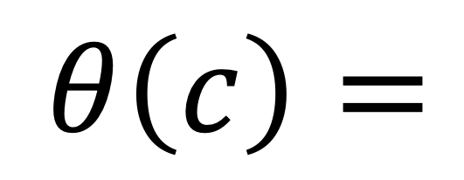
Wavefront Algorithm – WAVEFRONT
8
7
6
6
6
6
6
6
6
8
7
6
5
5
5
5
5
5
$$θ\left(c\right)=$$
8
7
NA
NA
4
4
4
4
4
7
7
NA
NA
3
3
3
3
4
7
6
NA
NA
3
2
2
NA
NA
7
6
5
4
3
2
1
NA
NA
THIS IS THE POTENTIAL FUNCTION!

Slide 23
Gradient Acsent – Find the coverage path
8
7
6
6
6
6
6
6
6
8
7
6
5
5
5
5
5
5
$$θ\left(c\right)=$$
8
7
NA
NA
4
4
4
4
4
7
7
NA
NA
3
3
3
3
4
7
6
NA
NA
3
2
2
NA
NA
7
6
5
4
3
2
1
NA
NA
THIS IS THE POTENTIAL FUNCTION!

Slide 24
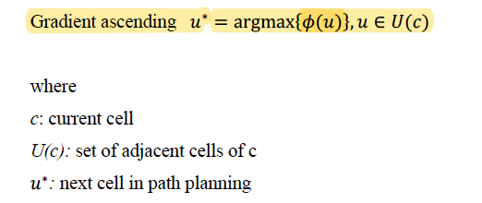
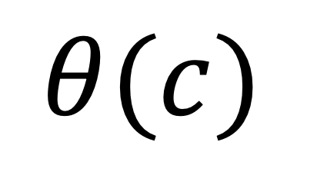
Gradient Ascent
$$θ(c)$$

Slide 25
Gradient Acsent – Find the coverage path
8
7
6
6
6
6
6
6
6
Chosen
8
7
6
5
5
5
5
5
5
Possible
8
7
NA
NA
4
4
4
4
4
7
7
NA
NA
3
3
3
3
4
7
6
NA
NA
3
2
2
NA
NA
7
6
5
4
3
2
1
NA
NA

Slide 26
Gradient Acsent – Find the coverage path
8
7
6
6
6
6
6
6
6
Chosen
8
7
6
5
5
5
5
5
5
Possible
8
7
NA
NA
4
4
4
4
4
7
7
NA
NA
3
3
3
3
4
7
6
NA
NA
3
2
2
NA
NA
7
6
5
4
3
2
1
NA
NA

Slide 27
Gradient Acsent – Find the coverage path
8
7
6
6
6
6
6
6
6
Chosen
8
7
6
5
5
5
5
5
5
Possible
8
7
NA
NA
4
4
4
4
4
7
7
NA
NA
3
3
3
3
4
7
6
NA
NA
3
2
2
NA
NA
7
6
5
4
3
2
1
NA
NA

Slide 28
Gradient Acsent – Find the coverage path
8
7
6
6
6
6
6
6
6
Chosen
8
7
6
5
5
5
5
5
5
Possible
8
7
NA
NA
4
4
4
4
4
7
7
NA
NA
3
3
3
3
4
7
6
NA
NA
3
2
2
NA
NA
7
6
5
4
3
2
1
NA
NA

Slide 29
Gradient Acsent – Find the coverage path
8
7
6
6
6
6
6
6
6
Chosen
8
7
6
5
5
5
5
5
5
Possible
8
7
NA
NA
4
4
4
4
4
7
7
NA
NA
3
3
3
3
4
7
6
NA
NA
3
2
2
NA
NA
7
6
5
4
3
2
1
NA
NA

Slide 30
Gradient Ascent – Find the coverage path
8
7
6
6
6
6
6
6
6
Chosen
8
7
6
5
5
5
5
5
5
Possible
8
7
NA
NA
4
4
4
4
4
7
7
NA
NA
3
3
3
3
4
7
6
NA
NA
3
2
2
NA
NA
7
6
5
4
3
2
1
NA
NA
Heuristic – make smallest turns if multiple equal
weighted neighbors available

Slide 31
Gradient Ascent – Find the coverage path
8
7
6
6
6
6
6
6
6
Chosen
8
7
6
5
5
5
5
5
5
Possible
8
7
NA
NA
4
4
4
4
4
7
7
NA
NA
3
3
3
3
4
7
6
NA
NA
3
2
2
NA
NA
7
6
5
4
3
2
1
NA
NA
Heuristic – make smallest turns if multiple equal
weighted neighbors available

Slide 32
Gradient Ascent – Find the coverage path
8
7
6
6
6
6
6
6
6
Chosen
8
7
6
5
5
5
5
5
5
Possible
8
7
NA
NA
4
4
4
4
4
7
7
NA
NA
3
3
3
3
4
7
6
NA
NA
3
2
2
NA
NA
7
6
5
4
3
2
1
NA
NA

Slide 33
Gradient Ascent – Find the coverage path
8
7
6
6
6
6
6
6
6
Chosen
8
7
6
5
5
5
5
5
5
Possible
8
7
NA
NA
4
4
4
4
4
7
7
NA
NA
3
3
3
3
4
7
6
NA
NA
3
2
2
NA
NA
7
6
5
4
3
2
1
NA
NA

Slide 34
Gradient Ascent – Find the coverage path
8
7
6
6
6
6
6
6
6
Chosen
8
7
6
5
5
5
5
5
5
Possible
8
7
NA
NA
4
4
4
4
4
7
7
NA
NA
3
3
3
3
4
7
6
NA
NA
3
2
2
NA
NA
7
6
5
4
3
2
1
NA
NA

Slide 35
Gradient Ascent – Find the coverage path
8
7
6
6
6
6
6
6
6
Chosen
8
7
6
5
5
5
5
5
5
Possible
8
7
NA
NA
4
4
4
4
4
7
7
NA
NA
3
3
3
3
4
7
6
NA
NA
3
2
2
NA
NA
7
6
5
4
3
2
1
NA
NA

Slide 36
Gradient Ascent – Find the coverage path
8
7
6
6
6
6
6
6
6
Chosen
8
7
6
5
5
5
5
5
5
Possible
8
7
NA
NA
4
4
4
4
4
7
7
NA
NA
3
3
3
3
4
7
6
NA
NA
3
2
2
NA
NA
7
6
5
4
3
2
1
NA
NA

Slide 37
Gradient Ascent – Find the coverage path
8
7
6
6
6
6
6
6
6
Chosen
8
7
6
5
5
5
5
5
5
Possible
8
7
NA
NA
4
4
4
4
4
7
7
NA
NA
3
3
3
3
4
7
6
NA
NA
3
2
2
NA
NA
7
6
5
4
3
2
1
NA
NA
Heuristic – make smallest turns if multiple equal
weighted neighbors available

Slide 38
Gradient Ascent – Find the coverage path
8
7
6
6
6
6
6
6
6
Chosen
8
7
6
5
5
5
5
5
5
Possible
8
7
NA
NA
4
4
4
4
4
7
7
NA
NA
3
3
3
3
4
7
6
NA
NA
3
2
2
NA
NA
7
6
5
4
3
2
1
NA
NA

Slide 39
Gradient Ascent – Find the coverage path
8
7
6
6
6
6
6
6
6
Chosen
8
7
6
5
5
5
5
5
5
Possible
8
7
NA
NA
4
4
4
4
4
7
7
NA
NA
3
3
3
3
4
7
6
NA
NA
3
2
2
NA
NA
7
6
5
4
3
2
1
NA
NA

Slide 40
Gradient Ascent – Find the coverage path
8
7
6
6
6
6
6
6
Chosen
8
7
5
5
5
5
5
5
Possible
8
7
NA
NA
4
4
4
4
4
7
7
NA
NA
3
3
3
3
4
7
6
NA
NA
3
2
2
NA
NA
7
6
5
4
3
2
1
NA
NA

Slide 41
Gradient Ascent – Find the coverage path
8
7
6
6
6
6
6
6
6
Chosen
8
7
6
5
5
5
5
5
5
Possible
8
7
NA
NA
4
4
4
4
4
7
7
NA
NA
3
3
3
3
4
7
6
NA
NA
3
2
2
NA
NA
7
6
5
4
3
2
1
NA
NA
Heuristic – make smallest turns if multiple equal
weighted neighbors available

Slide 42
Gradient Ascent – Find the coverage path
8
7
6
6
6
6
6
6
6
Chosen
8
7
6
5
5
5
5
5
5
Possible
8
7
NA
NA
4
4
4
4
4
7
7
NA
NA
3
3
3
3
4
7
6
NA
NA
3
2
2
NA
NA
7
6
5
4
3
2
1
NA
NA
Heuristic – make smallest turns if multiple equal
weighted neighbors available

Slide 43
Gradient Ascent – Find the coverage path
8
7
6
6
6
6
6
6
6
Chosen
8
7
6
5
5
5
5
5
5
Possible
8
7
NA
NA
4
4
4
4
4
7
7
NA
NA
3
3
3
3
4
7
6
NA
NA
3
2
2
NA
NA
7
6
5
4
3
2
1
NA
NA
Heuristic – make smallest turns if multiple equal
weighted neighbors available

Slide 44
Gradient Ascent – Find the coverage path
8
7
6
6
6
6
6
6
6
Chosen
8
7
6
5
5
5
5
5
5
Possible
8
7
NA
NA
4
4
4
4
4
7
7
NA
NA
3
3
3
3
4
7
6
NA
NA
3
2
2
NA
NA
7
6
5
4
3
2
1
NA
NA
Heuristic – make smallest turns if multiple equal
weighted neighbors available. If same
angle and weight choose at random.

Slide 45
Gradient Ascent – Find the coverage path
8
7
6
6
6
6
6
6
6
Chosen
8
7
6
5
5
5
5
5
5
Possible
8
7
NA
NA
4
4
4
4
4
7
7
NA
NA
3
3
3
3
4
7
6
NA
NA
3
2
2
NA
NA
7
6
5
4
3
2
1
NA
NA
If no possible moves left and there are unchecked nodes, start at the highest, closest, weighted node.

Slide 46
Gradient Ascent – Find the coverage path
8
7
6
6
6
6
6
6
6
Chosen
8
7
6
5
5
5
5
5
5
Possible
8
7
NA
NA
4
4
4
4
4
7
7
NA
NA
3
3
3
3
4
7
6
NA
NA
3
2
2
NA
NA
7
6
5
4
3
2
1
NA
NA
If no possible moves left and there are unchecked nodes, start at the highest, closest, weighted node.

Slide 47
Gradient Ascent – Find the coverage path
8
7
6
6
6
6
6
6
6
Chosen
8
7
6
5
5
5
5
5
5
Possible
8
7
NA
NA
4
4
4
4
4
7
7
NA
NA
3
3
3
3
4
7
6
NA
NA
3
2
2
NA
NA
7
6
5
4
3
2
1
NA
NA
If no possible moves left and there are unchecked nodes, start at the highest, closest, weighted node.

Slide 48
Gradient Ascent – Find the coverage path
8
7
6
6
6
6
6
6
6
Chosen
8
7
6
5
5
5
5
5
5
Possible
8
7
NA
NA
4
4
4
4
4
7
7
NA
NA
3
3
3
3
4
7
6
NA
NA
3
2
2
NA
NA
7
6
5
4
3
2
1
NA
NA
If no possible moves left and there are unchecked nodes, start at the highest, closest, weighted node.

Slide 49
Gradient Ascent – Find the coverage path
8
7
6
6
6
6
6
6
6
Chosen
8
7
6
5
5
5
5
5
5
Possible
8
7
NA
NA
4
4
4
4
4
7
7
NA
NA
3
3
3
3
4
7
6
NA
NA
3
2
2
NA
NA
7
6
5
4
3
2
1
NA
NA
If no possible moves left and there are unchecked nodes, start at the highest, closest, weighted node.

Slide 50
Gradient Ascent – Find the coverage path
8
7
6
6
6
6
6
6
6
Chosen
8
7
6
5
5
5
5
5
5
Possible
8
7
NA
NA
4
4
4
4
4
7
7
NA
NA
3
3
3
3
4
7
6
NA
NA
3
2
2
NA
NA
7
6
5
4
3
2
1
NA
NA
If no possible moves left and there are unchecked nodes, start at the highest, closest, weighted node.

Slide 51
Gradient Ascent – Find the coverage path
8
7
6
6
6
6
6
6
6
Chosen
8
7
6
5
5
5
5
5
5
Possible
8
7
NA
NA
4
4
4
4
4
7
7
NA
NA
3
3
3
3
4
7
6
NA
NA
3
2
2
NA
NA
7
6
5
4
3
2
1
NA
NA

Slide 52
Gradient Ascent – Find the coverage path
8
7
6
6
6
6
6
6
6
Chosen
8
7
6
5
5
5
5
5
5
Possible
8
7
NA
NA
4
4
4
4
4
7
7
NA
NA
3
3
3
3
4
7
6
NA
NA
3
2
2
NA
NA
7
6
5
4
3
2
1
NA
NA

Slide 53
Gradient Ascent – Find the coverage path
8
7
6
6
6
6
6
6
6
Chosen
8
7
6
5
5
5
5
5
5
Possible
8
7
NA
NA
4
4
4
4
4
7
7
NA
NA
3
3
3
3
4
7
6
NA
NA
3
2
2
NA
NA
7
6
5
4
3
2
1
NA
NA
When goal node hit, make sure there are no unvisited nodes. If there are, fly to them and start again. If none, reach the goal!

Slide 54
Gradient Ascent – Find the coverage path
8
7
6
6
6
6
6
6
6
Chosen
8
7
6
5
5
5
5
5
5
Possible
8
7
NA
NA
4
4
4
4
4
7
7
NA
NA
3
3
3
3
4
7
6
NA
NA
3
2
2
NA
NA
7
6
5
4
3
2
1
NA
NA
When goal node hit, make sure there are no unvisited nodes. If there are, fly to them and start again. If none, reach the goal!

Slide 55
Gradient Ascent – Find the coverage path
8
7
6
6
6
6
6
6
6
8
7
6
5
5
5
5
5
5
8
7
4
4
4
4
4
7
7
3
3
3
3
4
7
6
3
2
2
7
6
5
4
3
2
1
This is the optimal coverage path returned
from gradient ascent.

Slide 56
Using the Path in a Controller

