Slide 1
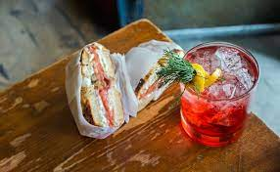
Foods & Drinks
Jondi
Tsveniashvili
Food and
cocktail recipes

Slide 2
Contents of this project
Here’s what you’ll find in this Project:
For building was used: Android studio (Java)
#Libraries: droidsondrodis, Picasso, Retrofit2, Firebase.
#Navigation drawer
#Activities
#Fragments
#Mutable live data
#JSON/API
#Firebase Authentication
#Alert Dialogs
#Toasts
#Arrays
#Interfaces
#Functions
#StringBuilder
#Encapsulations
#Constructors
#RecyclerView
#Singleton Pattern

Slide 3
contents
03
01
Section
Section
Section
Section
04
02
Alcoholic drinks
Food
(Default Seafood category)
Non-alcoholic drinks
Food categories

Slide 4
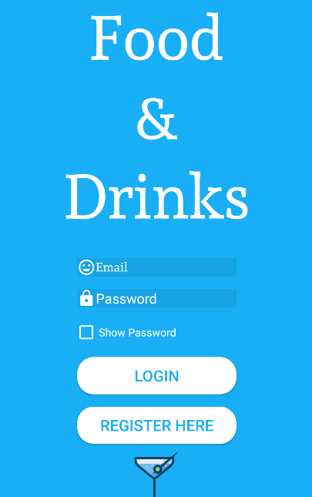
Login
‘
First Screen
First Time
After registration
#Firebase Authentication

Slide 5
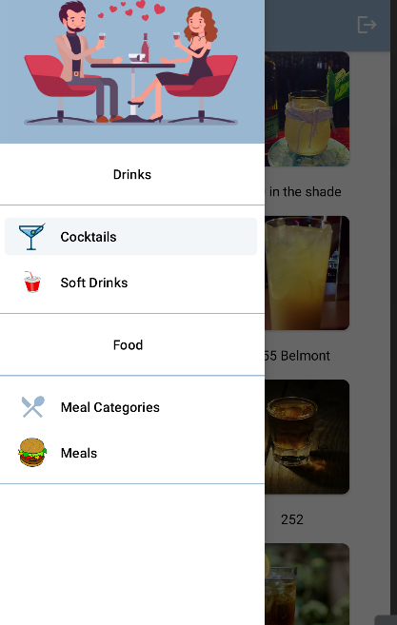
Navigation drawer

Slide 6
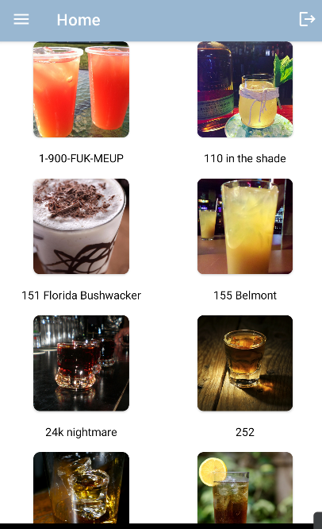
Second Screen
User can Choose drink by tapping

Slide 7
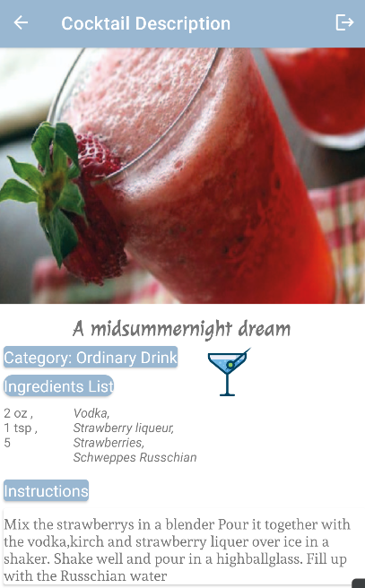
Details
Back
Log out
After tapping on chosen drink user moves to detailed screen with instructions and measures for making current cocktail

Slide 8
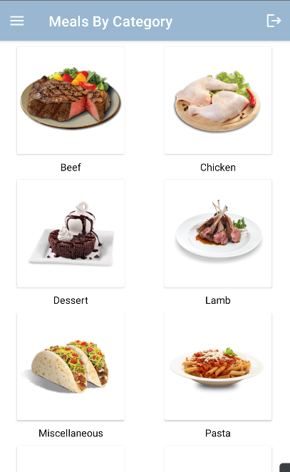
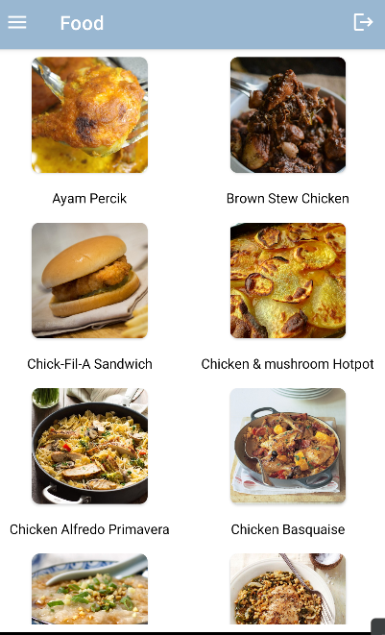
Mercury
Mars
Food by category
Category
Choose Food By category
After category is tapped app moves to screen with list of meals by chosen category

Slide 9
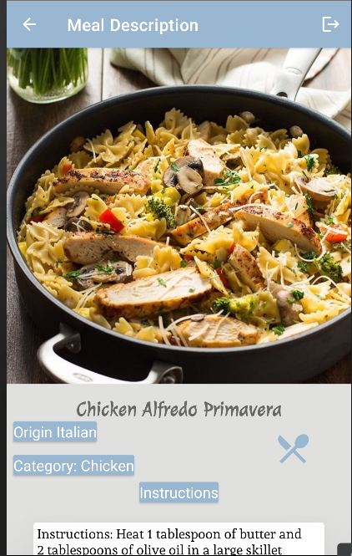
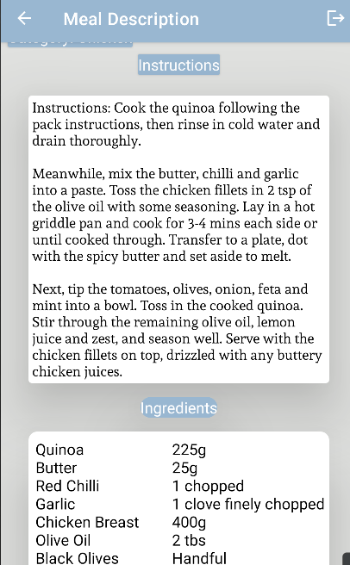
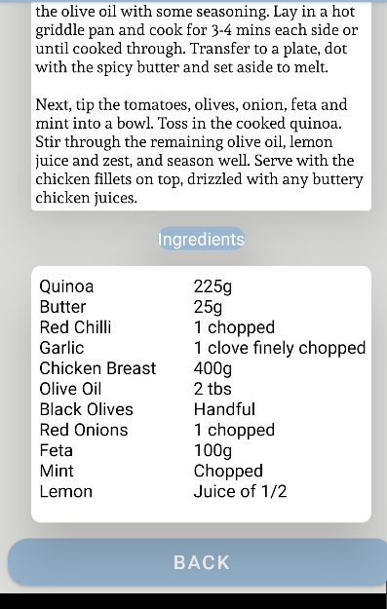
Meal Details
So after category next step is meal by tapping on meal user moves to meal’s details (instructions, measures, ingredients….)

