Slide 1
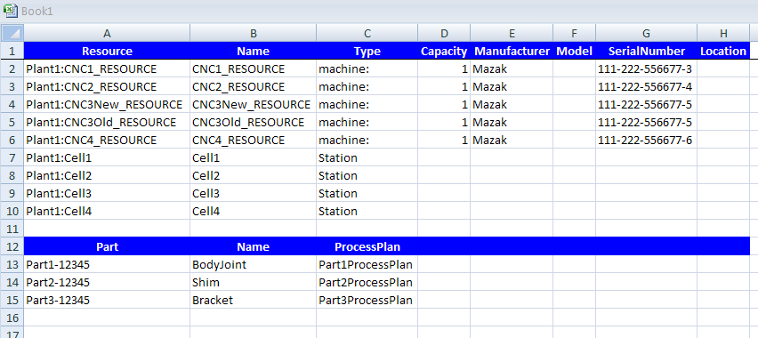
NIST Virtual Factory Testbed
Model based on Arena DES example found at:
www.cs.uml.edu/~giam/Mikkeli/IntroToArena.4.ppt

Slide 2
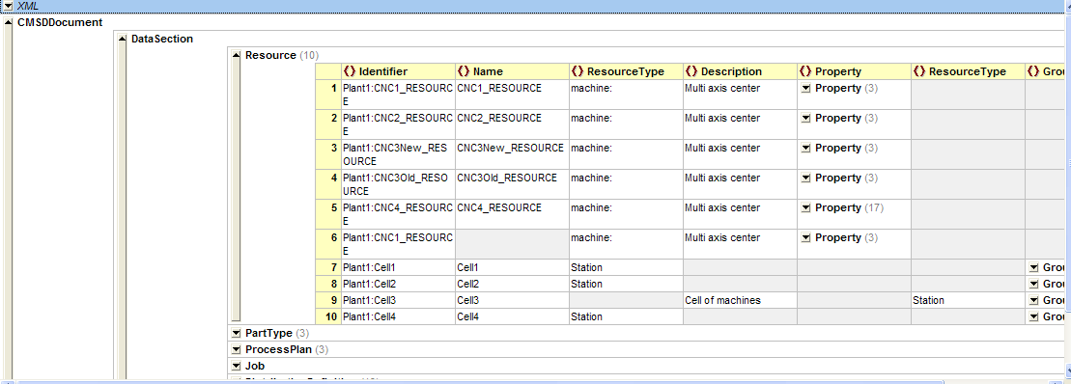
CMSD Resources – XMLSpy

Slide 3
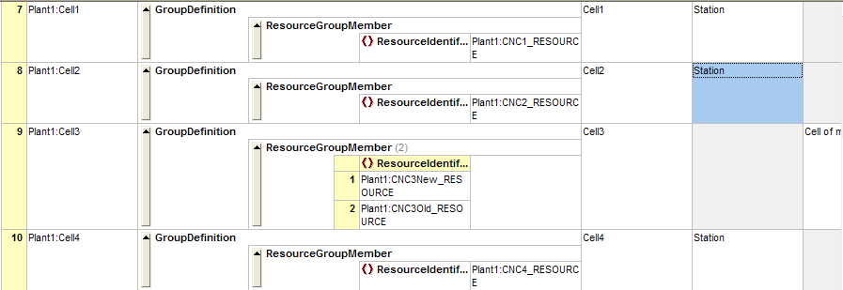
Cell – Group of Resources

Slide 4
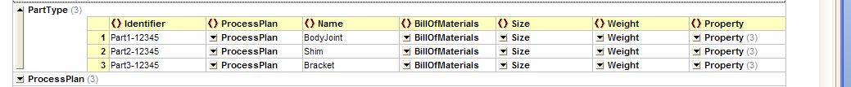
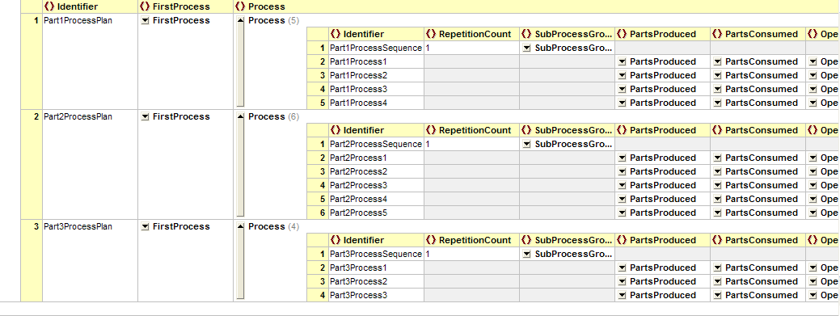
Parts and Process Plans

Slide 5
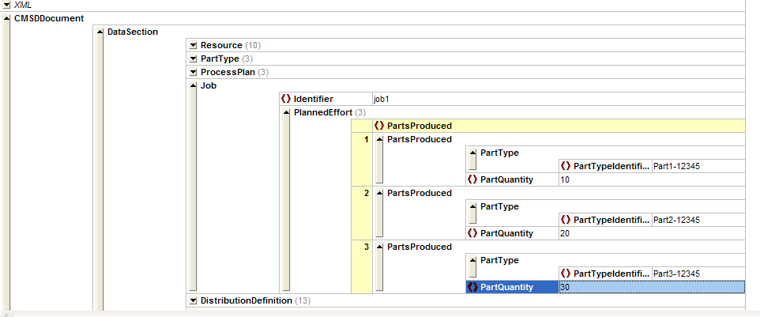
CMSD Job - 10,20,30

Slide 6
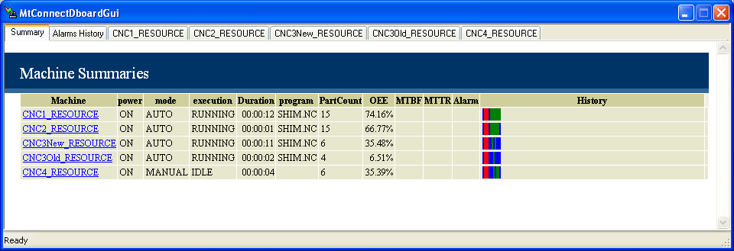
NIST Virtual Factory Dashboard

Slide 7
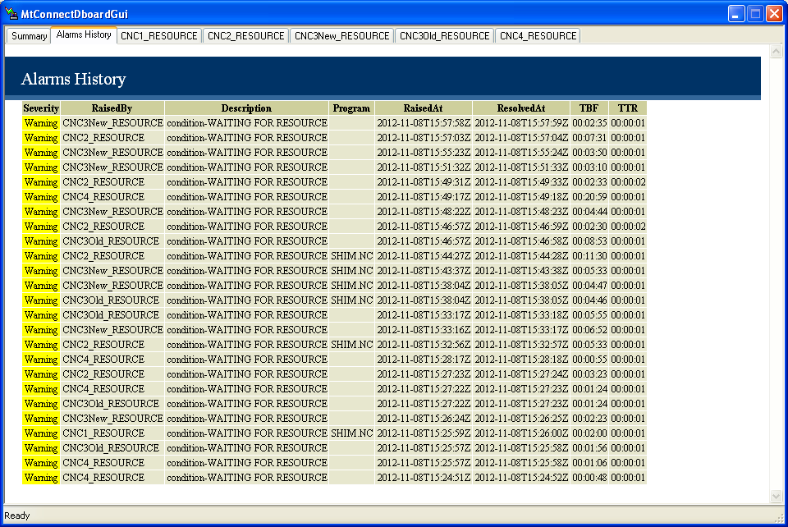
Condition Monitoring – w/ TBF, TTF

Slide 8
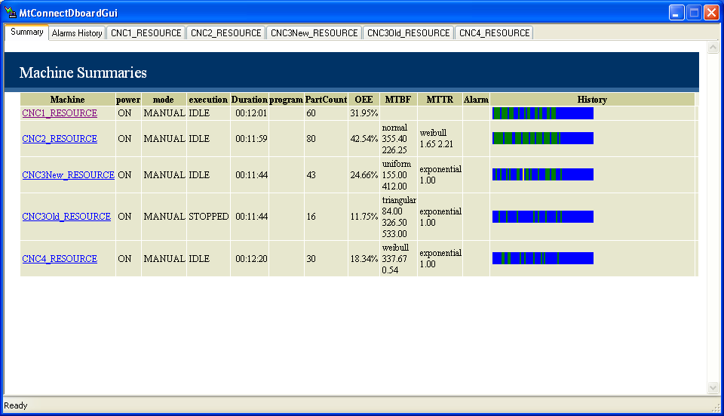
Automated MTBF, MTTR

Slide 9
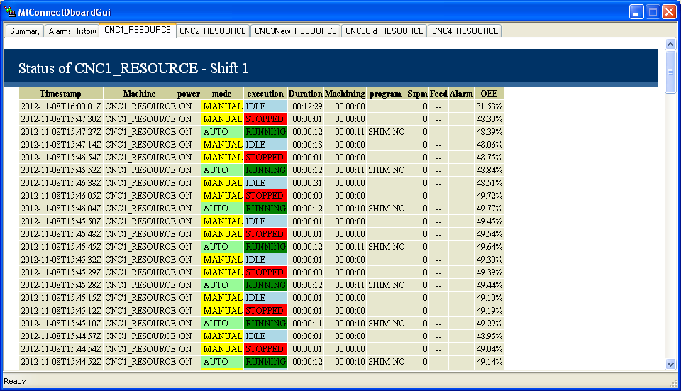
Per Machine Monitoring

Slide 10
Final Analysis
Finished Part1-12345 Parts = 10 Finished Part2-12345 Parts = 20 Finished Part3-12345 Parts = 30

