Slide 1

PANDEMIC AND STOCK RETURNS: THE EFFECTS OF COVID-19 ON INDUSTRY PROFITABILITY AND INVESTOR ATTITUDES TOWARDS RISK
By
Jones A. Paintsil

Slide 2
Introduction
Stock market returns are driven by changes in profitability and investor attitudes towards risk.
How did the Covid-19 play role?
Firms exposed to trading and businesses in China (Ramelli & Wagner, 2019).
For US, Government restrictions on commercial activities (Baker, Bloom, Davis & Kost, 2020).
Notes:
This affected the stock market in US and China

Slide 3
Introduction
Hours of work were reduced for both men and women (Garcia & Cowan, 2022).
Covid-9 disrupted many household earnings concerning the job market.
The effect was felt mainly through parents without college degrees and occupations not involving telework.

Slide 4

Aim of the research
Establish a relationship between the pandemic and stock returns.
Examine the industries that were risky during the pandemic.
Examine the relationship between riskiness and profitability.

Slide 5
Research Questions
Which industries experienced a higher equity market performance since the beginning of 2020?
Are the average daily abnormal returns statistically different from zero?
Which industries are relatively risky in 2019, 2020, and 2021?
How do the industries with relatively risky returns change across these years?
Does riskiness affect stock return?
Are there difference in daily abnormal returns of the ‘risky’ vs ‘safe’ industries during early phase of the pandemic?

Slide 6
Hypothesis
HO: There is no statistically differences between average returns and market returns.
H1: There is a statistical difference between average returns and market returns.
HO: There is no statistically differences in abnormal returns between risky and safe industries.
H1: There is a statistically differences in abnormal returns between risky and safe industries.

Slide 7
Data Exploration
Data source
Daily stock returns on 12 industry portfolios from Kenneth French's website.
The Fama and French Data.
Methods
Naïve approach
Daily average return minus market return
Robust approach
Fama and French (‘Mkt-RF’,SMB,HML, RMW, CMA).
Variable of interest
Daily abnormal return
Risky vs Safe industries

Slide 8
Data Analysis-Summary
 |  | Abnormal Returns (Obs=757) | Abnormal Returns (Obs=757)
 | Naïve Approach |  |  | Fama & French
Industries | Mean (%) |  | Median (%) | Mean (%) | Median (%)
Business & Equipment | 0.046 |  | 0.08 | 0.065 | 0.198
Chemicals & Allied products | -0.021 |  | -0.02 | 0.08 | 0.11
Consumer Durables | 0.144 |  | 0.08 | 0.15 | 0.188
Energy | -0.038 |  | -0.04 | 0.043 | 0.036
Money (Finance) | -0.048 |  | -0.18 | 0.031 | 0.049
Healthcare, Med Equipment | -0.03 |  | -0.02 | 0.035 | 0.073
Manufacturing | -0.01 |  | -0.057 | 0.019 | 0.077
Consumer non-durables | -0.008 |  | -0.026 | 0.021 | 0.069
Other industries | -0.012 |  | -0.01 | 0.044 | 0.125
Shops | 0.001 |  | -0.019 | 0.043 | 0.117
Telecommunication | -0.054 |  | -0.049 | -0.018 | -0.003
Utilities | -0.042 |  | -0.036 | -0.021 | 0.047

Slide 9
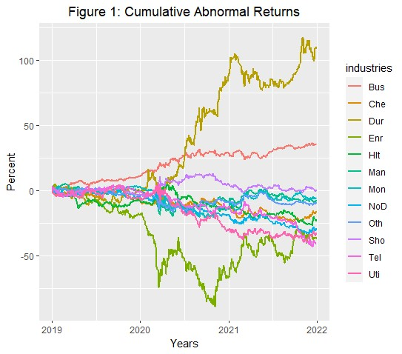
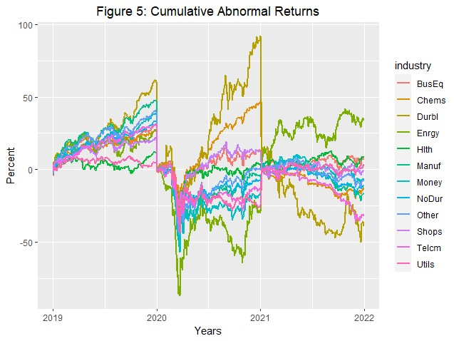
Data Analysis-Industry with higher equity market performance
Naïve approach
Fama & French

Slide 10
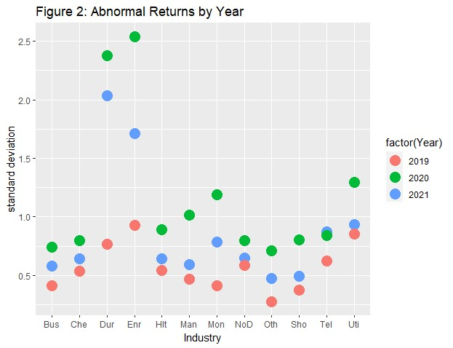
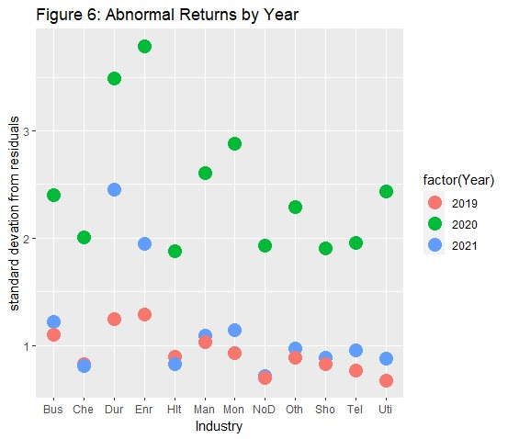
Data Analysis-standard Deviations
Naïve Approach
Fama & French

Slide 11
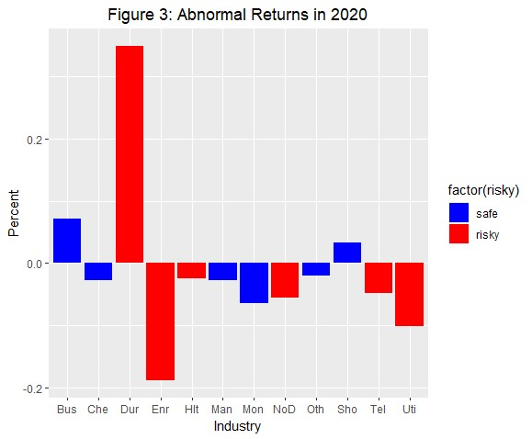
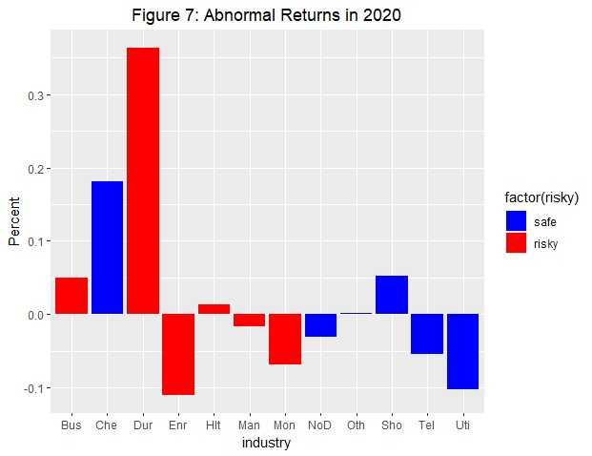
Data Analysis-2020 Abnormal return (Risky vs. Safe)
Naïve Approach
Fama & French

Slide 12
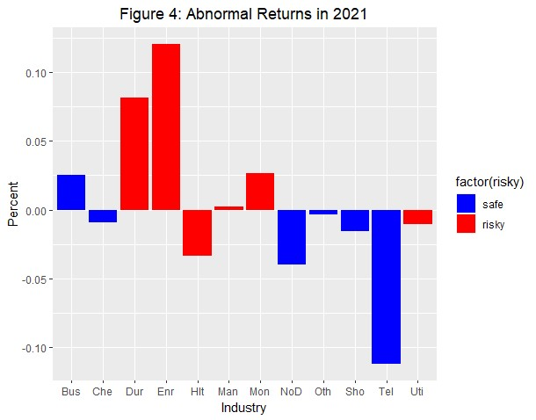
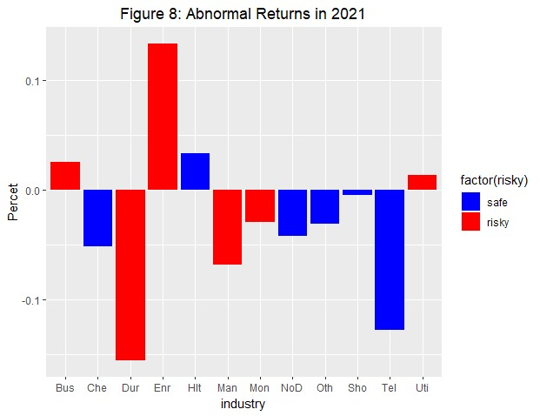
Data Analysis-2021 Abnormal return (Risky vs Safe)
Naïve Approach
Fama & French

Slide 13
Data Analysis-T-test
Industries | Average return (%) | Market return (%) | Difference (Abnormal returns-%) | T-statistic | P-value
Business & Equipment | 0.148 | 0.102 | 0.046 | 0.577 | 0.564
Chemicals & Allied product | 0.081 | 0.102 | -0.021 | -0.290 | 0.772
Consumer Durables | 0.245 | 0.102 | 0.144 | 1.344 | 0.179
Energy | 0.054 | 0.102 | -0.048 | -0.452 | 0.652
Money (Finance) | 0.072 | 0.102 | -0.030 | -0.422 | 0.673
Healthcare, Med Equipment & Drugs | 0.092 | 0.102 | -0.010 | -0.120 | 0.905
Manufacturing | 0.094 | 0.102 | -0.008 | -0.093 | 0.926
Consumer non-durable | 0.064 | 0.102 | -0.038 | -0.549 | 0.583
Other industries | 0.090 | 0.102 | -0.012 | -0.163 | 0.871
Shops | 0.102 | 0.102 | 0.001 | 0.008 | 0.993
Telecommunication | 0.048 | 0.102 | -0.054 | -0.754 | 0.451
Utilities | 0.059 | 0.102 | -0.042 | -0.555 | 0.579
Daily average return-market return

Slide 14
Data Analysis-T-test
 |  | Category | T-statistic | P-value | Risky (%) | Safe (%)
Naïve Approach | 2020 | risky vs. safe | 0.122 | 0.903 | -0.011 | -0.005
 | 2021 | risky vs. safe | -1.59 | 0.112 | 0.0312 | -0.026
Fama Approach | 2020 | risky vs. safe | -0.330 | 0.741 | 0.039 | 0.008
 | 2021 | risky vs. safe | -0.519 | 0.604 | -0.014 | -0.037

Slide 15
Conclusion
The Covid-19 pandemic affected industry performance.
The risky industries during the pandemic are Consumer durables, Energy, Healthcare, Medical Equipment, and Drugs.
Shops, Other industries, Business and Equipment were safe during the pandemic.
Safe industries yield lower returns.

Slide 16
Conclusion
In contrast, risky industries earn higher returns in profit and losses.
There was no difference in statistically difference between daily average returns and market returns.
No difference in abnormal returns between risky and safe industries during the phase of the COVID-19 pandemic.

Slide 17

Thank you

