Slide 1
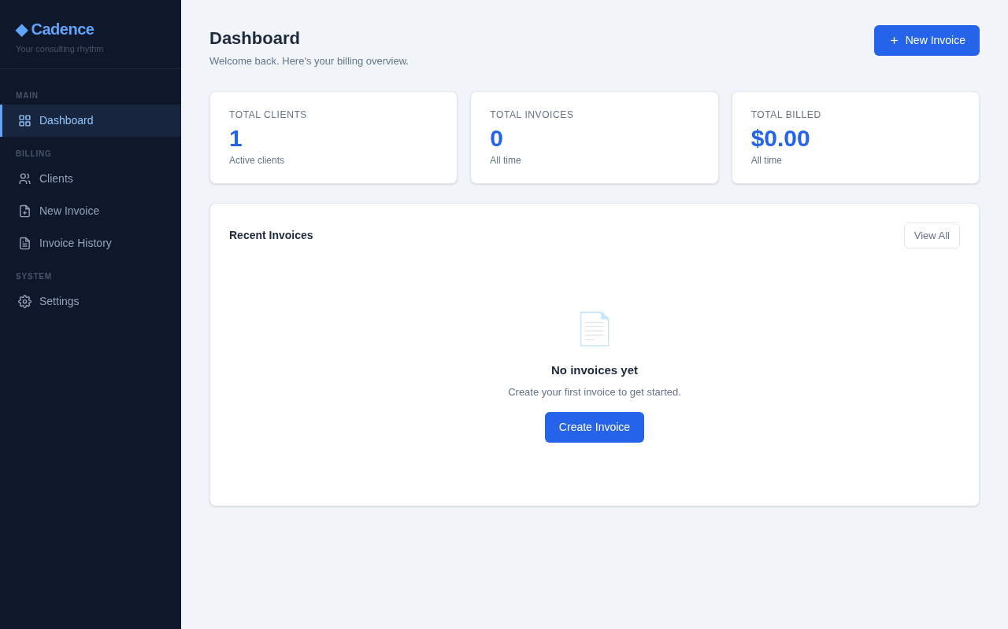
CADENCE MARKETING DECK
Your consulting rhythm.
A local Windows app that turns Microsoft 365 calendar sessions into polished invoices for educational therapists, tutors, and solo practitioners.
Calendar
Invoices
Local data

Slide 2
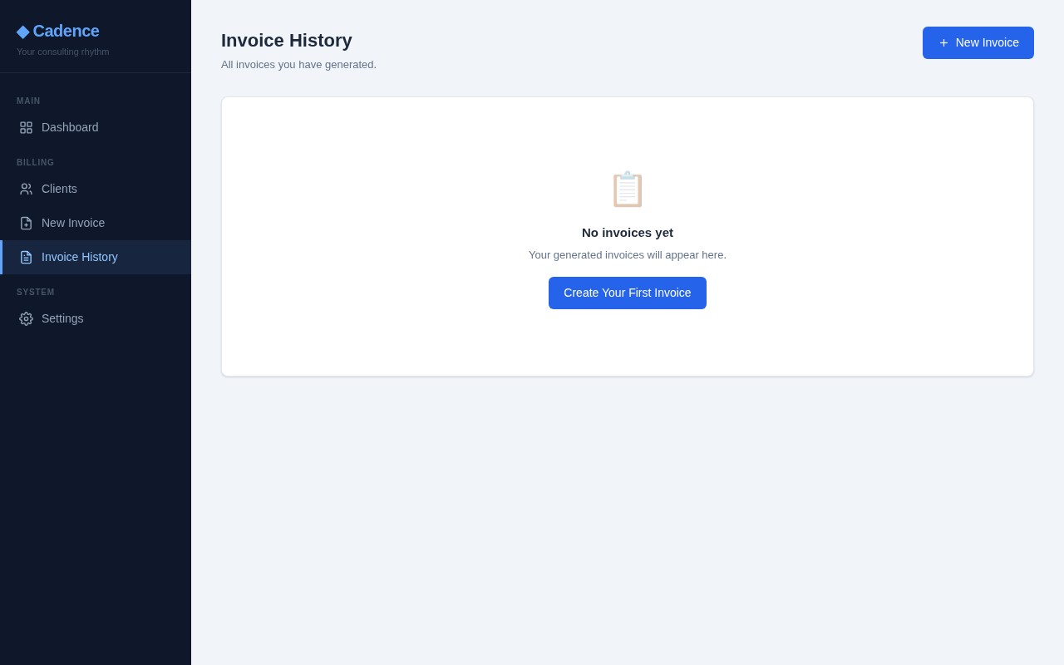
THE ADMIN DRAG
Solo practices should not need a billing department.
Cadence is positioned around a simple promise: keep the practitioner in session mode while invoices, payments, and reporting stay organized.
01
Calendar sessions already know the work
No duplicate entry when appointments can become invoice line items.
02
Parents need clean, credible PDFs
Professional invoices are created with session detail, billing address, and payment instructions.
03
Tax season needs a paper trail
Payment status, annual summaries, and CSV export keep income visible.

Slide 3
THE CORE STORY
From session calendar to sent invoice in one clean flow.
Microsoft 365 calendar
Student matching
PDF invoice
Email + tracking
>
Appointment titles are matched against student initials so billable sessions can be found quickly.
>
Every selected session becomes a line item at the configured rate, with the right bill-to details.
>
Send through Microsoft 365, save to Sent Items, then track payment status and income.
Cadence reads selected Outlook calendars through Microsoft Graph. Outlook does not need to be open.

Slide 4
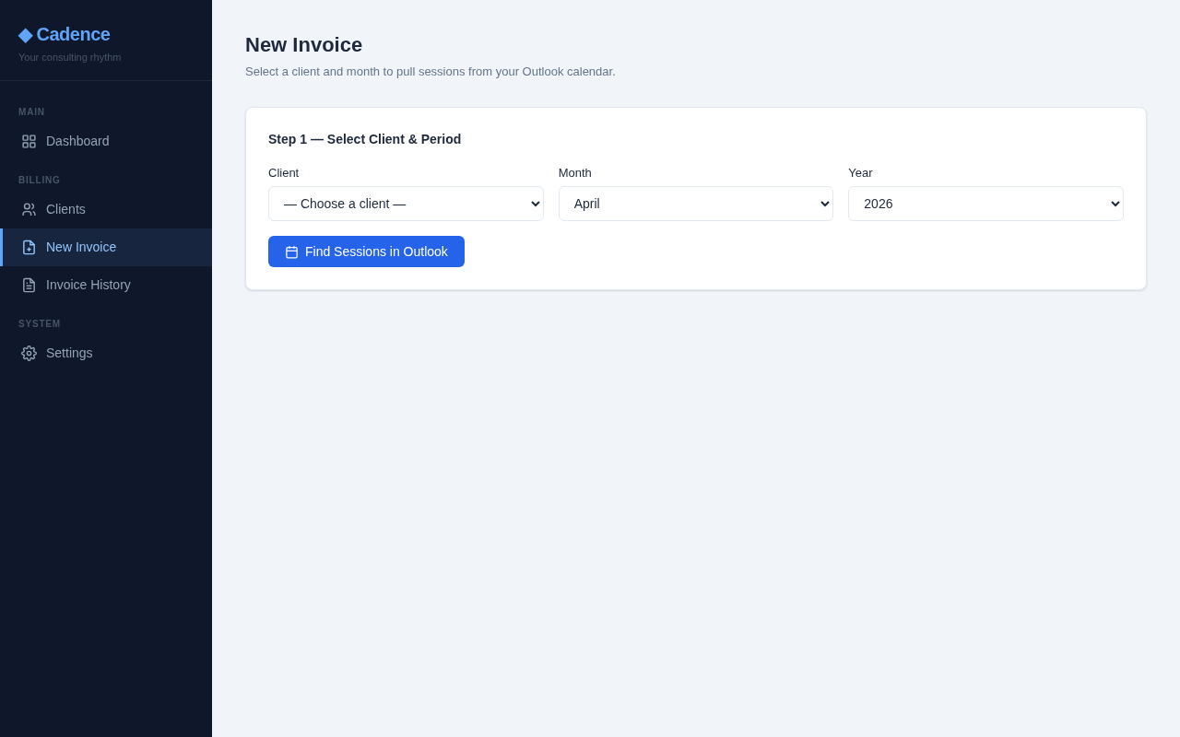
PRODUCT PROOF
The main action is exactly where a practitioner expects it.
Choose a client and month, pull sessions from Outlook, and generate the invoice without rebuilding the month by hand.
Configured rate
Uses the practitioner’s standard or student-specific session rate.
Month folders
Saves invoices into month-based PDF folders automatically.
Duplicate guard
Prevents accidental duplicate invoices unless overridden.

Slide 5
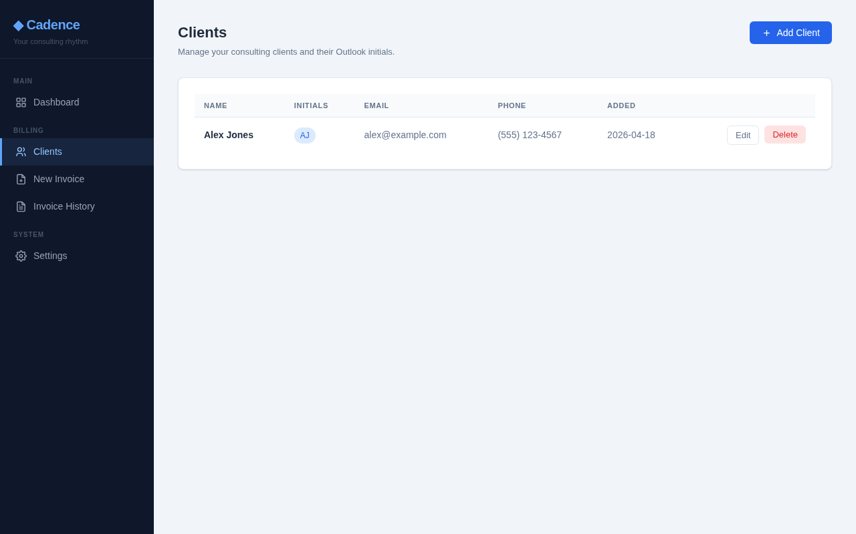
PRACTICE MANAGEMENT
Cadence keeps the business context close to the billing moment.
Client records
Student, parent, services, grade, birthday, and billing fields in one place.
Flexible bill-to
Parent 1, Parent 2, or custom payer details flow into the PDF.
Import-ready
Bulk student import from Excel helps a practice get live faster.
Archive-friendly
Keep current families clean while preserving history.

Slide 6
TRUST POSITION
Local-first
Microsoft 365 native
No subscription. No hosted database. No extra billing portal.
Everything runs on the user’s PC; no Cadence cloud service is required.
Uses Microsoft Graph for calendar reads and invoice email sending.
Installable
Backup + OneDrive
Cadence runs on the practitioner’s own Windows PC, connects to their Microsoft 365 account, and stores practice data locally.
A Windows installer can include everything needed; no Python setup for end users.
Built-in backup and configurable storage folders support practical two-PC workflows.

Slide 7
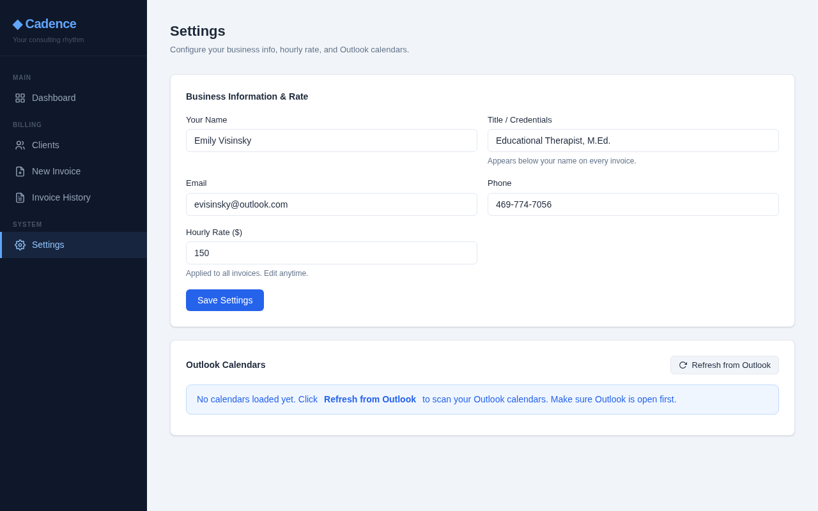
SETUP STORY
Configuration is front-loaded so monthly billing stays simple.
Business identity, rate, Microsoft 365 connection, calendar selection, storage, backup, and import live in the settings flow.
Marketing angle: Cadence feels purpose-built because every setting maps to a real solo-practice chore.

Slide 8
LAUNCH MESSAGE
Best-fit audience
Make monthly billing feel like closing the loop.
Educational therapists, tutors, academic coaches, and independent service providers who already schedule sessions in Outlook.
Cadence gives solo practitioners a calmer way to move from sessions delivered to invoices sent, payments tracked, and income ready to report.
Primary CTA: schedule a short demo using one real billing month.

