Slide 1
ISE 547

Slide 2
How do we evaluate llm-generated content?
Evaluation methods measure how well our system is performing.
Manual evaluation (human review) of each summary would be time-consuming, costly and would not be scalable
So we have to complement with automatic evaluation. Many automatic evaluation methods attempt to measure the same qualities of text that human evaluators would consider.
Those qualities could include fluency, coherence, relevance, factual consistency, and fairness. Similarity in content or style to a reference text can also be an important quality of generated text.

Slide 3
Reference-based metrics

Slide 4
Reference-based metrics
Reference-based metrics are used to compare generated text to a reference, the human annotated ground truth text. Many of these metrics were developed for traditional NLP tasks before LLMs were developed but remain applicable to LLM-generated text.
You saw the simplest example of one such metric in HW2: accuracy, but you’ve likely also seen such metrics in machine learning or analytics classes (precision, recall, F-measure…)
However, it is not evident how we can use a metric like accuracy to evaluate generated text (why not?)

Slide 5
Bleu
The BLEU (bilingual evaluation understudy) score evaluates the quality of machine-translated text from one natural language to another.
Therefore, it’s typically used for machine-translation tasks, however, it’s also being used in other tasks such as text generation, paraphrase generation, and text summarization.
The basic idea involves computing the precision, which is the fraction of candidate words in the reference translation. Scores are calculated for individual translated segments—generally sentences—by comparing them with a set of good quality reference translations.
Those scores are then averaged over the whole corpus to reach an estimate of the translation's overall quality. Punctuation or grammatical correctness is not taken into account when scoring.

Slide 6
Key concepts
n-grams: contiguous sequences of words of length n – unigram = 1 word (“cat”), bigram = 2 words (“the cat”), etc.
Modified precision: – Count how many candidate n-grams appear in reference(s), – But “clip” counts so you don’t over-reward repeated words.
Brevity penalty (BP): – Penalizes outputs that are too short compared to references.
Final score: – Weighted average of log precisions across n=1…4 – Multiply by brevity penalty
Interpretation: BLEU ranges from 0 to 1 (often shown as 0–100). Higher is better.

Slide 7
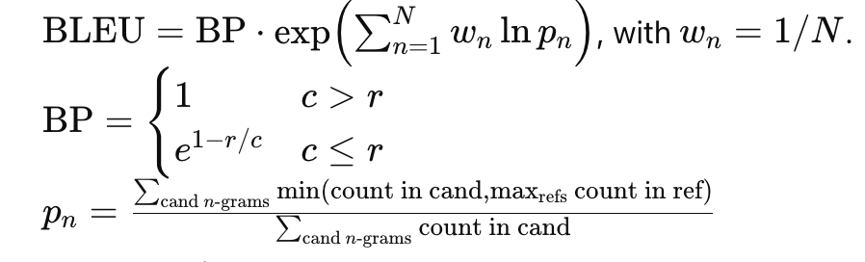
Formula
Brevity penalty
Modified precision
c = length of the candidate translation (number of words)
r = length of the reference translation(s) chosen for brevity penalty (usually the closest reference length to c)
N = highest n-gram order used (often 4 → unigrams, bigrams, trigrams, 4-grams)
w_{n} = weight for each order (often uniform: =1/N)
Let’s go into this in more detail

Slide 8
Detailed example
Ref: “the cat is on the mat” Cand: “the cat sat on the mat”
Token counts (with clipping to reference):
Unigrams (cand 6): overlap = {the×2, cat×1, on×1, mat×1} = 5 → p₁=5/6
Bigrams (cand 5): cand = [the cat, cat sat, sat on, on the, the mat]; ref = [the cat, cat is, is on, on the, the mat] → matches = {the cat, on the, the mat} = 3 → p₂=3/5
Trigrams (cand 4): only on the mat matches → p₃=1/4
4-grams (cand 3): no match → p₄=0
Lengths: c=6, r=6 → BP=1
BLEU-4 (unsmoothed) = 0 (because p₄=0)
BLEU-4 (+1 smoothing) p₁=(5+1)/(6+1)=6/7≈0.857, p₂=(3+1)/(5+1)=4/6≈0.667, p₃=(1+1)/(4+1)=2/5=0.40, p₄=(0+1)/(3+1)=1/4=0.25 GM = exp(¼·(ln.857+ln.667+ln.40+ln.25)) ≈ 0.489; BP=1 → BLEU ≈ 0.49

Slide 9
Now you do one
Reference: “the cat is on the mat” Candidate: “the cat the cat on the mat”

Slide 10
Example of multiple references+brevity penalty
Refs: R1: “there is a cat on the mat” (7) R2: “a cat is on the mat” (6) Cand: “there is cat on mat” (5)
Effective reference length r = closest to c ⇒ r=6 → BP = exp(1 − r/c) = exp(1 − 6/5) ≈ 0.819
Modified precisions (clip counts against max over the two refs):
Unigrams (cand 5): all present across refs → p₁=5/5=1
Bigrams (cand 4): [there is, is cat, cat on, on mat]; matches: there is, cat on → p₂=2/4=0.5
Trigrams (cand 3): none in refs → p₃=0
4-grams (cand 2): none → p₄=0
BLEU-4 (unsmoothed) = 0
BLEU-4 (+1 smoothing) p₁=1.00, p₂=(2+1)/(4+1)=0.6, p₃=(0+1)/(3+1)=0.25, p₄=(0+1)/(2+1)≈0.333 GM ≈ exp(¼·(ln1+ln.6+ln.25+ln.333)) ≈ 0.473 → BLEU ≈ 0.819 × 0.473 ≈ 0.39

Slide 11
Let’s do another one
References:
R1: “a cat is sitting on the mat” (7 words)
R2: “the cat is on the mat” (6 words)
Candidate: “cat on the mat” (4 words)

Slide 12
Some things to note about bleu
Few human translations will attain a perfect BLEU score, since a perfect score would indicate that the candidate is identical to one of the reference translations.
For this reason, it is not necessary to attain a perfect score. Given that there are more opportunities to match with the addition of multiple reference translations, it is good to have one or more reference translations that will be useful for maximizing the BLEU score.
Typically, the BLEU computation considers individual words or unigrams of candidate that occur in target. However, for more accurate evaluations of a match, one could compute bigrams or even trigrams and average the score obtained from various n-grams to compute the overall BLEU score.

Slide 13
Limitations of bleu
Surface-level only – BLEU measures word/phrase overlap, not true meaning or semantic similarity.
Insensitive to synonyms or paraphrases – “the cat is on the mat” vs. “the feline rests on the rug” → BLEU score can be very low despite being a good translation.
Harsh at sentence level – One missing bigram or trigram → score can drop to zero without smoothing.
Length bias – Encourages outputs close in length to references (short translations penalized, but overly long ones may not be penalized enough).
Reference dependence – Quality depends on having multiple reference translations; with only one reference, BLEU can unfairly punish valid alternatives.
Not always human-aligned – Correlation with human judgments is decent for large corpora, but weaker for individual sentences or creative tasks.
Takeaway: BLEU is a useful baseline for large-scale evaluation, but not sufficient on its own — often combined with human evaluation or newer metrics

Slide 14
rouge
As opposed to the BLEU score, the Recall-Oriented Understudy for Gisting Evaluation (ROUGE) evaluation metric measures the recall.
It’s typically used for evaluating the quality of generated text and in machine translation tasks.
However, since it measures recall, it's used in summarization tasks. It’s more important to evaluate the number of words the model can recall in these types of tasks.

Slide 15
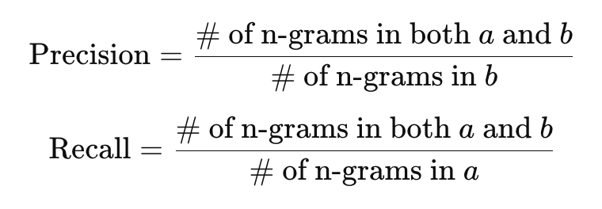
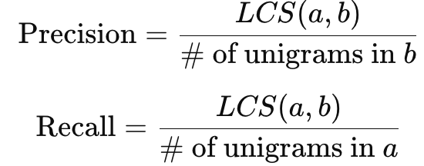
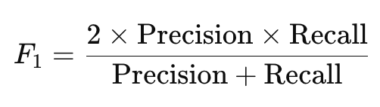
Rouge-n v.s. rouge-l
The most popular evaluation metrics from the ROUGE class are ROUGE-N and ROUGE-L:
Rouge-N: measures the number of matching 'n-grams' between a reference (a) and test (b) strings.
Rouge-L: measures the longest common subsequence (LCS) between a reference (a) and test (b) string.
For both Rouge-N and Rouge-L:

Slide 16
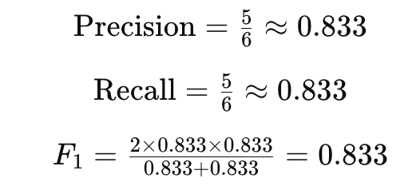
Example (ROUGE-1)
Reference (a): “the cat is on the mat” Candidate (b): “the cat sat on the mat”
Unigrams in a (reference): {the, cat, is, on, the, mat} → 6 tokens
Unigrams in b (candidate): {the, cat, sat, on, the, mat} → 6 tokens
Overlap (clipped): the×2, cat×1, on×1, mat×1 → total 5 overlaps (“sat” doesn’t match; “is” is missing)

Slide 17
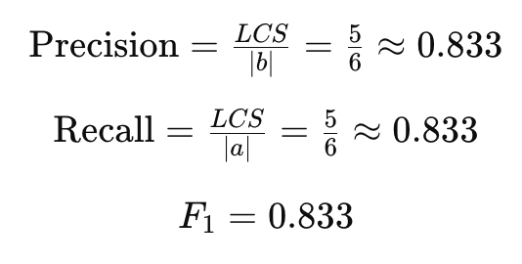
Example (rouge-l)
Reference (a): “the cat is on the mat” (6 unigrams) Candidate (b): “the cat sat on the mat” (6 unigrams)
Longest Common Subsequence (LCS): “the cat on the mat” → length = 5 (we drop “is” from ref and “sat” from cand to align)

Slide 18
What is lcs?
A subsequence is a sequence that can be derived by deleting some elements (possibly none) from a sequence without changing the order of the remaining elements.
The Longest Common Subsequence (LCS) of two strings is the longest subsequence that appears in both.
Example:
Ref: “the cat is on the mat”
Cand: “the cat sat on the mat”
LCS = “the cat on the mat” (length 5).

Slide 19
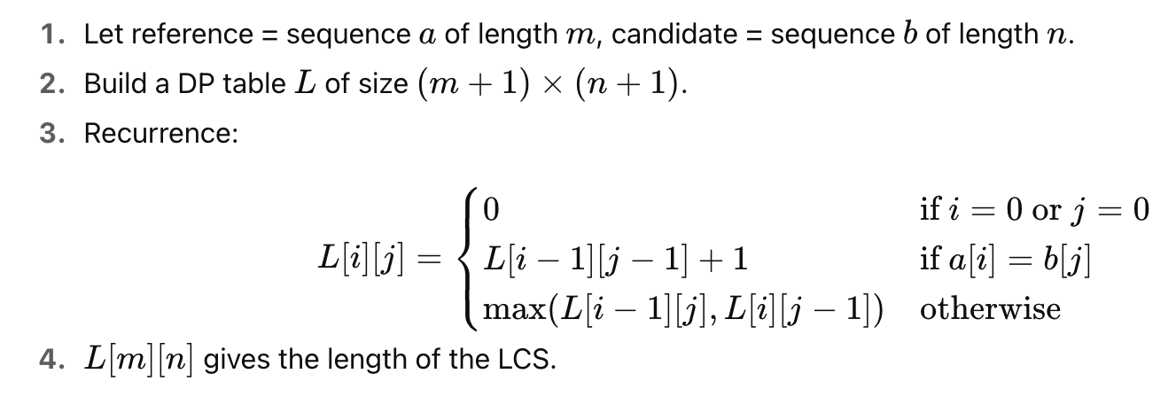
How to compute lcs
It’s a classic dynamic programming problem (you won’t have to solve the below except in very obvious cases)

Slide 20
Worked example
Ref: a b c d e Cand: a c e
DP table evolves like this (showing only matches):
LCS = a c e → length 3.

Slide 21
comparison
ROUGE-N cares about matching words (or n-grams), ignoring order beyond the n.
ROUGE-L cares about the longest matching sequence, rewarding fluency.
Let’s do an example of both
Reference: “the quick brown fox jumps over the lazy dog” Candidate: “the fast brown fox jumps over dog”
What happens if you make ‘quick’ to ‘fast’?

Slide 22
limitations
Overlap ≠ meaning – Like BLEU, ROUGE only measures surface overlap, not semantic similarity. – Synonyms or paraphrases (“doctor” vs. “physician”) are treated as mismatches.
Recall bias – ROUGE emphasizes recall (coverage of reference words), – May favor longer outputs that repeat reference terms without adding real quality.
Insensitive to fluency/grammar – A candidate can have high ROUGE but still be ungrammatical or incoherent.
Single-reference weakness – With only one reference, many valid alternative phrasings get unfairly penalized. – Multiple references help but are costly to produce.
Not context-aware – ROUGE counts n-gram matches but ignores sentence structure, discourse coherence, and factual accuracy.
Weak at fine-grained evaluation – Correlation with human judgments is better at corpus level than at single-sentence level.

Slide 23
other similarity metrics
Text similarity metrics: An example is the Levenshtein Similarity Ratio is a string metric for measuring the similarity between two sequences. Such metrics typically do not account for the meaning of words.
Semantic similarity metrics: Examples include BERTScore, MoverScore , and Sentence Mover Similarity (SMS) metrics that all rely on contextualized embeddings to measure the similarity between two texts. You saw an example of semantic similarity in Q2 of the exam.
While these metrics are relatively simple, fast, and inexpensive to compute compared to LLM-based metrics, studies have shown that they can have poor correlation with human evaluators, lack of interpretability, inherent bias, poor adaptability to a wider variety of tasks and inability to capture subtle nuances in language.

Slide 24
bertscore
A semantic evaluation metric for text generation (summarization, MT, etc.).
Instead of comparing surface n-grams, it uses contextual embeddings from large pre-trained language models (e.g., BERT, RoBERTa).
Measures semantic similarity between candidate and reference at the word/token level.
Published in 2020; has quickly become a popular complement to BLEU/ROUGE.
https://arxiv.org/pdf/1904.09675

Slide 25
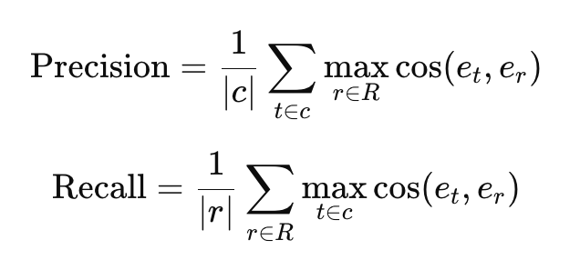
How does it work?
Encode both candidate and reference sentences into embeddings using BERT.
For each token in candidate, find the most similar token in the reference (cosine similarity).
Compute:
Precision: how well candidate tokens find good matches in the reference.
Recall: how well reference tokens are covered by candidate tokens.
F1: harmonic mean of precision and recall.

Slide 26
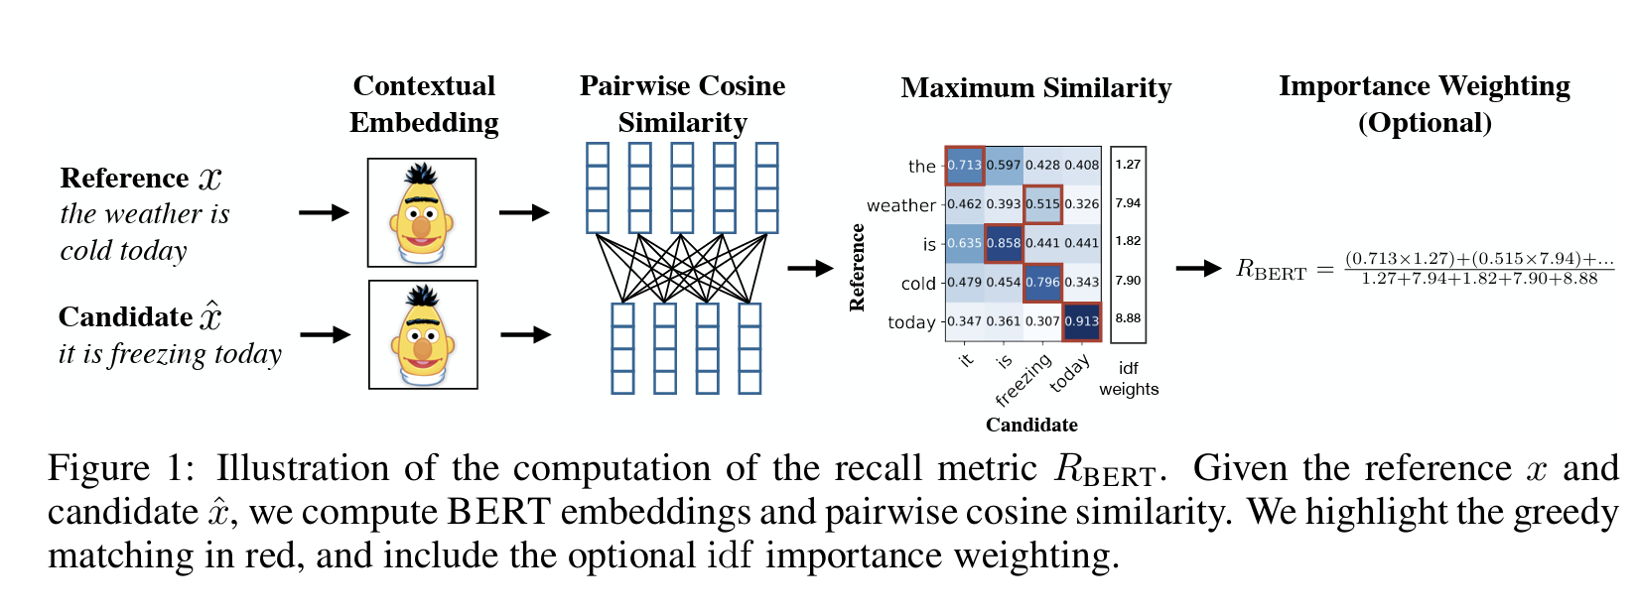
Visual illustration

Slide 27
Why bertscore?
Captures meaning, not just word overlap – “the cat is on the mat” vs. “the feline lies on the rug” → BLEU/ROUGE: low, BERTScore: high.
Language-aware – Uses contextual embeddings, so “bank” (river bank vs. financial bank) is disambiguated.
Better correlation with human judgments than BLEU/ROUGE, especially at sentence level.
Supports multiple languages and tasks.

Slide 28
But…like all metrics, it also has some limitations!
Dependent on the choice of pretrained model (BERT vs. RoBERTa vs. multilingual models).
Computationally more expensive than n-gram counts.
Scores can be high even if output is fluent but factually wrong (semantic similarity ≠ truth).
Not always interpretable (no easy “matched n-grams” to point to).

Slide 29
Reference-FREE metrics

Slide 30
introduction
Reference-free (context-based) metrics produce a score for the generated text and do not rely on ground truth. Evaluation is based on the context or source document.
Many of these metrics were developed in response to the challenge of creating ground truth data. These methods tend to be newer than reference-based techniques, reflecting the growing demand for scalable text evaluation as LLMs became increasingly powerful.
These include quality-based, entailment-based, factuality-based, question-answering (QA) and question-generation (QG) based metrics.

