Slide 1


Humans or robots?
John Kwon, Leo Kim, Nathan Li, Sophia Oh, Vaibhav Doshi

Slide 2

Problem & Business Implication
Problem
Human bidders on the site are becoming increasingly frustrated with their inability to win auctions against their software-controlled counterparts
Business Implication: E-commerce
Will decrease usage from the site’s core customer base
Affects retention of human consumers
Potential server capacity issues (costly, site down)

Slide 3
Dataset Description
Training set – Bidders who have been identified as 0 (human) or 1 (bot)
Test set – Bidders who were not yet identified as 0 or 1
Bids – All bids
Total number observations: 6 million
Initial Data
10 features: Bidder ID, Auction, Merchandise, Device, Time (coded), Country, IP, URL, Payment, Address
3 million observations
Consolidated & Reduced
Notes:
- 2013 observations of 4 variables
- 4700 observations of 3 variables
7,656,334 obs of 9 variables
Reduced to:

Slide 4
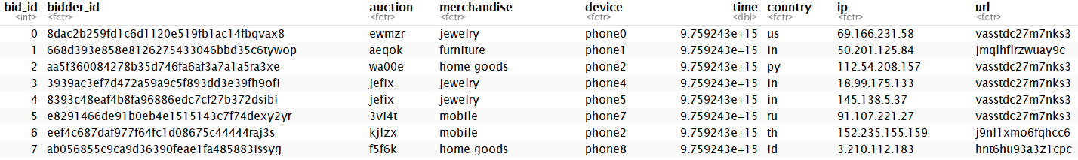
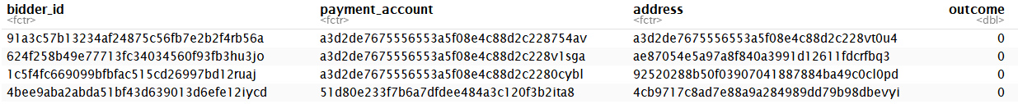
Raw Dataset

Slide 5


Robots vs. Humans
Behavioural
differences
Time
Location
Frequency
Types

Slide 6
Ask
Robots vs. Humans
Do bots participate in the same auctions?
Is auction size relevant?
Are multi device users bots?
Do bots share the same devices?
Are bots participating in multiple auctions?
Are bots frequent participators?
Does number of bids per auction matter?
Proximity to a bot?
Does bot activity occur more at a certain time of day?
Do certain types of merch attract more bots?
Are there high risk countries?

Slide 7
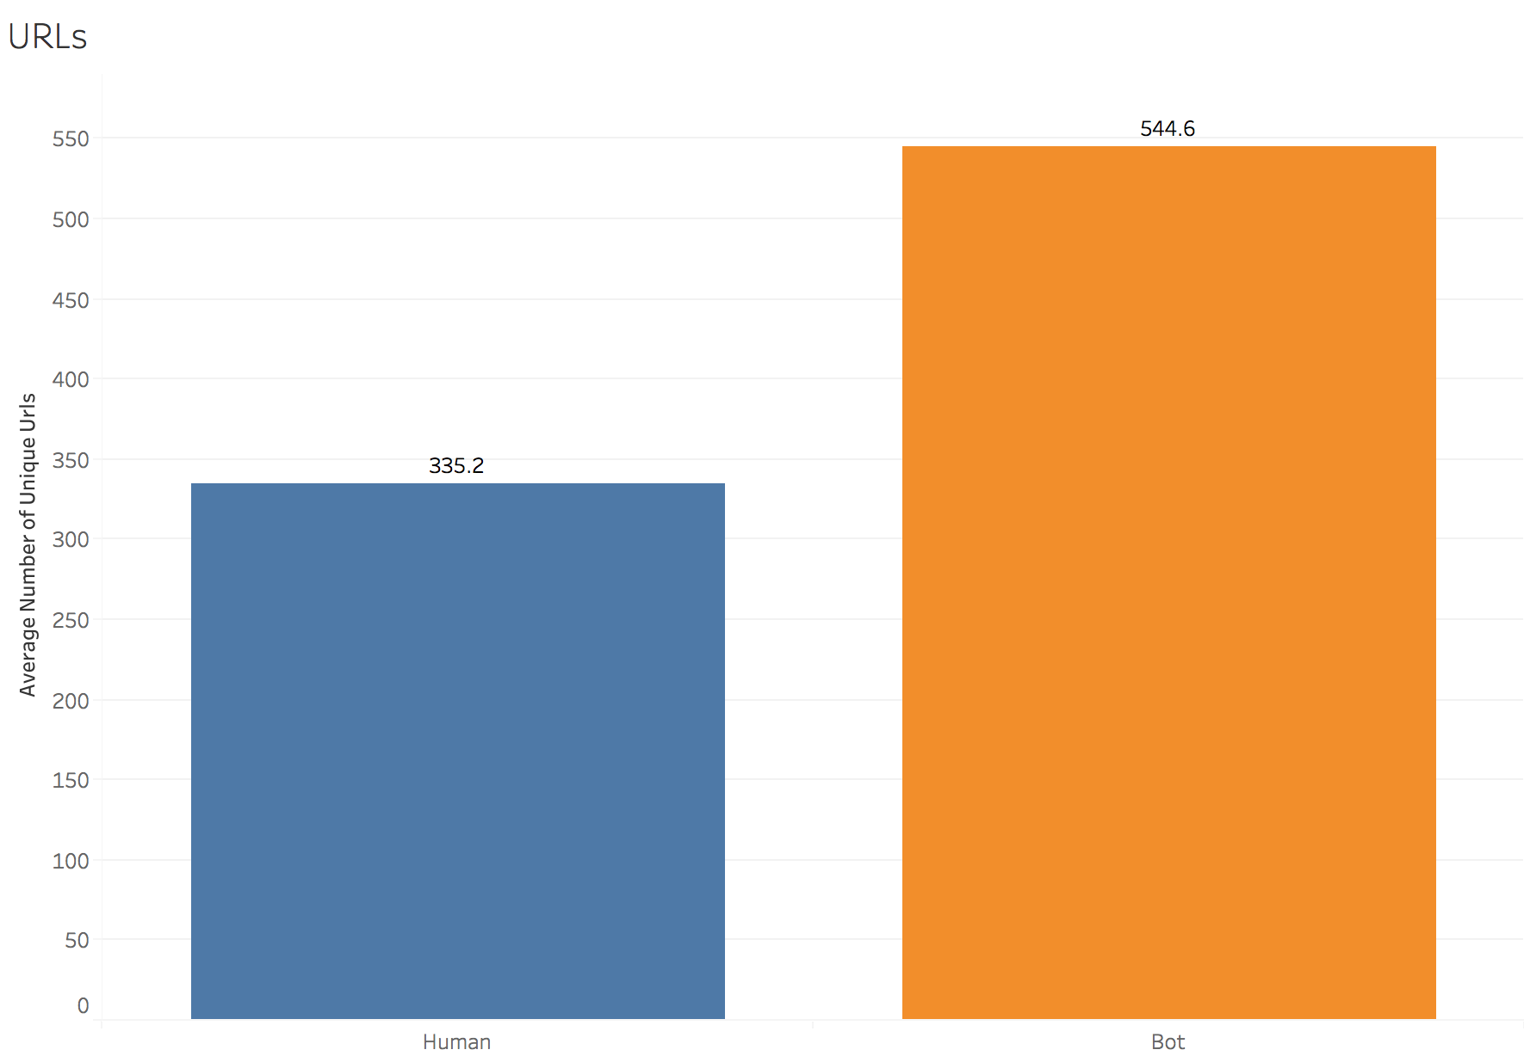
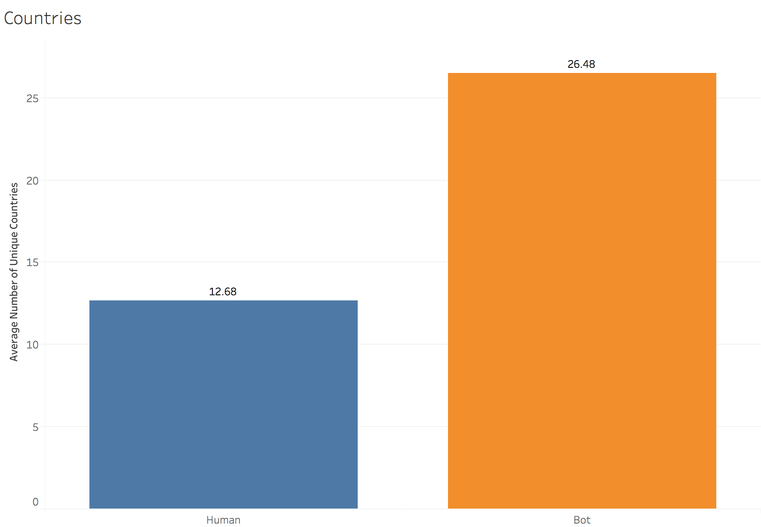
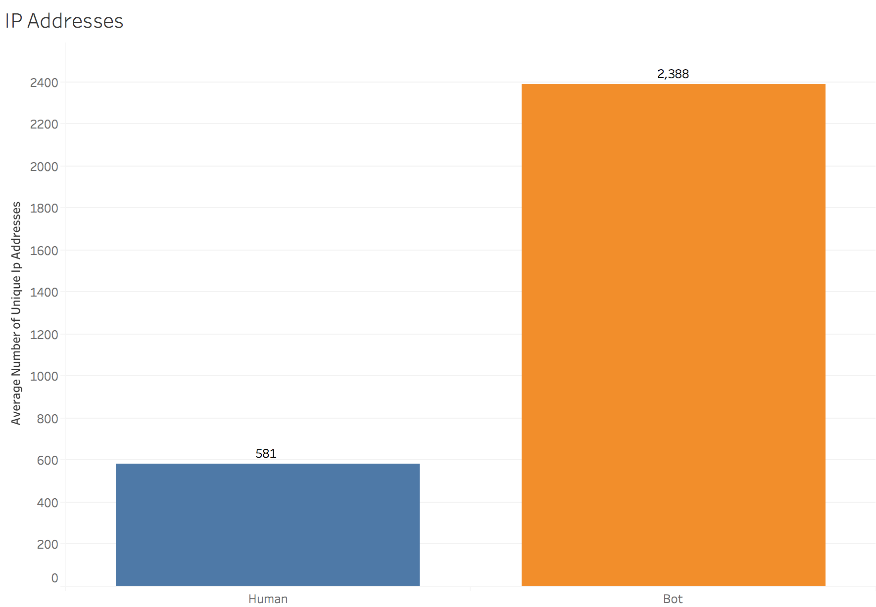
EDA & Variable Creation
Common to investigate the # of unique countries, URLs, and IP addresses when detecting bots
Visualizations showed that there is a clear distinction between humans and bots
Variables created by grouping all of the data points by their bidder ID and calculating the number of unique for each ID
Average # of Unique URLs
Average # of Unique Countries
Average # of IP Addresses

Slide 8
EDA & Variable Creation
Question: Is there a relationship between the bots and the devices they use?
Slightly different approach: assign each device a likelihood score
Out of all of the bids placed through each device, identify the percent came from bots
Similarly, we determined the percent of bidders that were bots for each device
ProportionBids_OutofTotal
ProportionBots_OutofTotal
Therefore, for each new data point, we can assess the likelihood of that data point being a bot based off of the device used
Over 5,729 different devices in total

Slide 9
Merchandise
Notes:
One of the variables we were given was the bid’s category of merchandise
Here’s a density distribution of bids by category
The rationale here was to tease out the higher risk categories

Slide 10
Merchandise
Notes:
Nothing breakthrough here, with the obvious interpretation being that
Higher proportion of bots participate in Mobile and sporting goods versus humans
And the way we codified the participation level was by
Getting a number of times a user bid per category

Slide 11




IP Addresses
Notes:
Ips
Through this network diagram
Supposedly, devices connected to the same router share the same external ip address
there was to find all the ip addresses associated with each user
And cross reference against all the ips we know are bad
Probably use the same VPNS
Take the fraction of overlapping ips over total ips, and you have a measure of how strongly associated a user is with bots
Now there was a problem with predicting on training data.
Bots had a 1.0
You have the outcome embedded into the variable
All model performance metrics will be inflated
Variable Leakage
VPNs? Public network

Slide 12
IP Addresses
?
Notes:
Ips
Through this network diagram
Supposedly, devices connected to the same router share the same external ip address
there was to find all the ip addresses associated with each user
And cross reference against all the ips we know are bad
Probably use the same VPNS
Take the fraction of overlapping ips over total ips, and you have a measure of how strongly associated a user is with bots
Now there was a problem with predicting on training data.
Bots had a 1.0
You have the outcome embedded into the variable
All model performance metrics will be inflated
Variable Leakage
VPNs? Public network

Slide 13
A Digression: Leaking Variables
bad_ip
[0-1]
1
Notes:
Leaking variable is the idea of baking information from the dependent variable into a feature
Can results in extreme over fitting in some cases

Slide 14
A Digression: Leaking Variables
bad_ip
[0-1]
…
893.167
652.419
123.456
134.667
167.122
592.812
696.969
…
123.456
134.667
167.122
1
Notes:
Leaking variable is the idea of baking information from the dependent variable into a feature
Can results in extreme over fitting in some cases

Slide 15
A Digression: Leaking Variables
bad_ip
outcome
[0-1]
0
1
1
Notes:
Leaking variable is the idea of baking information from the dependent variable into a feature
Can results in extreme over fitting in some cases

Slide 16
A Digression: Leaking Variables
bad_ip
[0-1]
1
…
893.167
652.419
123.456
134.667
167.122
592.812
696.969
…
123.456
177.633
167.122
0.67
Notes:
Leaking variable is the idea of baking information from the dependent variable into a feature
Can results in extreme over fitting in some cases

Slide 17
Models & Results
There was a low ratio of bots in the data set (~5%)
Ran tests on whether holding that ratio roughly constant in both training and testing sets would make a difference — it didn’t make a difference
Used a total of 21 variables
Number of bids by merchandise
URL
IP

Slide 18
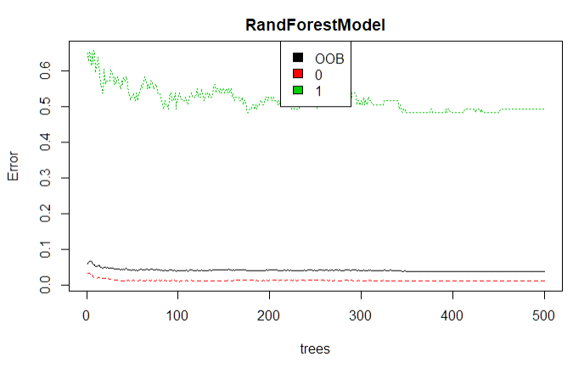
Models: Random Forest
Cut off the model at 100 trees

Slide 19
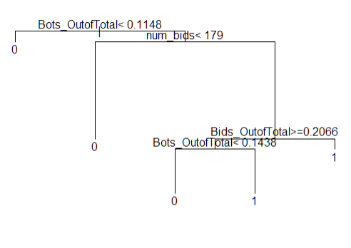
Models: Decision Tree
Pruned at cp = 0.04
Based on elbow

Slide 20
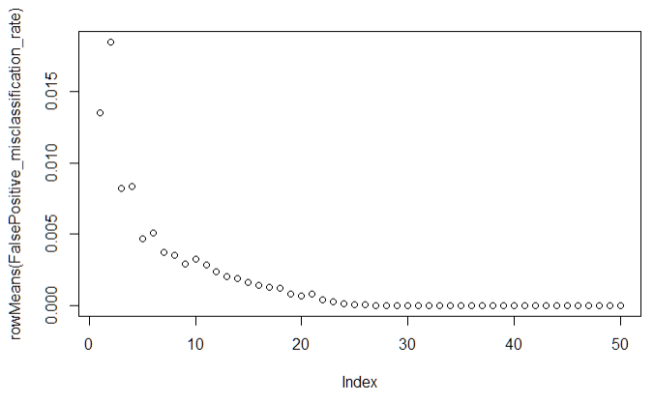
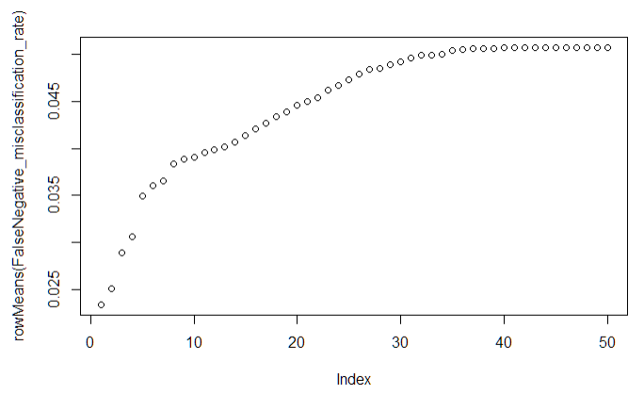
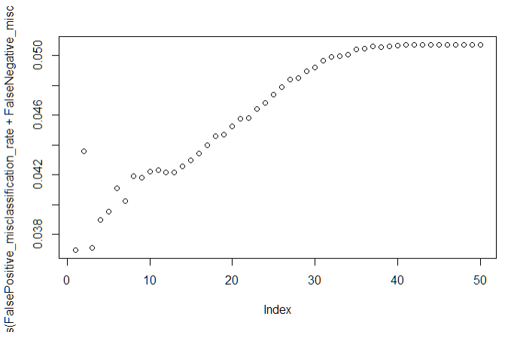
Models: KNN
Chose K = 1
Driven by distribution of humans and bots
K vs False Positive Rate
K vs False Negative Rate
K vs Misclassification Rate

Slide 21
Models: Logistic Regression
Kept only 4 / 19 variables

Slide 22
Model Results

Slide 23
Next Steps
More feature engineering and selection
Time between bids
Insight from payment and address variables – we currently just see them as IDs and don’t know how to interpret them
Refining the models with new features

Slide 24
Thank you

