Slide 1
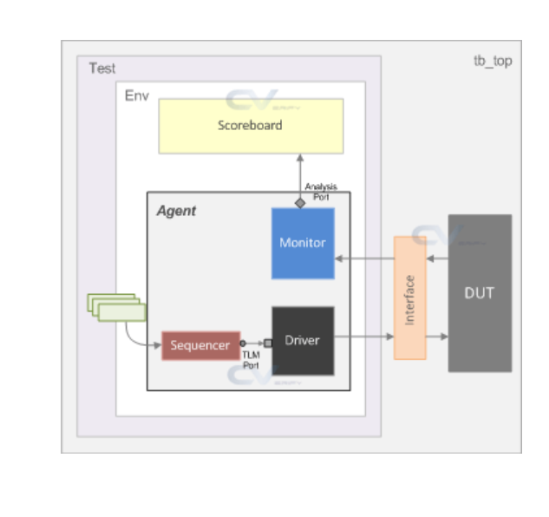
reg_rw_test
my_env
my_agent
my_driver
bus_if
traffic
uvm_sequencer
my_monitor
reg_env
reg2apb_adapter
uvm_reg_predictor
ral_sys_traffic(uvm_reg_block)
ral_block_traffic_cfg(uvm_reg_block)
default_map
ral_cfg_timer
(uvm_reg)
ral_cfg_ctl
(uvm_reg)
ral_cfg_stat
(uvm_reg)

