Slide 1
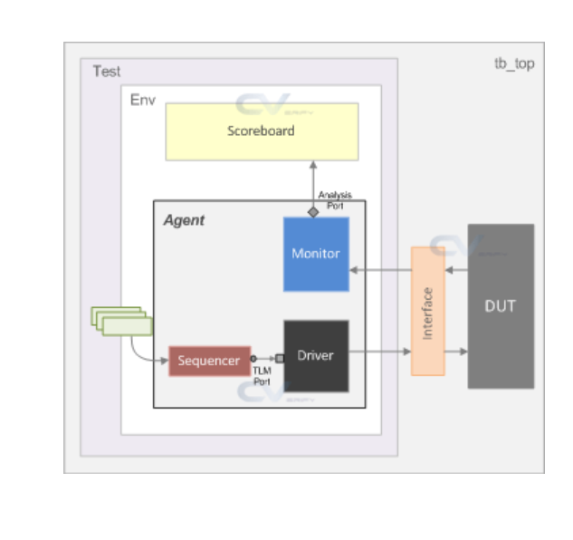
Frontdoor
Predictor
others
reg_rw_test
my_env
my_agent
my_driver
bus_if
④
traffic
uvm_sequencer
my_monitor
③
reg_env
①
②
reg2apb_adapter
uvm_reg_predictor
③
①, ⑤
ral_sys_traffic(uvm_reg_block)
②, ⑥
④
ral_block_traffic_cfg(uvm_reg_block)
default_map
(uvm_reg_ map)
ral_cfg_timer
(uvm_reg)
ral_cfg_ctl
(uvm_reg)
ral_cfg_stat
(uvm_reg)
add_reg()
add_reg()
add_reg()
add_submap()
default_map(uvm_reg_map)

