Slide 1
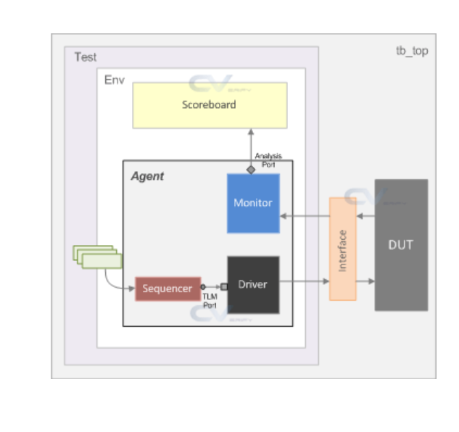
predictor_collision_test
my_env
apb_agent
my_driver
bus_if
traffic
uvm_sequencer
my_monitor
apb_agent
my_driver
uvm_sequencer
my_monitor
reg_env
uvm_reg_predictor
ral_sys_traffic(uvm_reg_block)
default_map

