Slide 1
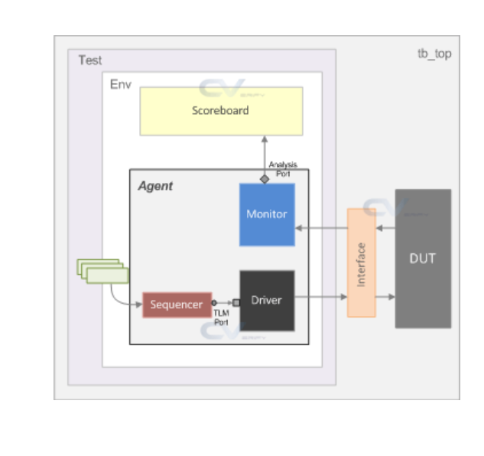
Frontdoor
Predictor
others
reg_rw_test
my_env
my_agent
my_driver
bus_if
traffic
uvm_sequencer
my_monitor
①
reg_env
reg2apb_adapter
②
uvm_reg_predictor
②
③
ral_sys_traffic(uvm_reg_block)
①
ral_block_traffic_cfg(uvm_reg_block)
default_map
ral_cfg_timer
(uvm_reg)
ral_cfg_ctl
(uvm_reg)
ral_cfg_stat
(uvm_reg)
add_reg()
add_reg()
add_reg()
add_submap()
default_map

