Slide 1
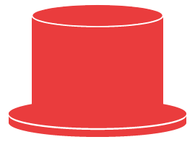
NEURO CLOUD
개발새발

Slide 2

INDEX
1. MOTIVATION
AI & FEAR
KNOWLEDGE & STORAGE
2. DEFINITION
3. SERVICES
CLIENT SERVICE
BUSINESS SERVICE

Slide 3
1. MOTIVATION
NEURO CLOUD

Slide 4


1. MOTIVATION
2030

Slide 5

1. MOTIVATION

Slide 6


1. MOTIVATION

Slide 7

2. DEFINITION
NEURO CLOUD

Slide 8
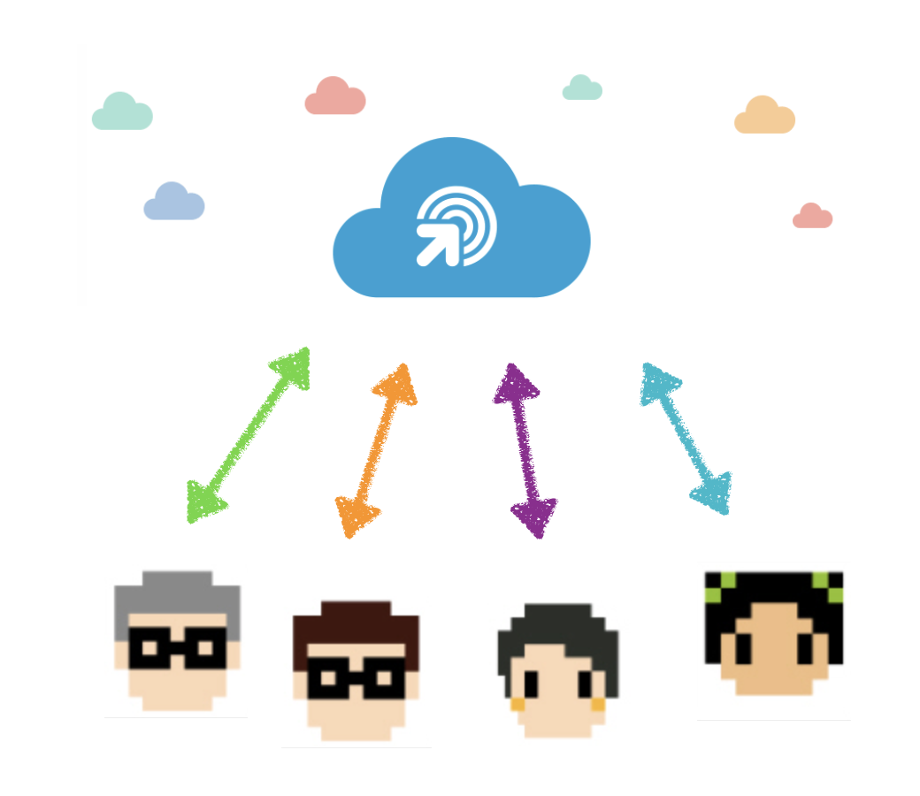
2. DEFINITION

Slide 9
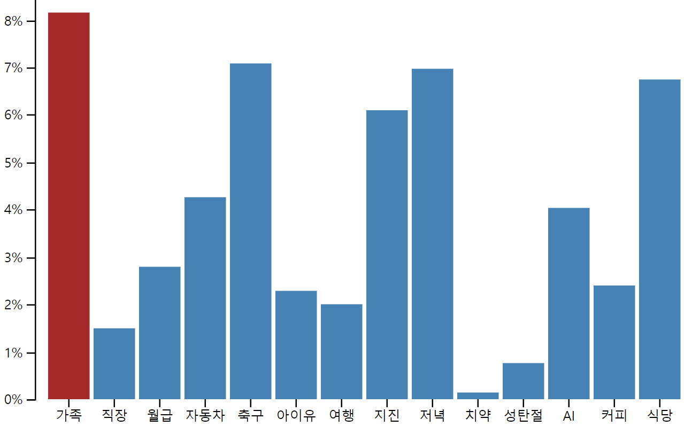

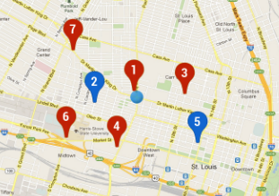
2. DEFINITION

Slide 10

3. SERVICES
NEURO CLOUD

Slide 11
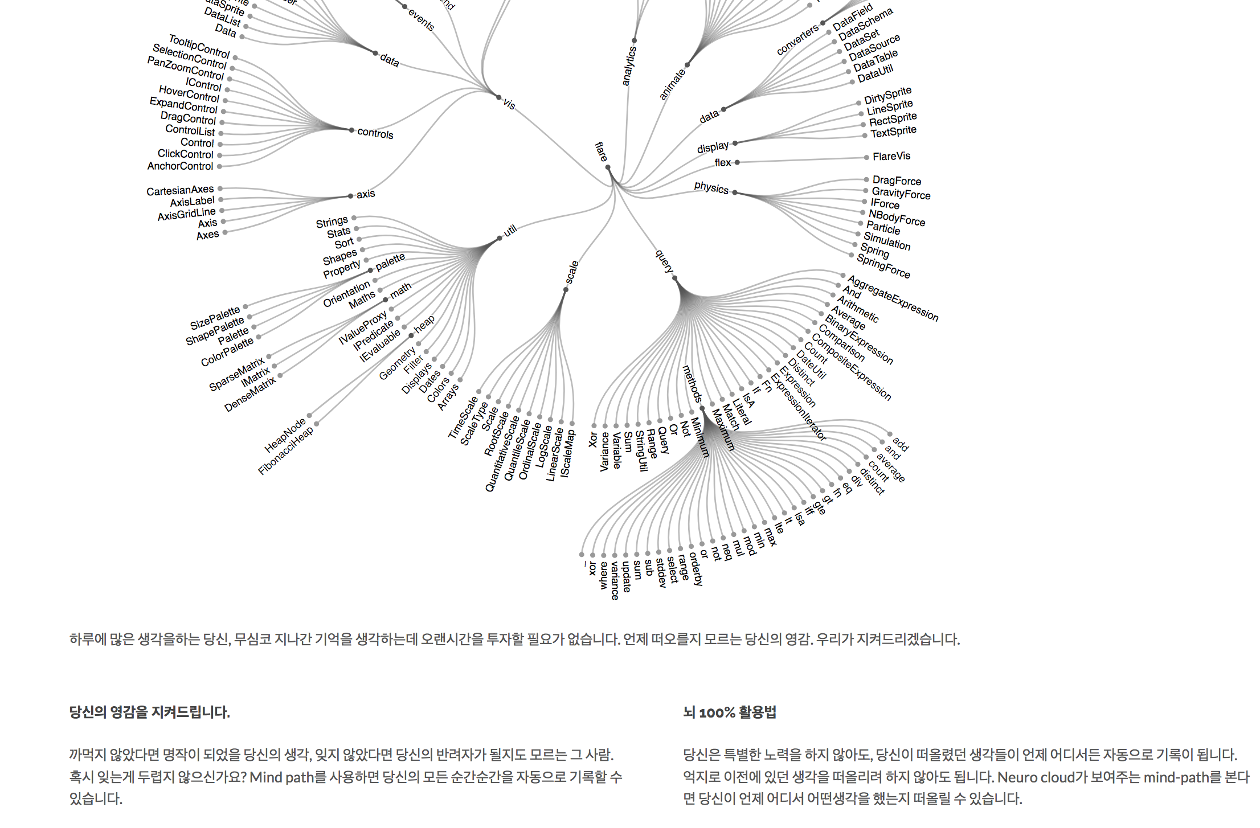
3. SERVICES

Slide 12
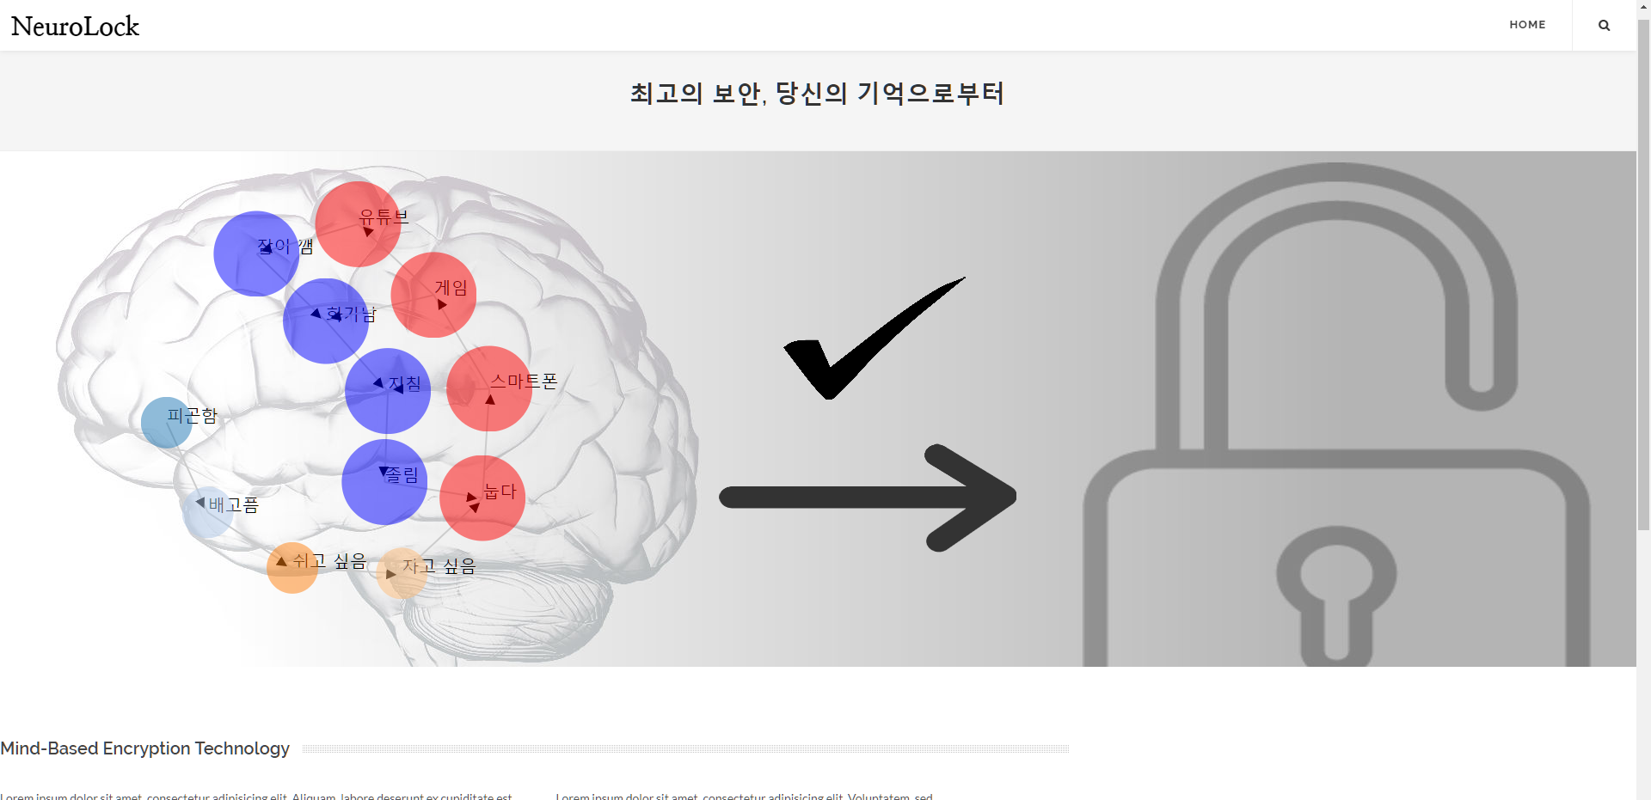
3. SERVICES

Slide 13
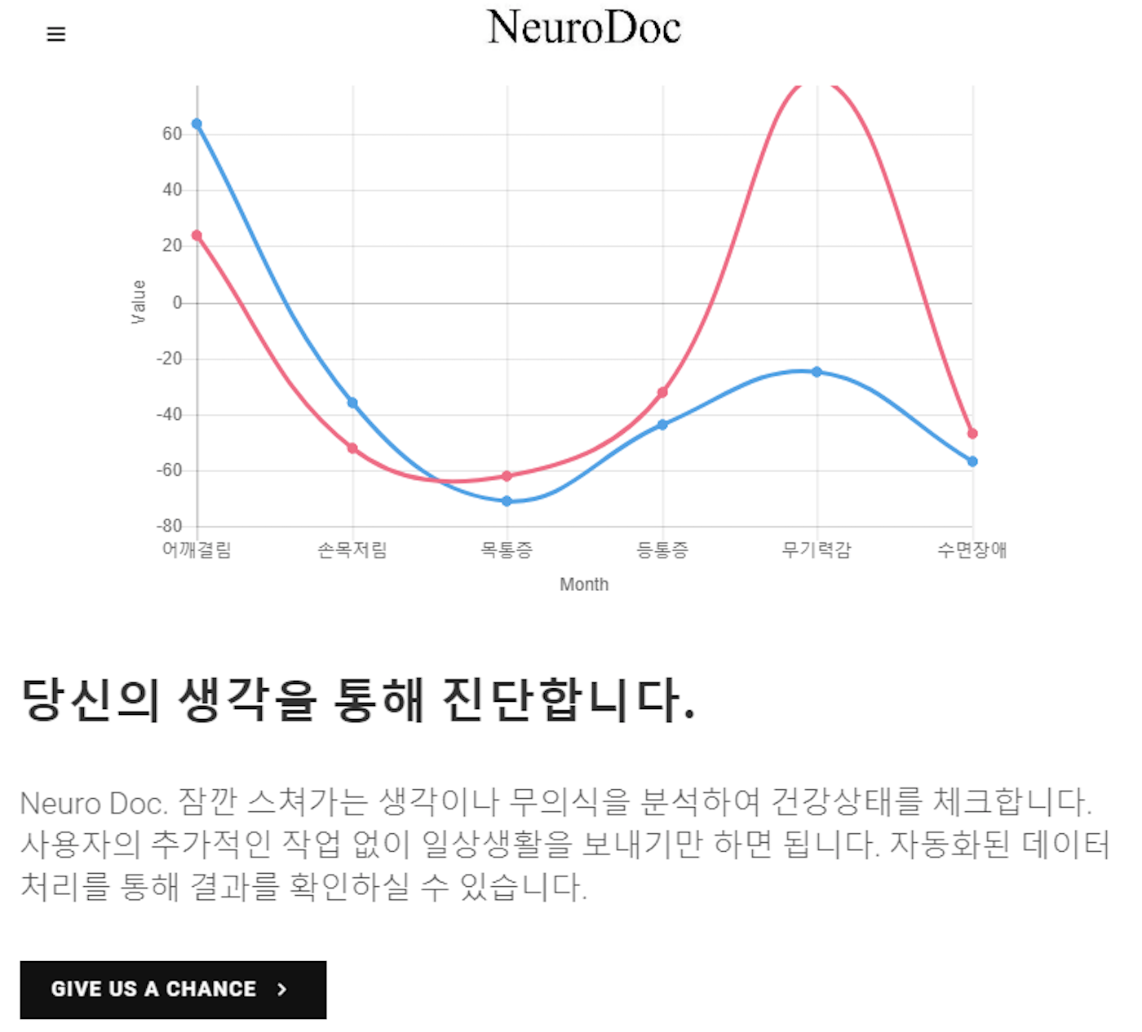
3. SERVICES

Slide 14

3. SERVICES

Slide 15
Q&A

Slide 16
THANK YOU

