Slide 1
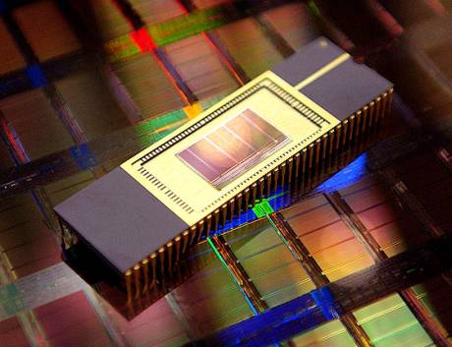

NVRAMOS 2024
Workshop on Operating System Support for
Next Generation Large Scale NVRAM
Oct 24-26, 2024, Jeju, Korea
NVRAMOS 2024
Workshop on Operating System Support for
Next Generation Large Scale NVRAM
Oct 24-26, 2024, Jeju, Korea
KIISE SIGFAST &
KIISE SIGFAST &
Name1
Name2
Affiliation1
Affiliation2
NVRAMOS 2024
Workshop on Operating System Support for
Next Generation Large Scale NVRAM
Oct 24-26, 2024, Jeju, Korea
NVRAMOS 2024
Workshop on Operating System Support for
Next Generation Large Scale NVRAM
Oct 24-26, 2024, Jeju, Korea
KIISE SIGFAST &
KIISE SIGFAST &
Name3
Name4
Affiliation3
Affiliation4

