Slide 1
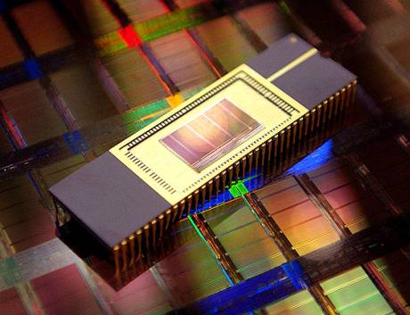

NVRAMOS 2023
Workshop on Operating System Support for
Next Generation Large Scale NVRAM
Oct 19-21, 2023, Jeju, Korea
NVRAMOS 2023
Workshop on Operating System Support for
Next Generation Large Scale NVRAM
Oct 19-21, 2023, Jeju, Korea
KIISE SIGFAST &
KIISE SIGFAST &
Name1
Name2
Affliation1
Affliation2
NVRAMOS 2023
Workshop on Operating System Support for
Next Generation Large Scale NVRAM
Oct 19-21, 2023, Jeju, Korea
NVRAMOS 2023
Workshop on Operating System Support for
Next Generation Large Scale NVRAM
Oct 19-21, 2023, Jeju, Korea
KIISE SIGFAST &
KIISE SIGFAST &
Name3
Name4
Affliatoin3
Affliatoin4

Slide 2
NVRAMOS 2023
Workshop on Operating System Support for
Next Generation Large Scale NVRAM
Oct 19-21, 2023, Jeju, Korea
NVRAMOS 2023
Workshop on Operating System Support for
Next Generation Large Scale NVRAM
Oct 19-21, 2023, Jeju, Korea
KIISE SIGFAST &
KIISE SIGFAST &
Name1
Name2
Affliation1
Affliation2
NVRAMOS 2023
Workshop on Operating System Support for
Next Generation Large Scale NVRAM
Oct 19-21, 2023, Jeju, Korea
NVRAMOS 2023
Workshop on Operating System Support for
Next Generation Large Scale NVRAM
Oct 19-21, 2023, Jeju, Korea
KIISE SIGFAST &
KIISE SIGFAST &
Name3
Name4
Affliatoin3
Affliatoin4

