Slide 1



RIGHT: an HTML canvas and JavaScript-based interactive data visualization package for linked graphics
ChungHa Sung†, JongHyun Bae†, SangGi Hong†, TaeJoon Song†, Jae W. Lee†, Junghoon Lee ‡
†Sungkyunkwan University ‡Merck Research Laboratories
{sch8906, bnbbkr, bethetaedu, thepotter89, jaewlee, flammy}@gmail.com
Abstract
Motivation
R Interactive Graphics via HTml (RIGHT) is the first package that implements linked graphs using HTML canvas and JavaScript and supports efficient linked graphics that can show obvious relationship between multiple plots using same data.
Also, HTML canvas and JavaScript make it possible to deliver the visualization to various platforms, including mobile devices since they are standard web technologies.
Why linked graphs?
Link between two graphs can provide users with deep insight when analyzing the data large set. Clicking or dragging nodes from one graph just shows the related nodes of another graph.
How does work?
<R command>
<JavaScript>
Obj <- RIGHT({
plot(conc ~Time, Theoph, color = color)
runServer.RIGHT(loessArray, {
obj <- loess(conc ~ Time, data = Theoph)
xRange <- range(Theoph$conc)
simArray <- data.frame(conc = seq(xRange[1],
xRange[2], length.out = 100))
simArray$Time <- predict(obj, newdata = simArray)
return(simArray)
})
lines(loessArray, Time, conc)
hist(Time, Theoph)
}, Theoph)
<script> var Theoph = createMainStructureE(rawArr1);</script>
<script>
var axis1 = new Axis(1, Theoph, 'Time', 'conc', {legend: 'Subject'});
var point1 = new Dot(axis1, Theoph, 'Time', 'conc', {});
var histObj1 = new ddply(Theoph, ['Time'], {});
var axis2 = new Axis(2, histObj1, 'Time', 'frequency', {});
var hist1 = new Bar(axis2, histObj1, 'Time', 'frequency', {});
Theoph.draw();
var AllAxisObjArr = [axis1, axis2];
eventTrigger(AllAxisObjArr);
</script>
<script>
// offload part.
var loessArray = createMainStructureE('Theoph');
var loffObj1 = new MakeLineObj(loessArray, 'Time', 'conc', {});
var loff1 = new Line(axis1, loffObj1, 'x1', 'x2', 'y1', 'y2', {});
$(function() {
setTimeout(function() {
window.Shiny.onInputChange('Theoph', Theoph.$isHidden);
}, 1)
});
</script>
Code generation
<Update Sequence>
Theoph
dot
Axis1
histObj1
R
loffObj1
line
Axis2
bar
: Data Object
: Graph Object
Dot update
: Axis Object
p nodes
 | 0 | 1 | 2 | … | n-1
0 | 1 | 0 | 0 | … | 0
1 | 0 | 1 | 1 | … | 0
2 | 0 | 0 | 0 | … | 0
3 | 1 | 1 | 0 | … | 0
4 | 0 | 0 | 0 | … | 0
︙ | ︙ | ︙ | ︙ | ︙ | ︙
P-1 | 0 | 0 | 0 | … | 0
Histogram Update
n nodes
1 | 0 | 0 | 0 | 0 | 〮〮 | 1
1 | 0 | 1 | 〮〮 | 1
isSelected for dot graph
<Relationship Array>
isSelected for histogram graph
 | 0 | 1 | 2 | … | n-1
0 | 1 | 0 | 0 | … | 0
1 | 0 | 1 | 1 | … | 0
2 | 0 | 0 | 0 | … | 0
3 | 1 | 1 | 0 | … | 0
4 | 0 | 0 | 0 | … | 0
5 | 0 | 0 | 1 | … | 1
︙ | ︙ | ︙ | ︙ |  | ︙
p-1 | 0 | 0 | 0 | … | 0
<Event Processing Data Structures>
- isSelected (length of nodes): array for checking selected nodes of graph
- isHidden (length of nodes): array for checking hidden nodes of graph
- Relationship Array (p by n nodes)
<Relationship Array>
Future Work
This project is still under active development:
- To provide server-offload using Shiny for users to help them draw graphs on low-computing devices, such as mobile.
- To develop an intuitive API to make it easy to draw graphs
(e.g., ggplot2-based API)
This work was supported in part by the Korean Ministry of Science, ICT & Future Planning (KEIT-10047038) and by Google Summer of Code (GSoC) 2013 and 2014.

Slide 2
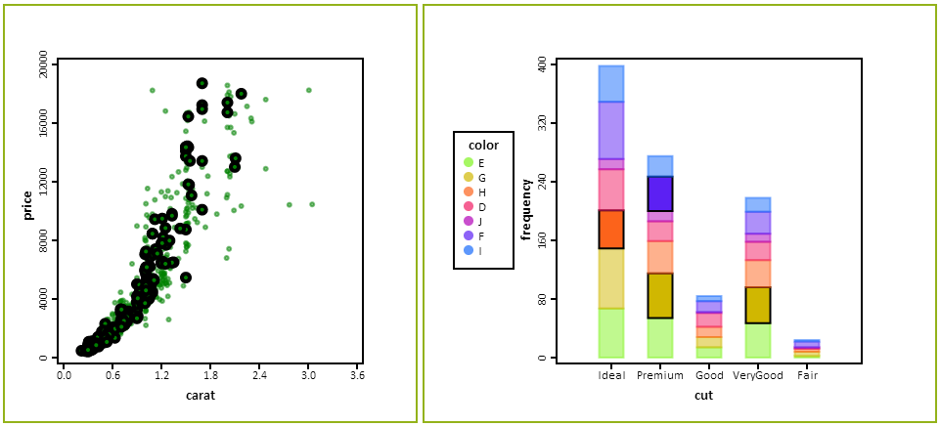
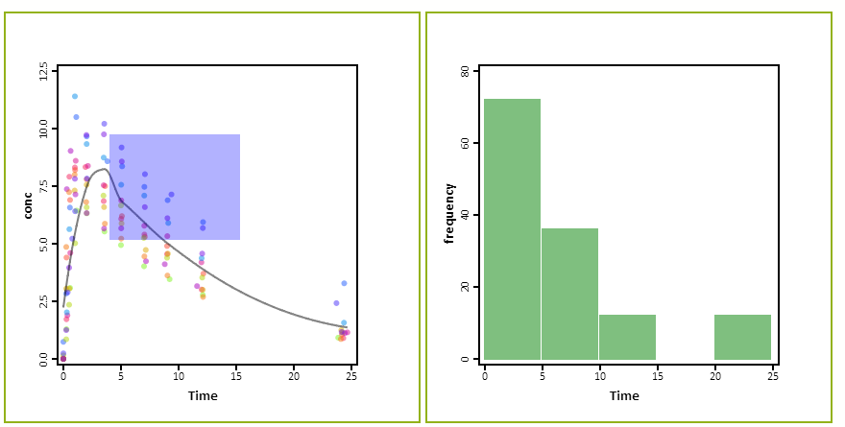
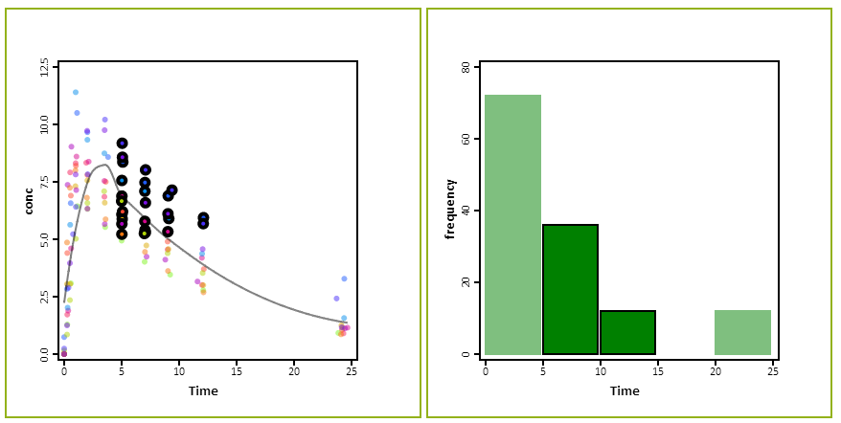
RIGHT: an HTML canvas and JavaScript-based interactive data visualization package for linked graphics
ChungHa Sung†, JongHyun Bae†, SangGi Hong†, TaeJoon Song†, Jae W. Lee†, Junghoon Lee ‡
†Sungkyunkwan University ‡Merck Research Laboratories
{sch8906, bnbbkr, bethetaedu, thepotter89, jaewlee, flammy}@gmail.com
Abstract
Motivation
R Interactive Graphics via HTml (RIGHT) is the first package that implements linked graphs using HTML canvas and JavaScript and supports efficient linked graphics that can show obvious relationship between multiple plots using same data.
Also, HTML canvas and JavaScript make it possible to deliver the visualization to various platforms, including mobile devices since they are standard web technologies .
Why linked graphs?
Link between two graphs can provide users with deep insight when analyz- ing the large set of data. Clicking or dragging nodes from one graph just shows the related nodes of another graph.
How does work?
<R command>
<JavaScript>
Obj <- RIGHT({
plot(conc ~Time, Theoph, color = color)
runServer.RIGHT(loessArray, {
obj <- loess(conc ~ Time, data = Theoph)
xRange <- range(Theoph$conc)
simArray <- data.frame(conc = seq(xRange[1], xRange[2], length.out = 100))
simArray$Time <- predict(obj, newdata = simArray)
return(simArray)
})
lines(loessArray, Time, conc)
hist(Time, Theoph)
}, Theoph)
<script> var Theoph = createMainStructureE(rawArr1);</script>
<script>
var axis1 = new Axis(1, Theoph, 'Time', 'conc', {legend: 'Subject'});
var point1 = new Dot(axis1, Theoph, 'Time', 'conc', {});
var histObj1 = new ddply(Theoph, ['Time'], {});
var axis2 = new Axis(2, histObj1, 'Time', 'frequency', {});
var hist1 = new Bar(axis2, histObj1, 'Time', 'frequency', {});
Theoph.draw();
var AllAxisObjArr = [axis1, axis2];
eventTrigger(AllAxisObjArr);
</script>
<script>
// offload part.
var loessArray = createMainStructureE('Theoph');
var loffObj1 = new MakeLineObj(loessArray, 'Time', 'conc', {});
var loff1 = new Line(axis1, loffObj1, 'x1', 'x2', 'y1', 'y2', {});
$(function() {
setTimeout(function() {
window.Shiny.onInputChange('Theoph', Theoph.$isHidden);
}, 1)
});
</script>
Code generation
<Update Sequence>
Theoph
dot
Axis1
histObj1
R
loffObj1
line
Axis2
bar
: Data Object
: Graph Object
: Axis Object
Dot update
 | 0 | 1 | 2 | … | n-1
0 | 1 | 0 | 0 | … | 0
1 | 0 | 1 | 1 | … | 0
2 | 0 | 0 | 0 | … | 0
3 | 1 | 1 | 0 | … | 0
4 | 0 | 0 | 0 | … | 0
︙ | ︙ | ︙ | ︙ | ︙ | ︙
p-1 | 0 | 0 | 0 | … | 0
Histogram Update
p nodes
n nodes
1 | 0 | 0 | 0 | 0 | 〮〮 | 1
1 | 0 | 1 | 〮〮〮 | 1
isSelected for dot graph
<Relationship Array>
isSelected for histogram graph
 | 0 | 1 | 2 | … | n-1
0 | 1 | 0 | 0 | … | 0
1 | 0 | 1 | 1 | … | 0
2 | 0 | 0 | 0 | … | 0
3 | 1 | 1 | 0 | … | 0
4 | 0 | 0 | 0 | … | 0
5 | 0 | 0 | 1 | … | 1
︙ | ︙ | ︙ | ︙ |  | ︙
p-1 | 0 | 0 | 0 | … | 0
<Event Structure>
- isSelected (length of nodes): array for checking selected nodes of graph
- isHidden (length of nodes): array for checking hidden nodes of graph
- Relationship Array (p nodes by n nodes)
<Relationship Array>
Future Work
This project is still under development
- To provide server-offload using Shiny for users to help them to draw graphs on low-computing devices, such as mobile.
- To improve API to be intuitive for making drawing graphs easy such as ggplot2.
This work was supported in part by the Korean Ministry of Science, ICT & Future Planning (KEIT-10047038) and by Google Summer of Code (GSoC) 2013 and 2014.

Slide 3
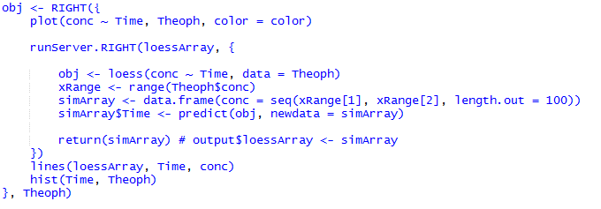
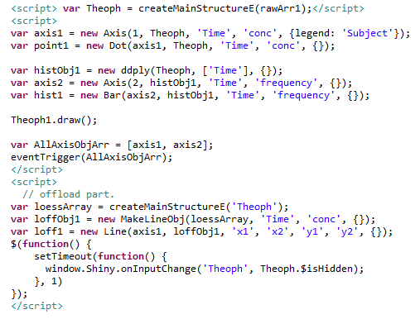
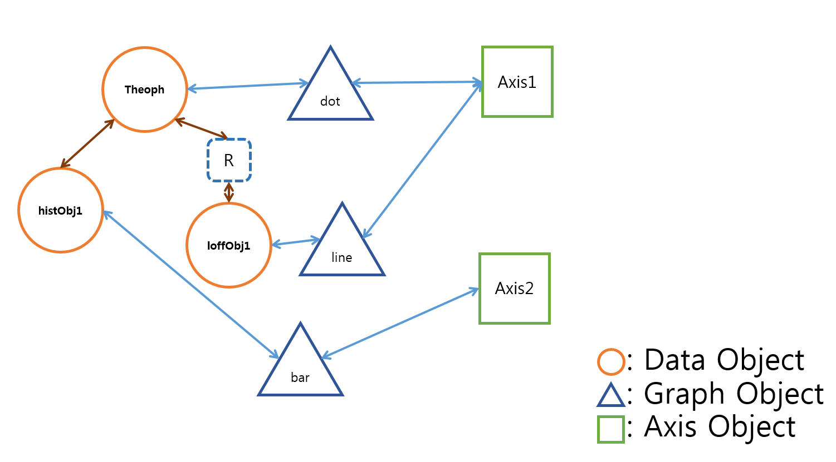
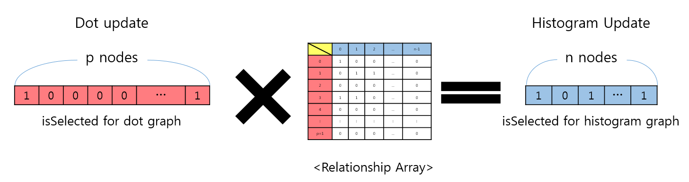
RIGHT: an HTML canvas and JavaScript-based interactive data visualization package for linked graphics ChungHa Sung†, TaeJoon Song†, Jae W. Lee†, Junghoon Lee ‡
†Sungkyunkwan University ‡Merck Research Laboratories
{sch8906, thepotter89, jaewlee}@gmail.com jung_hoon_lee@merck.com
Motivation
Why linked graphs?
Link between two graphs can provide users with deep insight when analyz- ing the large set of data. By just clicking or dragging nodes from one graph would show the related nodes of another graph. Because it is common that there are more than 2 fields on one data in many research areas, drawing many graphs of same data can be a critical role for users by helping them to predict and analyze the tendency of data better. Therefore, the bigger the size of data, the more time it takes for users to find connected node and relationship between graphs so that it can be a bottleneck of making a decision.
Abstract
R Interactive Graphics via HTml (RIGHT) is the first package that implements linked graphs using HTML canvas and JavaScript and supports efficient linked graphics that can show obvious relationship between multiple plots using same data.
Also, HTML canvas and JavaScript make it possible to deliver the visualization to various platforms, including mobile devices, since they are standard web technologies supported by most modern web browsers.
The development of this project has been funded by Google Summer of Code - R project (GSOC-r) from 2013.
How does work?
<R command>
<JavaScript>
<Update Sequence>

Slide 4
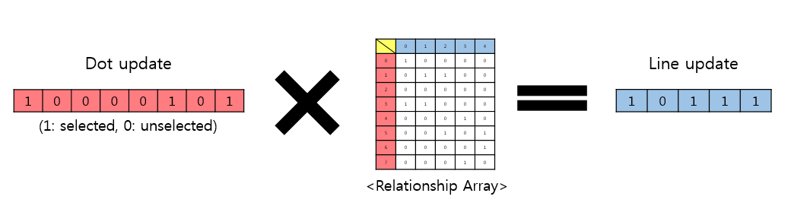
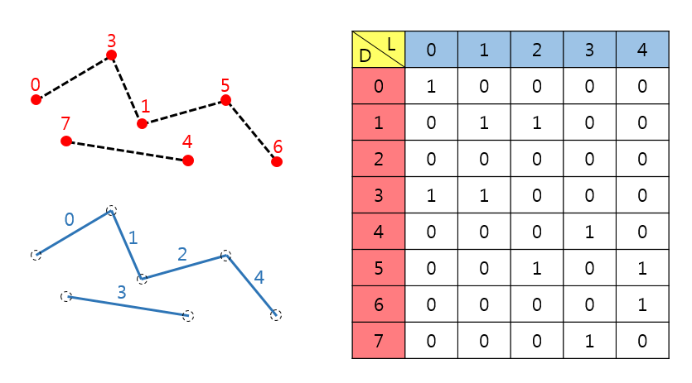
RIGHT: an HTML canvas and JavaScript-based interactive data visualization package for linked graphics ChungHa Sung†, TaeJoon Song†, Jae W. Lee†, Junghoon Lee ‡
†Sungkyunkwan University ‡Merck Research Laboratories
{sch8906, thepotter89, jaewlee}@gmail.com jung_hoon_lee@merck.com
Abstract
Motivation
This poster presents an overview of R Interactive Graphics via HTml (RIGHT) and the JavaScript data structure that perfectly enables efficient linked graphics with interactivity.
RIGHT is the first package that implements linked graphs using HTML canvas and JavaScript and supports efficient linked graphics that can show obvious relationship between multiple plots using same data.
Also, HTML canvas and JavaScript make it possible to deliver the visualization to various platforms, including mobile devices, since they are standard web technologies supported by most modern web browsers.
The development of this project has been funded by Google Summer of Code - R project (GSOC-r) from 2013.
Why linked graphs?
Link between two graphs can provide users with deep insight when analyz- ing the large set of data. By just clicking or dragging nodes from one graph would show the related nodes of another graph. Because it is common that there are more than 2 fields on one data in many research areas, drawing many graphs of same data can be a critical role for users by helping them to predict and analyze the tendency of data better. Therefore, the bigger the size of data, the more time it takes for users to find connected node and relationship between graphs so that it can be a bottleneck of making a decision.
Event Structure
<Update Sequence>
<Relationship Array>
Relationship Array can be used for update sequence. When some nodes of one graph is updated, the correlated node of another graph can be found by multiplying with Relationship Array. In this manner, we can simply propagate updated node numbers using array multiplication.
Relationship Array represents node relationship between two different graphs by assigning 1 or 0 to the value of array. As shown above, if two nodes from different graphs are connected (e.g. node 3 of dot <-> node 0, 1 of line), the appropriate value of the array is set by 1 (e.g. row number 3, and column number 0, 1).
<Event propagation>
How to run?
Supported Plots
After installing RIGHT package
RIGHT can support 5 basic plots: dot, line, histogram, box-whisker, pie.

Slide 5
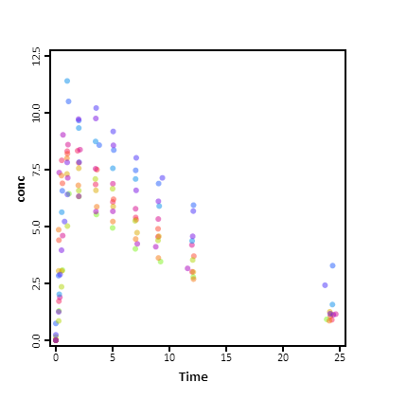
RIGHT: an HTML canvas and JavaScript-based interactive data visualization package for linked graphics ChungHa Sung†, TaeJoon Song†, Jae W. Lee†, Junghoon Lee ‡
†Sungkyunkwan University ‡Merck Research Laboratories
{sch8906, thepotter89, jaewlee}@gmail.com jung_hoon_lee@merck.com
Objective
Event Structure
Interactive data visualization has received broad interest in the R community due to its obvious benefits over static visualization: more information can be delivered concisely and intuitively by user engagement. As a result, various R packages supporting single-layer, multi-layer, and linked graphics have been developed, including rCharts, iPlots, cranvas, ggvis, animint and googleVis. However, supporting efficient linked graphics that can help answer obvious relationship between multiple plots using same data is still left on the table since it is hard to provide linked graphs fully without specific event structure and event-driven platform. This poster presents an overview of R Interactive Graphics via HTml (RIGHT) and the JavaScript data structure that perfectly enables efficient linked graphics. RIGHT is the first package that implements linked graphs using HTML canvas and JavaScript. Also, HTML canvas and JavaScript make it possible to deliver the visualization to various platforms, including mobile devices, since they are standard web technologies supported by most modern web browsers. This approach can also benefit from the improvement of JavaScript performance every generation, driven by various web applications with ever increasing complexity and sophistication.
<Relationship Array>
Relationship Array represents node relationship between two different graphs by assigning 1 or 0 to the value of array. As shown above, if two nodes from different graphs are connected (e.g. node 3 of dot <-> node 0, 1 of line), the appropriate value of the array is set by 1 (e.g. row number 3, and column number 0, 1). Therefore, we can figure out how one point in the plot is related to another point in another plot by checking this array.
<Update Sequence>
Relationship Array also can be used for update sequence. When some nodes of one graph is updated, the correlated node of another graph can be found by multiplying with Relationship Array. In this manner, we can simply propagate updated node numbers using array multiplication.
Motivation
Why linked graphs?
Link between two graphs can provide users with deep insight when analyz- ing the large set of data. By just clicking or dragging nodes from one graph would show the related nodes of another graph. Because it is common that there are more than 2 fields on one data in many research areas, drawing many graphs of same data can be a critical role for users by helping them to predict and analyze the tendency of data better. Therefore, the bigger the size of data, the more time it takes for users to find connected node and relationship between graphs so that it can be a bottleneck of making a decision.
Future Work
Server offload with shiny.
Using JavaScript-based platform can be extended to provide server-offload to users by taking advantage of Shiny package.
Supported plots
Dot graph
Line graph
Bar graph
Pie graph
Box-whisker graph

