Slide 1
Beginning of first row
Beginning of second row
Beginning of third row
1 | 2 | 3 | 4 | 5 | 6 | 7 | 8 | 9

Slide 2
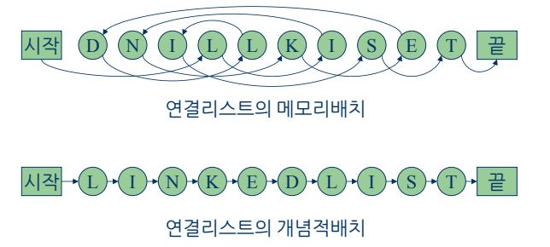
Start
End
Physical concept of Linked List
Start
End
Logical concept of Linked List

Slide 3
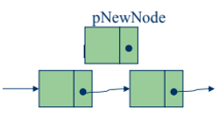
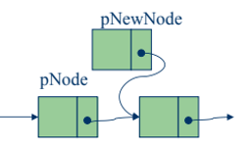
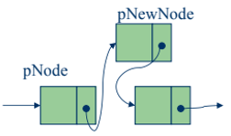

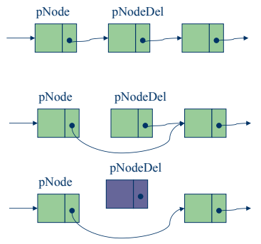
New Node
New Node
New Node
Head Node
Tail Node
Current
Next
Current
Delete Node
Next
Delete Node

Slide 4


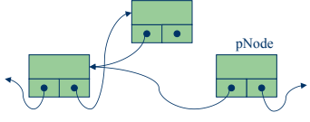
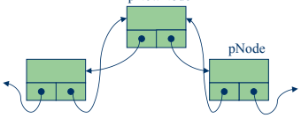

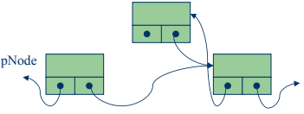
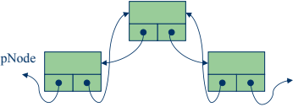

Head Node
Tail Node
New Node
New Node
New Node
Previous
Current
Previous
Current
Current
Previous
New Node
New Node
New Node
Current
Next
Current
Next
Current
Next

Slide 5
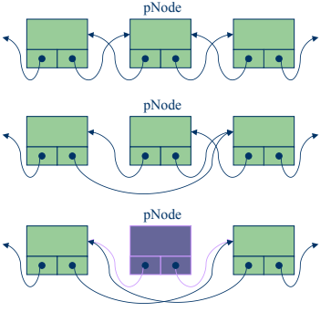
Delete Node
Delete Node
Delete Node

Slide 6
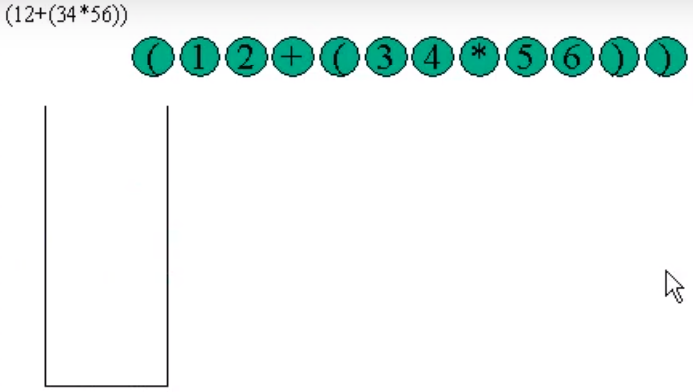
To change infix notation to postfix notation,
1. use the precedence of operator: '(' : 0, +-: 1, */ : 2
2. If meeting '(', push operand from stack
3. If meeting ')', add element to the result until getting
'(', and throw away '('
4. If meeting operator, pop and add the element to the
result until getting lower operator, and throw away
itself.
5. add operands
6. When all input is complete, pop the rest all operators
and add them to the result.

Slide 7
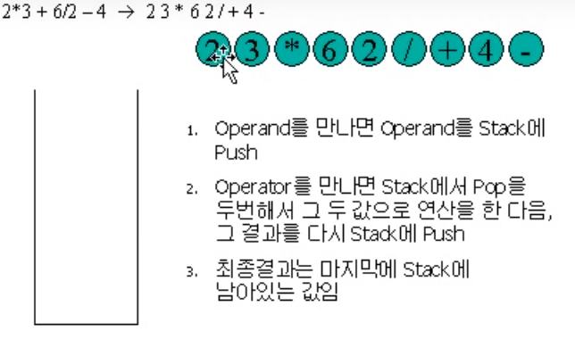
To calculate the postfix,
1. Push the operator from stack when
meeting operand.
2. Pop two times operator, operate
two values, and push the result in
stack.
3. Last one remaining in stack is the
final result

Slide 8
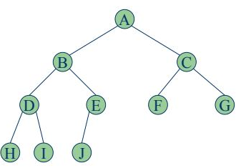
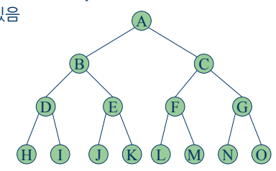

Slide 9
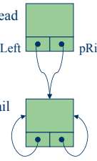
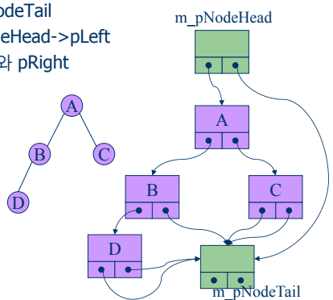
Start
right
left
Start
End
End

Slide 10
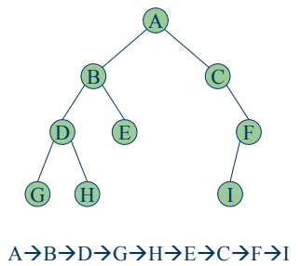
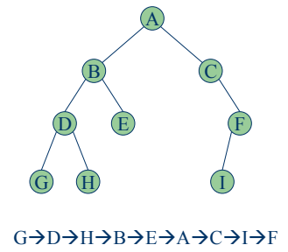
1
2
3
2
3
1
3
1
2

Slide 11
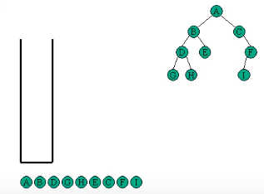
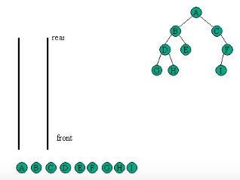
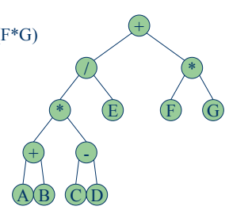

Slide 12
