Slide 1
Beginning of first row
Beginning of second row
Beginning of third row
1 | 2 | 3 | 4 | 5 | 6 | 7 | 8 | 9

Slide 2
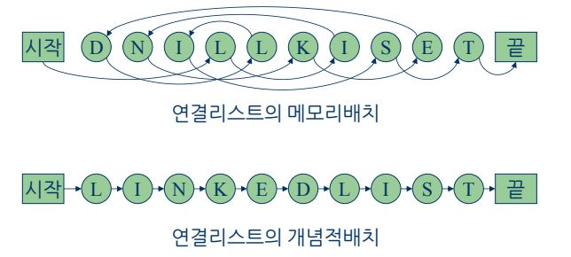
Start
End
Physical concept of Linked List
Start
End
Logical concept of Linked List

Slide 3
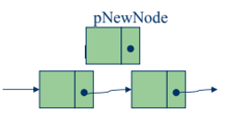
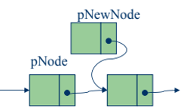
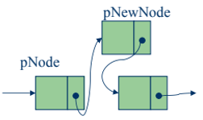

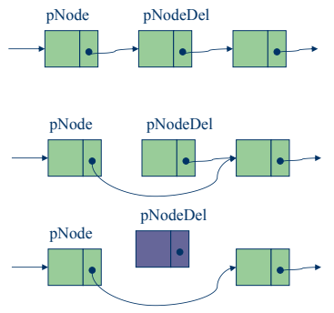
New Node
New Node
New Node
Head Node
Tail Node
Current
Next
Current
Delete Node
Next
Delete Node

Slide 4


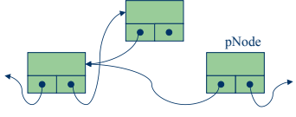
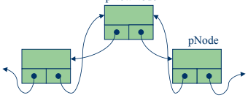

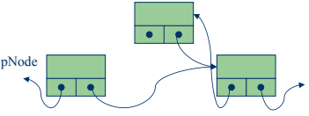
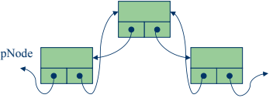

Head Node
Tail Node
New Node
New Node
New Node
Previous
Current
Previous
Current
Current
Previous
New Node
New Node
New Node
Current
Next
Current
Next
Current
Next

Slide 5
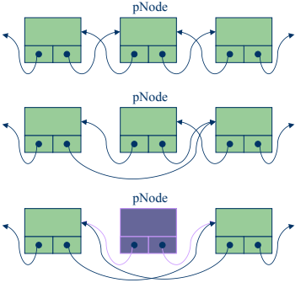
Delete Node
Delete Node
Delete Node

Slide 6
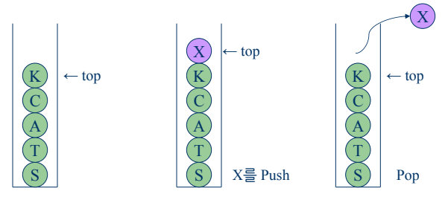
Push 'X'
Pop the 'X'

Slide 7
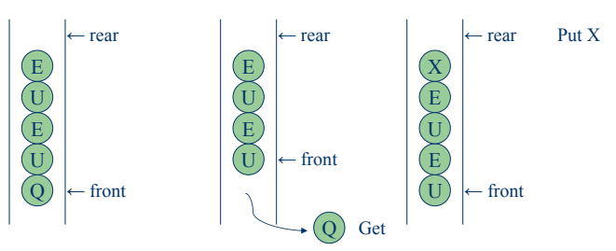

Slide 8
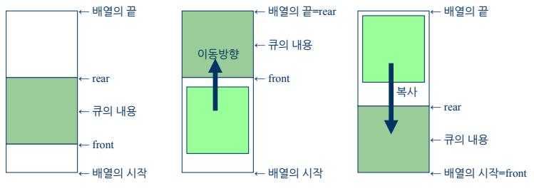
End of Array
End of Array
= rear
End of Array
move
elements
rear
copy
elements
front
elements
Beginning of Array
Beginning of Array
Beginning of Array
= front

Slide 9
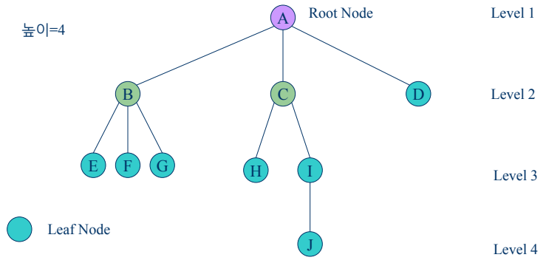

Slide 10
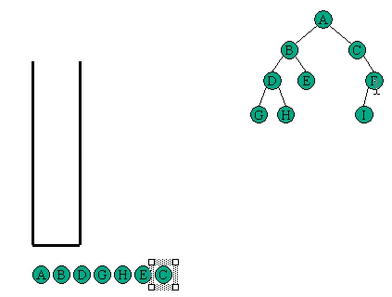

Slide 11
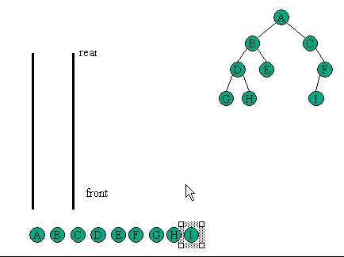

Slide 12



Ordered Part
Unordered Part
Ordered Part
Unordered Part
Ordered Part
Unordered Part

Slide 13
