Slide 1
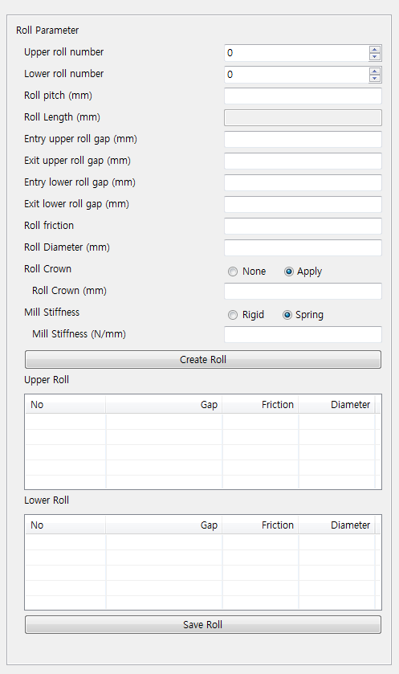
Hold Down Roll Information
Hold Down Roll Generation
None
Upper
Lower
Front Roll 배치
Front H/D Roll Dia. (mm)
100.0
Front H/D Roll Pitch(mm)
250.0
Front H/D Roll Vertical. Pos. (mm)
300.0
Rear Roll 배치
Rear H/D Roll Dia. (mm)
100.0
Rear H/D Roll Pitch(mm)
250.0
Rear H/D Roll Vertical Pos. (mm)
300.0
Roll Gap Movement Information
Upper Roll Gap Movement
Upper Entry Roll Gap Movement (mm)
20.0
Upper Exit Roll Gap Movement (mm)
15.0
Upper Roll Gap Staying Time (sec.)
1.0
Upper Roll Moving Time (sec.)
2.0
Lower Roll Gap Movement
Entry Lower Roll Gap Movement (mm)
20.0
Entry Lower Roll Gap Movement (mm)
15.0
Lower Roll Gap Staying Time (sec.)
1.0
Lower Roll Gap Moving Time (sec.)
2.5

Slide 2
Hold Down Roll Information
Hold Down Roll Generation
None
Upper
Lower
Front Roll 배치
Front H/D Roll Dia. (mm)
100.0
Front H/D Roll Pitch(mm)
250.0
Front H/D Roll Vertical. Pos. (mm)
300.0
Rear Roll 배치
Rear H/D Roll Dia. (mm)
100.0
Rear H/D Roll Pitch(mm)
250.0
Rear H/D Roll Vertical Pos. (mm)
300.0

Slide 3
Roll Gap Movement Information
Upper Roll Gap Movement
Upper Entry Roll Gap Movement (mm)
20.0
Upper Exit Roll Gap Movement (mm)
15.0
Upper Roll Gap Staying Time (sec.)
1.0
Upper Roll Moving Time (sec.)
2.0
Lower Roll Gap Movement
Entry Lower Roll Gap Movement (mm)
20.0
Entry Lower Roll Gap Movement (mm)
15.0
Lower Roll Gap Staying Time (sec.)
1.0
Lower Roll Gap Moving Time (sec.)
2.5

