Slide 1
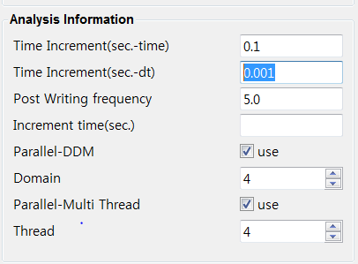
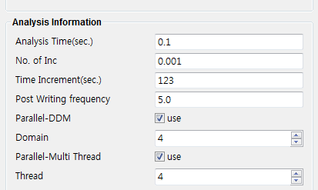
박스 색으로 매칭
UI Label 변경 |  | 변수 선언 변경
전 | 후 | Proc 선언 | 전 | 후
Time Increment(sec.-time) | Analysis Time(sec.) | lcase_time | %lcase_time% | %lcase_time%
Time Increment(sec.-dt) | No. of Inc | lcase_inc | %lcase_dt% | %lcase_inc%
Post Writing frequency | Post Writing frequency | post_inc | %post_inc% | %post_inc%
Increment time(sec.) | Time Increment(sec.) | lcase_dt | %inc_time% | %lcase_dt%

Slide 2
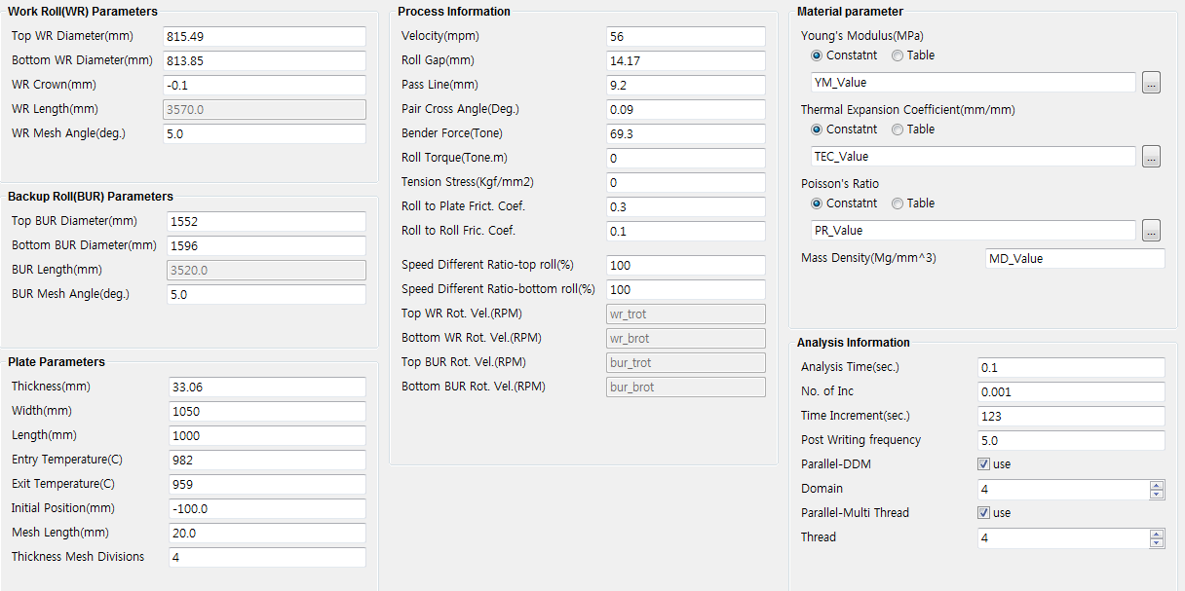
설명 :
wr_tdia %WR TDIA%
빨간색 : proc 선언 변수
초록색 : 프로그램에서 값 치환 할 때 변수
wr_tdia %WR TDIA%
pl_vel_mpm %SPEED%
wr_bdia %WR BDIA%
roll_gap %ROL GAP%
wr_crown %WR ICRN%
pass_line %PAS LINE%
%YM VALUE%
wr_len %wr_len%
p_cross_ang %P-CROSS%
wr_div_angle %wr_div_angle%
bend_f %BEND%
roll_torque %TORQ%
%TEH VALUE%
tens_f %TENS%
bur_tdia %BUR TDIA%
f_r2p %f_r2p%
f_r2r %f_r2r%
%PR VALUE%
bur_bdia %BUR BDIA%
%MD VALUE%
bur_len %bur_len%
%tb_vel_rate_top%
bur_div_angle %bur_div_angle%
%tb_vel_rate_bottom%
%wr_trot%
%wr_brot%
%bur_trot%
lcase_time %lcase time%
p_thk %ENTRY THK%
%bur_brot%
lcase_inc %lcase_inc%
p_wid %STP WID%
lcase_dt %lcase_dt%
p_len %STP LEN%
post_inc %post_inc%
p_ent_temp %ENTRY TEMP%
p_exit_temp %EXIT TEMP%
%Domain%
p_in %p_in%
pl_m %pl_m%
%Thread%
t_div %t_div%

Slide 3
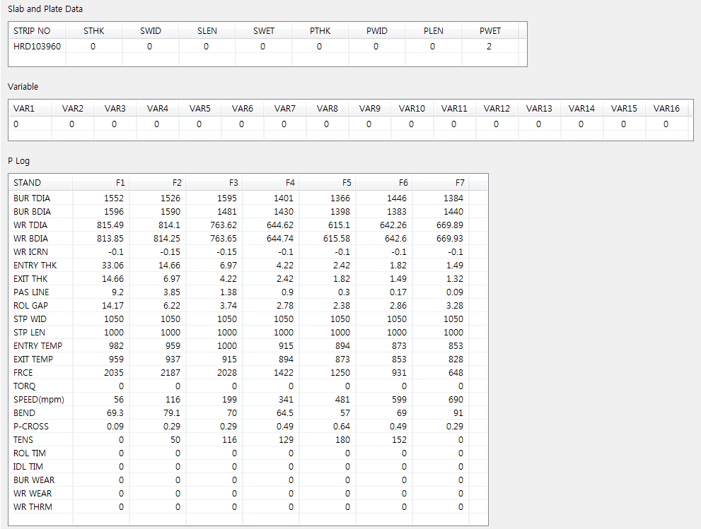
%STHK%
%SWID%
%SLEN%
%SWET%
%PTHK%
%PWID%
%PLEN%
%PWET%
%VAR1%
%VAR2%
%VAR3%
%VAR4%
%VAR5%
%VAR6%
%VAR7%
%VAR8%
%VAR9%
%VAR10%
%VAR11%
%VAR12%
%VAR13%
%VAR14%
%VAR15%
%VAR16%
%FRCE%
%EXIT THK%
%ROL TIM%
%IDL TIM%
%BUR WEAR%
%WR WEAR%
%WR THRM%

Slide 4
Top WR Rot. Vel.(RPM) | => 수식 Velocity(mpm)*1000/60/(top wr Dia./2)*(Speed Different Ratio-top roll/100)*60/(2*pi) => 치환변수로 표현 %SPEED% * 1000 / 60 / ( %WR TDIA% /2 ) * ( %tb_vel_rate_top% / 100 ) * 60 / ( 2 * pi ) => UI Label로 표현 Velocity(mpm) * 1000 / 60 / ( Top WR Diameter(mm) / 2 ) * ( Speed Different Ratio-top roll(%) / 100 ) * 60 / 100 ) * 60 / ( 2 * pi )
Bottom WR Rot. Vel.(RPM) | => 수식 Velocity(mpm)*1000/60/(bot. wr Dia./2)*(Speed Different Ratio-bot roll/100) *60/(2*pi) => 치환변수로 표현 %SPEED% * 1000 / 60 / ( %WR BDIA% /2 ) * ( %tb_vel_rate_bottom% / 100 ) * 60 / ( 2 * pi ) => UI Label로 표현 Velocity(mpm) * 1000 / 60 / ( Bottom WR Diameter(mm) / 2 ) * ( Speed Different Ratio-bottom roll(%) / 100 ) * 60 / 100 ) * 60 / ( 2 * pi )
Top BUR Rot. Vel.(RPM) | => 수식 Velocity(mpm)*1000/60/(top bur Dia./2)*(Speed Different Ratio-top roll/100)*60/(2*pi) => 치환변수로 표현 %SPEED% * 1000 / 60 / ( %BUR TDIA% /2 ) * ( %tb_vel_rate_top% / 100 ) * 60 / ( 2 * pi ) => UI Label로 표현 Velocity(mpm) * 1000 / 60 / ( Top BUR Diameter(mm) / 2 ) * ( Speed Different Ratio-top roll(%) / 100 ) * 60 / 100 ) * 60 / ( 2 * pi )
Bottom BUR Rot. Vel.(RPM) | => 수식 Velocity(mpm)*1000/60/(bot. bur Dia./2)*(Speed Different Ratio-bot roll/100)*60/(2*pi) => 치환변수로 표현 %SPEED% * 1000 / 60 / ( %BUR BDIA% /2 ) * ( %tb_vel_rate_bottom% / 100 ) * 60 / ( 2 * pi ) => UI Label로 표현 Velocity(mpm) * 1000 / 60 / ( Bottom BUR Diameter(mm) / 2 ) * ( Speed Different Ratio-bottom roll(%) / 100 ) * 60 / 100 ) * 60 / ( 2 * pi )

Slide 5
UI Label 변경 |  | 변수 선언 변경
전 | 후 | Proc 선언 | 전 | 후 | 수식
Time Increment(sec.-time) | Analysis Time(sec.) | lcase_time | %lcase_time% | %lcase_time% | => 수식 p_len*p_thk/(roll_gap*pl_vel)*.8 => 치환변수로 표현 %STP LEN% * %ENTRY THK% / ( %ROL GAP% * %SPEED%*1000.0/60.0 ) *0.8 UI Label 로 표현 Length(mm) * Thickness(mm) / (Roll Gap(mm) * Velocity(mpm) * 1000.0/60/.0) *0.8
Time Increment(sec.-dt) | No. of Inc | lcase_inc | %lcase_dt% | %lcase_inc% | 2000 -> InitValue.txt 에서 입력
Post Writing frequency | Post Writing frequency | post_inc | %post_inc% | %post_inc% | UI 입력
Increment time(sec.) | Time Increment(sec.) | lcase_dt | %inc_time% | %lcase_dt% | => 수식 lcase_time / lcase_inc => 치환변수로 표현 %lcase_time% / %lcase_inc% => UI Label 로 표현 Analysis Time(sec.) / No. of Inc

