Slide 1
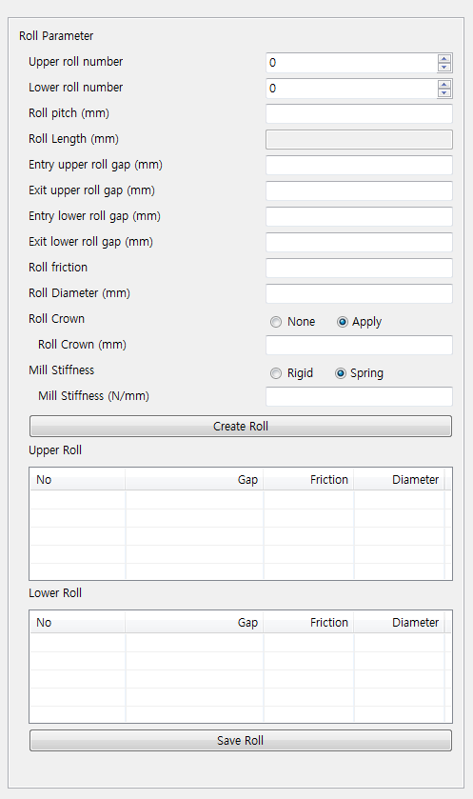
Hold Down Roll Information
Hold Down Roll Generation
None
Upper
Lower
Front Roll 배치
Front H/D Roll Dia. (mm)
100.0
Front H/D Roll Pitch(mm)
250.0
Front H/D Roll Vertical. Pos. (mm)
300.0
Rear Roll 배치
Rear H/D Roll Dia. (mm)
100.0
Rear H/D Roll Pitch(mm)
250.0
Rear H/D Roll Vertical Pos. (mm)
300.0
Roll Gap Movement Information
Upper Roll Gap Movement
Upper Entry Roll Gap Movement (mm)
20.0
Upper Exit Roll Gap Movement (mm)
15.0
Upper Roll Gap Staying Time (sec.)
1.0
Upper Roll Moving Time (sec.)
2.0
Lower Roll Gap Movement
Entry Lower Roll Gap Movement (mm)
20.0
Entry Lower Roll Gap Movement (mm)
15.0
Lower Roll Gap Staying Time (sec.)
1.0
Lower Roll Gap Moving Time (sec.)
2.5

Slide 2
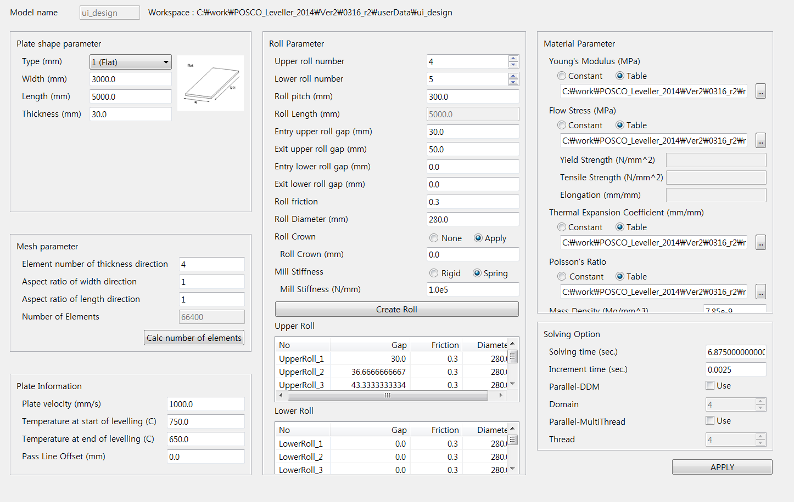
1. Hold Down Roll
활성화 시킬것
Hold Down Roll Information
Front Roll 배치
Upper
Lower
Front H/D Roll Dia. (mm)
100.0
Front H/D Roll Pitch(mm)
250.0
Front H/D Roll Vertical. Pos. (mm)
300.0
Rear Roll 배치
Upper
Lower
Rear H/D Roll Dia. (mm)
100.0
Rear H/D Roll Pitch(mm)
250.0
Rear H/D Roll Ver. Pos. (mm)
300.0

Slide 3

2. Changable Roll Gap
Roll Movement Information
Entry Upper Roll Gap-Start (mm)
20.0
Roll Gap Movement Information
Entry Upper Roll Gap-End (mm)
15.0
Upper Roll Gap Movement
Entry Upper Roll Staying Time (sec.)
1.0
Entry Upper Roll Moving Time (sec.)
2.5
Upper Entry Roll Gap Movement (mm)
20.0
Exit Upper Roll Gap (mm)
25.0
Upper Exit Roll Gap Movement (mm)
15.0
Entry Lower Roll Gap-Start (mm)
20.0
Upper Roll Gap Staying Time (sec.)
1.0
Entry Lower Roll Gap-End (mm)
15.0
Upper Roll Moving Time (sec.)
2.0
Entry Lower Roll Staying Time (sec.)
1.0
Lower Roll Gap Movement
Entry Lower Roll Moving Time (sec.)
2.5
Entry Lower Roll Gap Movement (mm)
20.0
Exit Lower Roll Gap (mm)
25.0
Entry Lower Roll Gap Movement (mm)
15.0
Lower Roll Gap Staying Time (sec.)
1.0
Lower Roll Gap Moving Time (sec.)
2.5

Slide 4
Hold Down Roll Information
Hold Down Roll Generation
None
Upper
Lower
Front Roll 배치
Front H/D Roll Dia. (mm)
100.0
Front H/D Roll Pitch(mm)
250.0
Front H/D Roll Vertical. Pos. (mm)
300.0
Rear Roll 배치
Rear H/D Roll Dia. (mm)
100.0
Rear H/D Roll Pitch(mm)
250.0
Rear H/D Roll Vertical Pos. (mm)
300.0

Slide 5
Roll Gap Movement Information
Upper Roll Gap Movement
Upper Entry Roll Gap Movement (mm)
20.0
Upper Exit Roll Gap Movement (mm)
15.0
Upper Roll Gap Staying Time (sec.)
1.0
Upper Roll Moving Time (sec.)
2.0
Lower Roll Gap Movement
Entry Lower Roll Gap Movement (mm)
20.0
Entry Lower Roll Gap Movement (mm)
15.0
Lower Roll Gap Staying Time (sec.)
1.0
Lower Roll Gap Moving Time (sec.)
2.5

