Slide 1


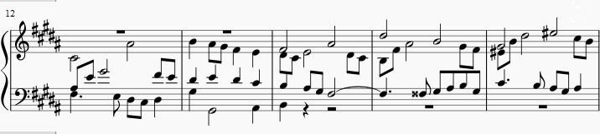
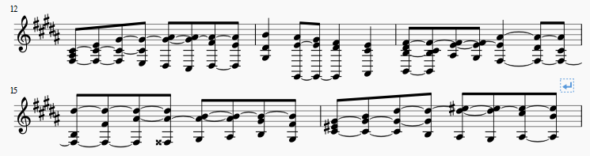



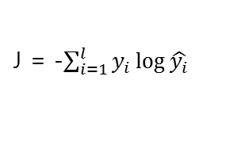

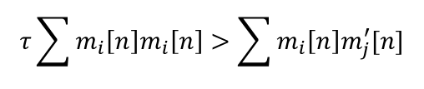


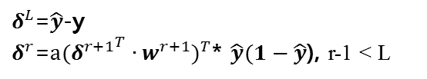


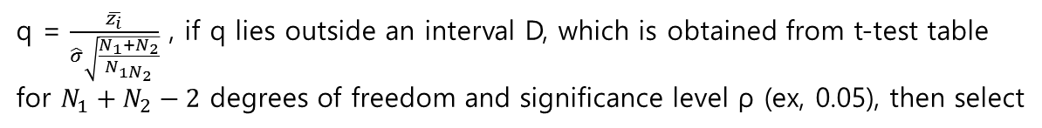




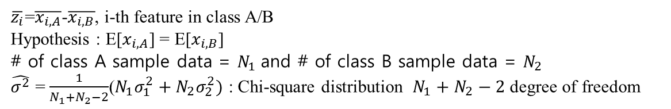





Composer detection based on the harmonic motif
Digital Media Lab
School of Electrical Engineering, Korea University
지도교수 : 설 상 훈 교수님
Feature extraction
2014170966 Jongyeong Lee
Multi-layer Perceptron
Results
From Fugue No. 23 in 4 voices in B major by Johan Sebastian Bach
Hidden layer
$$w^{r}+= ∆w^{r}$$
Backpropagation
τ = 0.8, initial weight/bias std = 0.2/0.4, lf_step=0.04
Hidden node = 80, layer = 5, train/ test data =2210/474
a = 2, b = 0.5, Beethoven and Bach
$$x_{1}$$
$$w^{1}$$
f
f
$$w^{L}$$
h
$${\hat{y}}_{1}$$
Where, $∆w^{r}$ = $−μ{δ^{r}}^{T}y^{r−1}$ , and
μ is learning factor
Error rate : 20.25%
Combine treble clef and base clef
$$x_{2}$$
$$⋮$$
f
$$⋯$$
f
$$⋮$$
$δ^{L}$=$\hat{y}$-y
$δ^{r}$=${{{a(δ}^{r+1}}^{T}{∙w}^{r+1})}^{T}$* $\hat{y}(1−\hat{y}$), r-1 < L
60% performance improvement over random selection(50%)
Tie two measures together as a motif candidate
motif 7th
$$x_{15}$$
$$⋮$$
f
$$⋮$$
f
h
$${\hat{y}}_{l}$$
Cross-entropy cost function
τ = 0.9, initial weight/bias std = 0.2/0.4, lf_step=0.04
Hidden node = 80, layer = 5, train/ test data =4763/1313
a = 2, b = 0.5, Beethoven, Bach and Chopin
motif 8th
Feedforward
J = -$\sum_{i=1}^{l}{y_{i}\log{\hat{y_{i}}}}$
Error rate : 38.46%
Input node
f : logistic = $\frac{1}{1+e^{−a(x−b)}}$
h : softmax = $\frac{e^{{\hat{y}}_{i}}}{\sum_{i=1}^{l}{e^{{\hat{y}}_{i}}}}$
Define ‘loss’ as ratio of J(new) to J(old)
84.6% performance improvement over random selection(67%)
Bias
τ = 0.9, initial weight/bias std = 0.2/0.4, lf_step=0.04
Hidden node = 80, layer = 5, train/ test data =6770/2099
a = 2, b = 0.5, Beethoven, Bach, Chopin and Alkan
Normal Order
Normal Order
Hidden neuron
Adaptive learning
candidate
μ = 0.001:0.301:0.001 = [0.001, 0.002, $⋯$, 2.999, 3.000]
Error rate : 51.74%
[8, 11, 3, 4, 8, 10, 4, 8, 3, 6, 8, 10, 1, 4, 11, 3, 6, 6, 8, 1, 4, 6, 10, 4, 6, 8, 4, 6, 10, 3, 6, 10, 6, 10, 1]
Initialize μ to a reasonable value. Ex) μ[two thirds of the length]
93% performance improvement over random selection(75%)
candidate
[11, 3, 6, 3, 6, 3, 6, 10, 3, 7, 10, 8, 10, 11, 10, 11, 8, 11, 6, 8, 11, 1, 5, 8, 8, 11, 1, 1, 3, 8, 8, 11, 3, 3, 5, 10, 3, 5, 8, 10, 1, 5, 5, 10, 11]
step = (loss-1)/lf_step , where lf_step means learning factor step
τ = 0.8, train/test data = 3695/1128
$$τ\sum{m_{i}\left[n\right]m_{i}\left[n\right]>\sum{m_{i}\left[n\right]m_{j}^{′}[n]}}$$
Case 1:
Step > 0 , which means an increase in cost
So, we have to decrease learning factor -> move to left by log(step)
Error rate : 51.51%
m’[n] means distinct harmonic motif, and m[n] means a motif candidate. And τ is threshold value which is a variable.
Case 2:
Step < 0 , which means an decrease in cost
So, we have to increase learning factor -> move to right by log(-step)
On average, each score has 10 to 20 harmonic motifs, depending on τ. Therefore, if the accuracy of a motif is over 50%, the composer of the score can be detected.
If this inequality is satisfied for all j, then it is considered to be one of the harmonic motif.
This means that each composer has a different tendency to use chords, and that the computer can recognize and distinguish it.
For all harmonic motif
Data input size = 15
$x_{1}$ : average number of chords with Z-Relation
$x_{2}$ : average number of dominant chords
$x_{3}$ : average number of tonic chords
$x_{4}$ : average number of repeated diatonic notes
$x_{5}$ : average number of consonant chords
$x_{6}$ : average number of the forte set class / 10 (normalized)
$x_{7}$ : standard deviation of the number of the forte set class / $\sqrt{10}$ (normalized)
$x_{8}$ : average number of the cardinality of the multiset(= # of pitch values) / 10
$x_{9}$ : standard deviation of the cardinality of the multiset / $\sqrt{10}$
$x_{10}$ : average number of minor 2nd / major 7th
$x_{11}$ : average number of major 2nd / minor 7th
$x_{12}$ : average number of minor 3rd / major 6th
$x_{13}$ : average number of major 3rd / minor 6th
$x_{14}$ : average number of perfect 4th / perfect 5th
$x_{15}$ : average number of tritones
Feature selection
To check if a feature is valid or not, t-test was used.
Features that distinguish Beethoven and Bach (ρ = 0.05)
: forte set class and cardinality of the multiset frequency of dominant use, consonant use, minor 3rd / major 6th , major 3rd / minor 6th , perfect 4th / perfect 5th
and tritones.
(feature # : 2, 5, 6, 7, 8, 9, 12, 13, 14, 15)
$\overline{z_{i}}$=$\overline{x_{i,A}}$-$\overline{x_{i,B}}$, i-th feature in class A/B
Hypothesis : E[$x_{i,A}$] = E[$x_{i,B}$]
# of class A sample data = $N_{1}$and # of class B sample data = $N_{2}$
$\hat{σ^{2}}$ = $\frac{1}{N_{1}+N_{2}−2}$(${N_{1}σ}_{1}^{2}+N_{2}σ_{2}^{2})$ : Chi-square distribution $N_{1}+N_{2}−2$ degree of freedom
q = $\frac{\overline{z_{i}}}{\hat{σ}\sqrt{\frac{N_{1}+N_{2}}{N_{1N_{2}}}}}$ , if q lies outside an interval D, which is obtained from t-test table
for $N_{1}+N_{2}−2$ degrees of freedom and significance level ρ (ex, 0.05), then select
Because only 15 features are used, There is no significant difference in performance even with only distinctive features
* $x_{10}\sim x_{15}$ is interval vector

