Slide 1
Algorithms
Logic Operators

Slide 2



HomeWorks-1
The three operators AND, OR and XOR are binary operators. That is, two operands are required in the operation.
For example, a AND b. For integers a and b, the operation results of the following three binary operators are defined as the following tables.

Slide 3
HomeWorks-1
For example
(1) 0 AND 0 = 0, 0 OR 0 = 0 & 0 XOR 0 = 0
(2) 0 AND 3 = 0, 0 OR 3 = 1 & 0 XOR 3 = 1
(3) 4 AND 9 = 1, 4 OR 9 = 1 but 4 XOR 9 = 0
Please write an program to input two integers a and b and an result of logical operation, and output its possible logical operations.

Slide 4
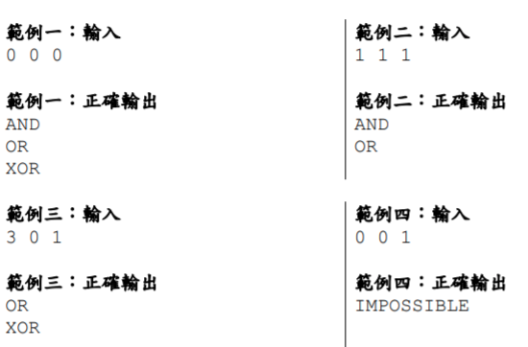
Example

