Slide 1
Introduction to Algorithms
慈濟大學
醫學資訊學系

Slide 2
HomeWork-Maximum-Flow Problem
Given a flow network G using the adjacency matrix representation with source s and sink t, write an algorithm to find a flow of maximum value from s to t.

Slide 3
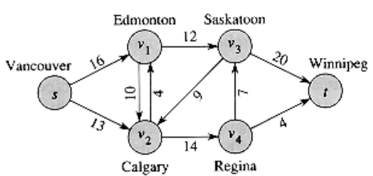
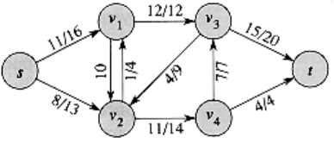
Example
The maximum flow = 23
12/12
12/16
12/20
4
9
7
13
4
14
12/12
12/12
12/16
19/20
12/16
12/20
4
4
7
9
7/7
9
11/13
4/4
4/13
4/4
11/14
4/14

Slide 4
References
http://staff.ustc.edu.cn/~csli/graduate/algorithms/book6/chap27.htm

