Slide 1
AMVR - Interaction
Tim Gysen & Joni Vanherck

Slide 2
Selection
Very dense environment, hundreds of objects of various sizes (from large to very small), possibly occluding each other

Slide 3
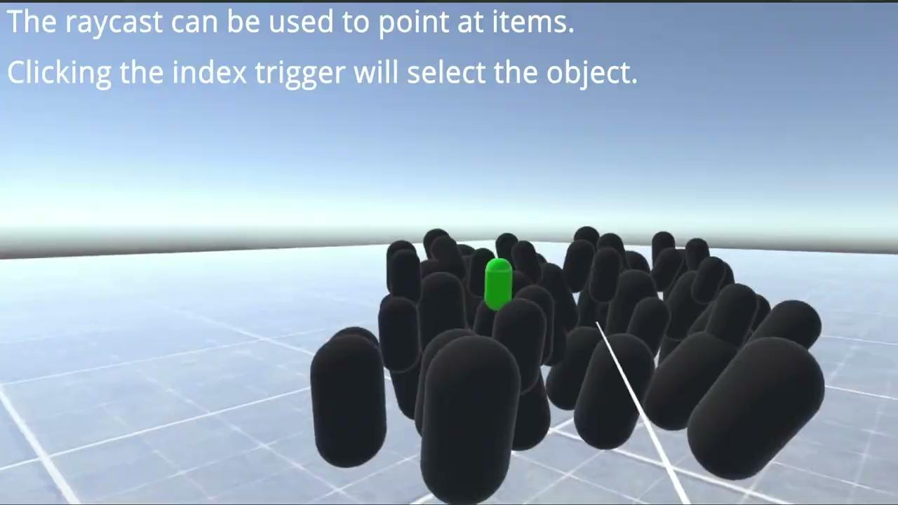
Selection - Methods
Simple pointer selection:
A raycast to point at objects and select them using the index trigger

Slide 4
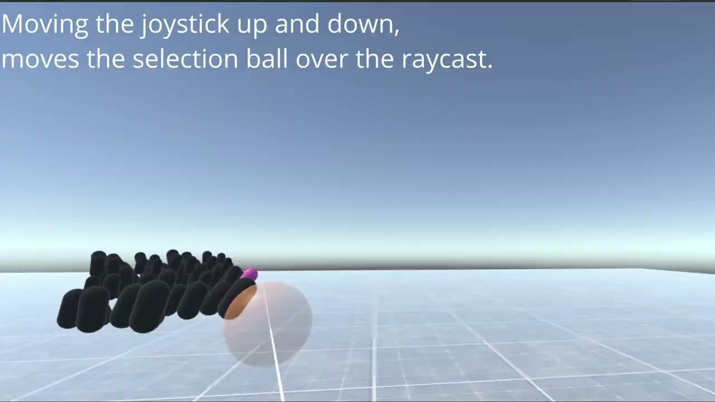
Selection - Methods
Selection ball method:
A raycast with a ball on it, every object inside the selection ball will be visible in a temporary grid overlay. Clicking the index trigger will display a large (‘expand’-like) grid to select from using a simple pointer.

Slide 5
Selection - Hypothesis
The selection ball method will result in a higher accuracy than the simple pointer selection method.
The simple pointer selection will result in a faster selection time than the selection ball method.
The selection ball method’s accuracy will decrease less when going further away than the simple pointer selection method’s accuracy.

Slide 6
Selection - Testing procedure
We let each user try the selection methods for a short time before the timed testing started.
During the tests, users had to try to select the correct object out of a total of 64 objects of varying sizes, some of which were occluded.
Each user was timed using both selection methods 15 times at short, medium, and long range.
The first selection was discarded as a practice round when switching between methods or ranges.
Half the users started with the simple pointer selection method, the other half started with the selection ball method.
After the tests, the users were asked to complete a survey about different aspects of the selection methods.

Slide 7
Selection - Results
Simple pointer selection method:
Short range (~2.5 m):
Average time: 2.02 s
Average accuracy: 66.67%
Medium range (~7-8 m):
Average time: 1.71 s
Average accuracy: 44.44%
Long range (~23-25 m):
Average time: 2.08 s
Average accuracy: 8.89%
Selection ball method:
Short range (~2.5 m):
Average time: 3.10 s
Average accuracy: 93.33%
Medium range (~7-8 m):
Average time: 4.90 s
Average accuracy: 84.44%
Long range (~23-25 m):
Average time: 9.76 s
Average accuracy: 84.44%
All average timings include the timings where the user failed to hit the target.

Slide 8
Selection - Results
The selection ball method is slower than the simple pointer method. This is due to the fact that if the target is located somewhere in the front of the ‘cloud’ of beans, the simple pointer method is very fast since it only needs a single press of the trigger. If the target is not visible, the user will instantly select a wrong object to go to the next challenge.
The selection ball method’s accuracy is significantly higher than the accuracy of the simple pointer method. Even if the target is not visible, the user can still use the selection ball to select it, resulting in a better accuracy.
The selection ball method is also a viable option for selecting items from a long range: the accuracy of the method does not change much based on the distance from the item. Using the simple pointer method to select something from a long range is very hard, which can also be seen looking at the accuracy: 8.89%.
The hypotheses agree well with what appears from these results.

Slide 9
Selection - Results
Question: | Simple pointer method | Selection ball method
I think I would like to use this method frequently (1-5) | 3 | 4.25
I found the method to be unnecessarily complex (1-5) | 2.25 | 1
I found the method to be easy to learn (1-5) | 4.5 | 5
I think that I would need the support of a technical person to be able to use the method (1-5) | 1 | 1.5
I found the method very cumbersome to use (1-5) | 3.5 | 1.75
I think there was too much inconsistency in the usability of the selection ball method. (1-5) | 4 | 1.5
I felt very confident using the method at a short range (1-5) | 4.5 | 4.5
I felt very confident using the method at a medium range (1-5) | 3 | 4.5
I felt very confident using the method at a long range (1-5) | 1.25 | 3.5
This table shows some of the results of the survey. If a method was rated better than the other, it is marked in green.

Slide 10
Selection - Results
The answers on the form are not what we would expect. This may be due to the small sample size or that the users may be biased towards our idea of what the best method should be. For example:
The users indicated that they think the selection ball method is easier to learn than the simple pointer method, while there is little to no learning to the simple pointer method.
Some users also think the simple pointer method is more complex than the selection ball method.

Slide 11
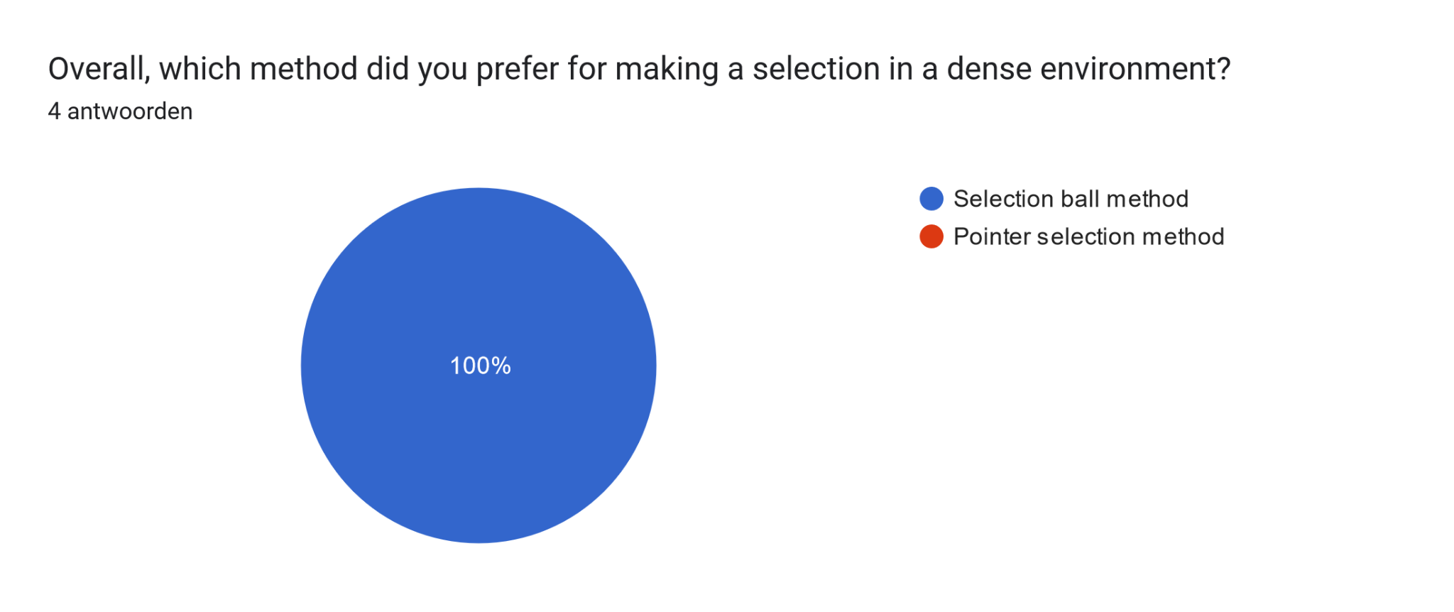
Selection - Results
Every user preferred the selection ball method for making a selection in a dense environment. Again, these users might be biased in favor of our method. Also, the simple pointer method is very simplistic and it is not a fair comparison to the selection ball method for selecting in a dense environment.

Slide 12
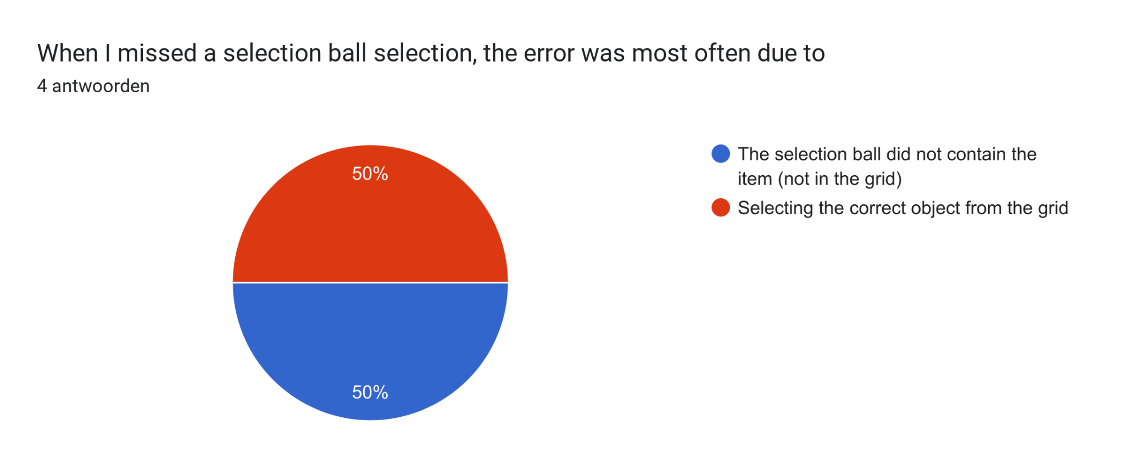
Selection - Improvements
Once the items are in the expand-like grid, it would be better to let them pick the object by selecting a bounding box around the objects, instead of requiring to aim directly at the object.

Slide 13
Selection - Conclusion
The selection ball method was preferred by everyone that participated in our user tests. The accuracy was a lot better than the accuracy of the simple pointer method, especially over a longer distance. The downside of this method is the time it takes to select an item, since there are two stages for selecting a single target. Also, the learning curve is higher in our opinion, but this was not reflected in the user study.

Slide 14
Locomotion
Looking for object in very dense environment, lots of objects occluding your view and blocking you

Slide 15
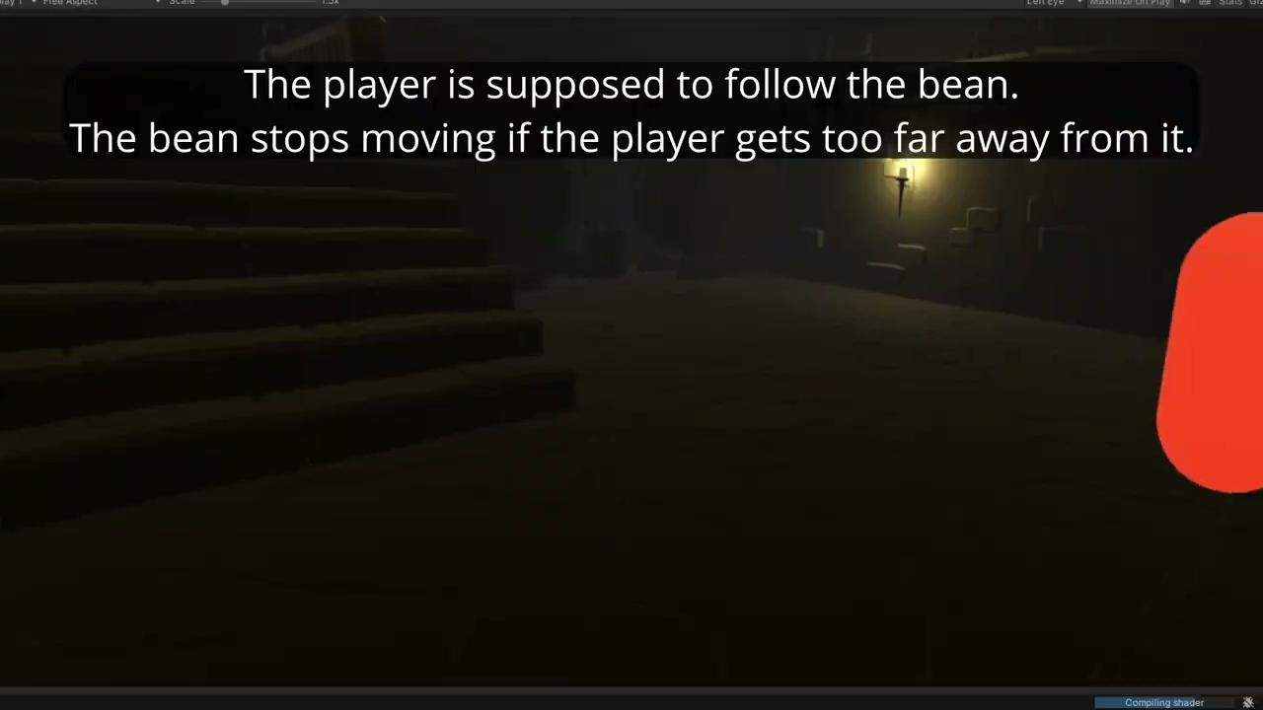
Locomotion - method
Follow method:

Slide 16
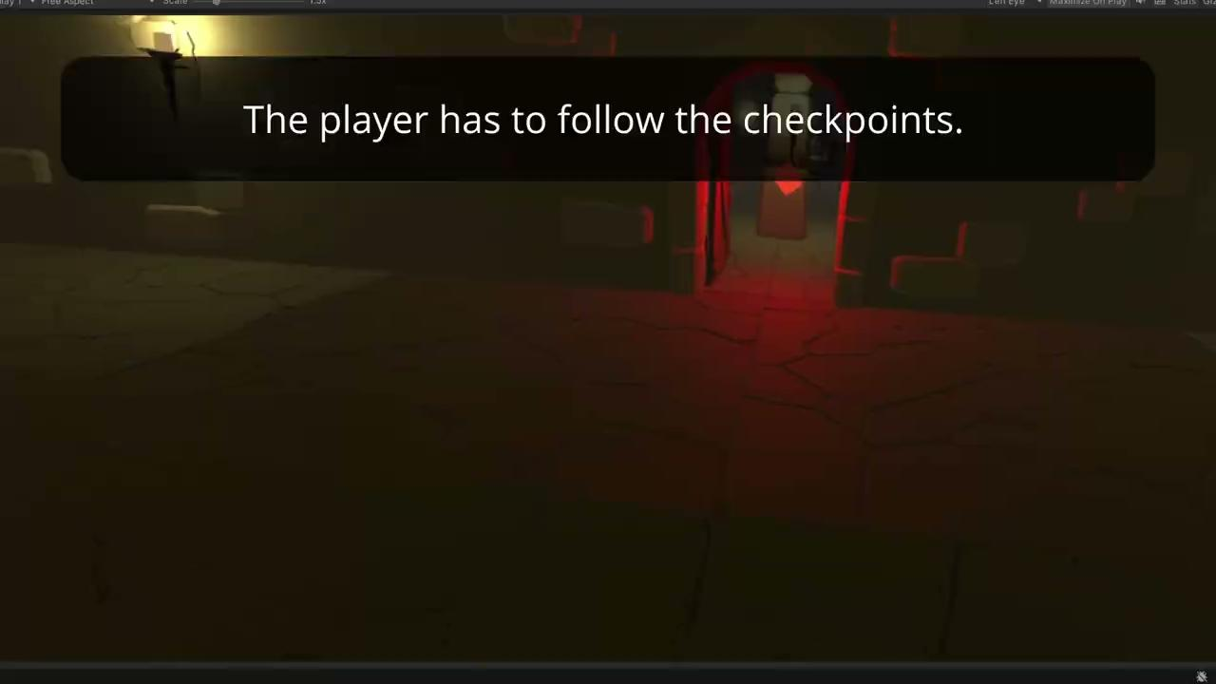
Locomotion - method
Checkpoint method:

Slide 17
Locomotion - Methods
Follow method:
A character leads the way towards the objective, the character stops when the player is not in a certain range from them. The player can also press a button to toggle between regular vision and “Eagle Vision”, in Eagle Vision colors are more muted, and the target (in our case the key the player had to pick up) is visible through walls and other objects, and glows. The target object also emits a sound that gets louder as the player gets closer to it, allowing them to locate the target more easily without the use of Eagle Vision.
Checkpoint method:
The player can move towards checkpoints that disappear when you come close, showing the way, one step at a time.

Slide 18
Locomotion - Hypothesis
The follow method will be more immersive for the user than the checkpoints method.
The checkpoints method will be more efficient than the follow method.
The usefulness of the Eagle Vision function in the follow method will be rated very high.
The usefulness of the sound in the follow method will not be rated very high.

Slide 19
Locomotion - Testing procedure
We let the users get used to the controls of running and turning in the VR environment before starting the timed tests, also, the follow and checkpoint methods were explained to them beforehand.
10 paths were made, all 10 work for both methods. Half the users were given path 1-5 when testing the follow method, and 6-10 for the checkpoint method, and the other way around for the second half of the users.
After the tests, users were asked to complete a survey about different aspects of the locomotion methods.

Slide 20
Locomotion - Results
On average, users took 23.78 seconds to complete a path using the follow method. The checkpoints method resulted in an average time of 23.98 seconds. These times are very similar, so from these tests we can conclude that both methods are about the same when it comes to efficiency.
This invalidates one of our hypotheses. We expected the checkpoint method to be more efficient, but they are almost identical, with the follow method being marginally better, but because of the small sample size and the many slight variables that difference is negligible.

Slide 21
Locomotion - Results
Survey results:
Question: | Follow method | Checkpoint method
I think I would like to use this method frequently (1-5) | 4.5 | 4
I found the method to be unnecessarily complex (1-5) | 1.75 | 2
I found the method to be easy to learn (1-5) | 4.5 | 4.5
I think that I would need the support of a technical person to be able to use the method (1-5) | 1.5 | 1.5
I found the method very cumbersome to use (1-5) | 1.25 | 1.5
I felt very confident using the method (1-5) | 5 | 4.75
This table shows some of the results of the survey, if a method was rated better than the other it is marked in green. We can see that if the ratings are not equal, the follow method has the upper hand every time.

Slide 22
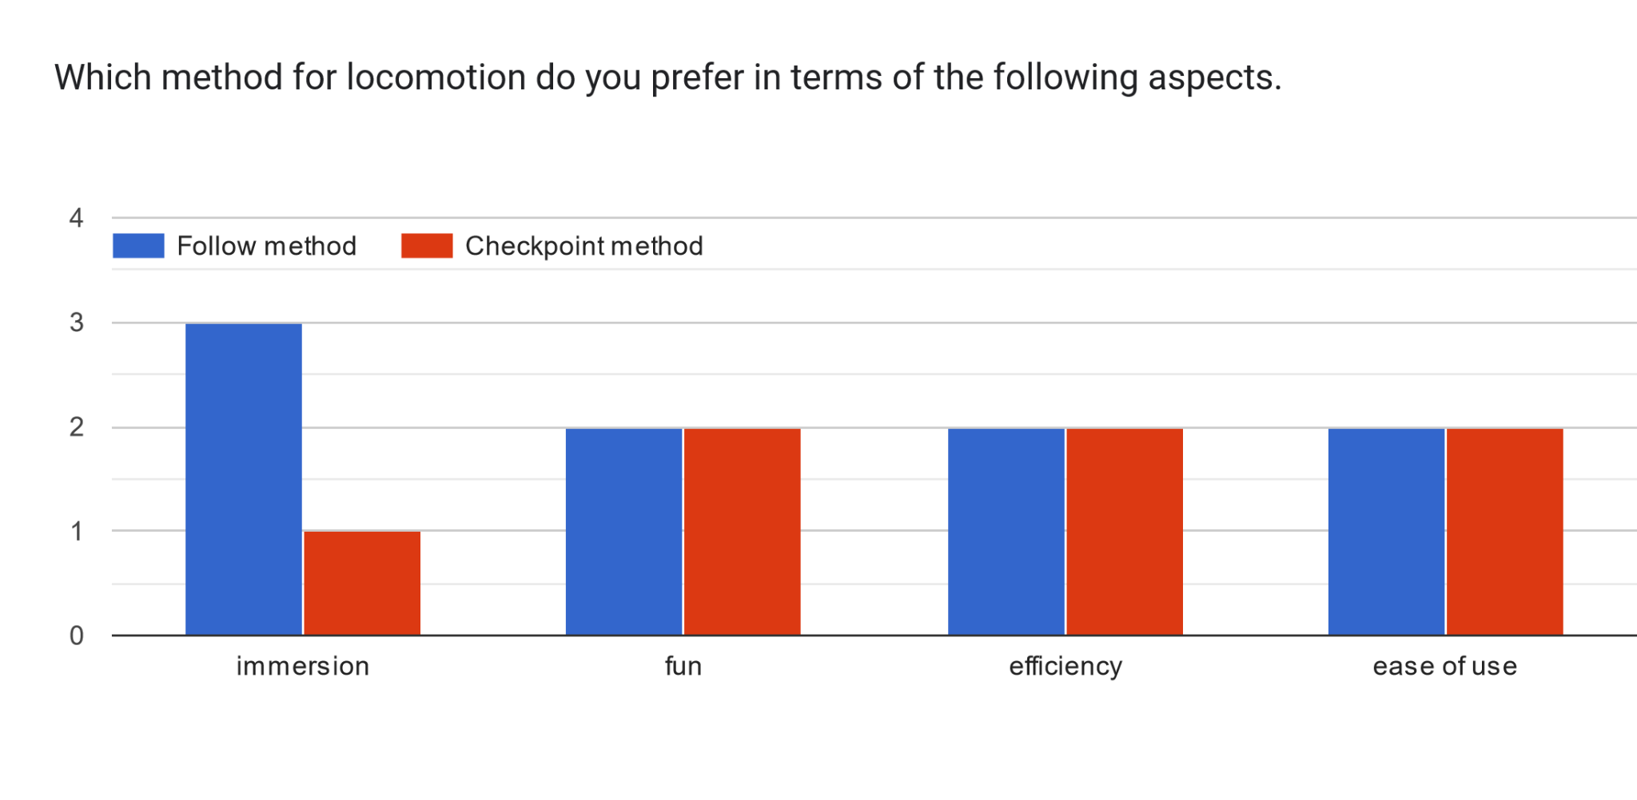
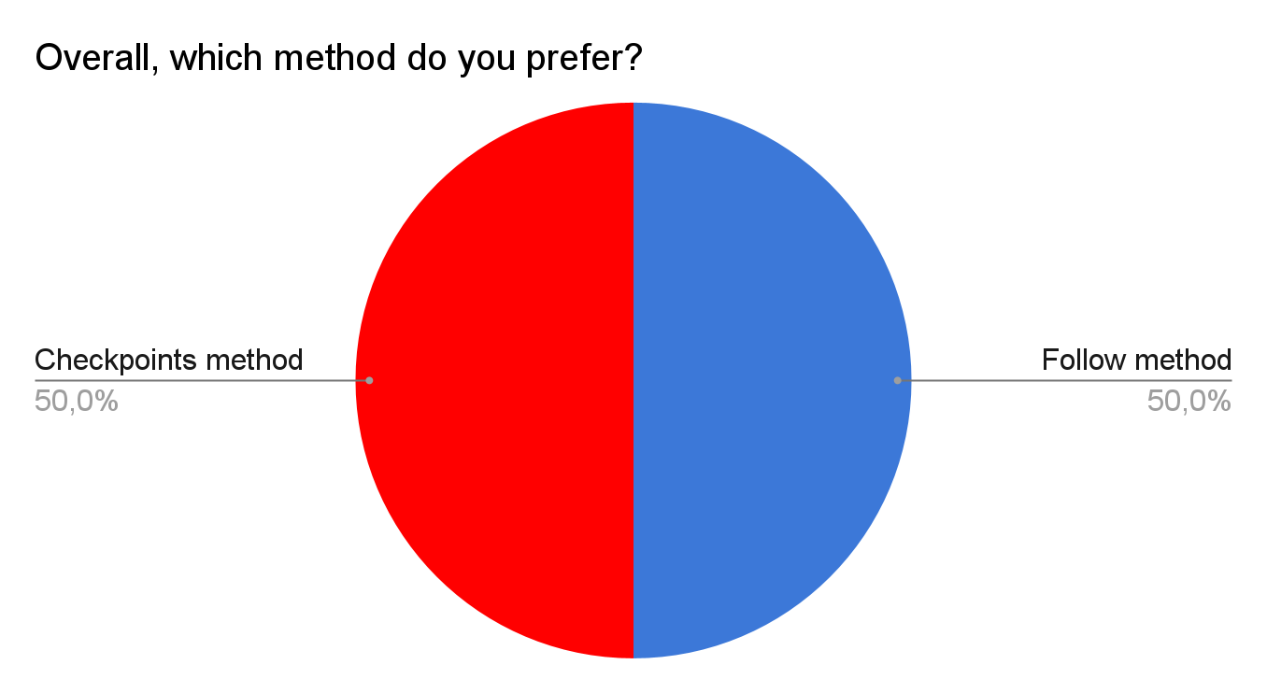
Locomotion - Results
The results in the first graph support our hypothesis that the follow method would be more immersive than the checkpoint method. Every other result in the graphs is a draw, which may be a result of our small sample size.

Slide 23
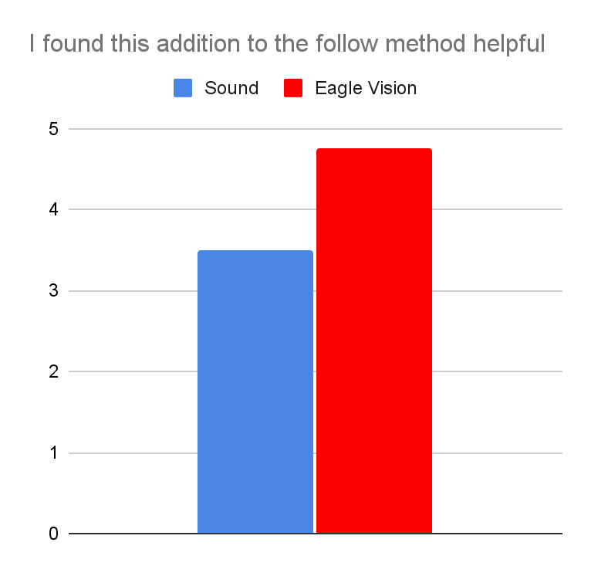
Locomotion - Results
Eagle Vision scored a 4.75 out of 5 in terms of usefulness, this result supports our hypothesis that it would get a very high rating.
Sound however, received a 3.5 out of 5, which goes against our hypothesis that it would not get a high rating.

Slide 24
Locomotion - Conclusion
Looking at our results, we can conclude that the follow method did better overall. It scored better in the survey, and the efficiency of both methods was near identical (with a negligible difference in favour of the follow method).
If we consider these results from a game designers’ perspective, we can see that in some scenarios, it is possible to increase how immersive a game is without losing efficiency by switching from the checkpoint method to the follow method.

