Slide 1
LONG and WIDE DFs & SANKEY diagrams

Slide 2
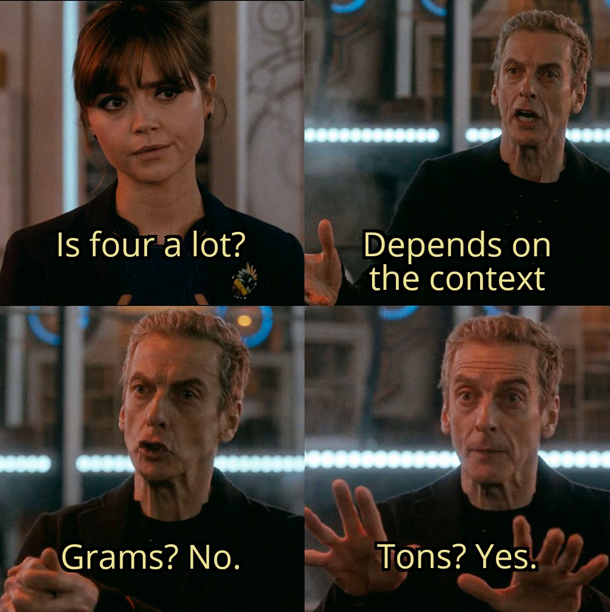

Slide 3
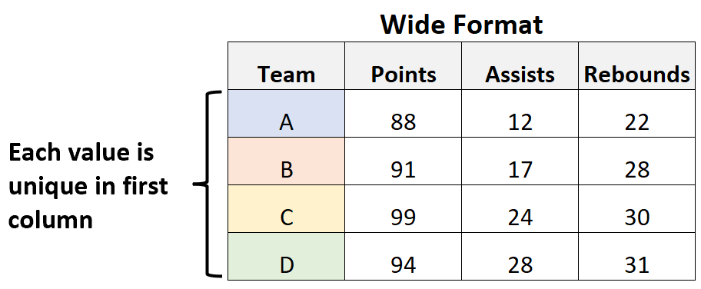
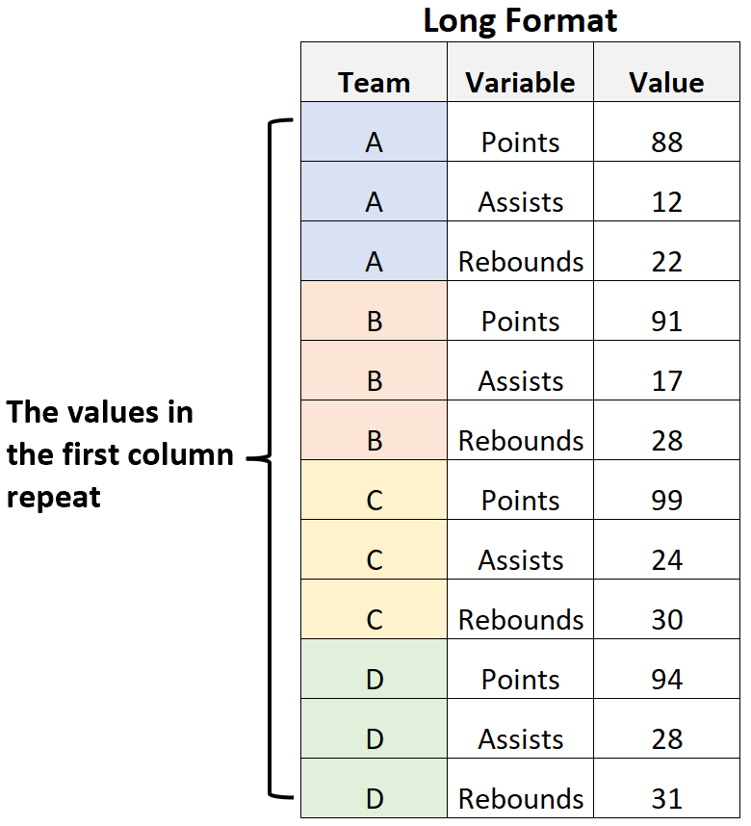
LONG vs WIDE DFs

Slide 4
LONG vs WIDE DFs

Slide 5
LONG vs WIDE DFs
ENTRY & ANALYSE

Slide 6
LONG vs WIDE DFs
ENTRY & ANALYSE
VISUALIZE

Slide 7
LONG vs WIDE DFs
tidyr::gather()

Slide 8
LONG vs WIDE DFs
tidyr::gather()

Slide 9
LONG vs WIDE DFs
tidyr::pivot_longer()

