Slide 1
FINAL PROJECT · VIBE CODING CEDIA 2026
Interactive Ohm’s law
An activity to predict, change one value and check the result.
Jonnathan Chamba (UTE) · Alexis Gaona (UTPL)
Project guide 18 · AI for teaching
Narration generated with an AI voice (ElevenLabs) and reviewed by the authors.
Vibe Coding CEDIA 2026 · Universidad UTE · UTPL
1 / 10
Notes:
COVER
NARRATION · ≈15 s · 30–40 words in English
Introduce the tool by name, say who is in the subgroup and which universities, and in one sentence what it solves.
Interactive Ohm's law. By Jonnathan Chamba, from U T E, and Alexis Gaona, from U T P L. A short classroom activity to predict, change one value and check the result.

Slide 2
FINAL PROJECT · VIBE CODING CEDIA 2026
The problem
The formula is explained on the board and few students predict before calculating.
A CONCRETE EXAMPLE
With 12 V and 6 Ω, 2 A flow. What if the resistance doubles?
Vibe Coding CEDIA 2026 · Universidad UTE · UTPL
2 / 10
Notes:
PART A · PRESENTATION (3 min in total)
THE PROBLEM · NARRATION · ≈35 s · 80–90 words
Describe the real task, who struggles with it and what it costs today. A concrete example beats a general figure.
In Electronics the formula for Ohm's law is explained on the board. A week later almost nobody remembers it. Students rarely predict a result before they calculate it. They also rarely see what happens when only one value changes while the others stay fixed. For example, with a twelve volt battery and a six ohm resistor, two amperes flow. What happens if the resistance doubles? Few people anticipate the answer before doing the math. Our activity makes that prediction the first step.

Slide 3
FINAL PROJECT · VIBE CODING CEDIA 2026
The tool
WHO USES IT
WHAT GOES IN
WHAT COMES OUT
Electronics students, with the teacher and a projector.
A prediction, one value to move and Ohm’s formula.
Calculated result, circuit, text equivalent and explanation.
Vibe Coding CEDIA 2026 · Universidad UTE · UTPL
3 / 10
Notes:
THE TOOL · NARRATION · ≈30 s · 70–80 words
Who uses it, what goes in and what comes out. Name the project guide it builds on.
We built a browser activity in Spanish and English. Electronics students use it, together with the teacher and a classroom projector. Each student chooses what to calculate. They receive a numeric result, a drawn circuit and a text description. At the end they submit a written explanation. With an S C O R M package it can report completion to an L M S. The same page works on a phone.

Slide 4
FINAL PROJECT · VIBE CODING CEDIA 2026
How it works
1 · INPUT
2 · AI
3 · REVIEW
4 · RESULT
A prediction and one value.
The AI wrote the code; it does not calculate.
Compare and explain the change.
Result, table and circuit.
A person always decides.
Vibe Coding CEDIA 2026 · Universidad UTE · UTPL
4 / 10
Notes:
HOW IT WORKS · NARRATION · ≈40 s · 95–105 words
Walk through the four steps. Make clear what the AI does and what a person always decides.
The student predicts first. Until a prediction is typed, the controls stay locked. Then they move a single value and press Calculate. The code does the calculation, using Ohm's formula. The A I does not calculate anything inside the activity. Afterward, the page compares the prediction with the calculated result and explains the relationship in plain words for the student. The A I, Claude, wrote the code and the text. We defined the topic and reviewed every result. A person always decides whether the activity fits their class. That decision is never left to the A I.

Slide 5
FINAL PROJECT · VIBE CODING CEDIA 2026
Evidence that it works
8/8
3
0
code tests pass
hand-calculated examples match
students have tested it
Verified: the calculation. Pending: the learning.
Vibe Coding CEDIA 2026 · Universidad UTE · UTPL
5 / 10
Notes:
EVIDENCE · NARRATION · ≈35 s · 80–90 words
Figures from your own tests. Separate what was checked from what is still a proposal.
We calculated three examples by hand. Twelve volts and six ohms give two amperes. Five volts and half an ampere give ten ohms. Two tenths of an ampere and one hundred ohms give twenty volts. The page repeats eight code tests every time it opens, and all eight pass. Edge cases include negative values and zero resistance. We also checked errors, a small screen and a simulated report. The calculation is verified. Learning with students is not verified yet. That difference matters, and we state it openly.

Slide 6
FINAL PROJECT · VIBE CODING CEDIA 2026
Limits and responsible use
WHAT IT DOES NOT DO
DATA AND PRIVACY
NEXT STEP
Power, voltage drops, Kirchhoff and impedance.
It stores no student data.
Test it with students and in an online course.
Vibe Coding CEDIA 2026 · Universidad UTE · UTPL
6 / 10
Notes:
LIMITS AND RESPONSIBLE USE · NARRATION · ≈25 s · 55–65 words
What it does not do, how it protects data and the next step (Moodle or another LMS, or the next AI-native level).
This activity does not cover power, voltage drops, Kirchhoff's laws or impedance. It uses an ideal battery and direct current. It stores no personal data about students. We still need to test it with students and in a real online course. That is our next step. Until then we do not claim that it improves learning.

Slide 7
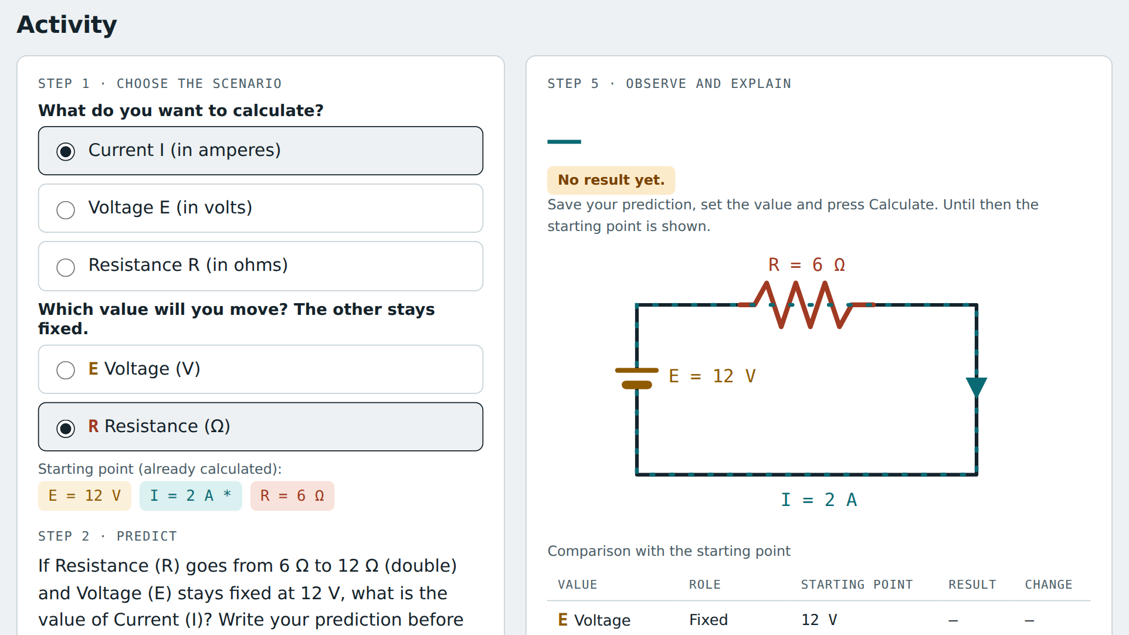
FINAL PROJECT · VIBE CODING CEDIA 2026
Demo · Input
Choose what to calculate and save the prediction before adjusting.
Vibe Coding CEDIA 2026 · Universidad UTE · UTPL
7 / 10
Notes:
PART B · DEMO (2 min in total)
NARRATION · ≈30 s · 70–80 words in English
Show the start or input screen. Say what the person enters and why.
Now the demonstration. On the start screen of the activity we choose what to calculate, the current, and which value moves, the resistance. The other value stays fixed. The starting point is twelve volts and six ohms, which gives two amperes. The activity asks how many amperes flow if the resistance rises to twelve ohms. We type our prediction, one point five amperes. Until then the controls stay locked. Only then do they unlock.

Slide 8
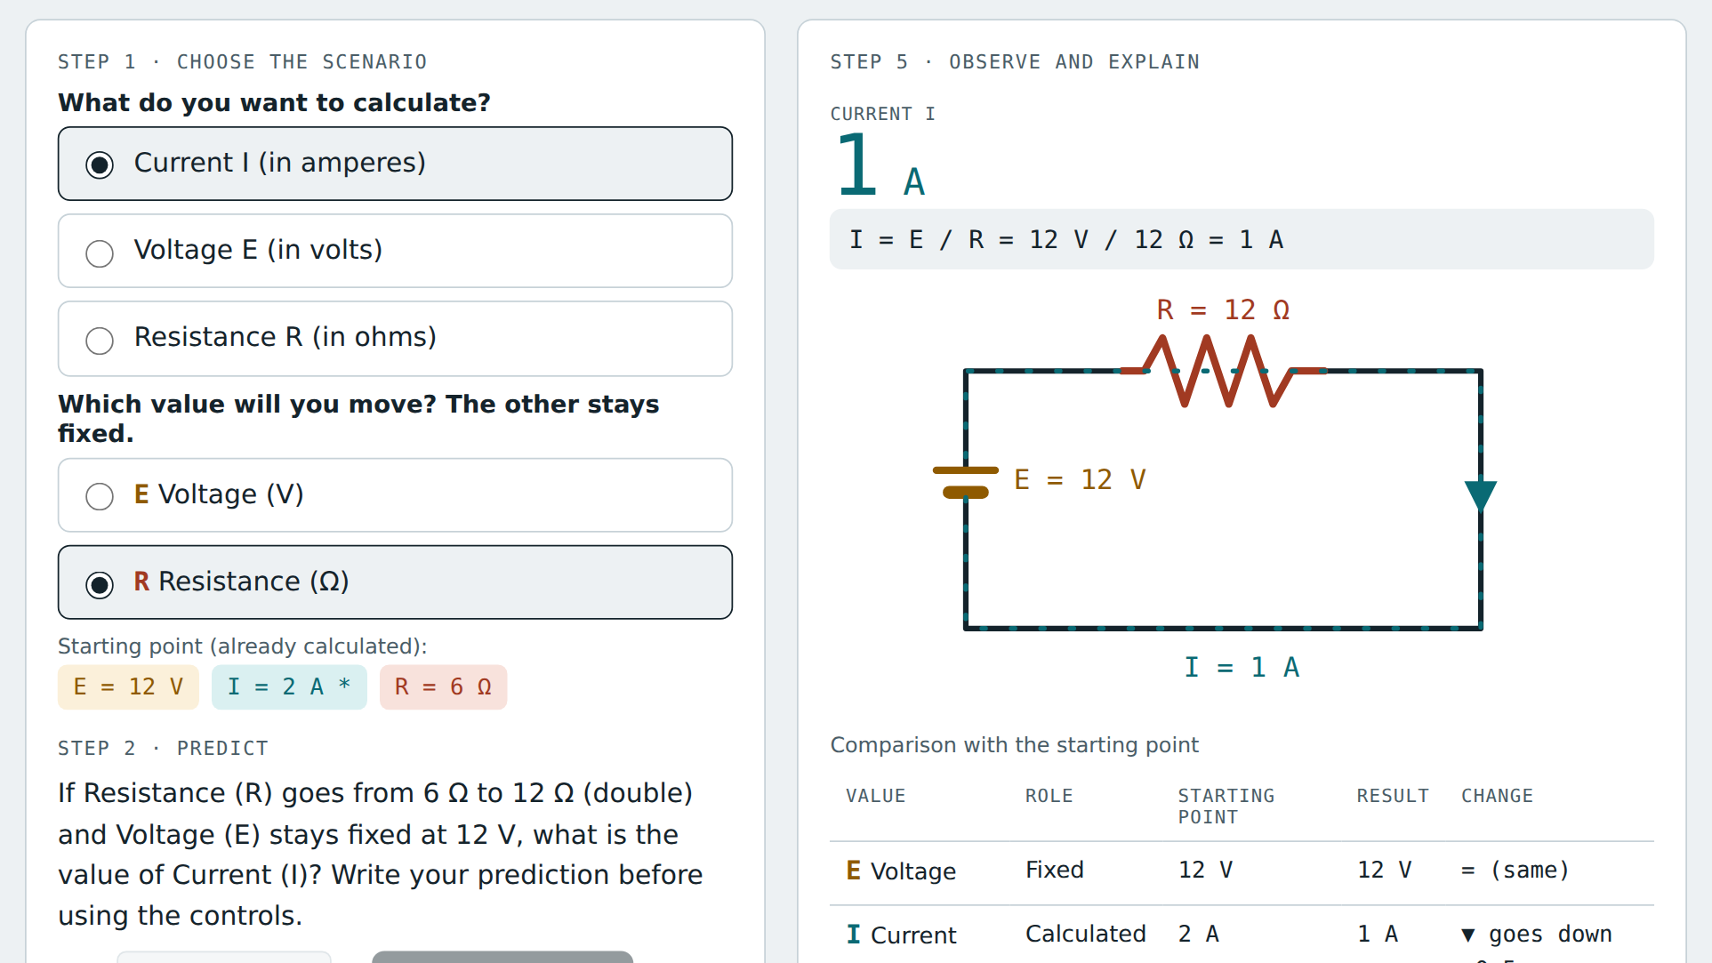
FINAL PROJECT · VIBE CODING CEDIA 2026
Demo · Result
Result calculated by the code: 1 A when resistance doubles.
Vibe Coding CEDIA 2026 · Universidad UTE · UTPL
8 / 10
Notes:
NARRATION · ≈35 s · 80–90 words in English
Show the main result. Point to where to look on the screenshot and what it means.
We set the resistance to twelve ohms and press Calculate. Look first at the large number with its unit: one ampere. The answer comes from the code, not from the A I. Below it you see the formula with the numbers. The circuit changes, and a table compares the result with the starting point. The resistance doubled and the current dropped by half. A text describes all of this for anyone who cannot see the picture. The activity also works with a keyboard.

Slide 9
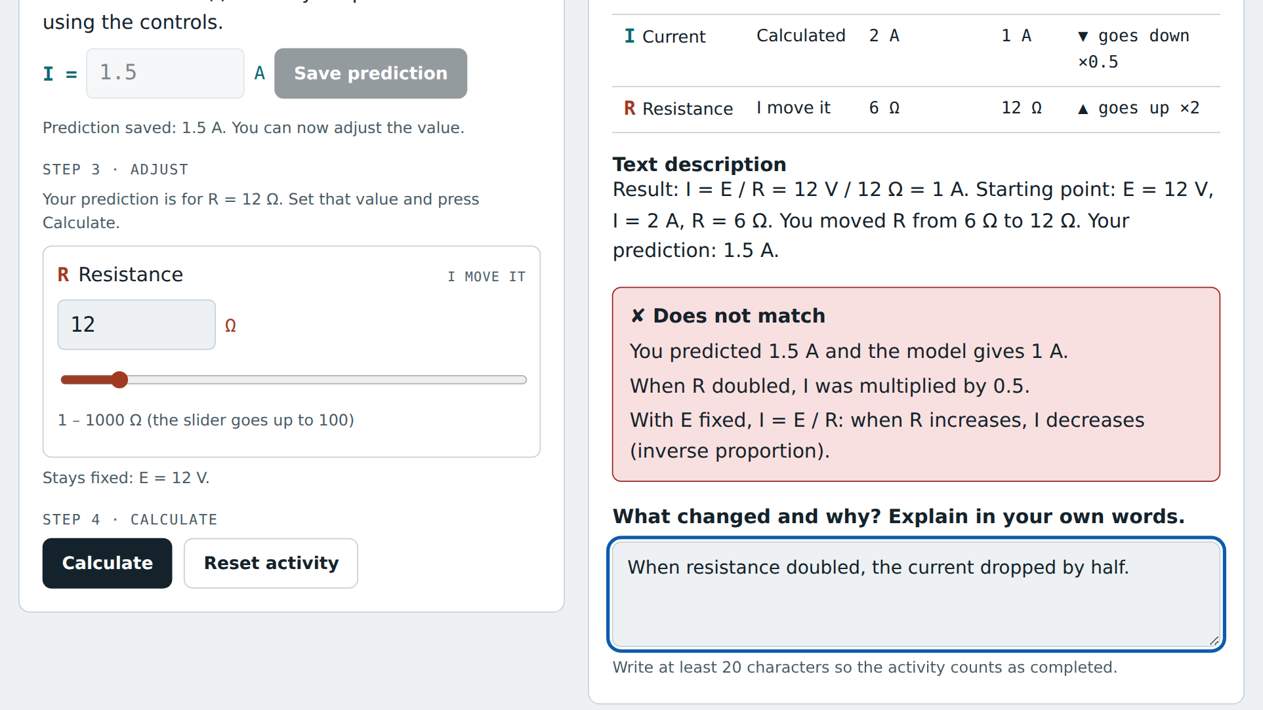
FINAL PROJECT · VIBE CODING CEDIA 2026
Demo · Review and delivery
Feedback: a 1.5 A prediction against the model’s 1 A.
Vibe Coding CEDIA 2026 · Universidad UTE · UTPL
9 / 10
Notes:
NARRATION · ≈30 s · 70–80 words in English
Show where the person reviews, approves or exports. Close the demo with the test that backs it.
The activity compares the prediction with the result. We predicted one point five amperes and the model gives one ampere. They do not match, and the activity says so without judging. It explains that with the voltage fixed, the current drops as the resistance rises. Then we write what changed and why in our own words, and answer a question with new values. The S C O R M package then marks the activity as completed.

Slide 10
FINAL PROJECT · VIBE CODING CEDIA 2026
Predict, check and explain
Next step: test it with students and share it.
github.com/JonnaIsma/vibe-coding-proyecto-final
Jonnathan Chamba (UTE) · Alexis Gaona (UTPL)
Vibe Coding CEDIA 2026 · Universidad UTE · UTPL
10 / 10
Notes:
CLOSE · NARRATION · ≈25 s · 55–65 words
What changes in the subgroup's work, the next step and a short invitation. End on a complete sentence.
With this activity the formula is no longer just a board exercise. The student predicts, checks and explains. Our next step is to test it with students and improve its instructions. The files and links are in the project repository. The methodological note explains the method, the limits and the maintenance. Thank you for your attention.

