Slide 1
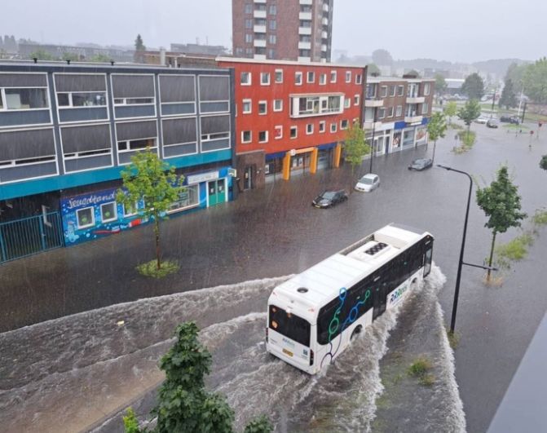
Civil Engineering Challenges
Advising on how the Haaksbergerstraat in Enschede can be more resilient against rainwater nuisance.

Slide 2
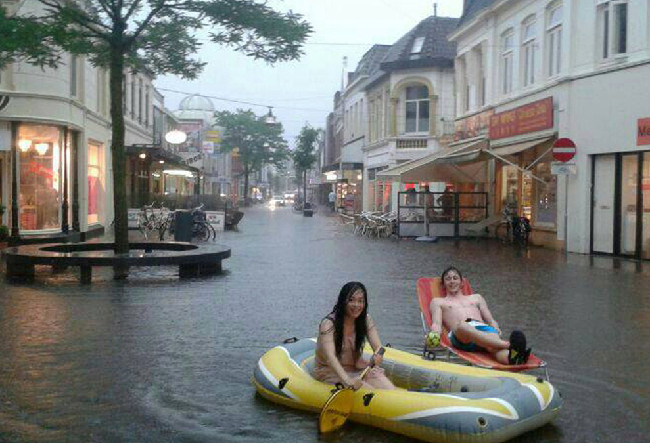
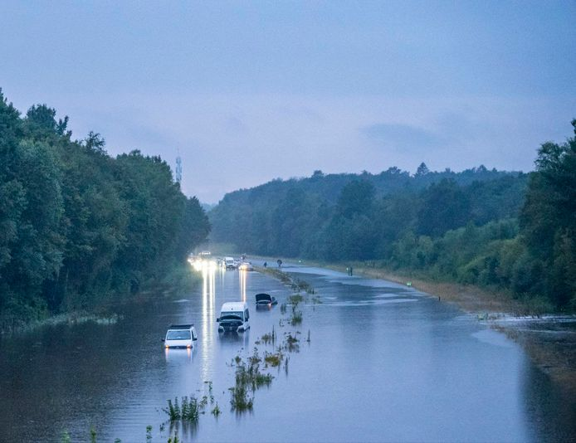
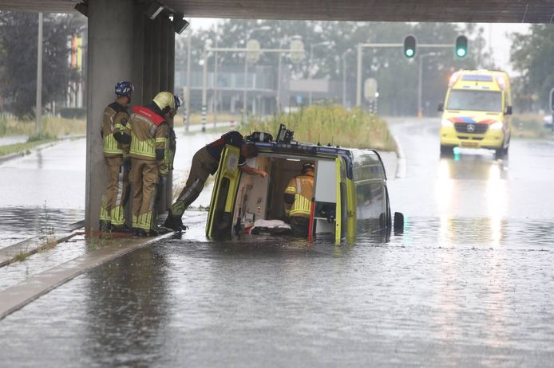
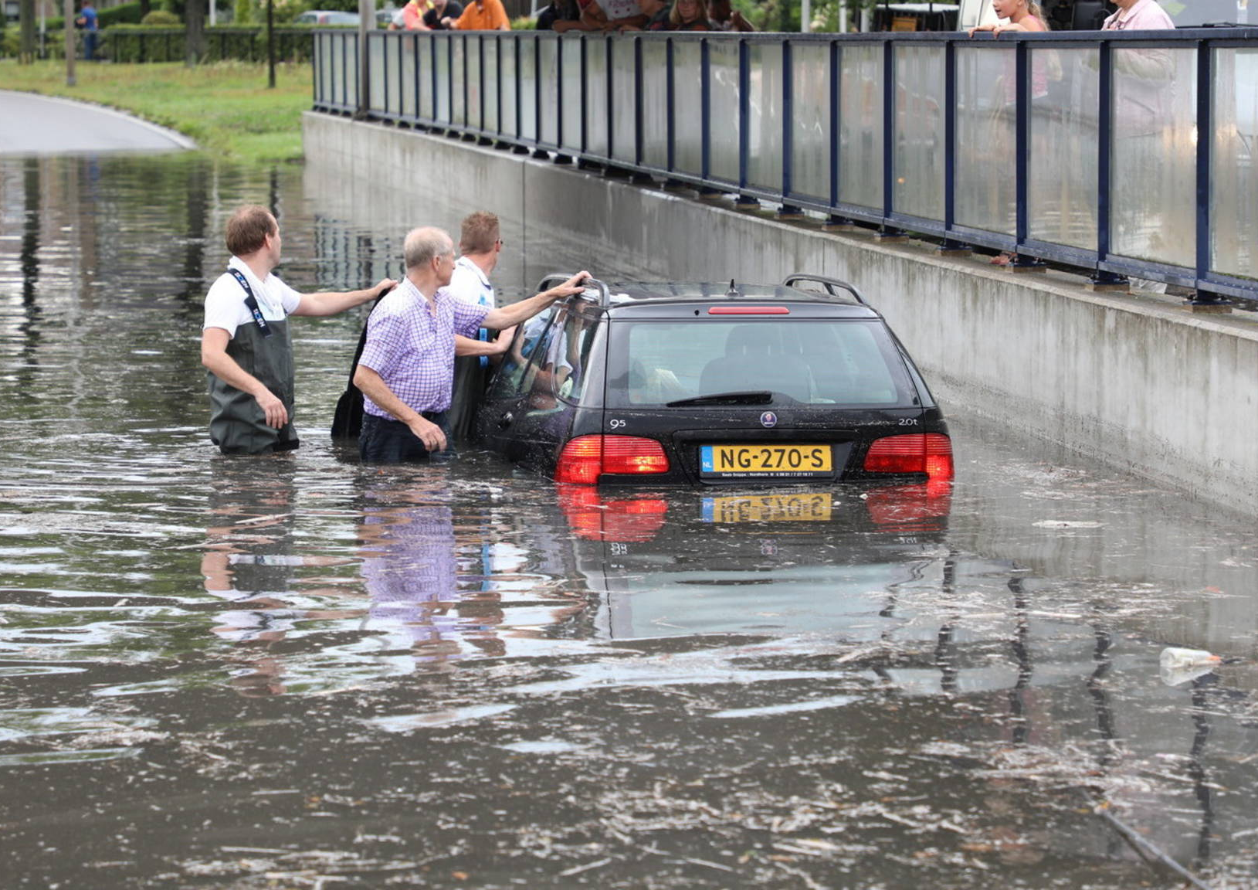
Event 21 of July 2024
50 houses not inhabitable anymore
Millions of damage

Slide 3
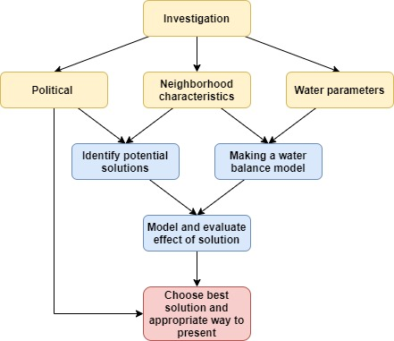
General approach

Slide 4
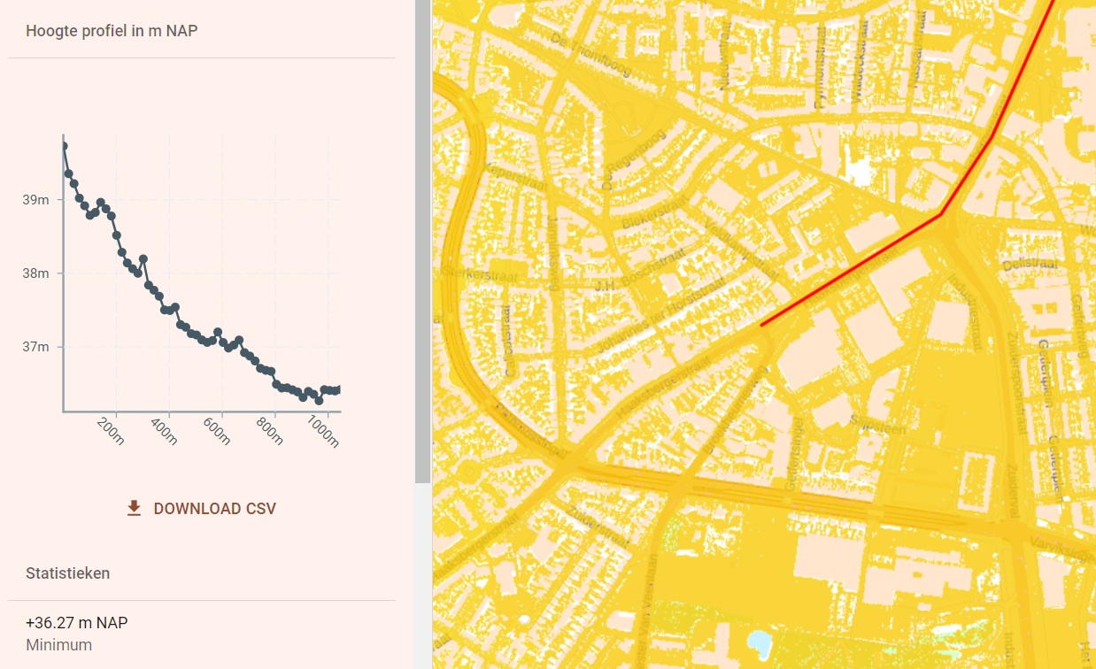
Neighborhood characteristics
Elevation
Sewage system
Rounding neighborhoods

Slide 5


Political
What is done already?
Who is responsible

Slide 6
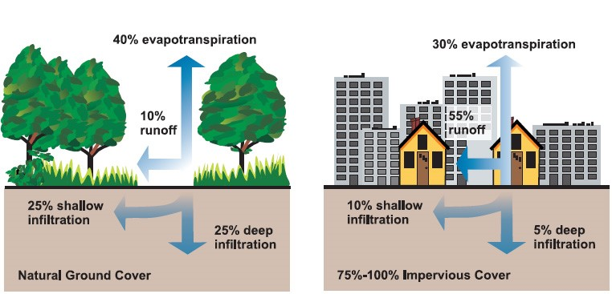
Water parameters
Infiltration parameters

Slide 7
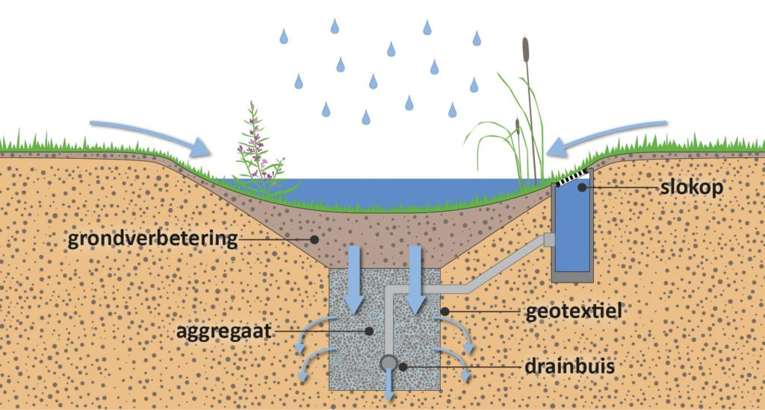
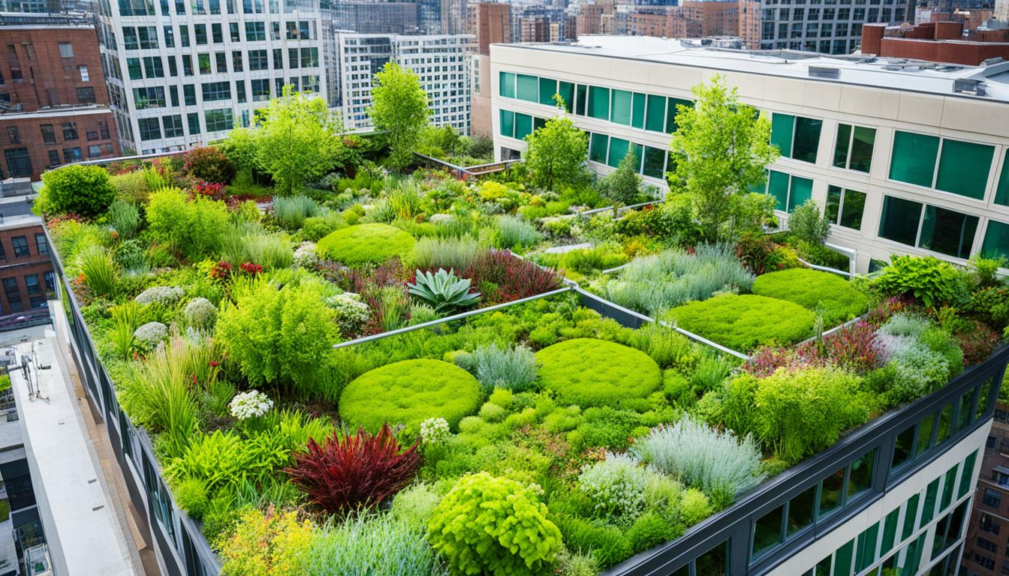
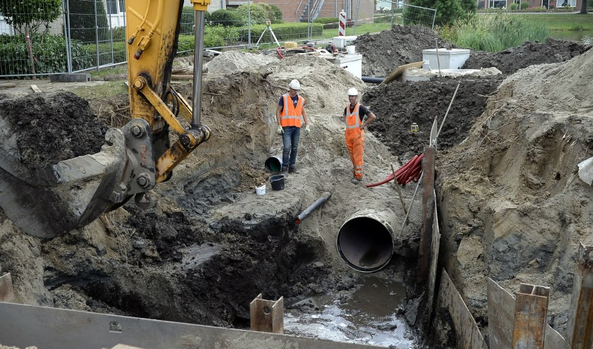
Solutions

Slide 8
Impact
Bring solutions to light for the authorities to help the local people with water nuisance.
A video to explain what the difference in water on the streets would be

