Slide 1

Data Analysis Test
Logo removed

Slide 2
Logo removed
Data Given
Dataset given of what seems to be a office supplies & furniture store.
Overview:
~10k rows, 21 columns
Sales data: Dates, item info, profit, discounts, customer info, location info.
Questions given.

Slide 3
Logo removed
Questions to answer
What is the total share of sales per person?
How many days does it take on average to ship orders (grouped by ship mode)?
How much monthly profit comes from each segment and how much discount is granted
Extra insights?

Slide 4
FYI
Logo removed
Slides designed to be presented and talked over.
Not as a all-in-one reference.

Slide 5
Logo removed
Processing Notes
*** Returns & their paired sales taken out of sales dataset
Processed in Jupyter Notebooks with Python.

Slide 6
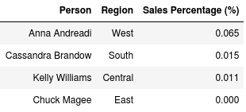
Logo removed
What is the percentage of total sales per person in the list given, by currency value?
Filtered for people and regions in given “people” worksheet.
Sub total per person / total sales by currency

Slide 7
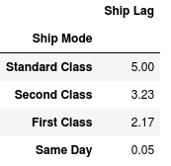
Logo removed
2. Average time between ordering and shipping (grouped by ship mode) ?
Definition of ship date could change result interpretation. Possibly biased by product. (e.g. Big bulky table vs. a book)
“Ship Lag” = average ( Ship Date - Order Date). Per class. In units of days.

Slide 8
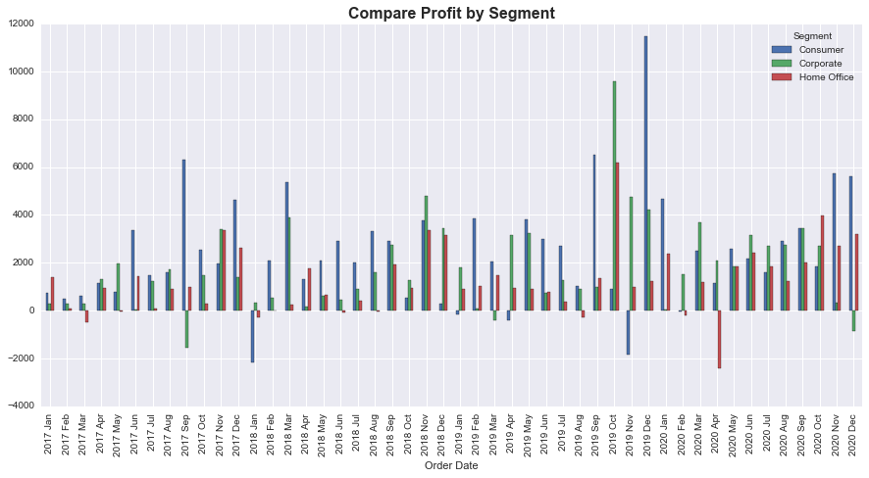
Logo removed
3. How much profit and discount comes from each segment monthly?

Slide 9
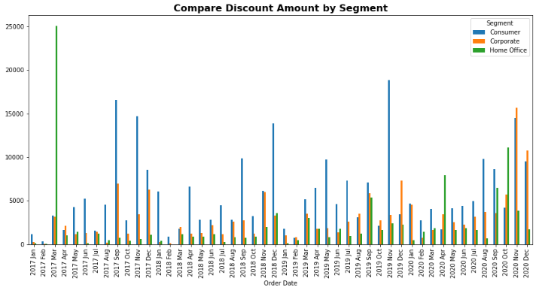
Logo removed
3. Cont… How much profit and discount comes from each segment monthly?
**Outlier checked.
6 purchases of Cisco
Teleconference package
At ~$11,000 each.
40% Discount

Slide 10
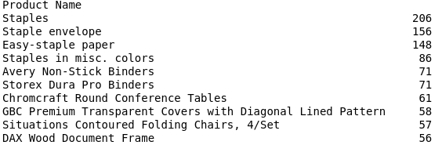
Logo removed
4. Extra Insights
Most Sold Products

Slide 11
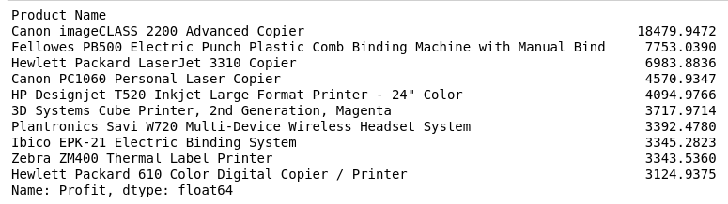
Logo removed
4. Extra Insights
Most Profitable Products … Printing!!

Slide 12
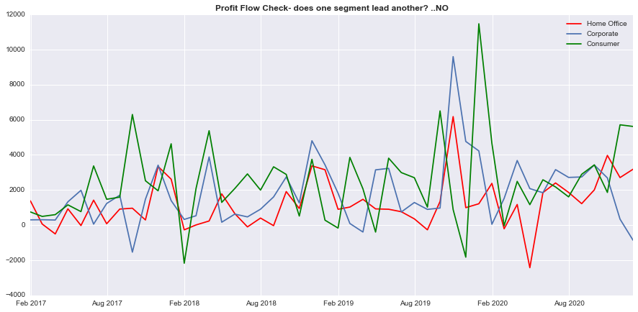
Logo removed
4. Extra Insights
Profit flow.
Does one Segment
lead another?
NO.
But a pattern emerges…

Slide 13
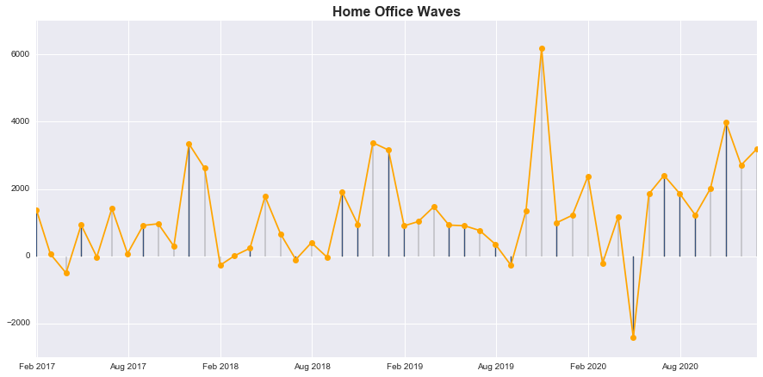
Logo removed
Wave pattern in the
Home Office segment.
Spikes every november.

Slide 14
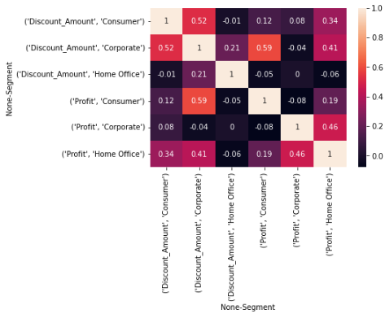
Logo removed
Discount does not correlate
to price!

