Slide 1
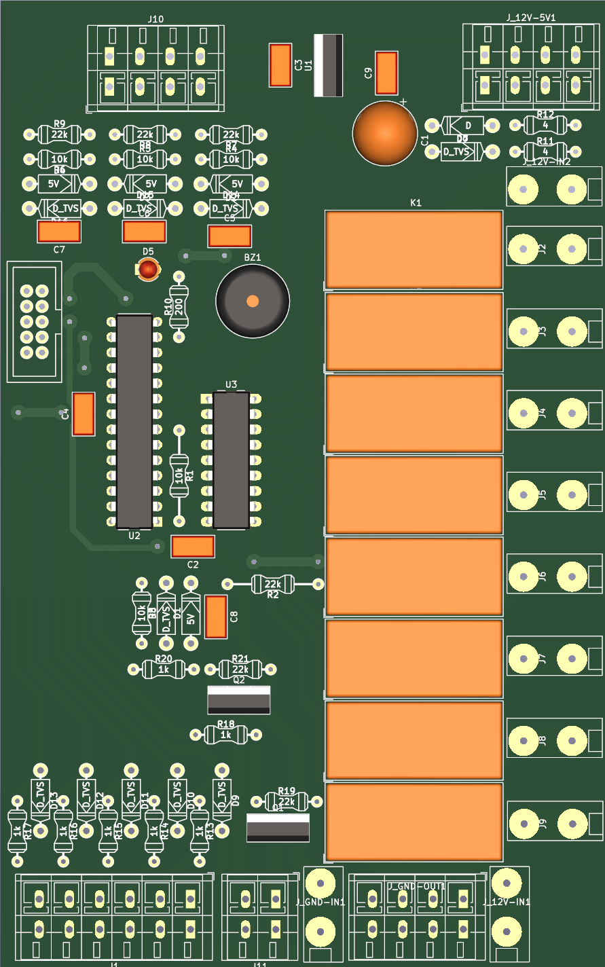
5V out
5V out
12V
12V
PCB IHC - Connection plan
PB2 S Low Beam → 12V
PB1 S Brake → 12V
PB0 free (worklight?)
GND
ISP programmer
12V IN 4mm2
PD5 K1 Blinker left (rear)
PB7 K2 Blinker right (rear)
PB6 K3 Blinker left (front only)
PD4 K4 Blinker right (front only)
PD3 K5
PD2 K6 free worklight?
PD1 K7 High beam
PD0 K8 Low beam
S_HIGH_BEAM → GND PB3
S_HORN → GND PB4
S_BLINK_LEFT → GND PC0
S_BLINK_RIGHT → GND PC1
S_WARNING_LIGHTS → GND PC2
GND
GND
GND
12V
12V
12V IN 4mm2
OUT_HORN → 12V mos1 PC4
mos2 PC3
Notes:
- Parking light: switch directly with key switch

