Slide 1
An Adaptive Large Neighborhood Search
for the Prize-Collecting Skill Vehicle Routing Problem
Umais Chaudhary · Rehman Kerimov · Dustin Schulz · Marco Leander vom Orde
31-MM34 Metaheuristics · SoSe 26 · Bielefeld University

Slide 2
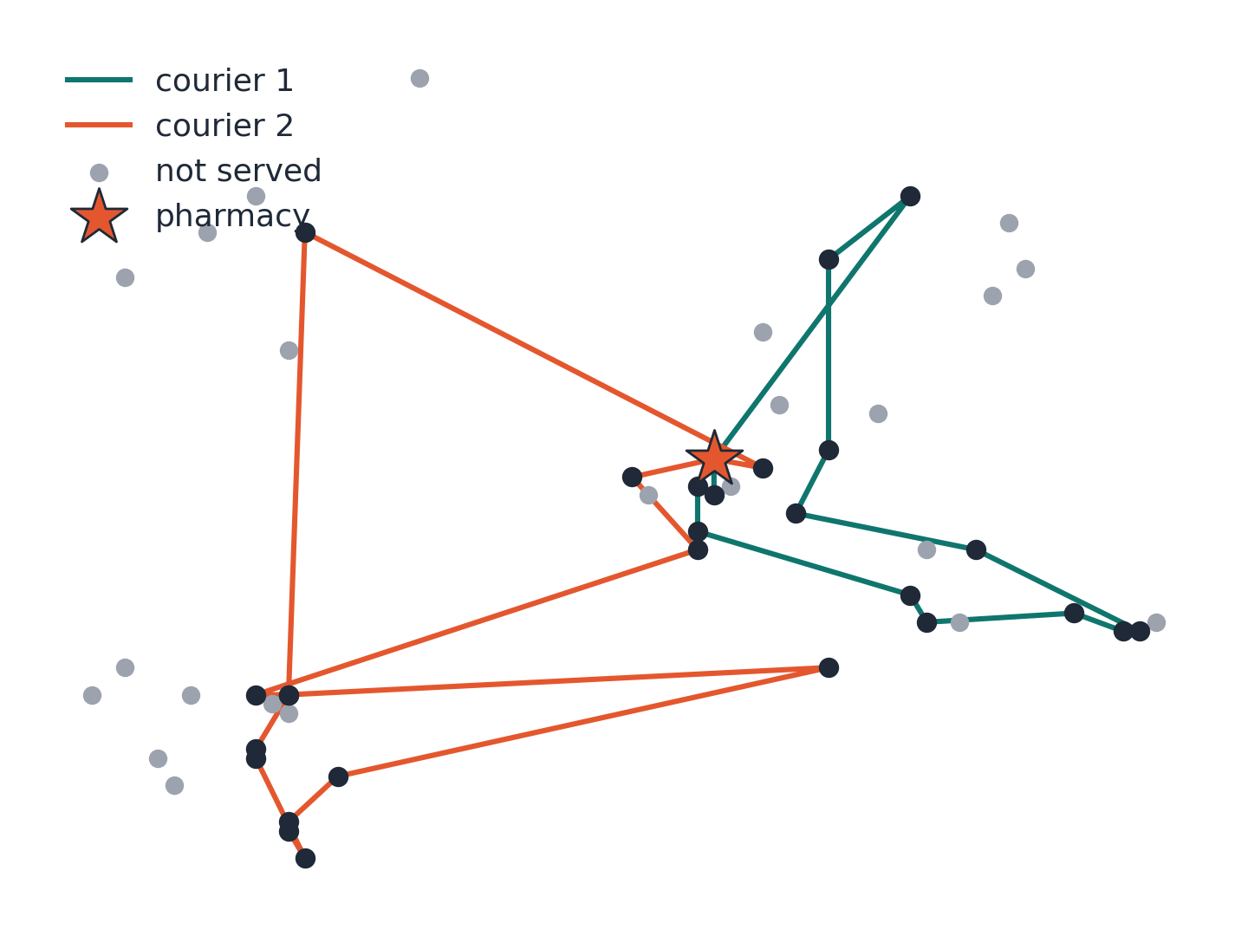
The problem: pharmacy home delivery
• Customers: profit, time window, required skills
• Couriers: skill set, shift, start/end at pharmacy
• Serving is optional – maximize collected profit
• Feasibility: skills, time windows, shift end
• 20 instances: n = 50 … 1000, 2–25 couriers
• Yardstick: singleton upper bound (UB)
– profit of all customers servable in a dedicated round trip
n = 50 instance, our 30 s solution: 27 of 50 customers served
2

Slide 3
Why ALNS?
• Selection + routing in one move
– destroy/repair changes the served set directly – repairs can grow it
• Extremely heterogeneous benchmark
– pure Python, 30 s budget: ~30,000 iterations on n=50, ~600 on n=1000
– adaptive weights re-allocate effort per instance, no per-instance tuning
• Rugged feasibility (skills + time windows)
– simulated annealing on a penalized score crosses infeasible ridges
• Validated on the closest published relative
– service technician routing, Kovacs et al. 2012 · framework: Ropke & Pisinger 2006
3

Slide 4
The solver at a glance
Profit-greedy
construction
Destroy
(15 operators)
Repair
(9 operators)
SA acceptance
penalized score
Adaptive weights
score / runtime
• Loop until wall-clock deadline (1 s reserved for output)
• Time-based exponential cooling: T = 100 → 0.001 over the remaining budget
• Restart after 500 rejections: randomized greedy + reheat to 0.75·T₀
• Incumbent x* only replaced by feasible solutions → output always valid
• Constant-time insertion feasibility via cached forward time slacks
4

Slide 5
Deep dive: route caches make moves constant-time
• Per route we cache: arrival, departure, waiting, forward time slack
– slack[j] = largest delay position j absorbs without violating any later window/shift
• Insertion test touches only the two neighboring positions
– thousands of candidate tests per repair pass, no re-simulation
• Full O(route) re-simulation only when …
– a route actually changes (one cache rebuild, then amortized)
– a route is infeasible (slacks undefined, penalty needs simulation)
• Move cache per (customer, courier), invalidated per route
– after an insertion only the changed courier is rescanned
• Trade-off: memory + bookkeeping per accepted move
– pays off: ALNS is single-trajectory – one solution, one cache set
– population-based methods would replicate this per individual
Algorithm 2: constant-time insertion test (customer c, courier k, position j)
t_arr ← depart_k[j−1] + d(prev, c)
if t_arr > due_c: return infeasible
t_dep ← max(t_arr, ready_c) + service_c
shift ← t_dep + d(c, next) − arrival_k[j]
return feasible ⇔ shift ≤ slack_k[j]
Effect: evaluation dominates runtime, so this decides how many iterations 30 s buy
(~30,000 on n=50, ~600 on n=1000, in pure Python)
5

Slide 6
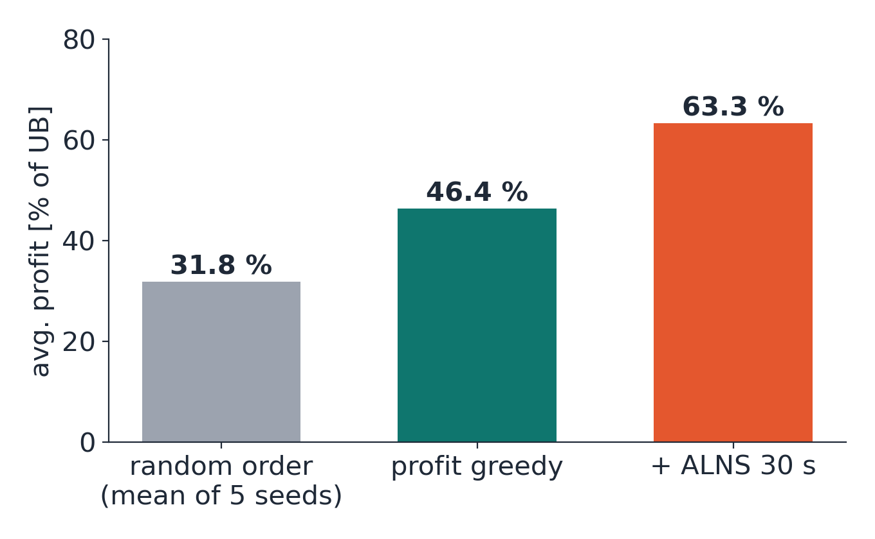
Initial solution: profit greedy
• Sort by decreasing profit,
• insert at cheapest feasible position
• < 0.5 s even for n = 1000
• Feasible by design – empty plan as safe fallback
• Measured, not argued:
– random order reaches only 68.6 % of greedy profit
– multi-start over 4 orderings: better starts, same finals,
– 4× construction cost → discarded
6

Slide 7
Operator portfolio: 15 destroy + 9 repair
Destroy
• random · cost-based (worst density, 2× worst detour, largest saving)
• relatedness: related, Shaw, time-only Shaw, temporal Shaw, cluster
• structural: route, sequence, time-window segment · history-based
• skill-scarcity removal – problem-specific
– frees contested couriers whose skills unserved customers need
Repair
• greedy best · noisy greedy · regret-2 (positions) · regret-3 (distinct couriers)
• single-pass: profit order, scarce-skill-first, LRFI, random position, Shaw insertion
• candidates = removed + up to 40 sampled unserved → repairs can grow the served set
7

Slide 8
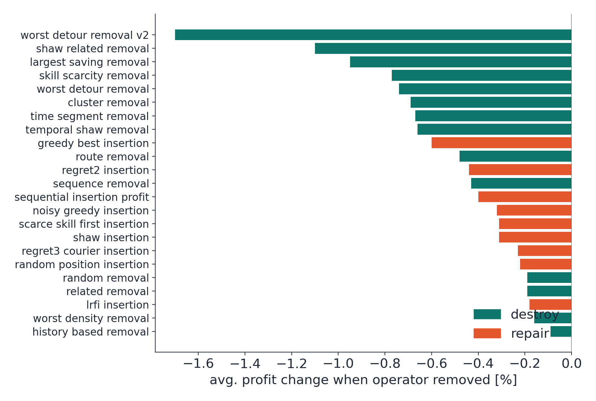
Component analysis: leave-one-out ablation
• 3 instances × 2 seeds × 90 s per removed operator
• Every operator contributes on average – no dead weight
• Strongest: noised worst-detour (−1.7 %), Shaw removals
• Skill-scarcity ranks 4th → problem-specific design pays off
• Lower half ≈ noise floor (baseline seed spread 0.1–1.8 %), but kept: sharp worst cases act as insurance
8

Slide 9
Parameter study: a flat plateau
• Grid over temperature scaling, destroy sizes, candidate pool, stagnation limit
– 16 configurations × 3 instances × 2 seeds × 30 s, common random numbers
• Top configurations within 0.4 pp of each other – inside seed noise
• Validation: nominal winner re-run on all 20 instances
winner 322,587 vs. defaults 323,172 (−0.2 %)
• Tuning on 3 instances does not generalize – defaults kept
• What matters: operators + runtime-normalized adaptivity, not fine-tuned constants
9

Slide 10
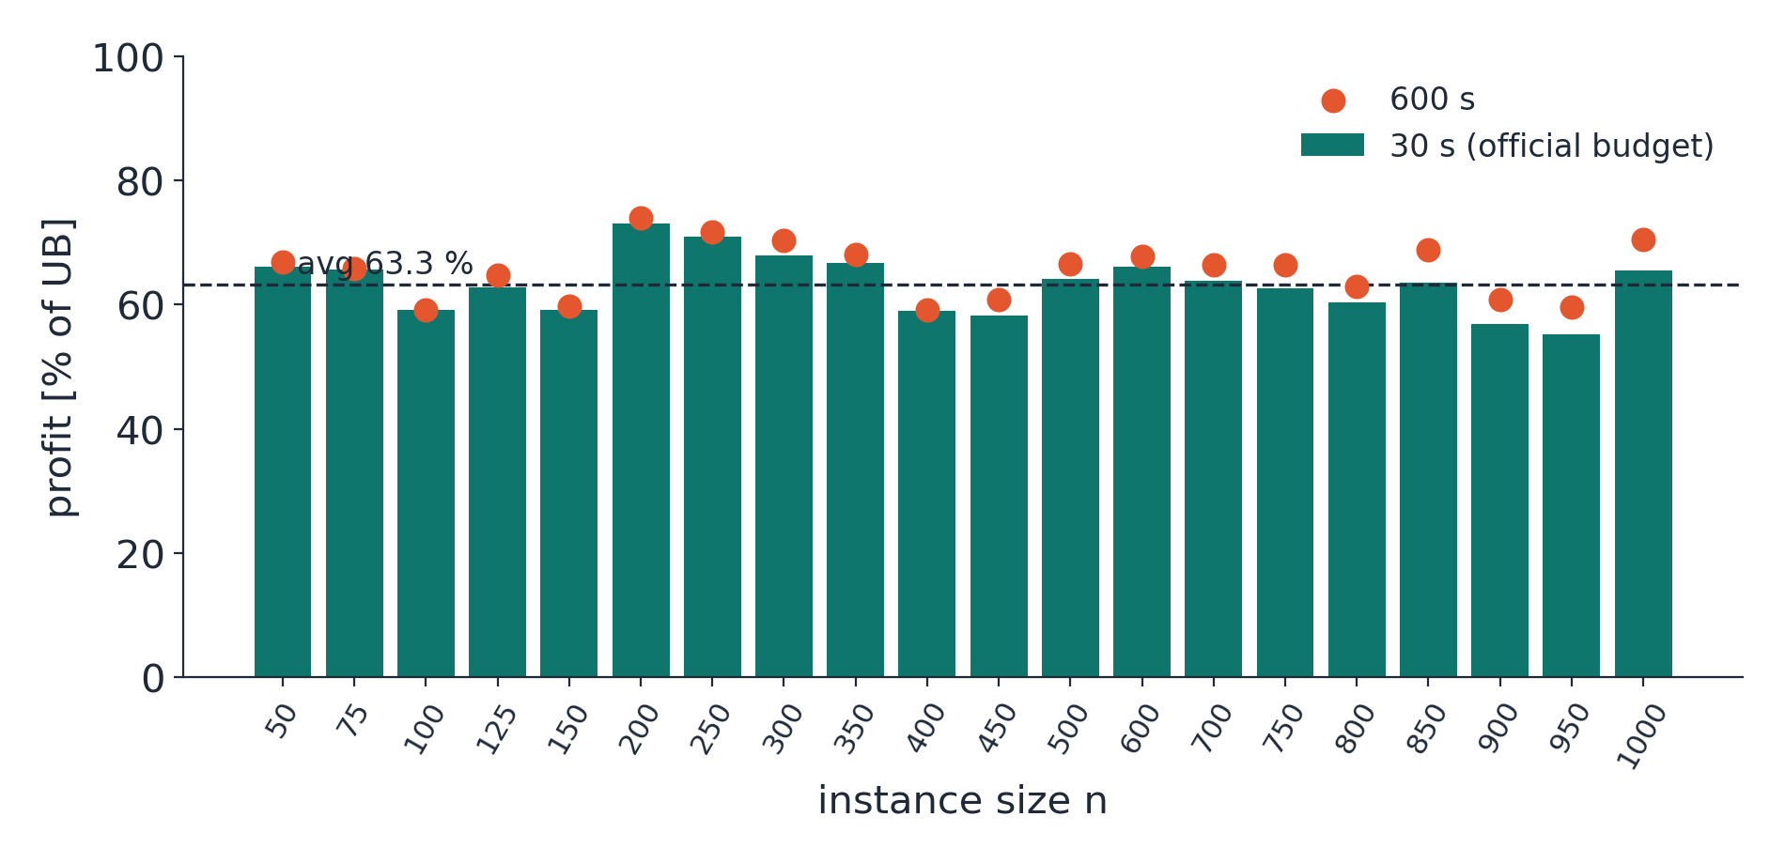
Overall performance (official 30 s budget)
• Avg. 63.3 % of UB (55–73 %)
• Total profit 323,172
• All 20 solutions checker-verified
• 10 seeds × 20 instances:
– CV 0.2–1.5 % per instance
– total 322,599 ± 1,057
• %UB spread mostly reflects bound looseness
10

Slide 11
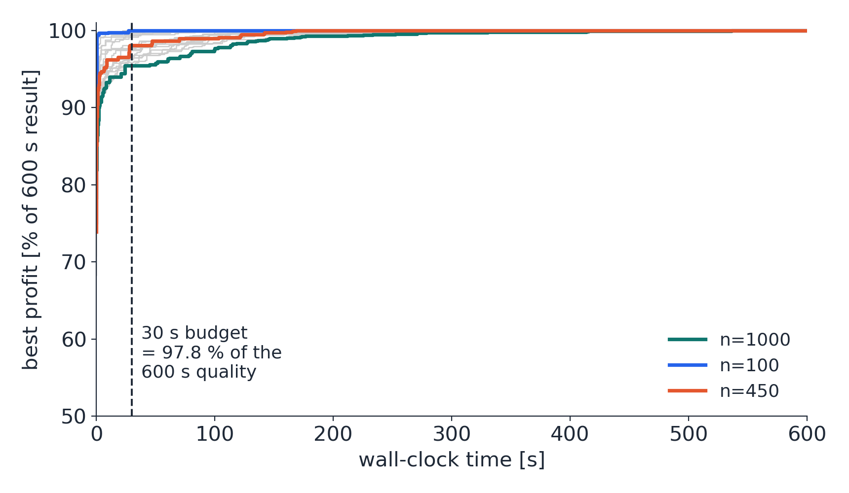
Is 30 s enough? Convergence over 600 s
• 30 s captures 97.8 % of the 600 s quality
• Time-based cooling compresses the schedule into any budget
• n ≤ 350 converge in 1–5 min
• n ≥ 750 still improve in the final minute → budget-bound, not converged
• Extra 570 s buy +2.2 pp of UB, mostly on large instances
11

Slide 12
Takeaways
• ALNS was the right fit: selection handled natively, one configuration across n = 50…1000
• Fix the yardstick first – the cheap UB made every design decision measurable
• Throughput before operator richness – constant-time insertion tests beat any single operator
• Measure instead of argue – ablation, parameter grid, 10-seed variation
• What distinguishes our ALNS:
– runtime-normalized adaptive weights + time-based cooling
– → the wall-clock budget itself is the controlling parameter
Future work: string removals (SISR) · time-aware insertion scoring · set-covering post-optimization
12

Slide 13
Backup: Pseudocode

Slide 14
Algorithm 1: ALNS main loop
x = current solution · x* = best feasible solution found
x ← greedy construction; x* ← x; T ← T₀
while wall-clock time remains do
choose destroy d and repair r by roulette wheel over weights w
x' ← r(d(x)) (remove q customers, reinsert removed + sampled unserved)
if exp((f(x') − f(x))/T) > u ~ U(0,1) then x ← x' (penalized score f)
if x' feasible and profit(x') > profit(x*) then x* ← x'
credit d and r with score σ ∈ {25, 10, 3, 0}; record their runtime
every L iterations: w ← (1−ρ)·w + ρ · σ̄ / (1 + (t̄/τ)^α)
update T on the exponential wall-clock schedule T₀ → T_min
if 500 consecutive rejections then x ← randomized greedy; T ← max(T, 0.75·T₀)
return x*
f = profit − infeasibility penalties · σ̄, t̄ = mean score/runtime per segment · L = segment length, ρ = reaction factor

Slide 15
Algorithm 3: greedy construction
Also used with shuffled order for restarts
x ← empty plan (all couriers idle, all customers unserved)
O ← customers with ≥ 1 compatible courier, sorted by decreasing profit
for i ∈ O do
best ← ∅
for courier k with Q_i ⊆ S_k, position j in route of k do
if inserting i at (k, j) keeps time windows, shift and return feasible
and travel-time increase < that of best then best ← (k, j)
if best ≠ ∅ then insert i at best (else leave i unserved)
return x
Feasibility checked before every insertion → the plan is feasible at every step; worst case = empty (feasible) plan

Slide 16
Algorithm 4: shared destroy machinery
Used by all destroy operators
function removalSize(x):
f ← uniform sample from operator fraction range [f_min, f_max]
return q = min( max(1, round(f·|served|)), min(100, 0.25·n), |served| )
function biasedPick(sorted pool P, bias β): (worst / most related first)
return and remove P[ ⌊rand()^β · |P|⌋ ]
function finishDestroy(removed set R):
remove every c ∈ R from its route, mark unserved, record origin
rebuild route caches of all affected couriers
return partial solution + R as candidate pool for the repair
β > 1 concentrates picks near the front of the ranking without being deterministic (Shaw randomization)

Slide 17
Algorithm 5: ranking-based removal (7 operators)
Skeleton
q ← removalSize(x)
P ← served customers sorted by
criterion (worst first)
repeat q times:
R ← R ∪ biasedPick(P, β)
return finishDestroy(R)
Criteria (rank ascending)
random uniform sample, no criterion
worst density static profit / (min travel+service) + noise, top-q
skill scarcity profit_c / (1 + demand on c's courier), top-q
worst detour profit_c / (max(δ_c,0)+1), β = 4
worst detour v2 same ratio · noise in [0.95, 1.05], β = 3
largest saving detour δ_c alone, profit ignored, β = 3
history-based gap δ_c − δ_c^best (best seen this run), β = 3
δ_c = d(prev,c) + d(c,next) − d(prev,next) at the current position of c

Slide 18
Algorithm 6: seed-growth removal (4 operators)
Skeleton
q ← removalSize(x)
R ← {random served seed}
while |R| < q do
s ← random element of R
P ← ≤ 100 nearest served neighbors
of s, sorted by r(s,·)
R ← R ∪ biasedPick(P, β=4)
return finishDestroy(R)
Relatedness r(i,j) (smaller = more related)
related d̂(i,j) (distance only)
Shaw 0.5·d̂ + 0.25·t̂_ready + 0.25·(1−J)
time-only Shaw t̂_ready alone
temporal Shaw 0.5·d̂ + 0.25·t̂_service + 0.25·(1−J)
d̂ = distance / max distance
t̂ = time difference / planning horizon
J = Jaccard similarity of required skill sets
t̂_service uses CURRENT service-begin times

Slide 19
Algorithm 7: structural removals
route / sequence / time-window segment
route removal:
P ← non-empty routes sorted by profit per used shift time (worst first)
repeat 1–2 times: empty route biasedPick(P, β=3), add customers to R
sequence removal:
q ← removalSize(x)
for routes in random order, until |R| = q:
add a random contiguous segment of the route
time-window segment removal:
center a window of width 0.15·horizon at a random service start
R ← customers whose cached service start falls inside the window
if |R| > q_max then R ← uniform sample of size q_max

Slide 20
Algorithm 8: cluster removal (Kovacs et al. 2012)
MST split + route hopping
q ← removalSize(x); v ← random route with ≥ 3 customers (none: uniform sample)
while |R| < q do
build minimum spanning tree over remaining customers of v
drop its longest edge → two clusters
add one of the two clusters (coin flip) to R
v ← route of the nearest still-served neighbor of a random removed customer
if no such splittable route exists then break
return finishDestroy(R)
Removes spatially coherent blocks per route – breaks up geographic mis-assignments between couriers

Slide 21
Algorithm 9: shared repair machinery
Used by all repair operators
function candidatePool(removed R):
C ← R (still unserved) ∪ up to 40 extra unserved customers,
half best by static profit density, half a uniform sample
return C
function best(c): (uses the cached time slacks, Algorithm 2)
over all compatible couriers k and positions j:
evaluate Δ(c,k,j) = profit_c − penalty increase
return move maximizing Δ, ties broken by smaller travel delta
function applyMove(m):
insert, rebuild cache of the changed route, rescan only that courier

Slide 22
Algorithm 10: best-first repair (4 operators)
Skeleton
C ← candidatePool(R)
loop
for c ∈ C with best(c) ≠ ∅
and Δ > 0:
compute selection key of c
if no such c then break
applyMove(best move of best key)
C ← C \ {c}
Selection keys
greedy best largest Δ
noisy greedy largest Δ/(1+max(0,travel delta))
· noise in [0.85, 1.15]
regret-2 largest Δ₁ − Δ₂ over the two best
POSITIONS (+ urgency bonus if only one)
regret-3 largest Σ(travelᵢ − travel₁) over best
(couriers) insertions on 3 DISTINCT couriers
(+ bonus per missing courier)

Slide 23
Algorithm 11: single-pass repair (5 operators)
Skeleton
C ← candidatePool(R),
ordered by operator rule
for c ∈ C do
m ← best(c) (random-position:
uniform feasible position)
if m ≠ ∅ and Δ(m) > 0 then
applyMove(m)
Orderings
sequential profit decreasing profit, ties by
tighter time window
scarce-skill-first fewest compatible couriers,
then profit, profit density
LRFI reverse removal order,
extras afterwards
random position shuffled order, random
feasible position (diversify)
Shaw insertion most related to last inserted
(Shaw measure, β = 4)

